Slide 1
Developed by Al Johnston
4 - 12 - 2016
The white background is still a design choice.

Slide 2
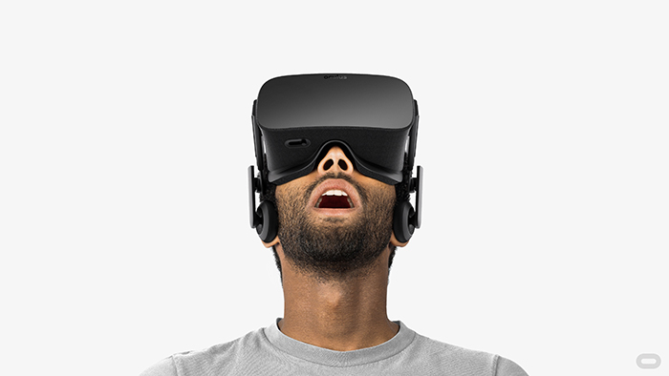
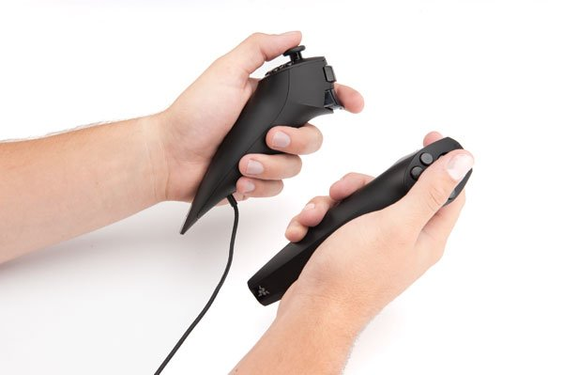
What is Barrier to Entry?
Barrier to Entry is a first person swashbuckling sword-fighting game that utilizes both Virtual Reality and hand tracking

Slide 3
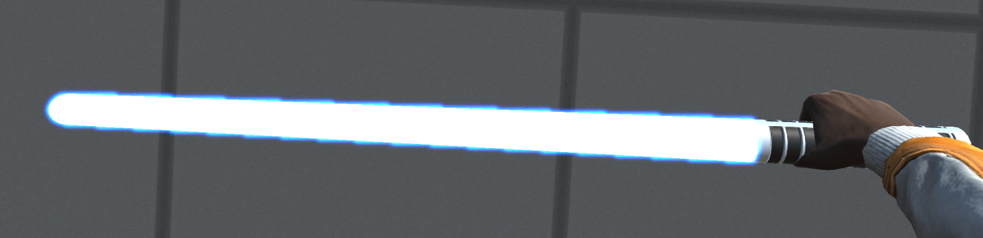
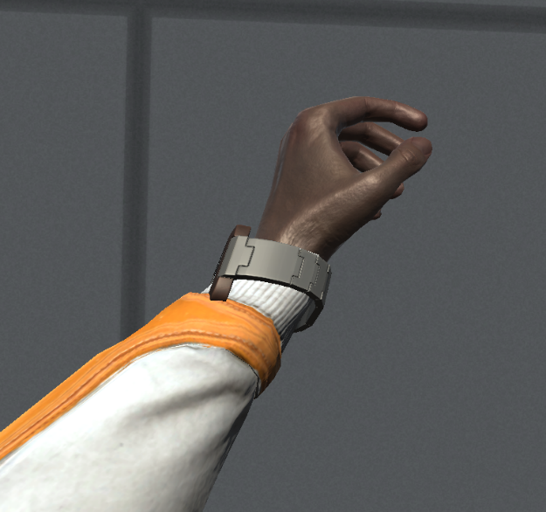
So what can I do in Barrier to Entry?
As the player, you have two major things to control:
Your weapon
Your secondary powers

Slide 4
Al’s Dreams and Aspirations
This project should ideally accomplish 3 things:
Provide a 1 to 1 game to real world translation of hand placement
Provide physical combat, allowing the player to directly engage an opponent and receive feedback from in-game collisions
Provide competent AI that can both respond to player attacks to defend itself and initiate attacks on the player

Slide 5

Why is this a worthy project?
The project idea originated during the days of
It both matches and stretches my capabilities: there’s nothing I can’t do yet most of it lies just out of reach. So this project requires that I grow as a programmer.
So far I’ve used skills from Linear Algebra and Graphic Design (along with mountains of coding) to develop the game.

Slide 6
So… what about those neat VR menus?
…(TODO)…

Slide 7
Can I try?
Sure. But don’t expect to hit anything for now. Aside from, perhaps, a wall or a post.

Slide 8
Was it hard?
Yep. The challenge came where I didn’t expect it, in making the weapon move and be governed by physics. (shh… it’s still not entirely done)
Currently I’m working on AI, which I don’t expect to be a challenge now that I know my plan of attack (pun intended)

Slide 9
How’s it coming along?
Well. Currently, I’ve completed physics-based movement as well as a character model generator, and am working on AI. But there’s a laundry list of things still to come:
Required for “success”: AI, Secondary Powers, Configs, GUI
In-Between: Better physics, which depends on how bad it’s needed
Ideal world: Level Design, Sound Design, Weapon Collision Effects

Slide 10
Questions?
I assure you I can get all of it done and more if I put more time than I have been into it. So you don’t need to ask about whether I can get it done. I promise, the force will be with you. Just not yet.

