Slide 1
Class Format
Lectures
Books: we will specify reading for each week
Hager/Wellein (see Piazza resources page)
Grama et al ( -- do --)
Additional reading material, as provided
Homeworks : aim at 6
Programming assignments: aim at 6
Tentative: Two midterm exams, and one final exam
Tentative breakdown:
Homework | Program. Assignments | Exams | Class Participation (In class Quizzes)
20% | 25% | 50% | 5%

Slide 2
Computers
EWS workstations to begin with
Later:
Taub, the campus cluster and 10 nodes with 64 core Xeon Phi’s specially purchased for this course
Possible access to Blue Waters, at least for projects, is under consideration

Slide 3
Course Organization
On the web
Engineering wiki page
https://wiki.cites.illinois.edu (look for cs 484)
Lecture notes
(always pdf, some also in ppt) will be posted online
Possibly videos of lectures
Homework assignments, updates: online
Piazza: CS 484 hosted at piazza.com
You are responsible for checking these regularly
Email: if you email me, always cc the TAs, unless it’s a matter that you don’t want them to know

Slide 4
Rough Course Outline
This week:
Basic functionality of a processor
Speed comes at the cost of complexity, and variability of performance
Performance oriented programming
Measurement, Tools, Caches
Shared memory programming, within a node:
OpenMP, Pthreads, TBB/Cilk
MPI for multiple-node programming
Other topics: hybrid programming, new programming models, ..

Slide 5
Today’s Discussion
Building blocks of computers
Why has frequency scaling stalled?
Conception of parallel computing
Machine organization
……..
Complexity of Modern Processors Makes Performance Optimization Challenging

Slide 6
Computers
We have been able to make a “Machine” that can do complex things
Add and multiply really fast
Weather forecast, design of medicinal drugs
Speech recognition, Robotics, Artificial Intelligence..
Web browsers, internet communication protocols
What is this machine based on?

Slide 7
The Modest Switch
All these capabilities are built from an extremely simple component:
A controllable switch
The usual Electrical switch we use every day
The electric switch we use turns current on and off
But we need to turn it on and off by hand
The result of turning the switch on?
The “top end” in the figure becomes
raised to a high voltage
Which makes the current flow through the bulb
The Controllable Switch
Voltage controls if the switch is on or off
High voltage at input: switch on
Otherwise it is off

Slide 8

Lets use them creatively
Input1
Output is high if both the inputs input1 AND input2 are high
If either of the inputs is low, the output is low.
Output
This is called an AND gate
Input2
Now, can you make an OR gate with switches?

Slide 9
OR Gate
Input1
Output
Input2
Output is low iff both inputs are low
I.e. Output is high if either of the inputs (or both) are high (input1 OR input2)

Slide 10


Basic Gates
There are three basic kinds of logic gates
Operation:
AND
of two inputs
OR of two inputs
NOT
(complement)
on one input
Logic gate:
Two Questions:
How can we implement such switches?
What can we build with Gates?
Adders, controllers, memory elements, computers!

Slide 11
How to make switches?
Use mechanical power
Use hydrolic pressure
Use electromechanical switches (electromagnet turns the switch on)
Current technology:
Semiconductor transistors
A transistor can be made to conduct electricity depending on the input on the 3rd input
CMOS “gates” (actually, switches)
Two properties of Switches and Gates:
Size
Switching and Propagation delay

Slide 12
Clock Speeds
If we can make transistors smaller
Which means smaller capacitances..
Imagine filling up “tanks” with “water” (electrons)
We can turn them on or off faster
Which means we can make our computers go faster
Clock cycle is selected so that the parts of the computer can finish basic calculations within the cycle
And indeed:

Slide 13
The Virtuous Cycle
If you can make transistors smaller,
You can fit more of them on a chip
Cost per transistor decreases
AND: propagation delays get smaller
So they can run faster!
Can you make them smaller?
Technological progress needed, but can be done
This led to:
Cheaper and faster processors every year

Slide 14
Moore’s law
Commonly (mis) stated as
“Computer performance doubles every 18 months”
Gordon Moore observed in 1965
“The complexity… has increased roughly a factor of two per year. [It] can be expected to continue…for at least 10 years”
Its about number of transistors per chip
Funny thing is: it held true for 40+ years
And still going until 2020
“Self fulfilling prophecy”

Slide 15
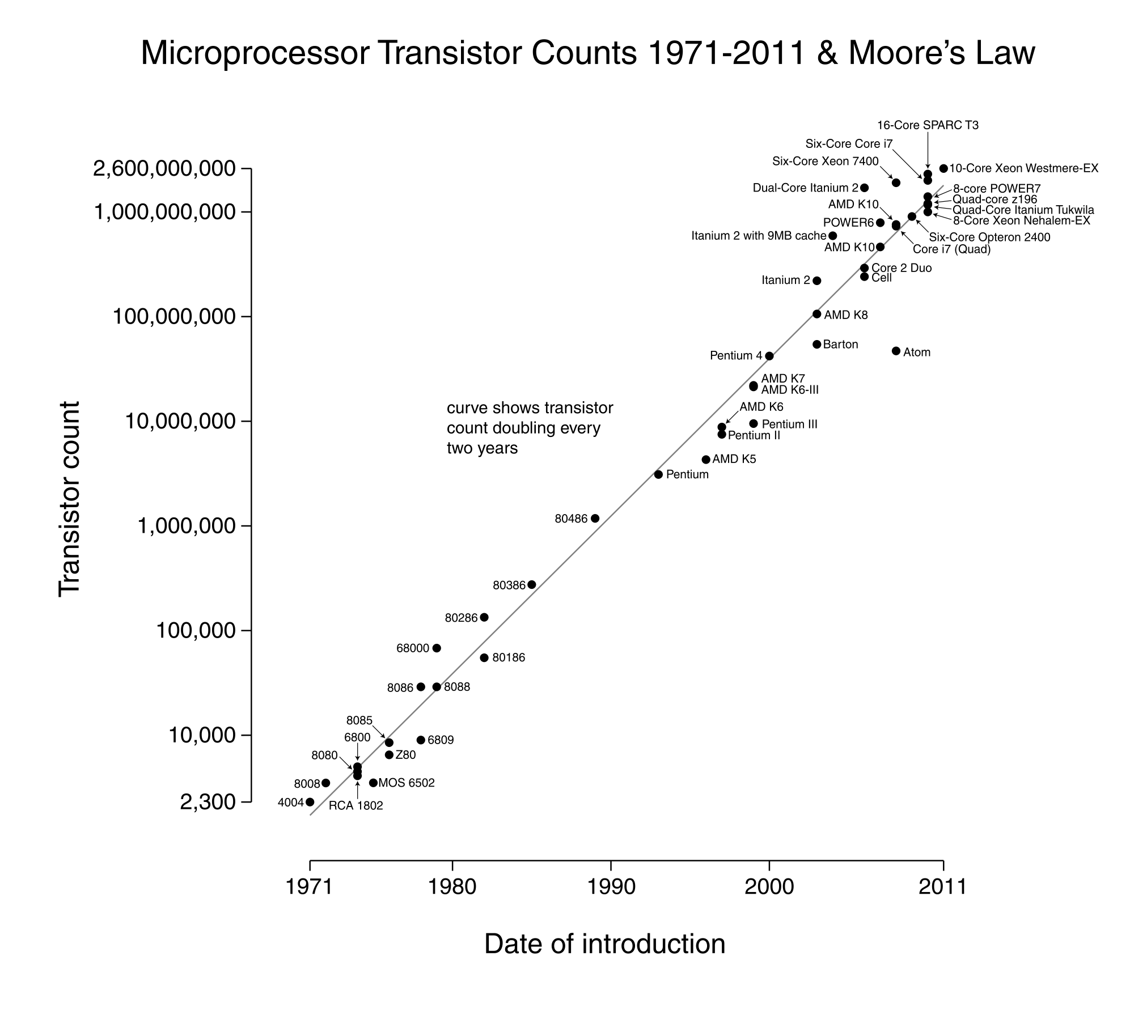

Slide 16
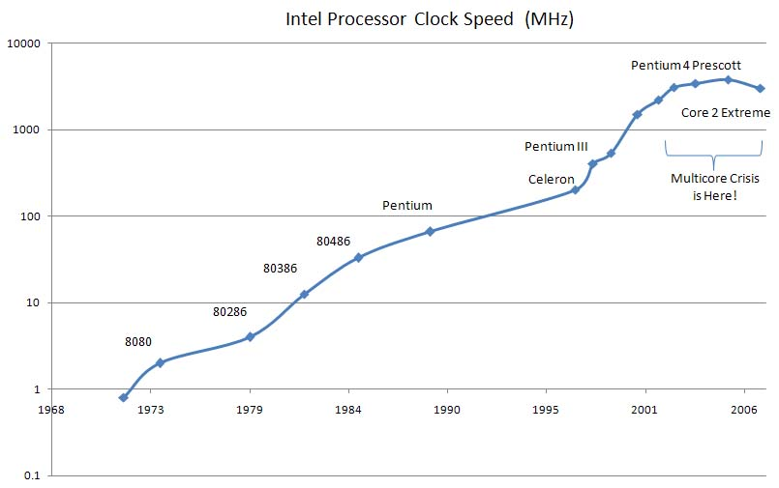
Clock Speeds Increased
Intel Processor Clock Speed (MHz)
Notice a little trick: x axis goes only to 2003!

Slide 17
Until they stopped increasing!
Intel Processor Clock Speed (MHz)
Why?

Slide 18
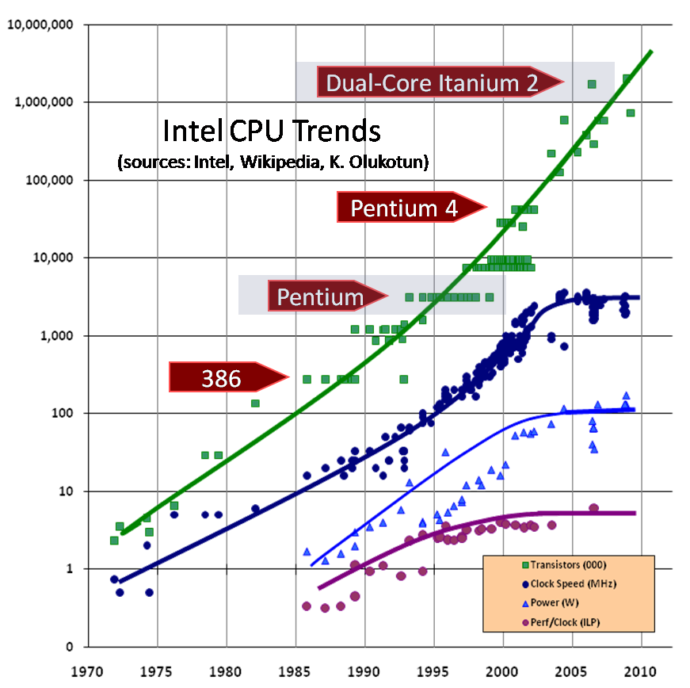
Source: Herb Sutter (orig. in DDJ)

Slide 19
Prediction in 1999 From Shekhar Borkar, Intel, at MICRO’99
So, the chips were getting too hot

Slide 20
Frequency and Power
There is a cubic relationship between them!
So, if frequency doubles, dynamic power increases 8-fold!
Static power is still a significant part of the total power
So, frequencies stalled around 2-3 GHz
Which is plenty fast

Slide 21
Power vs Frequency on a given processor

Slide 22
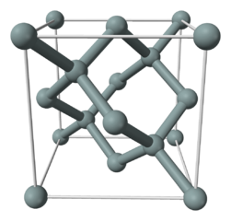
Number of Transistors/chip?
Well, they will keep on growing for the next ten years
May be a bit slowly
Current technology is 14 nanometers
22nm is still common
We may go to 5 nanometers feature size
i.e. gap between two wires (as a simple definition)
For comparison:
Distance between a carbon and a Hydrogen atom is 1 Angstrom = 0.1 nanometer!
Silicon-Silicon bonds are longer
5 Aº lattice spacing (image: wikipedia)
i.e. 0.5 nanometer
So, we are close to atomic units!

Slide 23
Consequence
We will get to 30-50 billion transistors/chip!
What to do with them?
Put more processors on a chip
Beginning of the multicore era:
Number of cores per chip doubles every X years
X= 2? 3?

Slide 24
Change is changing
To summarize:
We had been used to computers becoming faster every year.. That “change” was a constant
The change is: that the speeds are no longer changing..
So, Lets think about what happens over the next 10 years
And later:
What happens after ten years, when even the number of transistors don’t increase any more

Slide 25
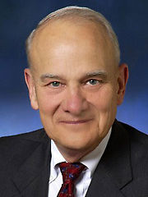
Bill Wulf in 1978
William Wulf is one of the most influential computer scientist
Visited IISc Bangalore around 1978..
When I was a grad student
Talked about his parallel computing projects
C.mmp
Stated motivations: Sequential processors cannot keep getting faster forever, because of physical limitations. We need many processors working in parallel to compute faster
But engineers kept making it go faster
Until now

Slide 26
Two problems
Maybe we have all the speed we need..
I.e. for all the apps that we need
Nyah..
Maybe 8-16 cores is all that you need
We are still seeing improvements because
We use multiple programs on the desktop
Browsers can do multiple things: get data, draw pictures, ..
But now, we have enough power.. Right?
So, unless one (or more) parallel “killer app” appears, the market (for multicore chips) will stop growing

Slide 27
Alternative: Parallelism
If we find killer apps that need all the parallel power we can bring to bear
With 50B transistors, at least 100+ processor cores on each chip
There is a tremendous competitive advantage to building such a killer app
So, given our history, we will find it
What are the enabling factors:
Finding the application areas.
Parallel programming skills

Slide 28
A Few Candidate Areas
Simple parallelism:
Search images, scan files, ..
Speech recognition:
almost perfect already
But speaker dependent, minor training, and needs non-noisy environment
Frontier: speaker independent recognition with non-controlled environment
Broadly: Artificial intelligence
Data centers (data analytics, queries, cloud computing)
And, of course, HPC (High Performance Computing)
typically for CSE (Computational science and Engineering)

Slide 29
Parallel Programming Skills
So, all machines will be (are?) parallel
So, almost all programs will be parallel
True?
There are 10 million programmers in the world
Approximate estimate
All programmers must become parallel programmers
Right? What do you think?

Slide 30
Programming Models Innovations
Expect a lot of novel programming models
There is scope for new languages, unlike now
Only Java broke through after C/C++
This is good news:
If you are a computer scientist wanting to develop new languages
Bad news:
If you are an application developer
DO NOT WAIT FOR “AutoMagic” parallelizing compiler!

Slide 31
Small Clusters
Probably some of the biggest impact
Broadening of the market
Every company/department can afford a very powerful (100 TF? PF?) cluster
All kinds of activities can be computerized
Intel’s example:
fashion designers examining how a cloth will drape over a body, and how it will move
Via simulation
Operations Research
Business Strategies via AI support

Slide 32
Supercomputers
Exascale will be reached by 2022
May be 50 MW, and 10^18 ops/s
I expect
Will create breakthroughs in science and engineering of great societal impact
Biomedicine, materials,
Astronomy, Physics: theories
Engineering design of better artifacts
Controlled nuclear fusion (fission) may solve energy problems
Climate??
If society deems it beneficial, technology can be developed for beyond-exascale (1000 Eflops?)

Slide 33
Next Era: End of Moore’s Law
10-ish years from now
Maybe 7.. But the end-phase will be slowed down
No more increase in performance from a general purpose chip!
What can we predict about this era?
First, innovation would shift to functional specialization
would have started happening already
Next, innovation will shift to application areas, and molecular sciences: biomedical (nanobots?), materials,
Another 5-10 years, you can develop CSE applications knowing that machine won’t change under your feet
Maybe

Slide 34
Caution: Predicting Future
Remember:
1900 or so: “End of Science” predicted
1990 or so: “End of History” predicted

Slide 35
Summary
Times are changing:
i.e. they are getting more stagnant!
Those who can “get” parallel, will have an advantage
If killer parallel app doesn’t arrive, progress will stall
Complete “stasis” after 10-15 years..
But then such things have been predicted before

