Slide 1
Implementing Reductions and Broadcasts CS420
Laxmikant V. Kale

Slide 2
Types of reductions
Scalar Reductions
Input: each processor holds a number
Output: at the end of the operation, one designated processor (say 0) has the sum of all numbers
Instead of sum, one can use any commutative-associative operation
Such as Max, min, and, or, product, ..
3
26
PE0
2
PE1
12
PE2
PE3
9

Slide 3
Types of reductions
Vector Reduction
Input: each processor holds an array of numbers
Output: at the end of the operation, a designated processor has the sum of all numbers, respectively
i.e. Sum[i] = sum{A[i]}
Instead of sum, one can use any commutative-associative operation
Such as Max, min, and, or, product, ..
[3,2,7]
[15,17,25]
PE0
[1,2,3]
PE1
[4,5,6]
PE2
[7,8,9]
PE3

Slide 4
Types of reductions
Scalar (and Vector) All-Reduce
Each processor holds a number
At the end of the operation, all processors have the sum of all numbers
Again, instead of sum, one can use any commutative-associative operation
Such as Max, min, and, or, product, ..
PE0
3
26
2
26
PE1
12
26
PE2
9
26
PE3

Slide 5
Optimizing Reductions and Broadcasts
Naïve algorithm: all send to PE 0. ( O(P) )
Basic Spanning tree algorithm:
Organize processors in a k-ary tree
Leaves: send contributions to parent
Internal nodes: wait for data from all children, add mine,
Then, if I am not the root, send to my parent
What is a good value of k? Minimize the total time
Broadcasts algorithms are similar to reductions, but in reverse direction

Slide 6
P = 1024, K = 2
α * 2 * log₂(1024) = 20α
P = 1024, K = 4
α * 4 * log₄(1024) = 20α

Slide 7
Better spanning trees:
Observation: Only 1 level of the tree is active at a time
Also, A PE can’t deal with data from second child until it has finished “receive” of data from 1st.
So, second child could delay sending its data, with no impact
It can collect data from someone else in the meanwhile
4
2
3
3
1
1
2
1
2
1

Slide 8
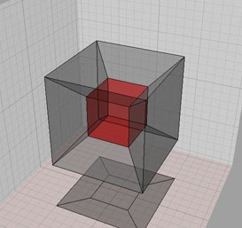
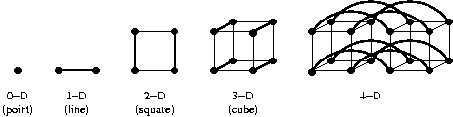
Hypercube topology
Recursive definition:
a single node is a hypercube (of 0 dimensions)
Starting with 2 hypercubes, and connecting the corresponding nodes of each to the other, gives you a hypercube (of higher dimension)
Alternative definition
A hypercube of dimension K includes 2^K nodes, each with a serial number between 0 and (2^k - 1)
Each node is connected to K neighbors, identified by changing exactly one bit in the k-bit representation of the node’s serial number

Slide 9
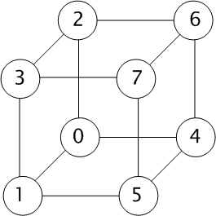
Hypercube based spanning tree
In each phase i, send data to neighbor in i’th dimension if its serial number is smaller than mine
Accumulate data from neighbors until it is my turn to send
log P phases, with at most one receive per processor per phase
0 000
1 001
2 010
3 011
4 100
5 101
6 110
7 111

Slide 10
More complex ideas
Observation: Only 1 level of the tree is active at a time
Exploit the actual values of send overhead, latency, and receive overhead
The picture on the right is not good for all values of receive overhead and latency.. But you can make a more tuned spanning tree for that.
4
1
2
3
3
1
1
2
1
2
1

Slide 11
Reductions with large datasets
What if n is large?
Example: simpler formulation of molecular dynamics:
Each PE has an array of forces for all atoms
Each PE is assigned a subset of pairs of atoms
Accumulated forces must be summed up across PEs
New optimizations become possible with large n:
Essential idea: use multiple concurrent reductions to keep all levels of the tree busy
Divide data (n bytes) into m segments of n/m bytes each
Start reduction for each segment.
n/m pipelined phases (I.e. phases overlap in time)
k: branching factor, as before
So, approximately:
Instead of

Slide 12
Concurrent reductions: load balancing!
Leaves of the spanning tree are doing little work
Use a different spanning tree for successive reductions:
E.g. first reduction uses a normal spanning tree rooted at 0, while second reduction uses a mirror-image tree rooted at (P-1)
This load balancing improve performance considerably

Slide 13
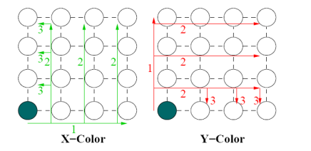
Topology Aware Reduction
What if we knew more about how processors are placed and can find concurrent reduction paths? Multi-color rings

Slide 14
Bucket Algorithms
In n-dimensional grids:
Reduce/broadcast along one dimension
Then, along the second dimension and so on
Parallelism across lines
More bandwidth available
How can you make it faster? Think of bandwidth.
Run multiple instances of such phase-wise reductions
A dimension is used by only one instance in a given phase
An instance uses different dimension in different phases!

