Slide 1


Charm++ Motivations and Basic Ideas
Laxmikant (Sanjay) Kale
http://charm.cs.illinois.edu
Parallel Programming Laboratory
Department of Computer Science
University of Illinois at Urbana Champaign

Slide 2
Challenges in Parallel Programming
Applications are getting more sophisticated
Adaptive refinements
Multi-scale, multi-module, multi-physics
E.g. load imbalance emerges as a huge problem for some apps
Exacerbated by strong scaling needs from apps
Strong scaling: run an application with same input data on more processors, and get better speedups
Weak scaling: larger datasets on more processors in the same time
Future challenge: hardware variability
Static/dynamic
Heterogeneity: processor types, process variation, ..
Power/Temperature/Energy
Component failure
To deal with these, we must seek
Not full automation
Not full burden on app-developers
But: a good division of labor between the system and app developers

Slide 3
What is Charm++?
Charm++ is a generalized approach to writing parallel programs
An alternative to the likes of MPI, UPC, GA etc.
But not to sequential languages such as C, C++, and Fortran
Represents:
The style of writing parallel programs
The runtime system
And the entire ecosystem that surrounds it
Three design principles:
Overdecomposition, Migratability, Asynchrony

Slide 4
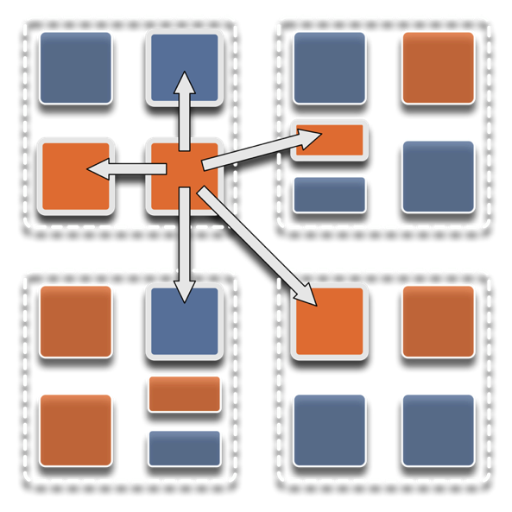
Overdecomposition
Decompose the work units & data units into many more pieces than execution units
Cores/Nodes/..
Not so hard: we do decomposition anyway

Slide 5
Migratability
Allow these work and data units to be migratable at runtime
i.e. the programmer or runtime, can move them
Consequences for the app-developer
Communication must now be addressed to logical units with global names, not to physical processors
But this is a good thing
Consequences for RTS
Must keep track of where each unit is
Naming and location management

Slide 6
Asynchrony: Message-Driven Execution
With over decomposition and Migratibility:
You have multiple units on each processor
They address each other via logical names
Need for scheduling:
What sequence should the work units execute in?
One answer: let the programmer sequence them
Seen in current codes, e.g. some AMR frameworks
Message-driven execution:
Let the work-unit that happens to have data (“message”) available for it execute next
Let the RTS select among ready work units
Programmer should not specify what executes next, but can influence it via priorities

Slide 7
Realization of this model in Charm++
Overdecomposed entities: chares
Chares are C++ objects
With methods designated as “entry” methods
Which can be invoked asynchronously by remote chares
Chares are organized into indexed collections
Each collection may have its own indexing scheme
1D, ..7D
Sparse
Bitvector or string as an index
Chares communicate via asynchronous method invocations
A[i].foo(….); A is the name of a collection, i is the index of the particular chare.

Slide 8
Parallel Address Space
Processor 0
Processor 1
Scheduler
Scheduler
Message Queue
Message Queue
Processor 2
Processor 3
Scheduler
Scheduler
Message Queue
Message Queue

Slide 9
Message-driven Execution
A[23].foo(…)
Processor 0
Processor 1
Scheduler
Scheduler
Message Queue
Message Queue
Notes:
Certain member functions of certain classes are globally visible
Invocation of a member function may lead to communication

Slide 10
Processor 0
Processor 1
Scheduler
Scheduler
Message Queue
Message Queue
Processor 2
Processor 3
Scheduler
Scheduler
Message Queue
Message Queue

Slide 11
Processor 0
Processor 1
Scheduler
Scheduler
Message Queue
Message Queue
Processor 2
Processor 3
Scheduler
Scheduler
Message Queue
Message Queue

Slide 12
Processor 0
Processor 1
Scheduler
Scheduler
Message Queue
Message Queue
Processor 2
Processor 3
Scheduler
Scheduler
Message Queue
Message Queue

Slide 13
Empowering the RTS
Adaptive
Runtime System
Introspection
Adaptivity
Asynchrony
Overdecomposition
Migratability
The Adaptive RTS can:
Dynamically balance loads
Optimize communication:
Spread over time, async collectives
Automatic latency tolerance
Prefetch data with almost perfect predictability

Slide 14
Charm++ Benefits
Over-decomposition
Scalable Tools
Automatic overlap of Communication and Computation
Message-driven execution
Perfect prefetch
compositionality
Emulation for Performance Prediction
Migratability
Fault Tolerance
Introspective and adaptive runtime system
Dynamic load balancing (topology-aware, scalable)
Temperature/Power/Energy Optimizations

Slide 15
Utility for Multi-cores, Many-cores, Accelerators:
Objects connote and promote locality
Message-driven execution
A strong principle of prediction for data and code use
Much stronger than principle of locality
Can use to scale memory wall:
Prefetching of needed data:
into scratch pad memories, for example
Processor 1
Scheduler
Message Queue
Notes:
Replace figure with a new drawing

Slide 16
Impact on communication
Current use of communication network:
Compute-communicate cycles in typical MPI apps
The network is used for a fraction of time
and is on the critical path
Current communication networks are over-engineered for by necessity
P1
P2
BSP based application

Slide 17
Impact on communication
With overdecomposition:
Communication is spread over an iteration
Adaptive overlap of communication and computation
P1
P2
Overdecomposition enables overlap

Slide 18
Decomposition Challenges
Current method is to decompose to processors
This has many problems
Deciding which processor does what work in detail is difficult at large scale
Decomposition should be independent of number of processors – enabled by object based decomposition
Adaptive scheduling of the objects on available resources by the RTS

Slide 19
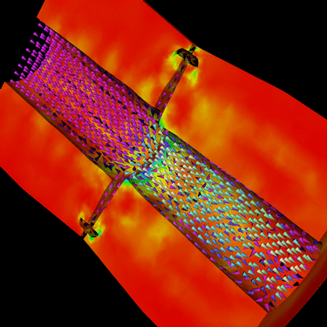
Decomposition Independent of numCores
Rocket simulation example under traditional MPI
With migratable-objects:
Benefit: load balance, communication optimizations, modularity
Solid
Solid
. . .
Solid
Fluid
Fluid
Fluid
1 2 P
Solid₁
Solid₂
Solid₃
. . .
Solid_{n}
Fluid₁
Fluid₂
. . .
Fluid_{m}
Notes:
19
In traditional MPI paradigm. The number of partitions of both modules is typically equal to the number of processor P
And although the i’th elements of fluid module and solid module are not connected geometrically in the simulation, they are glued together on the I’th processor.
Under Charm++/AMPI framework, the two modules each get their own set of parallel objects. And the size of the arrays are not restricted or related.
The benefit of this is performance optimizations and better modularity.
Problem: due to the asynchronous method invocation, the flow of control is buried deep into the object code

Slide 20
Compositionality
It is important to support parallel composition
For multi-module, multi-physics, multi-paradigm applications…
What I mean by parallel composition
B || C where B, C are independently developed modules
B is parallel module by itself, and so is C
Programmers who wrote B were unaware of C
No dependency between B and C
This is not supported well by MPI
Developers support it by breaking abstraction boundaries
E.g., wildcard recvs in module A to process messages for module B
Nor by OpenMP implementations:

Slide 21
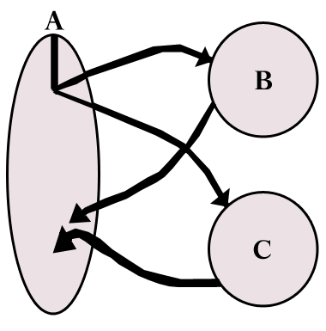
Without message-driven execution (and virtualization), you get either:
Space-division
B
C
Time
Notes:
Replace “scanned” diagram on the left with a better one, in all the slides that use this.

Slide 22
OR: Sequentialization
B
C
Time

Slide 23
Parallel Composition: A1; (B || C ); A2
Recall: Different modules, written in different languages/paradigms, can overlap in time and on processors, without programmer having to worry about this explicitly

Slide 24
Summary: What is Charm++?
Charm++ is a way of parallel programming based on:
Objects
Overdecomposition
Messages
Asynchrony
Migratability
Adaptive runtime system

Slide 25
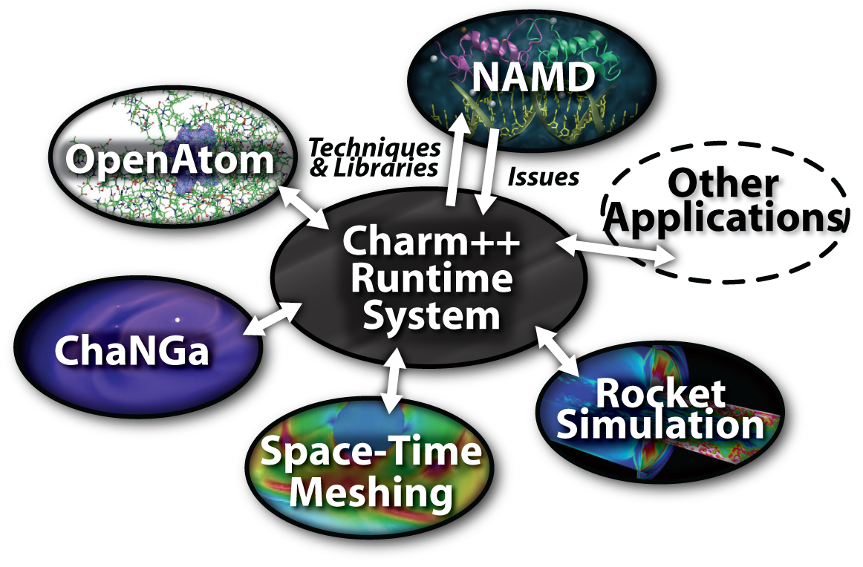
Charm++ and CSE Applications
Well-known Biophysics molecular simulations App
Gordon Bell Award, 2002
Nano-Materials..
Synergy
Enabling CS technology of parallel objects and intelligent runtime systems has led to several CSE collaborative applications
ISAM
Computational Astronomy
_{EpiSimdemics}
_{Stochastic}
_{Optimization}

Slide 26
Grainsize
Charm++ philosophy:
let the programer decompose their work and data into coarse-grained entities
It is important to understand what I mean by coarse-grained entities
You don’t write sequential programs that some system will auto-decompose
You don’t write programs when there is one object for each float
You consciously choose a grainsize, BUT choose it independent of the number of processors
Or parameterize it, so you can tune later

Slide 27
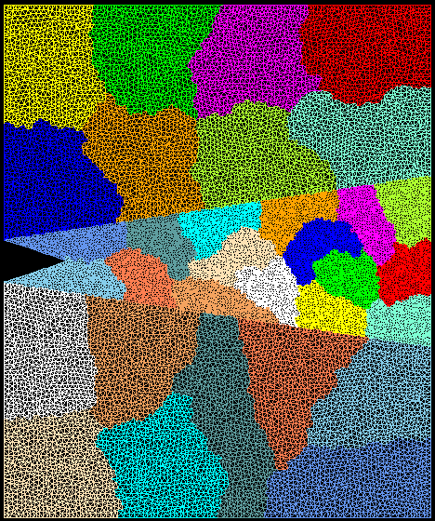
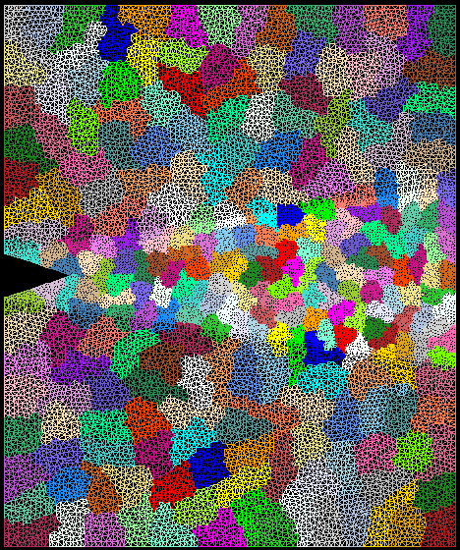
Crack Propagation
This is 2D, circa 2002…
but shows over-decomposition for unstructured meshes..
Decomposition into 16 chunks (left) and 128 chunks, 8 for each PE (right). The middle area contains cohesive elements. Both decompositions obtained using Metis. Pictures: S. Breitenfeld, and P. Geubelle

Slide 28
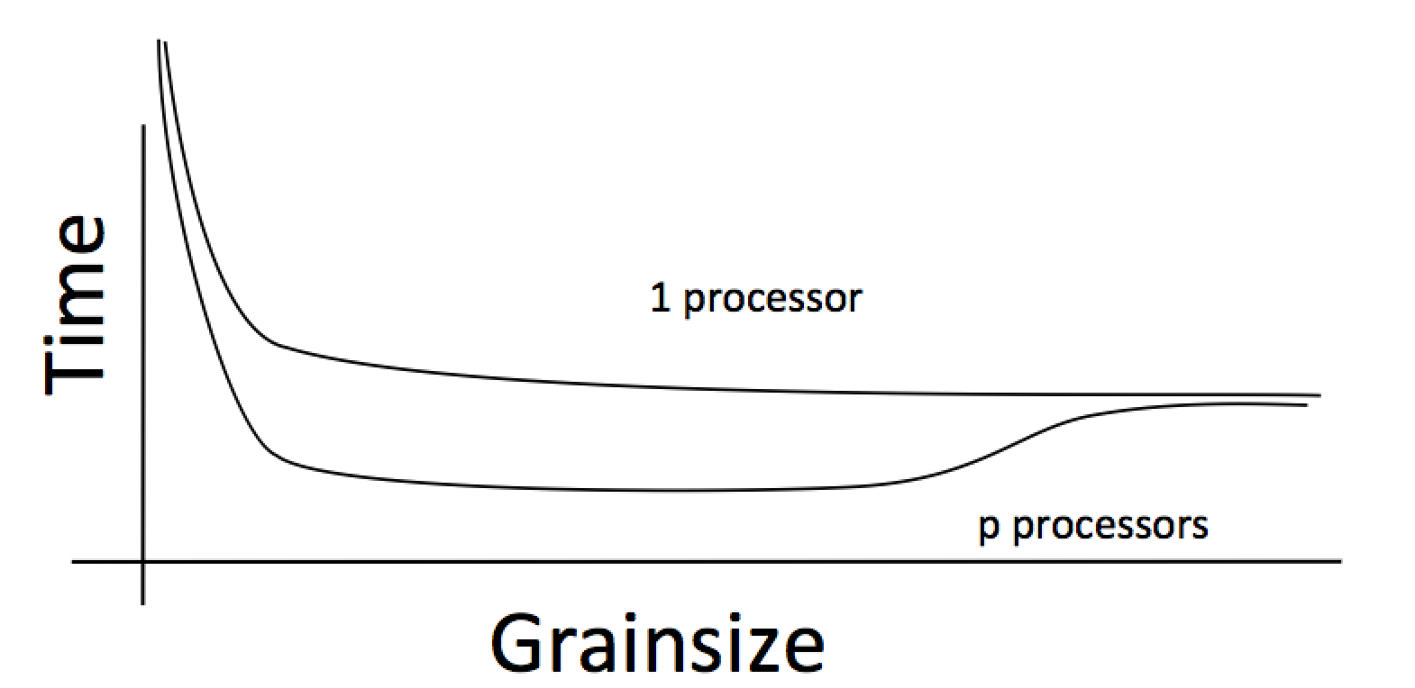
Working definition of grainsize:
amount of computation per remote interaction
Choose grainsize to be just large enough to amortize the overhead

Slide 29
Grainsize in a common setting
2 MB/chare,
256 objects per core

Slide 30
Rules of thumb for grainsize
Make it as small as possible, as long as it amortizes the overhead
More specifically, ensure:
Average grainsize is greater than kv (say 10v)
v: overhead per message, p: number of processors, T: sequential execution time
No single grain should be allowed to be too large
Must be smaller than T/p, but actually we can express it as
Must be smaller than kmv (say 100v)
Important corollary:
You can be at close to optimal grainsize without having to think about P, the number of processors
30

Slide 31
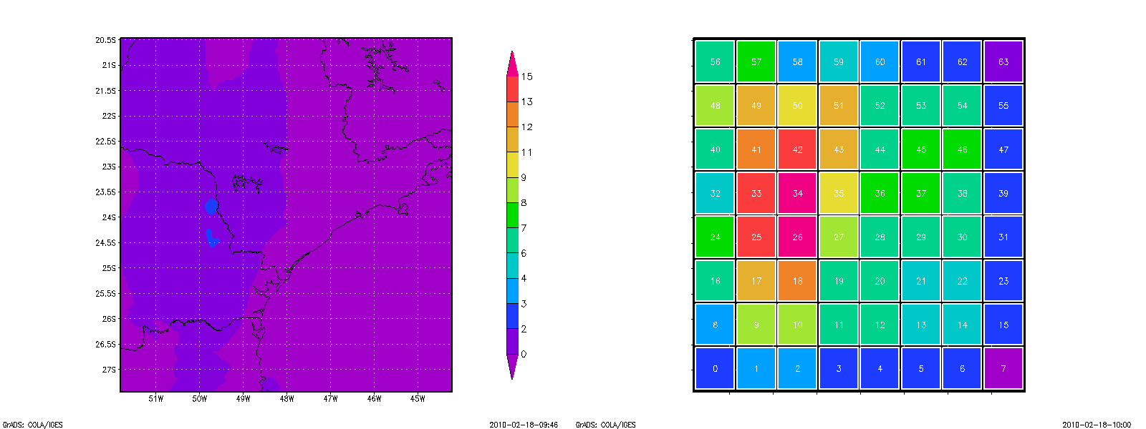
Grainsize: Weather Forecasting in BRAMS
Brams: Brazillian weather code (based on RAMS)
AMPI version (Eduardo Rodrigues, with Mendes, J. Panetta, ..)
Instead of using 64 work units on 64 cores, used 1024 on 64

Slide 32
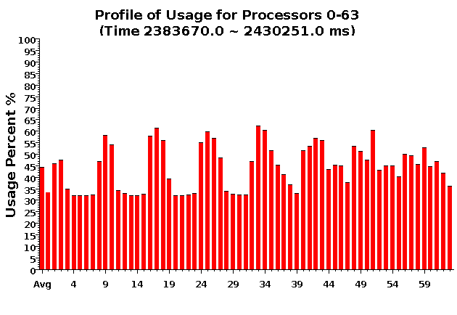
Baseline: 64 objects

Slide 33
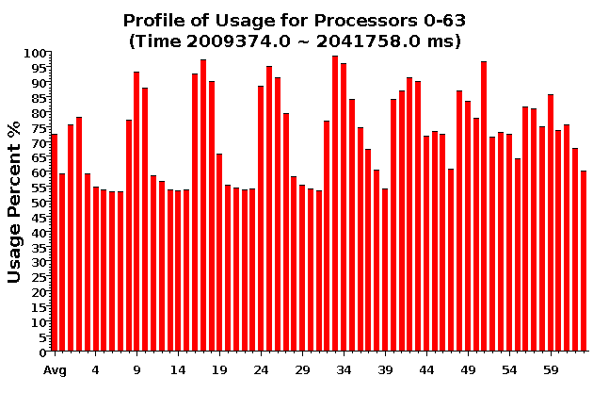
Over-decomposition: 1024 objects
Benefits from communication/computation overlap

Slide 34
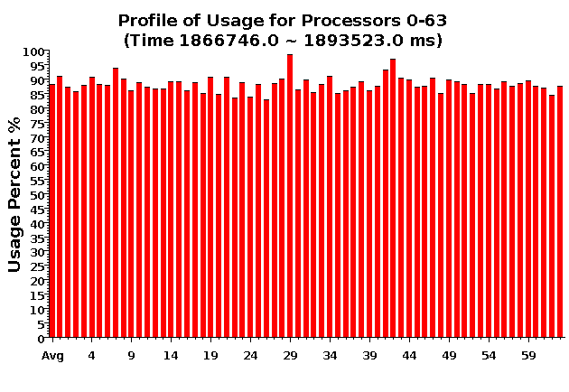
With Load Balancing: 1024 objects
No overdecomp (64 threads) | 4988 sec
Overdecomp into 1024 threads | 3713 sec
Load balancing (1024 threads) | 3367 sec

Slide 35
Summary
Charm++ embodies an adaptive, introspective runtime system
Many applications have been developed using it
NAMD, ChaNGa, Episimdemics, OpenAtom, …
Many miniApps, and third-party apps
Adaptivity developed for apps is useful for addressing exascale challenges
Resilience, power/temperature optimizations, ..
More Info: http://charm.cs.illinois.edu/ (including the miniApps)
Overdecomposition
Asynchrony
Migratability

