Slide 1
Hello World Example
hello.ci file
mainmodule hello {
mainchare Main {
entry Main(CkArgMsg ∗m);
};
};
hello.cpp file
#include <stdio.h>
#include ”hello.decl.h”
class Main : public CBase_Main {
public: Main(CkArgMsg∗ m) {
ckout << “Hello World!” << endl;
CkExit();
};
};
#include “hello.def.h”

Slide 2
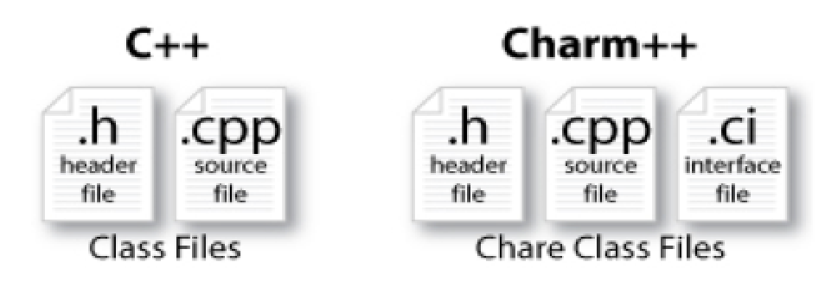
Charm++ File Structure
C++ objects (including Charm++ objects)
Defined in regular .h and .C files
Chare objects, entry methods (asynchronous methods)
Defined in .ci file
Implemented in the .C file

Slide 3
Hello World Example
Compiling
charmc hello.ci
charmc -c hello.C
charmc -o hello hello.o
Running
./charmrun +p7 ./hello
The +p7 tells the system to use seven cores

Slide 4
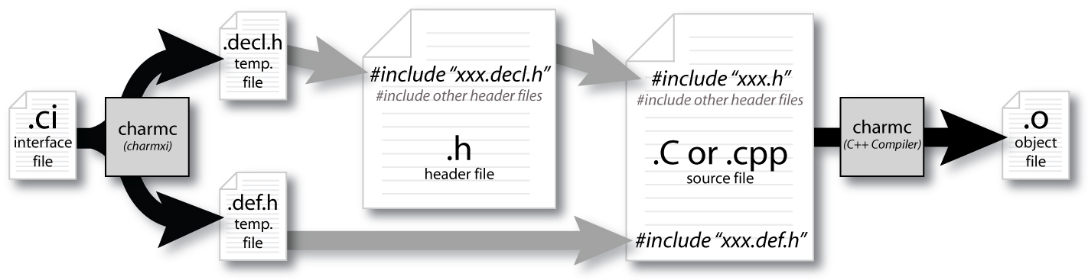
Compiling a Charm++ Program

Slide 5
Charm Interface: Modules
Charm++ programs are organized as a collection of modules
Each module has one or more chares
The module that contains the mainchare, is declared as the mainmodule
Each module, when compiled, generates two files:
MyModule.decl.h and MyModule.def.h
.ci file
[main]module MyModule {
//... chare definitions ...
};

Slide 6
Charm Interface: Chares
Chares are parallel objects that are managed by the RTS
Each chare has a set of entry methods, which are asynchronous methods that may be invoked remotely
The following code, when compiled, generates a C++ class CBase_MyChare that encapsulates the RTS object
This generated class is extended and implemented in the .C file
.ci file
[main]chare MyChare {
//... entry method definitions ...
};
.C file
class MyChare : public CBase_MyChare {
//... entry method implementations ...
};

Slide 7
Charm Interface: Entry Methods
Entry methods are C++ methods that can be remotely and asynchronously invoked by another chare
.ci file
entry MyChare(); /∗ constructor entry method ∗/
entry void foo();
entry void bar(int param);
.C file
MyChare::MyChare() { /∗... constructor code ...∗/ }
MyChare::foo() { /∗... code to execute ...∗/ }
MyChare::bar(int param) { /∗... code to execute ...∗/ }

Slide 8
Charm Interface: mainchare
Execution begins with the mainchare’s constructor
The mainchare’s constructor takes a pointer to system-defined class CkArgMsg
CkArgMsg contains argv and argc
The mainchare will typically creates some additional chares

Slide 9
Creating a Chare
A chare declared as chare MyChare {...}; can be instantiated by the following call:
CProxy_MyChare::ckNew(... constructor arguments ...);
To communicate with this class in the future, a proxy to it must be retained
CProxy_MyChare proxy =
CProxy_MyChare::ckNew(arg1);

Slide 10
Hello World with Chares
hello.cpp file
#include <stdio.h>
#include “hello.decl.h”
class Main : public CBase_Main {
public: Main(CkArgMsg∗ m) {
CProxy_Singleton::ckNew();
};
};
class Singleton :
public CBase_Singleton {
public: Singleton() {
ckout<<“Hello World!”<<endl;
CkExit();
};
};
#include ”hello.def.h”
hello.ci file
mainmodule hello {
mainchare Main {
entry Main(CkArgMsg ∗m);
};
chare Singleton {
entry Singleton();
};
};

Slide 11
Chare Proxies
A chare’s own proxy can be obtained through a special variable thisProxy
Chare proxies can also be passed so chares can learn about others
In this snippet, MyChare learns about a chare instance main , and then invokes a method on it:
.ci file
entry void foobar2(CProxy_Main main);
.C file
MyChare::foobar2(CProxy_Main main) {
main.foo();
}

Slide 12
Charm Termination
There is a special system call CkExit() that terminates the parallel execution on all processors (but it is called on one processor) and performs the requisite cleanup
The traditional exit() is insufficient because it only terminates one process, not the entire parallel job (and will cause a hang)
CkExit() should be called when you can safely terminate the application (you may want to synchronize before calling this)

Slide 13
Chare Creation Example: .ci file
mainmodule MyModule {
mainchare Main {
entry Main(CkArgMsg ∗m);
};
chare Simple {
entry Simple(int x, double y);
};
};

Slide 14
Chare Creation Example: .C file
#include “MyModule.decl.h”
class Main : public CBase_Main {
public: Main(CkArgMsg∗ m) {
ckout << “Hello World!” << endl;
double pi = 3.1415;
CProxy_Simple::ckNew(12, pi);
};
};
class Simple : public CBase_Simple {
public: Simple(int x, double y) {
ckout << “Radius:” << x << “,Area:” << y*x*x << endl;
CkExit();
};
};
#include “MyModule.def.h”

Slide 15
Asynchronous Methods
Entry methods are invoked by performing a C++ method call on a chare’s proxy
CProxy_MyChare proxy =
CProxy_MyChare::ckNew(... constructor arguments ...);
proxy.foo();
proxy.bar(5);
The foo and bar methods will then be executed with the arguments, wherever the created chare, MyChare, happens to live
The policy is one-at-a-time scheduling (that is, one entry method on one chare executes on a processor at a time)

Slide 16
Asynchronous Methods
Method invocation is not ordered (between chares, entry methods on one chare, etc.)!
For example, if a chare executes this code:
CProxy_MyChare proxy = CProxy_MyChare::ckNew(); proxy.foo();
proxy.bar(5);
These prints may occur in any order
MyChare::foo() {
ckout << “foo executes” << endl;
}
MyChare::bar(int param) {
ckout << “bar executes with ” << param << endl;
}

Slide 17
Asynchronous Methods
For example, if a chare invokes the same entry method twice:
proxy.bar(7);
proxy.bar(5);
These may be delivered in any order
MyChare::bar(int param) {
ckout << “bar executes with ” << param << endl;
}
Output
OR
bar executes with 5
bar executes with 7
bar executes with 7
bar executes with 5

Slide 18
Asynchronous Example: .ci file
mainmodule MyModule {
mainchare Main {
entry Main(CkArgMsg ∗m);
};
chare Simple {
entry Simple(double y);
entry void findArea(int radius, bool done);
};
};

Slide 19
Does this program execute correctly?
struct Main : public CBase_Main {
Main(CkArgMsg∗ m) {
CProxy_Simple sim = CProxy_Simple::ckNew(3.1415);
for (int i = 1; i < 10; i++) sim.findArea(i, false);
sim.findArea(10, true);
};
};
struct Simple : public CBase_Simple {
double y;
Simple(double pi) { y = pi; }
void findArea(int r, bool done) {
ckout << “radius: ” << r << “Area:” << y∗r∗r << endl;
if (done) CkExit();
};

Slide 20
Readonly variable
The only global variables officially allowed in a Charm++ programs are readonly variables
Readonly’s can be modified only in the constructor of the main chare
And from any functions called from them (not entry methods)
After the construcor finishes, before any other chares execute any methods, the readonly variables are available on all processors
Declare a readonly in .ci file and also in the .C file
In .ci: readonly int grainSize;
In .C, just a normal declaration

Slide 21
Fibonacci Example
readonly int grainSize;
mainmodule fib {
mainchare Main {
entry Main(CkArgMsg∗ m);
};
chare Fib {
entry Fib(int n, bool isRoot, CProxy_Fib parent);
entry void respond(int value);
};
};

Slide 22
Fibonacci Example
int grainSize;
class Main : public CBase_Main {
public: Main(CkArgMsg∗ m) { grainSize = 10;
CProxy_Fib::ckNew(atoi(m−>argv[1]), true, CProxy_Fib());
}
};
class Fib : public CBase_Fib {
public: CProxy_Fib parent; bool isRoot; int result, count;
Fib(int n, bool isRoot_, CProxy_Fib parent_)
: parent(parent_), isRoot(isRoot_), result(0), count(2) {
if (n < grainSize) respond(n);
else {
CProxy_Fib::ckNew(n − 1, false, thisProxy);
CProxy_Fib::ckNew(n − 2, false, thisProxy);
}
}
void respond(int val) {
result += val;
if (−−count == 0 || n < grainSize) {
if (isRoot) {
CkPrintf(“Fibonacci number is: %d\n”, result);
CkExit();
} else {
parent.respond(result);
delete this;
}
}
}
};
int grainSize;
class Main : public CBase_Main {
public: Main(CkArgMsg∗ m) { grainSize = 10;
CProxy_Fib::ckNew(atoi(m−>argv[1]),true, CProxy_Fib()); }
};
Fib(int n, bool isRoot_, CProxy_Fib parent_)
: parent(parent_), isRoot(isRoot_), result(0), count(2) {
if (n < grainSize) respond(n);
else {
CProxy_Fib::ckNew(n − 1, false, thisProxy);
CProxy_Fib::ckNew(n − 2, false, thisProxy);
}
}
void respond(int val) {
result += val;
if (−−count == 0 || n < grainSize) {
if (isRoot) {
CkPrintf(“Fibonacci number is: %d\n”, result);
CkExit();
} else {
parent.respond(result);
delete this;
}
}
}

Slide 23
Data types and entry methods
You can pass basic C++ types to entry methods (int, char, bool)
C++ STL data structures can be passed by including pup_stl.h
Arrays of basic data types can also be passed like this:
.ci file:
entry void foobar(int length, int data[length]);
.C file
MyChare::foobar(int length, int∗ data) {
// ... foobar code ...
}
Notes:
Can use expressions

Slide 24
N Queens program: design problem
Given a NxN chessboard, place N queens on it so that no two attack each other
Queens attack each other if they are in the same row, column or diagonal
Representation:
An array of size N. Q[i] indicates the column in which a queen in the I’th row has been placed. Convention: -1 for an empty row
Strategy:
Place queen in the next available (smallest number) row
Fire chares for all available places for the next queen

