Slide 1
Chare Arrays
Indexed collections of chares
Every item in the collection has a unique index and proxy
Can be indexed like an array or by an arbitrary object
Can be sparse or dense
Elements may be dynamically inserted and deleted
For many scientific applications, collections of chares are a convenient abstraction
Instead of creating networks of chares that learn about each other (by sending proxies to each other), each element in a chare array knows about all the others

Slide 2
Chare Array Location
By default, chare arrays are distributed to the processors in a “blocked” distribution
A initial mapping function can be specified (input is the index, output is the processor)
Called the home PE of the element
Chare array elements can be migrated by the user or the runtime (load balancing)

Slide 3
Declaring a Chare Array
.ci file:
array [1d] foo {
entry foo(); // constructor
// ... entry methods ...
}
array [2d] bar {
entry bar(); // constructor
// ... entry methods ...
}
.C file:
struct foo : public CBase_foo {
foo() { }
foo(CkMigrateMessage∗) { }
// ... entry methods …
};
struct bar : public CBase_bar {
bar() { }
bar(CkMigrateMessage∗) { }
};

Slide 4
Constructing a Chare Array
Constructed much like a regular chare
The size of each dimension is passed to the constructor
void someMethod() {
CProxy_foo myFoo = CProxy_foo::ckNew(10);
CProxy_bar myBar = CProxy_bar::ckNew(5, 5);
}
The proxy doesn’t have to be retained:
CProxy_foo::ckNew(10);
The proxy represents the entire array, and may be indexed to obtain a proxy to an individual element in the array
myFoo[4].invokeEntry(..);
myBar(2,4).method3(..);

Slide 5
thisIndex
1d: thisIndex returns the index of the current chare array element
2d: thisIndex.x and thisIndex.y return the indices of the current chare array element
.ci file:
array [1d] foo {
entry foo();
}
.C file:
struct foo : public CBase_foo {
foo() {
CkPrintf(“array index = %d”, thisIndex);
}
};

Slide 6
Chare Array: Hello Example
mainmodule arr {
mainchare Main {
entry Main(CkArgMsg∗);
}
array [1D] hello {
entry hello(int);
entry void printHello();
}
}

Slide 7
Chare Array: Hello Example
#include “arr.decl.h”
struct Main : CBase_Main {
Main(CkArgMsg∗ msg) {
int arraySize = atoi(msg->argv[1]);
CProxy_hello p = CProxy_hello::ckNew(arraySize);
p[0].printHello();
}
};
struct hello : CBase_hello {
hello(int n) : arraySize(n) { }
void printHello() {
CkPrintf(“PE[%d]: hello from p[%d]\n”, CkMyPe(), thisIndex);
if (thisIndex == arraySize – 1) CkExit();
else thisProxy[thisIndex + 1].printHello();
}
int arraySize;
};
#include “arr.def.h”

Slide 8
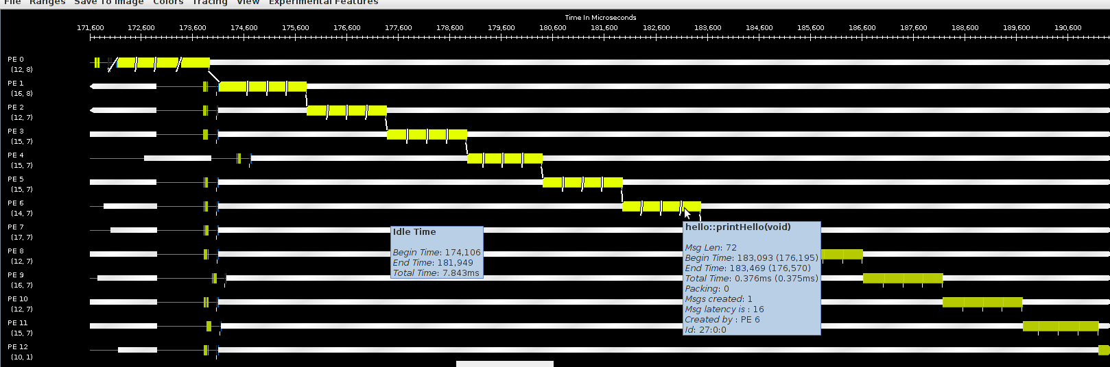
Hello World Array Projections Timeline View
Add “-tracemode projections” to link line to enable tracing
Run Projections tool to load trace log files and visualize performance
arrayHello on BG/Q 16 Nodes, mode c16, 1024 elements (4 per process)

Slide 9
Collections of Objects: Runtime Service
System knows how to ‘find’ objects efficiently:
(collection, index) → processor
Applications can specify a mapping or use simple runtime-provided options (e.g. blocked, round-robin)
Distribution can be static or dynamic!
Key abstraction: application logic doesn’t change, even though performance might

Slide 10
Collections of Objects: Runtime Service
Can develop and test logic in objects separately from their distribution
Separation in time: make it work, then make it fast
Division of labor: domain specialist writes object code, CS specialist writes mapping
Portability: different mappings for different systems, scales, or configurations

Slide 11
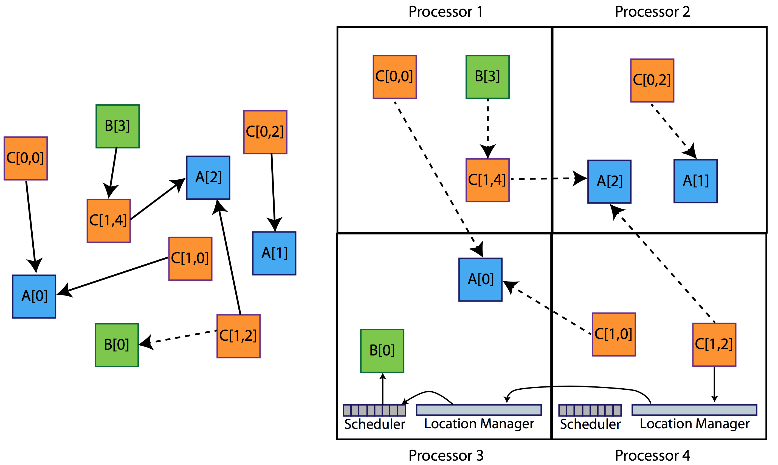
Collections of Objects

Slide 12
Broadcast
A message to each object in a collection
The chare array proxy object is used to perform a broadcast
It looks like a function call to the proxy object
From the main chare:
CProxy_Hello helloArray = CProxy_Hello::ckNew(helloArraySize);
helloArray.foo();
From a chare array element that is a member of the same array:
thisProxy.foo()
From any chare that has a proxy p to the chare array
p.foo()

Slide 13
Reduction
Combines a set of values: sum, max, concat, ..
Usually reduces the set of values to a single value
Combination of values requires an operator
The operator must be commutative and associative
Each object calls contribute in a reduction

Slide 14
Reduction: Example
mainmodule reduction {
mainchare Main {
entry Main(CkArgMsg∗ msg);
entry [reductiontarget] void done(int value);
};
array [1D] Elem {
entry Elem(CProxy_Main mProxy);
};
}
Entry Method Attribute

Slide 15
Entry Method Attributes
entry [attribute1, ..., attributeN] void EntryMethod(parameters);
There are several other attributes that one can attach to an EP
EP is my shortform for entry method (original: Entry Point)
In .ci file
There can be multiple attributes attached to an EP
We will learn them as they are needed
Later, you can visit the manual for more
Do not learn the language from its manual! Learn it from a tutorial
Then use the manual as a reference, and to refine your understanding

Slide 16
Entry Method Attributes
entry [attribute1, ..., attributeN] void EntryMethod(parameters);
Other attributes that are relevant now:
inline :
IF the the calling chare is on the same processor as the called chare,
call it right away..
No serialization.
Make sure you avoid infinite recursion or starvation of other work
Otherwise, it has no effect
Local
To be used when the programmer knows the calling and called chares are guaranteed to be on the same processor

Slide 17
Reduction: Example
#include “reduction.decl.h”
const int numElements = 49;
class Main : public CBase_Main {
public:
Main(CkArgMsg∗ msg) { CProxy_Elem::ckNew(thisProxy, numElements); }
void done(int value) { CkPrintf(“value: %d\n”, value); CkExit(); }
};
class Elem : public CBase_Elem {
public:
Elem(CProxy_Main mProxy) { int val = thisIndex; CkCallback cb(CkReductionTarget(Main, done), mProxy); contribute(sizeof(int), &val, CkReduction::sum_int, cb);
}
};
#include ”reduction.def.h”
Output
value: 1176
Program finished.

Slide 18
Parallel Prefix Sum Algorithm
Given array A[0..N-1], produce B[N], such that B[k] is the sum of all elements of A up to A[k]
Data dependency from iteration to iteration.
How can this be parallelized at all?
It looks like the problem is inherently sequential, but theoreticians came up with a beautiful algorithm called recursive doubling or just parallel prefix
B[0] = A[0];
for (i=1; i<N; i++)
B[i] = B[i−1] + A[i];

Slide 19
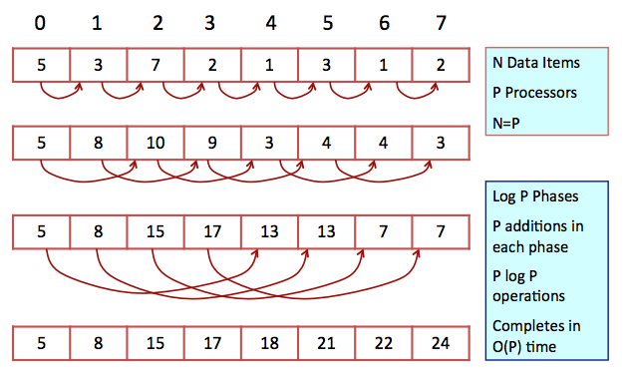
Parallel Prefix: Recursive Doubling Algorithm

Slide 20
Parallel Prefix Example: prefix.ci
mainmodule prefix{
readonly CProxy_Main mainProxy;
readonly int numElements;
readonly CProxy_Prefix prefixArray;
mainchare Main {
entry Main(CkArgMsg*);
entry [reductiontarget] void done();
};
array [1D] Prefix {
entry Prefix();
entry void step();
entry void passValue(int);
};
};

Slide 21
#include "prefix.decl.h"
#include <math.h>
/*readonly*/ CProxy_Main mainProxy;
/*readonly*/ CProxy_Prefix prefixArray;
/*readonly*/ int numElements;
class Main : public CBase_Main {
Main(CkArgMsg* msg) {
mainProxy= thisProxy;
if (msg->argc > 1) numElements = atoi(msg->argv[1]); else numElements = 8;
delete msg;
prefixArray = CProxy_Prefix::ckNew(numElements);
}
void done(){ CkExit(); }
};
class Prefix : public CBase_Prefix {
int value, distance;
Prefix() {
distance = 1;
srand(time(NULL));
value = rand() % 10;
step();
}
Wrong Parallel Prefix: Why?

Slide 22
void Prefix(CkMigrateMessage*){};
void step(){
if(distance >= numElements) {
CkPrintf("Prefix[%d].value = %d\n", thisIndex, value);
CkCallback cb(CkReductionTarget(Main, done), mainProxy); contribute(sizeof(int), &value, CkReduction::sum_int, cb);
}
else{
if (thisIndex+distance<numElements)
thisProxy[thisIndex+distance].passValue(value);
}
}
void passValue(int incoming_value){
value += incoming_value;
distance = distance*2;
step();
}
};
#include "prefix.def.h"
Wrong Parallel Prefix: Why?

Slide 23
Prefix(CkMigrateMessage*){};
void step(){
if(distance >= numElements) {
CkPrintf("\nPrefix[%d].value = %d\n", thisIndex, value);
CkCallback cb(CkReductionTarget(Main, done), mainProxy); contribute(sizeof(int), &value, CkReduction::sum_int, cb);
}
else{
if (thisIndex+distance<numElements)
thisProxy[thisIndex+distance].passValue(value);
//if you no longer receive, but need to continue sending
if(thisIndex-distance < 0){
distance = distance*2;
step();
}
}
}
void passValue(int incoming_value){
value += incoming_value;
distance = distance*2;
step();
}
};
#include "prefix.def.h"
Wrong Parallel Prefix: Why?

Slide 24
Parallel Prefix Example, Correct Version: prefix.ci
mainmodule prefix{
readonly CProxy_Main mainProxy;
readonly int numElements;
readonly CProxy_Prefix prefixArray;
mainchare Main {
entry Main(CkArgMsg*);
entry [reductiontarget] void done();
};
array [1D] Prefix {
entry Prefix();
entry void step(int);
entry void passValue(int stage, int value); //need to include stage
};
};

Slide 25
Parallel Prefix Example: prefix.C I
#include "prefix.decl.h"
#include <math.h>
/*readonly*/ CProxy_Main mainProxy;
/*readonly*/ CProxy_Prefix prefixArray;
/*readonly*/ int numElements;
class Main : public CBase_Main {
Main(CkArgMsg* msg) {
mainProxy= thisProxy;
numElements = 8; // Default numElements to 8
if (msg->argc > 1) numElements = atoi(msg->argv[1]);
delete msg;
prefixArray = CProxy_Prefix::ckNew(numElements);
}
void done() { CkExit(); }
};

Slide 26
Parallel Prefix Example: prefix.C II
class Prefix : public CBase_Prefix {
int* valueBuf, *flagBuf, value, stage, numStages;
Prefix() {
stage = 0;
numStages = log2(numElements);
valueBuf = (int*) malloc(numStages*sizeof(int));
flagBuf = (int*) malloc(numStages, sizeof(int));
srand(thisIndex);
value = rand()%10+1;
step(value);
}
Prefix(CkMigrateMessage*){};

Slide 27
void step(int value){
if(stage >= numStages){
CkPrintf("Prefix[%d].value = %d\n", thisIndex, value);
CkCallback cb(CkReductionTarget(Main, done), mainProxy); contribute(sizeof(int), &value, CkReduction::sum_int, cb);
}
else{
int dest = thisIndex + (1<<stage);
if(dest < numElements)
thisProxy[dest].passValue(stage, value);
//if you no longer receive, but need to continue sending
if(thisIndex - (1<<stage) < 0)
{ stage++; step(value); }
}
}

Slide 28
void step(int value){
if(stage >= numStages){
CkPrintf("Prefix[%d].value = %d\n",
thisIndex, value);
CkCallback cb(CkReductionTarget(Main, done), mainProxy); contribute(sizeof(int), &value,
CkReduction::sum_int, cb);
}
else{
int sendIndex = thisIndex + (1<<stage);
if(sendIndex < numElements)
thisProxy[sendIndex].passValue(stage, value);
//if you no longer receive, but need to continue sending
if(thisIndex - (1<<stage) < 0){
stage++;
step(value);
}
}
}
void passValue(int incoming_stage, int incoming_val){
flagBuf[incoming_stage] = 1;
valueBuf[incoming_stage] = incoming_val;
for(int i=stage; i<numStages; i++){
if(flagBuf[i] == 0) break;
value += valueBuf[i];
stage++;
step(value);
}
}
};
#include "prefix.def.h"

