Slide 1
More Collectives, and one-sided communication
Laxmikant V. Kale
Based on content from
Cornell Virtual Workshop and
http://images.mpitutorial.com/

Slide 2
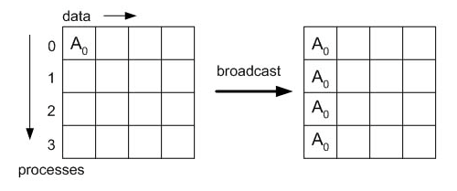
MPI Broadcast
int MPI_Bcast(void* buffer, int count, MPI_Datatype datatype, int root, MPI_Comm comm)

Slide 3
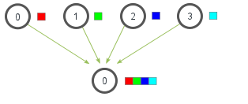
MPI Gather

Slide 4
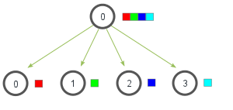
MPI_Scatter

Slide 5
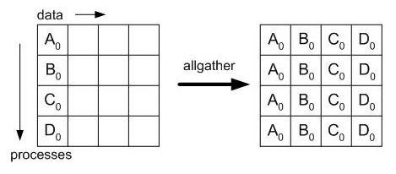
MPI AllGather
int MPI_Allgather(const void* sbuf, int scount,
MPI_Datatype stype, void* rbuf, int rcount,
MPI_Datatype rtype, MPI_Comm comm)

Slide 6
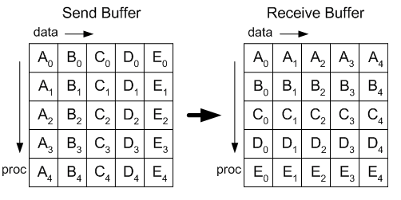
MPI AlltoAll
int MPI_Alltoall(const void* sbuf, int scount,
MPI_Datatype stype, void* rbuf, int rcount,
MPI_Datatype rtype, MPI_Comm comm)

Slide 7
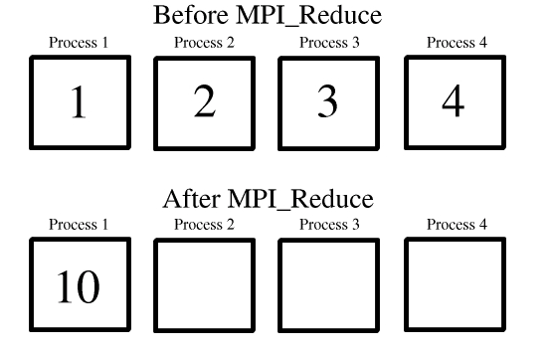
MPI Reduce: computation collective

Slide 8
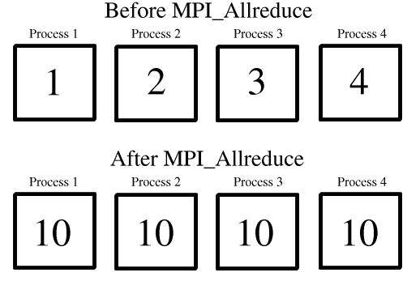
MPI Allreduce

Slide 9
One-sided Communication
Based on slides by
Pavan Balaji, Torsten Hoefler, and Martin Schulz

Slide 10
One-sided Communication
The basic idea of one-sided communication models is to decouple data movement with process synchronization
Should be able move data without requiring that the remote process synchronize
Each process exposes a part of its memory to other processes
Other processes can directly read from or write to this memory
Process 0
Process 1
Process 2
Process 3
Public Memory Region
Private Memory Region
Public Memory Region
Private Memory Region
Public Memory Region
Private Memory Region
Public Memory Region
Global Address Space
Private Memory Region
Private Memory Region
Private Memory Region
Private Memory Region
Private Memory Region

Slide 11
Two-sided Communication Example
Memory
Processor
Processor
Memory
Memory
Segment
Memory
Segment
Memory
Segment
Memory
Segment
Memory
Segment
Send
Recv
Send
Recv
MPI implementation
MPI implementation

Slide 12
One-sided Communication Example
Memory
Processor
Processor
Memory
Memory
Segment
Memory
Segment
Memory
Segment
Memory
Segment
Send
Recv
Send
Recv
MPI implementation
MPI implementation

Slide 13
Comparing One-sided and Two-sided Programming
Process 0
Process 1
SEND(data)
DELAY
Even the sending process is delayed
RECV(data)
Process 0
Process 1
PUT(data)
DELAY
Delay in process 1 does not affect process 0
GET(data)

Slide 14
Window creation models
Four models exist
MPI_WIN_CREATE
You already have an allocated buffer that you would like to make remotely accessible
MPI_WIN_ALLOCATE
You want to create a buffer and directly make it remotely accessible
MPI_WIN_CREATE_DYNAMIC
You don’t have a buffer yet, but will have one in the future
MPI_WIN_ALLOCATE_SHARED
You want multiple processes on the same node share a buffer
We will not cover this model today

Slide 15
MPI_WIN_CREATE
int MPI_Win_create(void *base, MPI_Aint size, int disp_unit, MPI_Info info, MPI_Comm comm, MPI_Win *win)
Expose a region of memory in an RMA window
Only data exposed in a window can be accessed with RMA ops.
Arguments:
base - pointer to local data to expose
size - size of local data in bytes (nonnegative integer)
disp_unit - local unit size for displacements, in bytes (positive integer)
info - info argument (handle)
comm - communicator (handle)

Slide 16
Example with MPI_WIN_CREATE
int main(int argc, char ** argv)
{
int *a; MPI_Win win;
MPI_Init(&argc, &argv);
/* create private memory */
a = (void *) malloc(1000 * sizeof(int));
/* use private memory like you normally would */
a[0] = 1; a[1] = 2;
/* collectively declare memory as remotely accessible */
MPI_Win_create(a, 1000*sizeof(int), sizeof(int),
MPI_INFO_NULL, MPI_COMM_WORLD, &win);
/* Array ‘a’ is now accessibly by all processes in
* MPI_COMM_WORLD */
MPI_Win_free(&win);
free(a);
MPI_Finalize(); return 0;
}

Slide 17
Data movement: Get
MPI_Get(
origin_addr, origin_count, origin_datatype,
target_rank,
target_disp, target_count, target_datatype,
win)
Move data to origin, from target
Separate data description triples for origin and target
Target Process
RMA
Window
Other preparatory calls are needed before data movement calls are made
See Put_and_get
Local
Buffer
Origin Process

Slide 18
Data movement: Put
MPI_Put(
origin_addr, origin_count, origin_datatype,
target_rank,
target_disp, target_count, target_datatype,
win)
Move data from origin, to target
Same arguments as MPI_Get
Target Process
RMA
Window
Other preparatory calls are needed before data movement calls are made
See Put_and_get
Local
Buffer
Origin Process

Slide 19
Data aggregation: Accumulate
Like MPI_Put, but applies an MPI_Op instead
Predefined ops only, no user-defined!
Result ends up at target buffer
Different data layouts between target/origin OK, basic type elements must match
Put-like behavior with MPI_REPLACE (implements f(a,b)=b)
Atomic PUT
Target Process
+=
RMA
Window
Other preparatory calls are needed before data movement calls are made
See Put_and_get
Local
Buffer
Origin Process

Slide 20
Additional Atomic Operations
Compare-and-swap
Compare the target value with an input value; if they are the same, replace the target with some other value
Useful for linked list creations – if next pointer is NULL, do something
Fetch-and-Op
Special case of Get_accumulate for predefined datatypes – faster for the hardware to implement

Slide 21
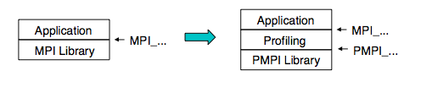
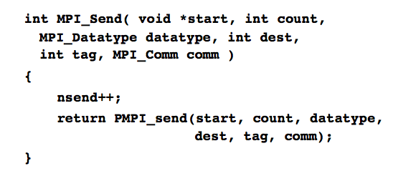
MPI Profiling
PMPI profiling interface provided by MPI standard

Slide 22
Many Profilers Available
JumpShot
TAU
HPC Toolkit
TotalView
Allinea Performance Reports
PGProf
STAT
Intel Vtune
MPIP – We focus on this as an example
Recommend using the one available on the system of interest

Slide 23
MPIP
Software developed by LLNL.
Collects only statistical information about MPI routines
Easy to download and install: mpip.sourceforge.net
Available on many systems
Link before the MPI library
mpicxx -g -o myprog myprog.c -L/usr/local/tools/mpiP/lib -lmpiP -lbfd -liberty -lintl -lm
Slides based on https://computing.llnl.gov/tutorials/bgq/#mpiP

Slide 24
MPIP
mpiP's output file is divided into 5 sections:
Environment Information
MPI Time Per Task
Callsites
Aggregate Times of Top 20 Callsites
Callsite Statistics

Slide 25
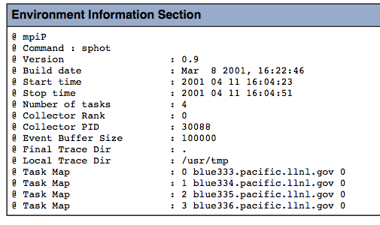
Useful for identifying the report

Slide 26
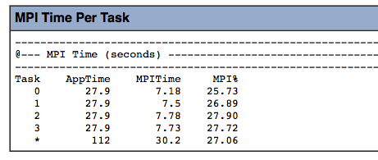
High level indicator of whether communication is an issue or not!

Slide 27
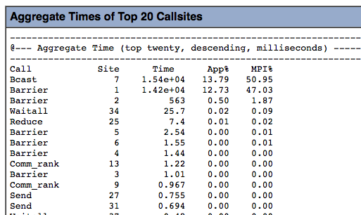
Which are the important calls?

Slide 28
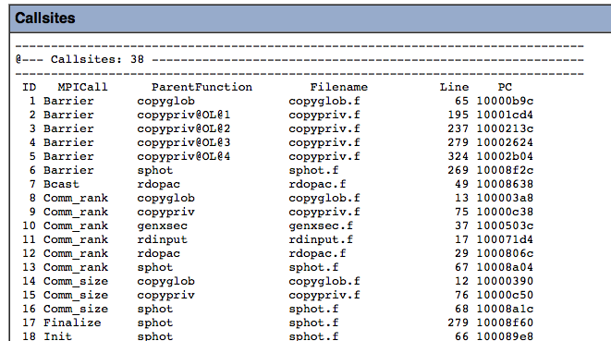
Where are these calls being made?

Slide 29
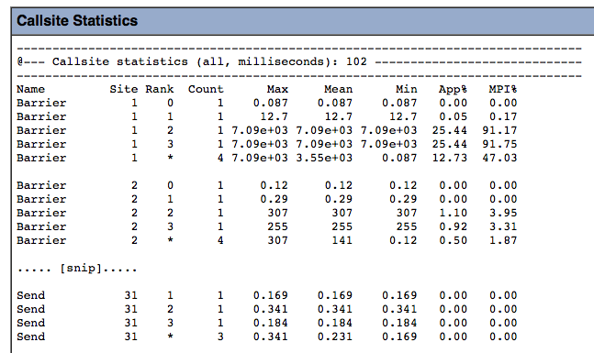
Detailed information about each call!

