Slide 1
CS420: High Performance Fortran
Laxmikant V. Kale
Slides based on John Merlin’s slides on HPF

Slide 2
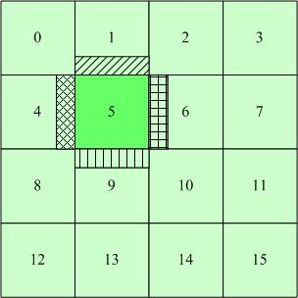
Motivation
OpenMP: Performance issues are not visible to the programmer
Jacobi Relaxation: The ghost layers are brought to a processor’s cache through communication
Solutions for a distributed memory machine?

Slide 3
HPF History
Developed on CMFORTRAN and FORTRAN90
Became extinct:
Was not powerful enough
Ideas/compilers were not clear
Became extinct before Earth simulator brought it back
Being worked on again at Rice, and in Japan

Slide 4
PROCESSORS directive
Declare processor arrangements:
!HPF$ PROCESSORS p (4), q (NUMBER_OF_PROCESSORS()/2, 2)
!HPF$ PROCESSORS s
PROCESSORS declares abstract processors
They may actually be processes and can have > 1 process on a physical processor

Slide 5
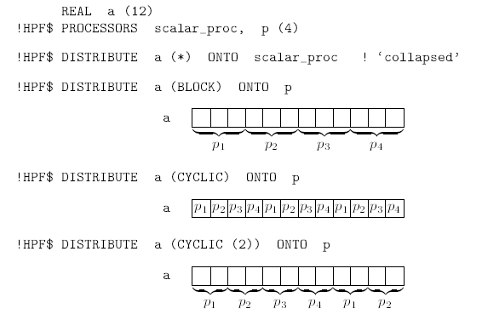
DISTRIBUTE directive
Distributes an array over a processor array

Slide 6
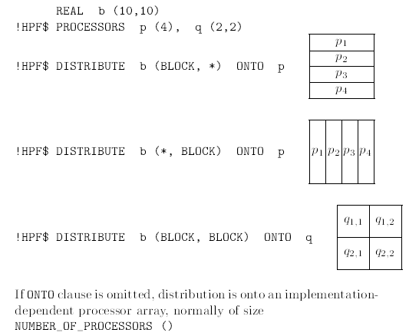

Slide 7
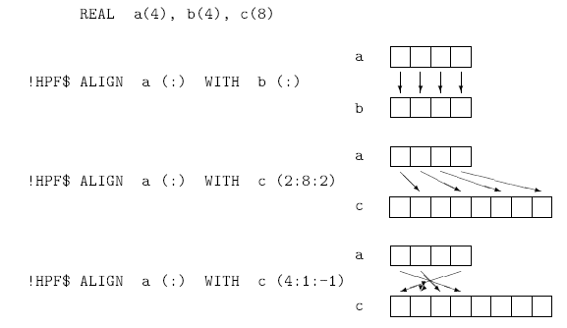
ALIGN directive
Relates an elements of an array to elements of another array such that the aligned elements are on the same processor

Slide 8
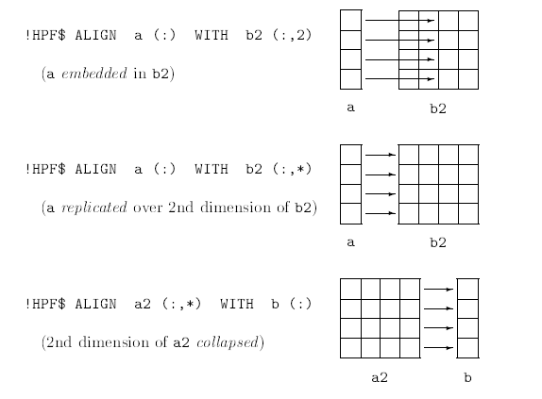

Slide 9
Concurrent execution features
Features that express the potential for data parallelism and concurrency
FORTRAN90 array syntax
The concurrent execution features introduced by HPF 1.0:
FORALL
PURE procedures
The INDEPENDENT directive

Slide 10
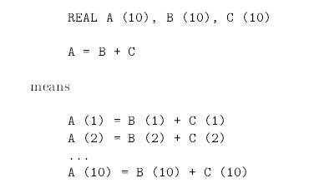
Data parallelism in Fortran 90
Fortran 90 has no explicit parallelism but its array features have implicit data parallelism

Slide 11
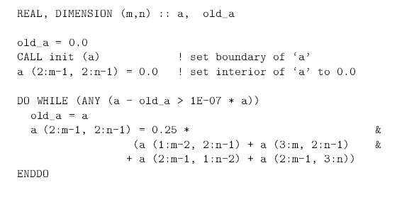
Example: Jacobi relaxation

Slide 12
FORALL statement
FORALL is a data parallel loop. E.g.
FORALL (i = 2:9) A(i) = 0.5*(A(i-1) + A(i+1))
Is equivalent to
A (2:9) = 0.5 * ( A (1:8) + A (3:10) )

Slide 13
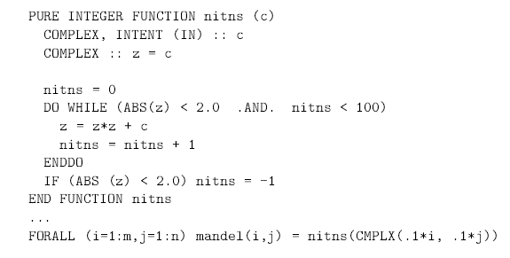
PURE functions and subroutines
There are no side-effects, so can be executed concurrently

Slide 14
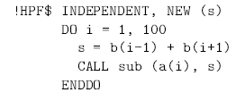
INDEPENDENT directive
This asserts that iterations of a DO-loop or FORALL are data independent and can be executed concurrently
INDEPENDENT is an assertion about the behavior of the program. If it is false, the program may fail

Slide 15
HPF and MPI
To support generality, we can make MPI calls through extrinsic (non-HPF) procedures
EXTRINSIC (HPF_SERIAL) to call Fortran95 on one processor
EXTRINSIC (HPF_LOCAL) to call Fortran95 concurrently on all processors

