Slide 1
CS420: Shared Memory and OpenMP
Laxmikant V. Kale
Slides based on Prof. Padua’s lecture on OpenMP

Slide 2
OpenMP: Introduction
Many programs
Use arrays and loops
Natural to think about the loops as parallel operations
And, such programs should be easy to express in parallel
OpenMP: Shared memory programming model.
Some people think:
Easy to convert sequential programs to parallel via OpenMP
It works well on shared memory hardware
Others think: its hard to get good performance
Probably both right to some degree..
You be the judge

Slide 3
OpenMP
Meant for C, C++ and FORTRAN
Standardizes 15 years of SMP practice
Set of compiler directives and library routines for parallel programmers

Slide 4
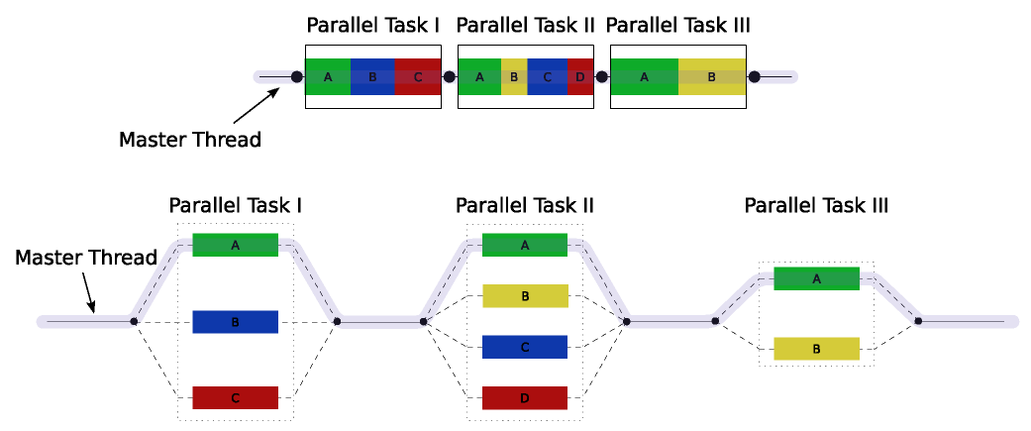
Programming Model
Fork-Join Parallelism: Single flow of control:
Master thread spawns slave threads as needed
Sequential sections should be small
http://en.wikipedia.org/wiki/OpenMP

Slide 5
Thread Interactions: Race conditions
Threads communicate by sharing variables
Unintended sharing can lead to race conditions
Race condition: when multiple threads make unsynchronized accesses to the same location, and at least one of those accesses is a “write”
Non-determinism: when the program’s outcome changes as the threads are scheduled differently (i.e. in different runs)
To control race conditions: use synchronization to protect data conflicts.
Synchronization is expensive, so: change how data is stored to minimize the need for synchronization.

Slide 6
General Rules
Most of the constructs are compiler directives
For C and C++
#pragma omp construct [clause [clause]…]
For FORTRAN
C$OMP construct [clause [clause]…]
!$OMP construct [clause [clause]…]
*$OMP construct [clause [clause]…]
Directives are ignored by non-OpenMP compilers

Slide 7
PARALLEL DO/FOR: Syntax
Specifies that the iterations of the immediately following do loop (Fortran) or for loop (C/C++) be executed in parallel.
#pragma omp parallel for [clause [clause ...]]
for (index = first; test_expr; increment_expr) {
body of the loop
}

Slide 8
Single precision a*x + y (saxpy)
Void saxpy(double *z, double a, double *x,
double *y, int n) {
for(int i=0; i<n; i++)
{
z[i] = a*x[i]+y[i];
}
return;
}

Slide 9
Single precision a*x + y (saxpy)
Void saxpy(double *z, double a, double *x,
double *y, int n) {
#pragma parallel for
for(int i=0; i<n; i++)
{
z[i] = a*x[i]+y[i];
}
return;
}

Slide 10
Parallel for: Execution
Master thread executes serial portion of code
Master thread enters saxpy function
Master thread encounters parallel for directive.
Creates slave threads (How many?)
T
I
M
E
Master and slave threads divide iterations of parallel
for loop and execute them concurrently (How?)
Implicit synchronization: wait for all threads to
finish their allocation of iterations
Master thread resumes execution after the for loop.
Slave threads disappear

Slide 11
Number of threads
Use environment variable
Use omp_set_num_threads() function
setenv OMP_NUM_THREADS 8 (on Unix with csh shell)
export OMP_NUM_THREADS =8 (with bash)
Void saxpy(double *z, double a, double *x,
double *y, int n) {
omp_set_num_threads(8);
#pragma parallel for
for(int i=0; i<n; i++)
{
z[i] = a*x[i]+y[i];
}
return;
}

Slide 12
Loop Scheduling: User Control
The manner in which iterations of a parallel loop are assigned to threads is called the loop’s schedule.
Unless specified otherwise, the default schedule is used which assigns iterations to threads as evenly as possible (good enough for saxpy)
Alternative user-specified schedules possible - more on this later

Slide 13
Communication between threads
Six clause types allow the programmer to specify how data is shared between threads executing a parallel do (data scope clauses):
private: private (list)
shared: shared(list)
default: default (private | shared | none) (ex: C/C++)
reduction: reduction(intrinsic operator : list)
firstprivate: firstprivate(list)
lastprivate: lastprivate(list)

Slide 14
Default data sharing
Most variables are shared by default
Global variables are shared among threads
Exception: loop index variables are private by default
Stack variables in function calls from parallel regions are thread-private

Slide 15
Example
double x, y;
int i, j, m, n, maxiter;
int depth[200][300];
extern int mandel_val();
n = 300;
m = 200;
maxiter = 200;
#pragma omp parallel for private(j, x, y)
for (i = 0; i < m; i++)
for (j = 0; j < n; j++) {
x = i/ (double) m;
y = j/ (double) n;
depth[i][j] = mandel_val(x, y, maxiter);
}

Slide 16
Private clause: Details
Each thread has its own copy of all variables declared private.
Private variables (implicit or explicit) are uninitialized when a thread starts. (Why?) (some exceptions)
The value of a private variable is unavailable to the master thread after a parallel loop terminates. (Why?)
firstprivate and lastprivate are solutions

Slide 17
Example
What’s wrong with this example:
int main(){
int IS=0;
#pragma omp for private(IS)
for(int j=0; j<1000; j++) {
…
… = IS;
…
}
printf(“%d\n”,IS);
return 0;
}

Slide 18
Firstprivate and lastprivate
firstprivate (list) initializes each thread’s copy of a private variable to the value of the master thread’s copy, for all variables in list.
lastprivate (list) writes back to the master’s copy the value contained in the private copy belonging to the thread that executed the sequentially last iteration of the loop, for all variables in list.

Slide 19
Corrected Example
int main(){
int IS=0;
#pragma omp for firstprivate(IS) lastprivate(IS)
for(int j=0; j<1000; j++) {
…
… = IS;
…
}
printf(“%d\n”,IS);
return 0;
}

Slide 20
Another example
double x[n][n], c[n][n], y[n], z[n];
x[0][0] = …
x[0][1] = …
int i;
#pragma omp parallel for firstprivate(x) lastprivate(i, x)
for(i = 0; i<n; i++){
x[0][1] = c[0][i] * x[0][0];
x[1][1] = c[1][i] * x[0][1] * x[0][1];
y[i] = x[1][1] + x[0][1];
z[i] = x[1][1] – x[0][1];
}
y[i-1] = x[1][0] + x[1][1];

Slide 21
Reduction Example
double sum(double *values, int n){
double s=0;
#pragma omp parallel for reduction (+:s)
for(int i=0; i<n; i++) {
s = s + values[i];
}
return;
}

Slide 22
Assigning iterations to threads
Motivation: to balance the work per thread when the work per iteration is inherently unbalanced
#pragma omp parallel for private(xkind)
for(int i=0; i<n; i++) {
xkind = f[i];
if (xkind < 10)
smallwork(x[i]);
else
bigwork(x[i]);
}

Slide 23
Schedule clause and general form
schedule (type[, chunk])
type = static, dynamic, guided or runtime
optional chunk = scalar integer value
static: iterations are divided as evenly as possible among all threads - simple static
static, chunk: iterations are divided into chunks of size chunk. Chunks are then assigned in round robin fashion to threads - interleaved

Slide 24
Schedule clause: dynamic or guided scheduling
dynamic, chunk: iterations are divided into chunks of size chunk (1 if unspecified) and are assigned to threads dynamically after an initial round robin assignment - simple dynamic
guided, chunk: chunk size decreases exponentially from an implementation dependent value to chunk (1 if unspecified). Chunks are assigned dynamically - guided self scheduling

