Slide 1


CS484 Parallel Programming
Performance via Complexity
Laxmikant (Sanjay) Kale
http://charm.cs.illinois.edu
Parallel Programming Laboratory
Department of Computer Science
University of Illinois at Urbana Champaign
Notes:
1

Slide 2
Outline
Components of a basic computer
Memory and Caches
Brief overview of Pipelining, Out of order execution, etc.
Theme: Modern processors attain their high performance by paying for in increased complexity.
The programmers, mainly, have to deal with the complexity and performance variability that results from it.
cs484: speed with complexity
2

Slide 3
Components of a Stored-Program computer
Instruction Memory
Data Memory
PC (Program Counter)
Move to the next location
Register Set
CPU
Register Name
Instruction
Data
cs484: speed with complexity
3

Slide 4
The Stored-Program Architecture
The processor includes a small number of registers, in a register file, with dedicated paths to ALU
All ALU instructions operate on registers
Only way to use memory is via:
Load Ri, x // copy content of memory location x to Ri
Store Ri, x // copy contents of Ri to memory location x
cs484: speed with complexity
4

Slide 5
Control Flow
Instructions are fetched from memory sequentially
using addresses generated by the program counter (PC)
After every instruction, the PC is incremented to point to the next instruction stored in memory
Control instructions like branches and jumps can directly modify PC
cs484: speed with complexity
5

Slide 6
Datapath - Schematic
Control Unit
Datapath
WR
DA
AA
D
Register file
A B
Branch
Control
V
C
N
Z
PC
BA
constant
ADRS
Instruction
RAM
OUT
1 0
Mux B
MB
FS
A B
ALU
G
ADRS DATA
Data RAM
OUT
Instruction Decoder
V
C
N
Z
MW
DA AA BA MB FS MD WR MW
0 1
Mux D
MD
cs484: speed with complexity
6

Slide 7
Obstacles to Speed
What are the possible obstacles to speed in this design?
Slow memory
Long chain of gate delays
“Floating point” computations
Virtual memory and paging
The theme for today:
Overcoming these obstacles can lead to significant increase in complexity, and can make performance difficult to predict and control
cs484: speed with complexity
7

Slide 8
Latency to Memory
Data processing involves transfers between data memory and processor registers
DRAM : large, inexpensive, non-volatile memory
Latency : ~50ns
Comparatively slow improvement over time: 80 -> 30 ns
A single core clock is 2 GHz: it beats twice in a nanosecond!
Can perform upward of 4 ALU operations/cycle
Modern processors have tens of cores on a single chip
Take away :
Memory is significantly slower than the processor
cs484: speed with complexity
8

Slide 9
Latency vs Throughput and Bandwidth
Imagine you are putting a fire out
Only buckets, no hose
100 seconds to walk with a bucket from water to fire, (and 100 to walk to walk back)
But if you form a bucket brigade
(needs people and buckets)
You can deliver a bucket every 10 seconds
So, latency is 100 or 200 seconds, but throughput/bandwidth is 0.1 buckets per second.. Much better
Whats more: you can increase bandwidth:
Just make more lines of bucket brigade
cs484: speed with complexity
9

Slide 10
Bandwidth Can Be Increased
More pins can be added to chips
3D stacking of memory can increase bandwidth further
Need methods that translate latency problems to bandwidth problems
Solution : Concurrency
Issues :
Data dependencies
cs484: speed with complexity
10

Slide 11
Cache Hierarchies and Performance
CPU
CPU
Caches
Cache
Memory
Memory
cs484: speed with complexity
11

Slide 12
Some typical speeds/times worth knowing
 | Latency | Bandwidth
Modern processor
L1 cache
L2-L3 cache
DRAM
Solid state drive
Hard drive
Network: Cluster
Network: Ethernet
Network: World-wide-web

Slide 13
Some typical speeds/times worth knowing
 | Latency | Bandwidth
Modern processor | 0.25 ns
L1 cache | several ns
L2-L3 cache | 10s ns
DRAM | 30-70 ns | 10-20GB/s
Solid state drive | 0.1ms | 200-1500 MB/s
Hard drive | 5-10 ms | 200MB/s
Network: Cluster | 1-10 µs | 1-10GB/s
Network: Ethernet | 100 µs | 1GB/s
Network: World-wide-web | 10s of ms | 10Mb/s (note b vs B

Slide 14
Why and how does a cache help?
Temporal and Spatial locality
Programs tend to access the same and/or nearby data repeatedly
Size of cache
Multiple levels of cache
Performance impact of caches
Designing programs for good sequential performance
cs484: speed with complexity
14
Notes:
14

Slide 15
Cache : Parameters and Metrics
Reuse ratio:
Captures how well data is reused once it is brought into cache
Fraction of times a data item is found in cache
Best possible: 1
Cache line : Spatial Locality
64 bytes or 128 bytes, consecutive memory addresses
Make it too short : what happens?
Make it too long : what happens?
Hit ratio
May be higher than that given by reuse ratio because of spatial locality
cs420: speed with complexity
15

Slide 16
Cache : write policies
For this code, no need to fetch the cache lines for A from memory
We are going to be overwriting those locations anyway
Two solutions
Special write instructions: write to buffer
Special “Zero out” instructions
Care must be taken because you are dealing with the whole cache line
Write-back vs Write-through
Write allocate issue :
On a write miss, the cache line is fetched from memory
Consider the following code
for (i = 0; i < n; i++)
A[i] = B[i]*x;
cs420: speed with complexity
16

Slide 17
Cache mapping and associativity
Say you have 64 KB of cache, 64 byte cache lines
So, 1024 cache blocks in all
On a read miss, you have to fetch a cache line from memory
(or from next level cache)
Where in the cache should it go?
i.e. which of the 1024 blocks should be used to store it??
Anywhere : fully-associative cache
Expensive
Solution: Set associative cache
cs420: speed with complexity
17

Slide 18

Set associative cache
Program’s memory: a sequence of cache lines
Where in the cache can the shaded one go
(if it needs to be brought into the cache?
Direct Mapped
Set associative: 4 sets of 2 cache lines each
cs420: speed with complexity
Fully associative
18

Slide 19
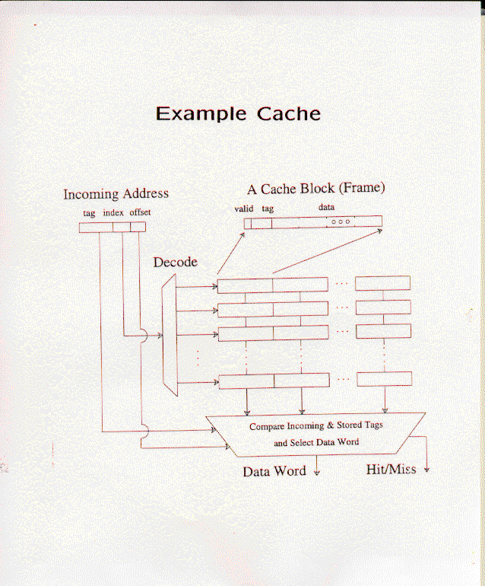
Source: Prof Sarita Adve’s lecture in C433
cs420: Speed with complexity
19

Slide 20
Cache replacement policy
Which cache line to evict?
For direct mapped cache, there is only one candidate
For associative caches, multiple choices exists, so a policy is needed
Random
LRU: least recently used,
What do you think will be a good policy?
But no significant impact on performance across applications is observed..
cs420: speed with complexity
20

Slide 21
Categorizing cache misses
Compulsory misses:
“cold” cache accesses. i.e. first time you access it
Capacity misses:
There is no space in cache
Conflict misses:
There is space, but it is not in the right set
The idea of a “working set”
A set of addresses that the program accesses over a time window
Question: which misses cannot happen with fully associative cache?
cs420: speed with complexity
21

Slide 22
Example
for (i = 0; i < n; i += M ) // M is the cache size in words
A[i] = B[i] + C[i];
What happens with:
Direct map cache?
Fully associative cache?
4-way associative cache?
How many cache misses
What if the loop repeats?
i.e. there is an outer loop
Working set: the data in A, B, and C
cs420: speed with complexity
22

Slide 23
Another example
for (i = 0; i < n; i++)
sum = sum + A[i];
How many cache misses?
What kind of misses are those?
Can we reduce the cost of those misses? How?
Answers:
One for every cache line.. N/k, where k is the size of a cache line in words
So, 64 byte cache line, single precision words of 4 bytes: k = 16
These are all compulsory misses
First time we access the data
cs420: speed with complexity
23

Slide 24
Prefetch
Look for pattern in memory accesses:
that you are accessing successive memory locations in A.
if I make the hardware detect this pattern, what can I do?
Two techniques:
Bring multiple cache lines in on a miss
Prefetch even more lines..: asynchronous load instructions
cs420: speed with complexity
24

Slide 25
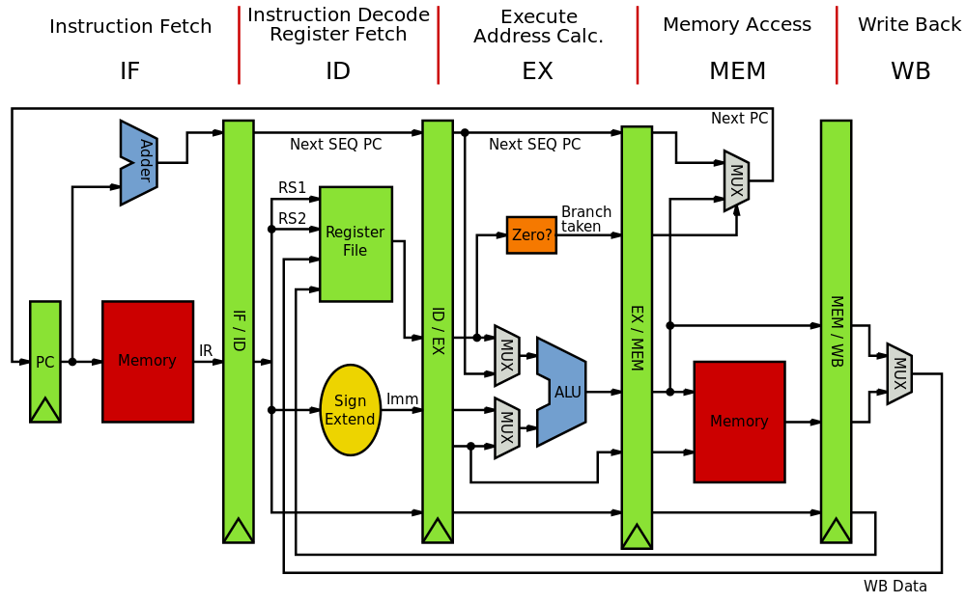
Reducing Gate Delays - Pipelining
Source: wikibooks.org

Slide 26
Pipelined processor
Allows us to reduce the clock period
Since long gate delay (critical paths) are reduced
But assumes we can always pipeline instructions
What can disturb a pipeline?
Hazards
Data hazard : instruction which needs a result calculated by a previous instruction
Control hazard : Branches and Jumps
cs484: speed with complexity
26

Slide 27
Avoiding Pipeline Stalls
Data forwarding:
In addition to storing the result in a register, forward it to the next instruction (store it in the pipelines buffer)
Branch prediction!
Separate hardware units that track branch statistics, and predict which way a branch will go!
E.g. a loop : branch will go back in all cases, except the last
cs484: speed with complexity
27

Slide 28
Floating Point Operations
A multiply and add is needed together in many situations
DAXPY: Double-precision Alpha X Plus Y
for (i=0; i<N; i++) Y[i] = a*X[i] + Y[i];
Special hardware units that can do the two together
And, of course, it is pipelined
When there are enough such operations in sequence, the pipeline is full, and you get 2 floating point ops per cycle
Machines support a FMAD instruction (saves instruction space)
cs420: speed with complexity
28

Slide 29
Out of order execution
Keep many instructions “in flight”
If there are data dependencies, buffer the instruction
Important techniques : register re-naming, scoreboarding etc to satisfy dependencies and ensure correctness
Also, try to issue multiple instructions per cycle!
cs484: speed with complexity
29

Slide 30
Superscalar processors
Can we execute multiple instructions per cycle?
FMAD was a single instruction
Idea: fetch multiple instructions in each cycle..
And execute as many of them in parallel as is possible without violating data dependencies
Need more hardware on chip
More registers for buffering results
Multiple load units etc.
IPC: instruction-level parallelism
How many can you execute each cycle?
Typically 2-3 is the max..
cs420: speed with complexity
30

Slide 31
Example program
Imagine a sequential program running using a large array, A
For each I, A[i] = A[i] + A[some other index]
How long should the program take, if each addition is a ns
What is the performance difference you expect, depending on how the other index is chosen?
for (i=0; i<size-1; i++) {
A[i] += A[i+1];
}
for (i=0, index2=0; i<size; i++) {
index2 += SOME_NUMBER; // smaller than size
if (index2 > size)
index2 -= size;
A[i] += A[index2];
}
cs484: speed with complexity
31
Notes:
31

Slide 32
Architecture Trends
Architecture over 2-3 decades was driven by the need to make clock cycle faster.
Pipelining developed as an essential technique early on.
Each instruction execution is pipelined:
Fetch, decode, execute, stages at least
In addition, floating point operations, which take longer to calculate, have their own separate pipeline
L1 cache accesses in Nehalem are pipelined – so even though it takes 4 cycles to get the result, you can keep issuing a new load every cycle, and you wouldn’t notice a difference (almost) if they are all found in L1 cache (i.e. are “hits”)
cs484: speed with complexity
32

Slide 33
Multiprogramming and virtual memory
A computers runs many programs, “simultaneously”
It gives each program a time slice of some milliseconds (10ms was typical)
How can it keep their memories from mixing up?
Answer: virtual memory
Each program thinks it has the whole processor to itself, and can address memory from 0 ..X gigabytes
This “virtual” address is mapped to a physical address by the hardware and Operating system, via “page tables”
Each page has (say) 4kilobytes of data.. It may or may not be in physical memory
If it is not in memory, it is kept on disk (in “swap” space)
The mapping itself is stored in memory!
cs484: speed with complexity
33

Slide 34
What is a good page size?
In most OSes it is set at 4KB
That’s fine for multiprogrammed machines
For a dedicated parallel computer?
HugePages option: 2 MB pages, 4 MB pages
On BlueWaters, simply load the 2 MB page module before compilation and execution
Loading a module redirects mallocs to use larger pages
cs420: speed with complexity
34

Slide 35
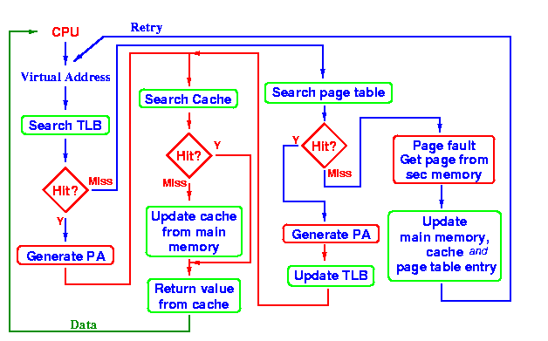
Load Instruction
Source : http://www.cs.auckland.ac.nz/~jmor159/363/html/TLB.html
cs484: speed with complexity
35

Slide 36
Compilers
Capabilities
Black-box nature
Optimization levels: -O1, -O2, -O3…
Higher level of optimization is better for performance, but occasionally (rarely) may compile wrong!
Lower levels make debugging easier.
Flags
More specialized, nuanced, control over what kinds of optimizations the compiler may try
Debug information retained
cs420: speed with complexity
36

Slide 37
Bottom line?
The speed increase has come at the cost of complexity
This leads to high performance variability that programmers have to deal with
It takes a lot to write an efficient program!
cs484: speed with complexity
37

