Slide 1
Performance analysis, Scalability and Isoefficiency
Laxmikant V. Kale

Slide 2
Major analytical/theoretical techniques
Typically involves simple algebraic formulae, and ratios
Typical variables are:
data size (N), number of processors (P), machine constants
Model performance of individual operations, components, algorithms in terms of the above
Be careful to characterize variations across processors, and model them with (typically) max operators
E.g. max{Load _{I}}
Remember that constants are important in practical parallel computing
Be wary of asymptotic analysis: use it, but carefully
Scalability analysis:
Isoefficiency
Notes:
2

Slide 3
Alpha-Beta cost model for communication
Typical communication costs involve per-message cost (𝛂 and per-byte cost 𝛃
These may arise in different contexts, each with its own 𝛂/ 𝛃 values
Incurred by CPU in processing messages
Latency on the network
Execution time for the program may involve
Sum of computation and communication
Max of computation and communication costs if overlapped
This irecv, isend..
Critical paths
e.g. reduction. Each processor may be sending a few messages, but the operation takes log P time, and you may be waiting for that duration

Slide 4
Example/s
What is the execution time of parallel prefix?
2N *t_{c} + k 𝛂 lg P (where t_{c} is computation cost for 1 add)
What about Wator time step, without reduction
Computation + communication
(N²/p)* t_{c} + 4 (𝛂 + N 𝛃)
If you can overlap some computation with communication?
Only a part of communication can be overlapped. CPU has to be involved for initiating communication
But a simplified view could be: MAX( (N²/p)* t_{c} + 4 𝛂 , 4 N 𝛃)

Slide 5
Scalability
The Program should scale up to use a large number of processors.
But what does that mean?
An individual simulation isn’t truly scalable
Why?
Notes:
5

Slide 6
Parallel Efficiency:
Efficiency : Sequential Time / (P · Parallel Time)
parallel time = computation + communication + idle
Speedup = Sequential Time / Parallel Time

Slide 7
Amdahl’s law
Assume that you have an algorithm, only portions of it are parallelizable
OpenMP: work on the master thread is not parallelized
What can we say about the speedup?

Slide 8
Strong scaling
Given a particular problem instance
i.e. a program with a given input
How many processors can we use profitably?
What is “profitably”?

Slide 9
Scalability
The Program should scale up to use a large number of processors.
But what does that mean?
An individual simulation isn’t truly scalable
Better definition of scalability:
If I double the number of processors, I should be able to retain parallel efficiency by increasing the problem size
Notes:
9

Slide 10
Isoefficiency
Equal efficiency curves
Problem size
Processors
Quantify scalability
How much increase in problem size is needed to retain the same efficiency on a larger machine?
Efficiency : Sequential Time / (P · Parallel Time)
parallel time = computation + communication + idle
One way of analyzing scalability:
Isoefficiency:
Equation for equal-efficiency curves
Use η(p,N) = η(x.p, y.N) to get this equation
If no solution: the problem is not scalable
in the sense defined by isoefficiency

Slide 11
Isoefficiency Basics
For this class, we will focus on communication volume as the impediment to scalability
i.e. number of bytes sent or received
So, the method for deriving isoefficiency function is:
Write an expression for communication cost: comm
Write an expression for computation cost: comp
Express both in terms of total (sequential) computation work: W
Write expression for the ratio comm/comp and equate to a constant (so the efficiency can remain constant)
Solve for W in terms of P (and eliminate all other variables)
Approximate expressions as needed

Slide 12
Approximations
If the computation cost is a.N³ + b.N
Approximate this as a.N³ , because the cubic term dominates over the linear term, for large N
N² + k.N.log N approximates to N²

Slide 13
Make sure to use the total work W
Example:
For a matrix of size N, say, the algorithm requires doing N³ operations (across all processors.. I.e. same as sequential if you are not doing extra work).
W = N³; I.e. N = W ^{1/3}
Make sure you replace all occurrences of N in the comm/comp ratio by W ^{1/3}

Slide 14
Using other metrics for isoefficiency
Sometimes, the communication volume is not the metric for measuring inefficiency
May be:
number of messages
Fraction of bisection bandwidth used
Use the dominant metric for overhead to determine equal efficiency equation
T_{parallel} = T_{comp} + T_{overhead}

Slide 15

Gauss-Jacobi Relaxation
Decomposition by:
Sequential Pseudocode:
Row
while (maxError > Threshold) {
Re-apply Boundary conditions
maxError = 0;
for i = 0 to N-1 {
for j = 0 to N-1 {
B[i,j] = 0.2 * (A[i,j] + A[i,j-1] +
A[i,j+1] + A[i+1, j] + A[i-1,j]) ;
if (|B[i,j]- A[i,j]| > maxError)
maxError = |B[i,j]- A[i,j]|
}
}
swap B and A
}
Blocks
Or Column

Slide 16
Isoefficiency of Jacobi Relaxation
Row decomposition
Computation per proc:
Communication:
Comm-to-comp Ratio:
Efficiency:
Isoefficiency:
Block decomposition
Computation per proc:
Communication:
Comm-to-comp Ratio:
Efficiency:
Isoefficiency:
Notes:
16

Slide 17
Isoefficiency of Jacobi Relaxation
Row decomposition
Computation per proc:
A * N * (N/P)
Communication:
16 * N
Comm-to-comp Ratio:
(16 * P) / (A * N) = γ
Efficiency: 1 / (1 + γ)
Isoefficiency:
Keep γ constant
16P/(A.N) = γ, ie P/N = k
problem-size W = N², N = sqrt(W)
P/sqrt(W) = k; W = (P/k)²
Block decomposition
Computation per proc:
A * N * (N/P)
Communication:
32 * N / P^{1/2}
Comm-to-comp Ratio:
(32 * P^{1/2}) / (A * N)
Efficiency: 1 / (1 + γ)
Isoefficiency:
P^{1/2}/(w)^{1/2} = k; w = p/k
Linear in p
Notes:
17

Slide 18
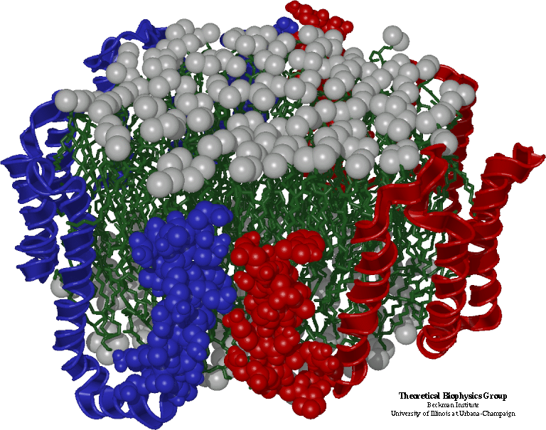
Simple Molecular Dynamics
Collection of [charged] atoms, with bonds
Newtonian mechanics
Thousands of atoms (1,000 - 500,000)
1 femtosecond time-step, millions needed!
At each time-step
Calculate forces on each atom
Bonds: treated like springs
Non-bonded: electrostatic and van der Waal’s
Short-distance: every timestep
Long range: ignore for this discussion
Calculate velocities and advance positions

Slide 19
The basic algorithm
Read atom info and iniialize
for I = 1, N
for J = 1, N
if (distance(A,i,j) < CutOff)
A[i].force = calculateForceBetween(A,i,j)
For i = 1,N
for each atom j that i is bonded to:
add forces on A[i] due to A[i]
// integrate
for I = 1, N
updatePositions(A,i)
A is an array of Atoms.
Each A[i] has:
double px,py,pz ; // positions
double vx, vy, vz; // velocities
double fx,fy,fz; // forces
double mass;
Aside: this ignores symmetry (Newton’s third law) which could be used to reduce the computation by half.. Its ok for now.

Slide 20
Parallelization using Atom replication
Done in early codes,
trying to extend their sequential code to run on parallel machines
Each processor keeps the entire array
Each processor calculates some subset of the interactions
This may involve calculating forces on arbitrary sets of atoms
So, need to add up all the forces and make them available to all processors (who then update the positions for all N)
All-reduce with an array of size N takes time N.logP
This is the communication cost

Slide 21
Analysis of replicated data
Computation: for each atom, a constant number of atoms are within its cutoff radius
Approx. 300 for typical simulations with 12 Angstrom cutoff
with relatively uniform densities
In any case, the number of interactions don’t increase with N
Computation time per processor: k.N/p
(with some large k)
Communication: N. logP
Communication/Computation Ratio: (P log P)/k
! No N in the expression.. Just keeps increasing with P, with no scope for reducing it with a larger problem size

Slide 22
Traditional Approaches: non isoefficient
Replicated Data:
All atom coordinates stored on each processor
Communication/Computation ratio: P log P
Partition the Atoms array across processors
Nearby atoms may not be on the same processor
C/C ratio: O(P)
Distribute force matrix to processors
Matrix is sparse, non uniform,
C/C Ratio: sqrt(P)

Slide 23
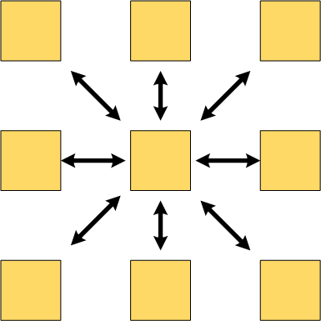
Spatial Decomposition
Atoms distributed to cubes based on their location
Size of each cube
Just a bit larger than cut-off radius
Communicate only with neighbors
Work: for each pair of neighbor objects
Communication to computation ratio: O(1)
However:
Load imbalance
Limited Parallelism

