Slide 1
Performance analysis, Scalability and Isoefficiency, continued.
Laxmikant V. Kale

Slide 2

Gauss-Jacobi Relaxation
Decomposition by:
Sequential Pseudocode:
Row
while (maxError > Threshold) {
Re-apply Boundary conditions
maxError = 0;
for i = 0 to N-1 {
for j = 0 to N-1 {
B[i,j] = 0.2 * (A[i,j] + A[i,j-1] +
A[i,j+1] + A[i+1, j] + A[i-1,j]) ;
if (|B[i,j]- A[i,j]| > maxError)
maxError = |B[i,j]- A[i,j]|
}
}
swap B and A
}
Blocks
Or Column

Slide 4
Recap of steps
Outline: Express total work as a function of number of processors, to satisfy the condition that parallel efficiency is constant
Work: can be measured many different ways,
but we will focus on total number of floating point operations, if you were to execute it sequentially
Alternative: DRAM accesses (equivalently, level 3 cache misses)
Efficiency may decrease with additional processors for many reasons, but we will focus on communication costs
Algorithm may have other parameters, such as data array size N, but they should be expressed as a function of W
So: write the equation: communication-time = K* computation-time, and solve for W in terms of P
Make simplifications as necessary

Slide 5
Isoefficiency of Jacobi Relaxation
Row decomposition
Computation per proc:
A * N * (N/P)
Communication:
16 * N
Comm-to-comp Ratio:
(16 * P) / (A * N) = γ
Efficiency: 1 / (1 + γ)
Isoefficiency:
Keep γ constant
16P/(A.N) = γ, ie P/N = k
problem-size W = N², N = sqrt(W)
P/sqrt(W) = k; W = (P/k)²
Notes:
5

Slide 6
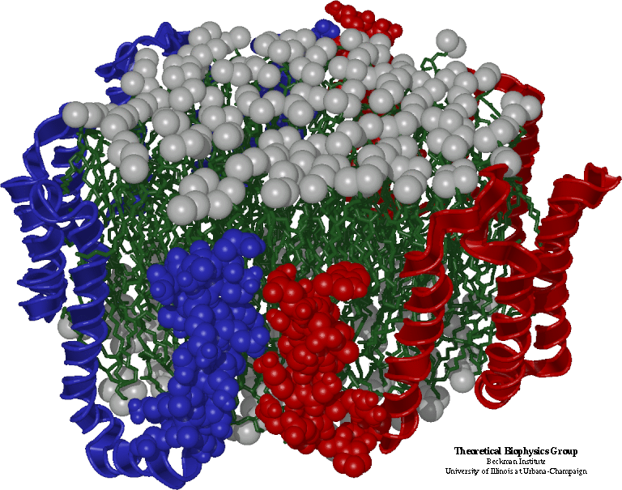
Simple Molecular Dynamics
Collection of [charged] atoms, with bonds
Newtonian mechanics
Thousands of atoms (1,000 - 500,000)
1 femtosecond time-step, millions needed!
At each time-step
Calculate forces on each atom
Bonds: treated like springs
Non-bonded: electrostatic and van der Waal’s
Short-distance: every timestep
Long range: ignore for this discussion
Calculate velocities and advance positions

Slide 7
The basic algorithm
Read atom info and iniialize
for I = 1, N
for J = 1, N
if (distance(A,i,j) < CutOff)
A[i].force = calculateForceBetween(A,i,j)
For i = 1,N
for each atom j that i is bonded to:
add forces on A[i] due to A[i]
// integrate
for I = 1, N
updatePositions(A,i)
A is an array of Atoms.
Each A[i] has:
double px,py,pz ; // positions
double vx, vy, vz; // velocities
double fx,fy,fz; // forces
double mass;
Aside: this ignores symmetry (Newton’s third law) which could be used to reduce the computation by half.. Its ok for now.

Slide 8
Parallelization using Atom replication
Done in early codes,
trying to extend their sequential code to run on parallel machines
Each processor keeps the entire array
Each processor calculates some subset of the interactions
This may involve calculating forces on arbitrary sets of atoms
So, need to add up all the forces and make them available to all processors (who then update the positions for all N)
All-reduce with an array of size N takes time N.logP
This is the communication cost

Slide 9
Analysis of replicated data
Computation: for each atom, a constant number of atoms are within its cutoff radius
Approx. 300 for typical simulations with 12 Angstrom cutoff
with relatively uniform densities
In any case, the number of interactions don’t increase with N
Computation time per processor: k.N/p
(with some large k)
Communication: N. logP
Communication/Computation Ratio: (P log P)/k
! No N in the expression.. Just keeps increasing with P, with no scope for reducing it with a larger problem size

Slide 10
Traditional Approaches: non isoefficient
Replicated Data:
All atom coordinates stored on each processor
Communication/Computation ratio: P log P
Partition the Atoms array across processors
Nearby atoms may not be on the same processor
C/C ratio: O(P)
Distribute force matrix to processors
Matrix is sparse, non uniform,
C/C Ratio: sqrt(P)

Slide 11
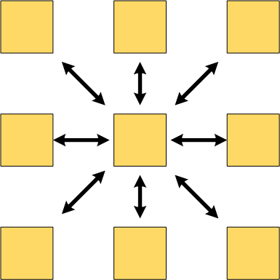
Spatial Decomposition
Atoms distributed to cubes based on their location
Size of each cube
Just a bit larger than cut-off radius
Communicate only with neighbors
Work: for each pair of neighbor objects
Communication to computation ratio: O(1)
However:
Load imbalance
Limited Parallelism

