Slide 1


Divide and Conquer and State-Space Search
Laxmikant (Sanjay) Kale
http://charm.cs.illinois.edu
Parallel Programming Laboratory
Department of Computer Science
University of Illinois at Urbana Champaign

Slide 2
Outline of topics for today
Divide and conquer
Search for first: solution: N-queens
Search for first solution: prioritization
Quiescence detection
A* and IDA* in parallel : PIOIDA*
15 puzzle
Bi-directional search, using groups:
15-puzzle, Rubik's cube
Duplication detection in search trees
Branch and bound
Graph coloring and AND-OR trees
Game trees, reduce-or trees
Prioritized load balancing

Slide 3
Charm++ support
State-space (combinatorial) search and divide and conquer applications
For today, we forget about chare arrays
Just focus on singleton chares
Charm++ concepts that are useful :
Singleton chares, with recursive, dynamic creation
Seed balancer
Priorities
Messages

Slide 4
Divide and conquer
Steps:
Divide the work: create chares for subpieces
Combine solutions: send messages to parents
Judiciously set grainsize
(or adapt, as we will see later , in graph coloring)
We have seen an example with Fibonacci
Quicksort is another example

Slide 5
Search for any feasible solution
Example: N-Queens:
place N queens on a NxN chessboard such that no two of them attack each other
Attack: are in the same row, column, or diagonal
General form:
start state is given,
goal state is either given or described, and
a set of permissible moves (operators) is defined

Slide 6
Search for any feasible solution
This can be thought of as divide-and-divide
No combining step
Question: how to stop search after a solution is found?
Of course, you can CkExit(), but the computation may not have ended
Send message to parent.. (and then? Send a kill message to other children)
The kill-chasing problem
Quiescence detection

Slide 7
Quiescence detection
How to use:
CkStartQD(callback) or
CkWaitQD() from a threaded method
What it does:
Calls back when all processors are idle and no messages are in transit
Very efficient algorithm (counts sent and received messages and handles all race conditions correctly)
How:
not our concern now, but see paper 93-11(charm website)

Slide 8
Finding first solution faster
The search tree is huge, how to quickly home in on a solution?
Various heuristics can rank children
Also, how to be consistent?
Search anomalies: more processors may slow it down and vice versa
We want monotonically increasing speedups, and consistency from run to run
Memory usage can be a big problem: exponential in depth
Left-to-right prioritization of the search tree

Slide 9
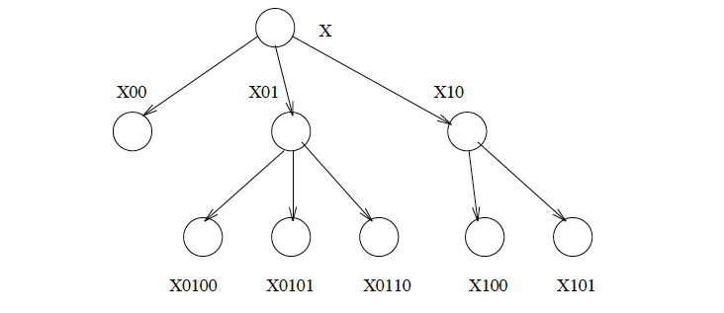
Left to right (prefix) prioritization
Priority is a bit-vector

Slide 10
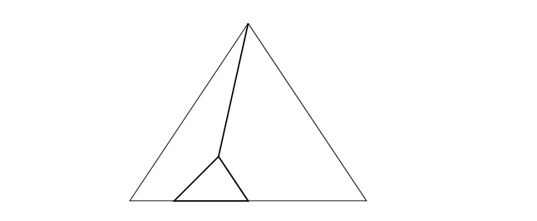
Broom-sweep search
With priorities, search tends proceed in this fashion,
Leading to very low memory usage: P +D
(P: processors, D: depth)

Slide 11
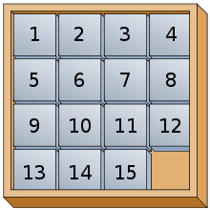
A* and IDA*
A*: based on the idea of “admissible heuristics”
Associate a “value” with each node,
calculated by an “evaluation function of the form:
f(n) = g(n) +h(n)
g(n): cost of getting to this node, n, from root
h(n): estimated cost of getting to goal state from n
If h (heuristic function) is always an underestimate of the true cost, then it is called an admissible heuristic

Slide 12
A* and IDA*
A*: based on the idea of “admissible heuristics”
Example: 15-puzzle
Associates a priority with each node
Use a priority queue, and
always process the highest prio node first
This guarantees that the first solution found is the best
Question: how to control memory usage?
Question: How to do this in parallel (“always”)

Slide 13
A* and IDA*
Depth first search (DFS) is space efficient, priority queue is not
Sequential IDA*:
do repeated depth-bounded DFS, each time increasing allowed by a fixed amount
Duplication, but not much more than twice for the common scenarios! And highly space efficient

Slide 14
Parallel IDA*
Use left to right priorities within each iteration,
Overlap multiple iterations, so that processor don’t stay idle for too long
But make sure work on higher priority iterations is done first

Slide 15
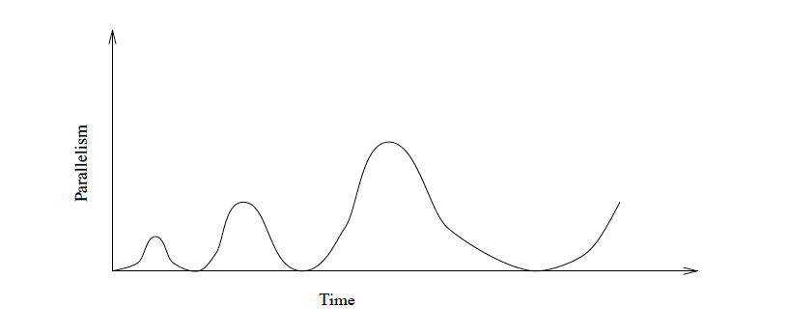

Slide 16
Bi-directional search, using groups:
15-puzzle, rubik’s cube
Duplication detection in search trees
Branch and bound
Graph coloring and AND-OR trees
Game trees, reduce-or trees
Prioritized load balancing

Slide 17
Duplication Detection
Same state may appear multiple times in the tree
(e.g. in 15 puzzle)
Solution?
Store active states in a distributed table
Before firing a chare, check the table

Slide 18
Bi-directional search
Consider 15-puzzle, peg-solitaire or Rubik's cube
Start state is known, goal state is known
(Not true for n-queens)
We can search backward from goal state too
If we do both, we can cut down the search tree dramatically
It’s exponential in the depth of the tree
How to do it?
Discuss

Slide 19
Bi-directional search
How to do it?
Store backward tree using chare groups
Replicate? Distribute?
Both schemes have their advantages

Slide 20
Branch and bound
Example: traveling salesperson problem
Needs priorities and needs ability to prune
Discussion:

Slide 21
Speculative Loss: Branch and Bound
Problem and parallelization via objects
B&B leads to a search tree, with pruning
Tree is naturally parallel structure, but…
Speculative loss:
Number of tree nodes processed increases with procs
Solution: Scalable Prioritized load balancing
Memory balancing
Good Speedup on 512 processors
1024 processor NCUBE, in 1990+
Lessons:
Importance of priorities
Need to work with application experts!
Sinha and Kale, 1992, Prioritized Load Balancing

Slide 22
Balancing load and priorities

Slide 23
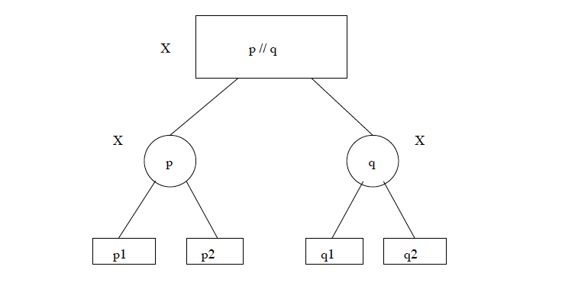
And-Or trees

Slide 24
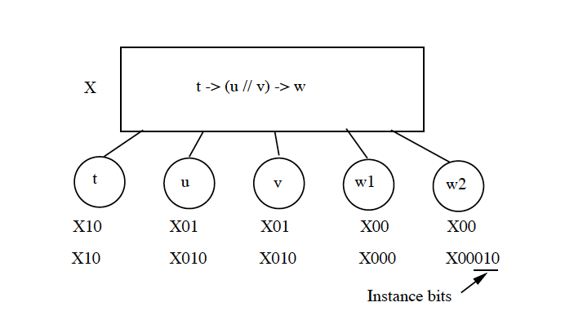
Reduce-Or trees

Slide 25
Algorithmic overhead: Game Tree Search
Game Trees for 2-person, zero-sum games (Chess)
Bad Sequential Algorithm:
Min-Max tree
Good Sequential algorithm: Evaluate using α−β search
Relies on left-to-right evaluation (dependency!)
Not parallel!
Prunes a large number of nodes

Slide 26
Algorithmic overhead: Game Tree Search
A (simple) solution:
Use min-max at top level of trees
Below a certain threshold (simple: depth),
use sequential α−β
Other variations:
Use prioritized tree generation at high levels, with Left-to-Right bias
Use α−β at top! Firing only essential leaves as subtasks
Useful for small # of processors
Or, relax “essential” in interesting ways

Slide 27
Graph Coloring
Given a bi-directional graph of V vertices and E edges
Find a way to color each vertex such that no two adjacent vertices are of the same color
Using no more than K colors
A very rich problem
In terms of parallel issues
Basic parallel formulation:
Search tree
Each state:
vector of vertices which have been colored
Optional/heuristic: # of colors available for each uncolored vertex
The graph itself is a readonly variable, not part of a state.

Slide 28
Heuristics
Can you come up with some?
What is their implication for parallel formulation

Slide 29
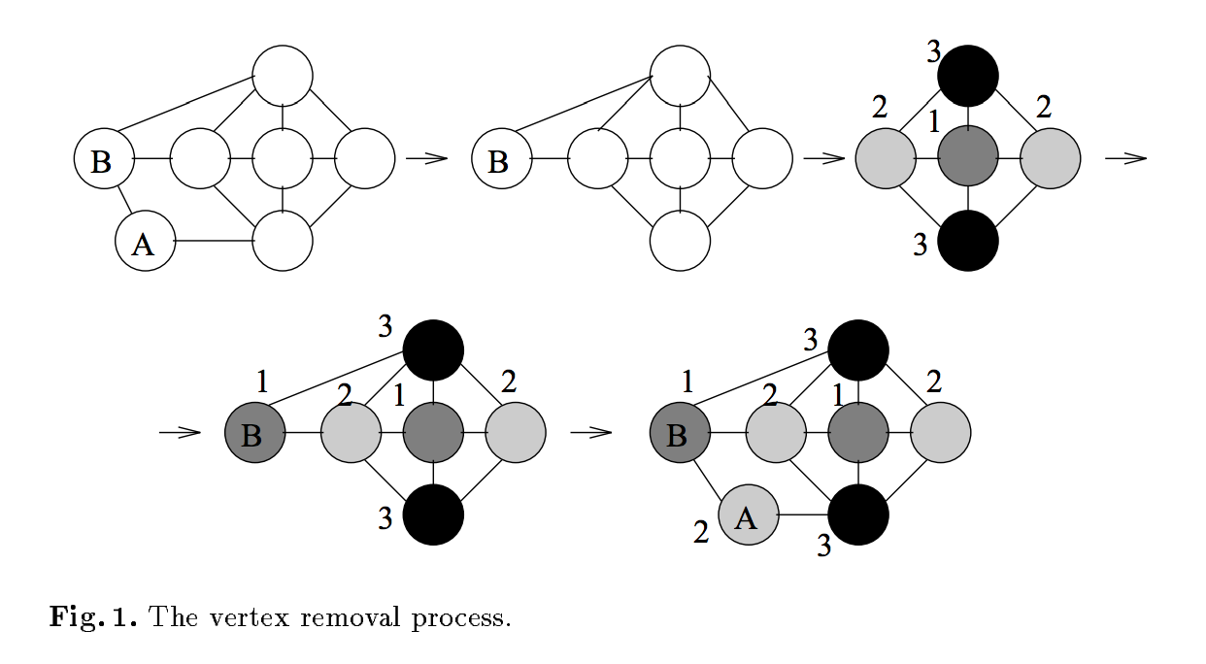
Vertex removal : 4 coloring

Slide 30
Heuristics
Which vertex to select next?
Which color to color it with?
Once its colored, can we simplify the graph or prune the subtree?
Any node with k-1 neighbors:
remove from the graph,
Recurse
Impossibility: A vertex with k or more neighbors with distinct colors.. Prune the tree
Is the graph partitioned?

