Slide 1


Slide 1
Forecasting South Africa's Youth Unemployment: A Data-Driven Adventure
Exploring the Global Landscape and Forecasting South Africa’s Journey

Slide 2
Slide 5
Our Journey Begins: What did We Set out to Achieve?
OBJECTIVE 1
OBJECTIVE 2
OBJECTIVE 3
Analyse global unemployment rates for 2022, identifying trends and anomalies.
Focus on South Africa’s unemployment rate from 1991 to 2022, understanding historical context and key events.
Apply various forecasting models to predict future unemployment trends in South Africa and identify the most accurate model.
2

Slide 3
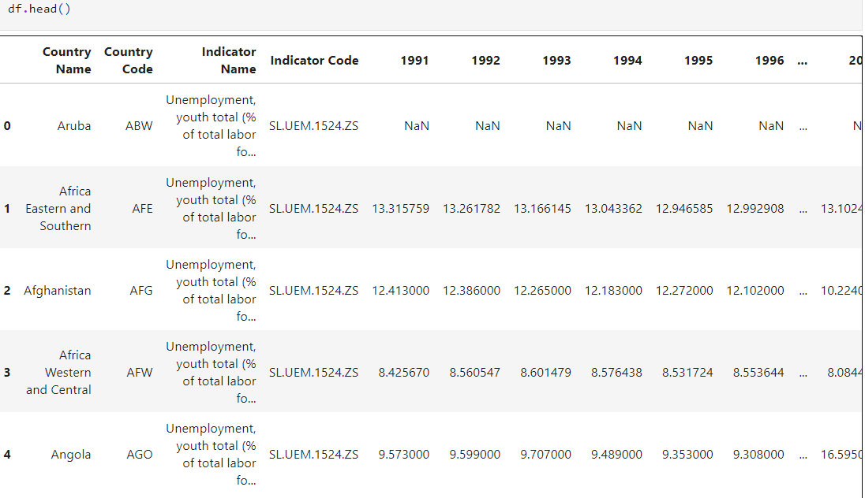
Slide 2
Gathering the Troops: Data Overview
DATASET
Regional youth unemployment rates from 1991 to 2022.
DATA SOURCES
Official government statistics, labour surveys
CLEANING PROCESS
Rows with >50% nulls were dropped, others filled using interpolation
Polishing the Data Gem
31 regions had unreported statuses; they were removed for consistency.
Interpolated values filled the gaps where data was missing.
Final verdict: Data was ready for action, no duplicates found!
*Only a few missing values (less than 50%),
no duplicates, making the data relatively clean*
3

Slide 4
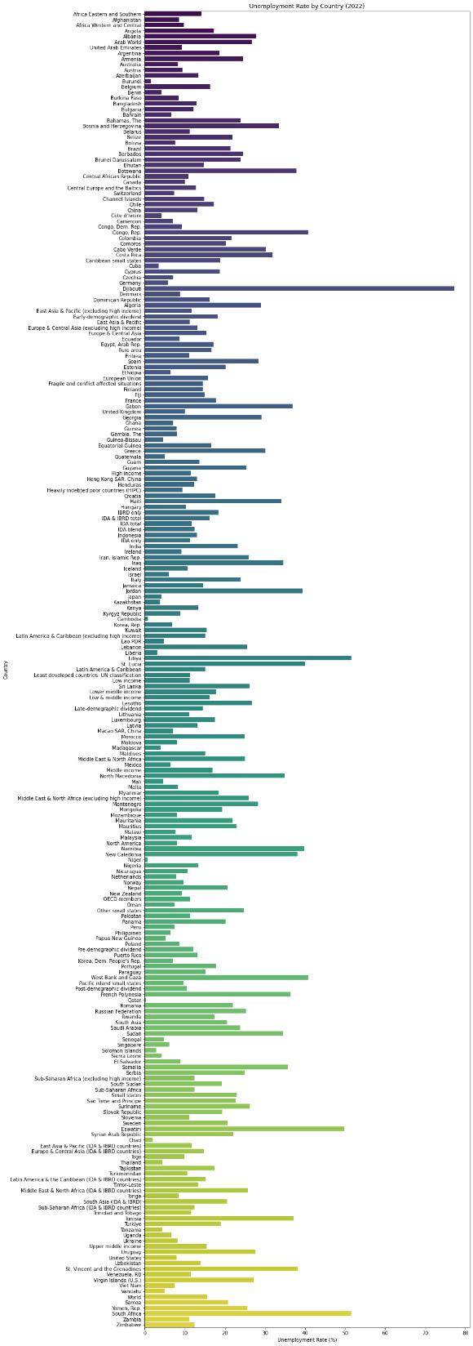
Slide 8
THE BIG PICTURE: GLOBAL
UNEMPLOYMENT
RATES IN 2022
Overview
In 2022, global unemployment rates varied widely, reflecting different economic conditions, labour market policies, and social factors.
Key Findings
Lowest Unemployment Rates: Countries like Qatar (0.2%), Thailand (1.0%), and Japan (2.6%) reported the lowest rates, largely due to stable economies and proactive labour policies.
Highest Unemployment Rates: Countries such as South Africa (34.5%), Sudan (30.6%), and Kosovo (26.2%) faced the highest rates, driven by economic instability and structural challenges.
Trends
Developed economies generally showed lower unemployment rates, while developing regions faced higher rates.
4

Slide 5
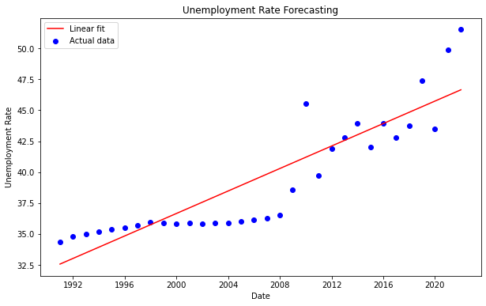
Slide 9
ZOOMING IN: SOUTH AFRICA’S UNEMPLOYMENT JOURNEY
Our model is versatile and can be applied to any region. We chose South Africa as our case study, but you can simply input the relevant country code to forecast unemployment rates for any other country
End of apartheid
and the beginning of economic
reforms
COVID-19 pandemic exacerbated
unemployment issues,
reaching a peak of 35.3%
2008 - 2009
RECENT TRENDS
1994
2020
Global financial crisis led to
significant job losses.
As of 2022, the unemployment rate stood at 34.5%, slightly lower than the peak but still one of the highest globally. TRENDS
5

Slide 6
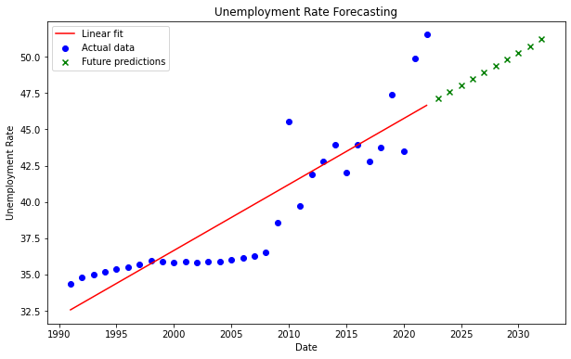
Slide 10
FIRST STOP: Linear Regression – A Straightforward Approach
Linear regression was used as a baseline model to understand the relationship between time (years) and unemployment rates.
Assumption
Unemployment rates change linearly over time.
Results
MSE: 6.59 – indicating a relatively high error rate.
Forecast: The model predicts a slight upward trend in unemployment over the next 10 years, though it doesn’t account for fluctuations or external factors.
Based off our linear regression model, South African unemployment rates are due for a linear increase, peaking at 52% in 2032.
6

Slide 7
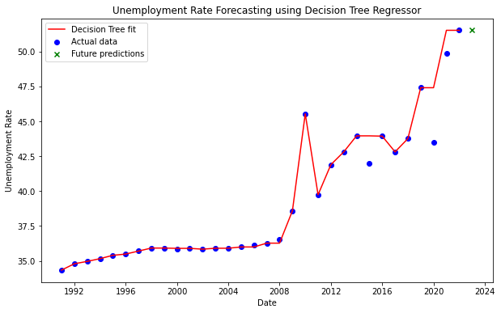
Slide 10
BRANCHING OUT: DECISION TREE REGRESSION
Decision Tree Regression was employed to capture non-linear relationships in the data, allowing for more nuanced predictions.
Structure
The model splits the data into branches based on decision rules derived from the historical data.
Results
MSE: 3.14 – a significant improvement over linear regression, indicating better model accuracy.
The MSE halved, which is good!
7

Slide 8
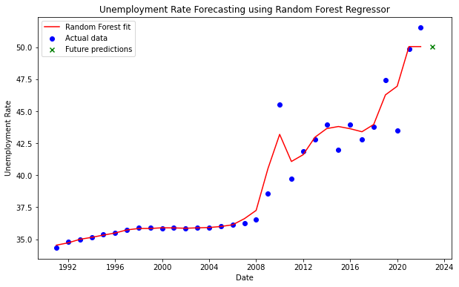
Slide 10
INTO THE WOODS: RANDOM FOREST REGRESSION
Random Forest, an ensemble learning method, was used to improve the accuracy of predictions by averaging the results of multiple decision trees.
Advantage
This model reduces overfitting and handles variability better than a single decision tree.
Results
MSE: 2.25 – high accuracy.
Limitation: Predictions are only accurate for one point forward due to the plateau effect.
Piecewise Constant Nature: Random Forest predictions stay constant within each tree’s leaf node.
Lack of Extrapolation: These models struggle with predicting trends beyond the training
With this model, we’re not out of the woods yet, but our predictions sure are branching out nicely!
8

Slide 9
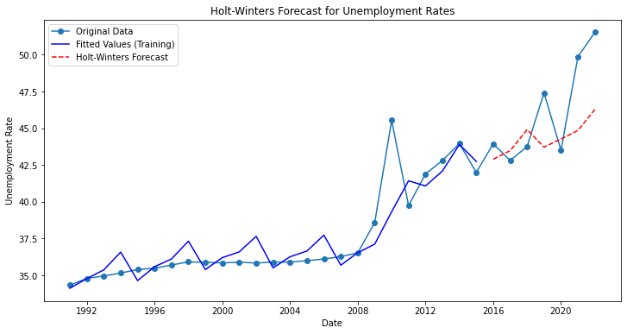
Slide 10
THE SEASONAL FORECAST: HOLT-WINTERS METHOD
Holt-Winters was applied to capture seasonal trends and long-term patterns in the unemployment data
Components
The model considers level, trend, and seasonality to make predictions
Results
MSE: 9.95!
We turned up the heat with Holt-Winters – unfortunately, the MSE melted a bit too.
9

Slide 10
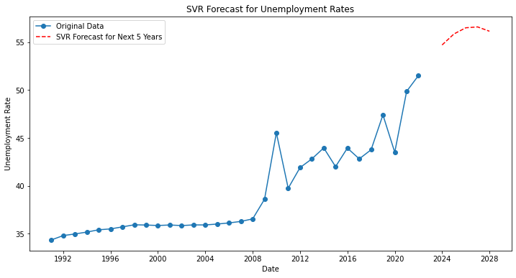

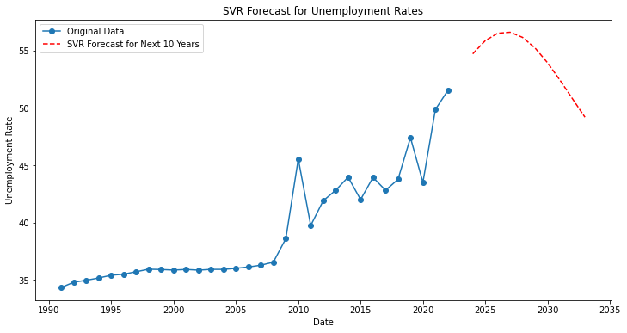
Slide 10
THE CHAMPION: SUPPORT VECTOR REGRESSION
SVR was employed for its robustness in handling non-linear relationships, making it ideal for complex datasets like unemployment rates.
Method
SVR works by finding a hyperplane that best fits the data, with a focus on minimizing prediction error.
Results
MSE: 3.37 - Our final and best train.
The SVR model differs from the linear regression model predictions. The SVR model has an MSE of 3.37 while linear regression only had an MSE of 6.59.
The SVR model has better accuracy.
SVR – making unemployment forecasts smoother than a well-oiled machine ;)
10

Slide 11
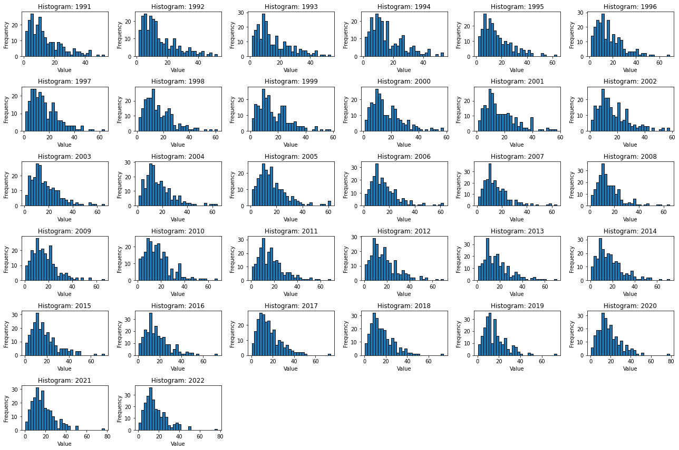
Slide 6
THE END OF THE ROAD: OUR FINAL THOUGHTS
Year
Values
South Africa’s unemployment rate is likely to remain high, with fluctuations depending on economic conditions and policy interventions.
SVR provided the most accurate predictions, making it the best model for forecasting unemployment in South Africa
2023
34.2%
2024
33.8%
2025
34.0%
2026
34.5%
INCOME PERCENTAGE
The model predicts a gradual increase in unemployment, with rates reaching approximately 52% by 2032
52%
11

Slide 12
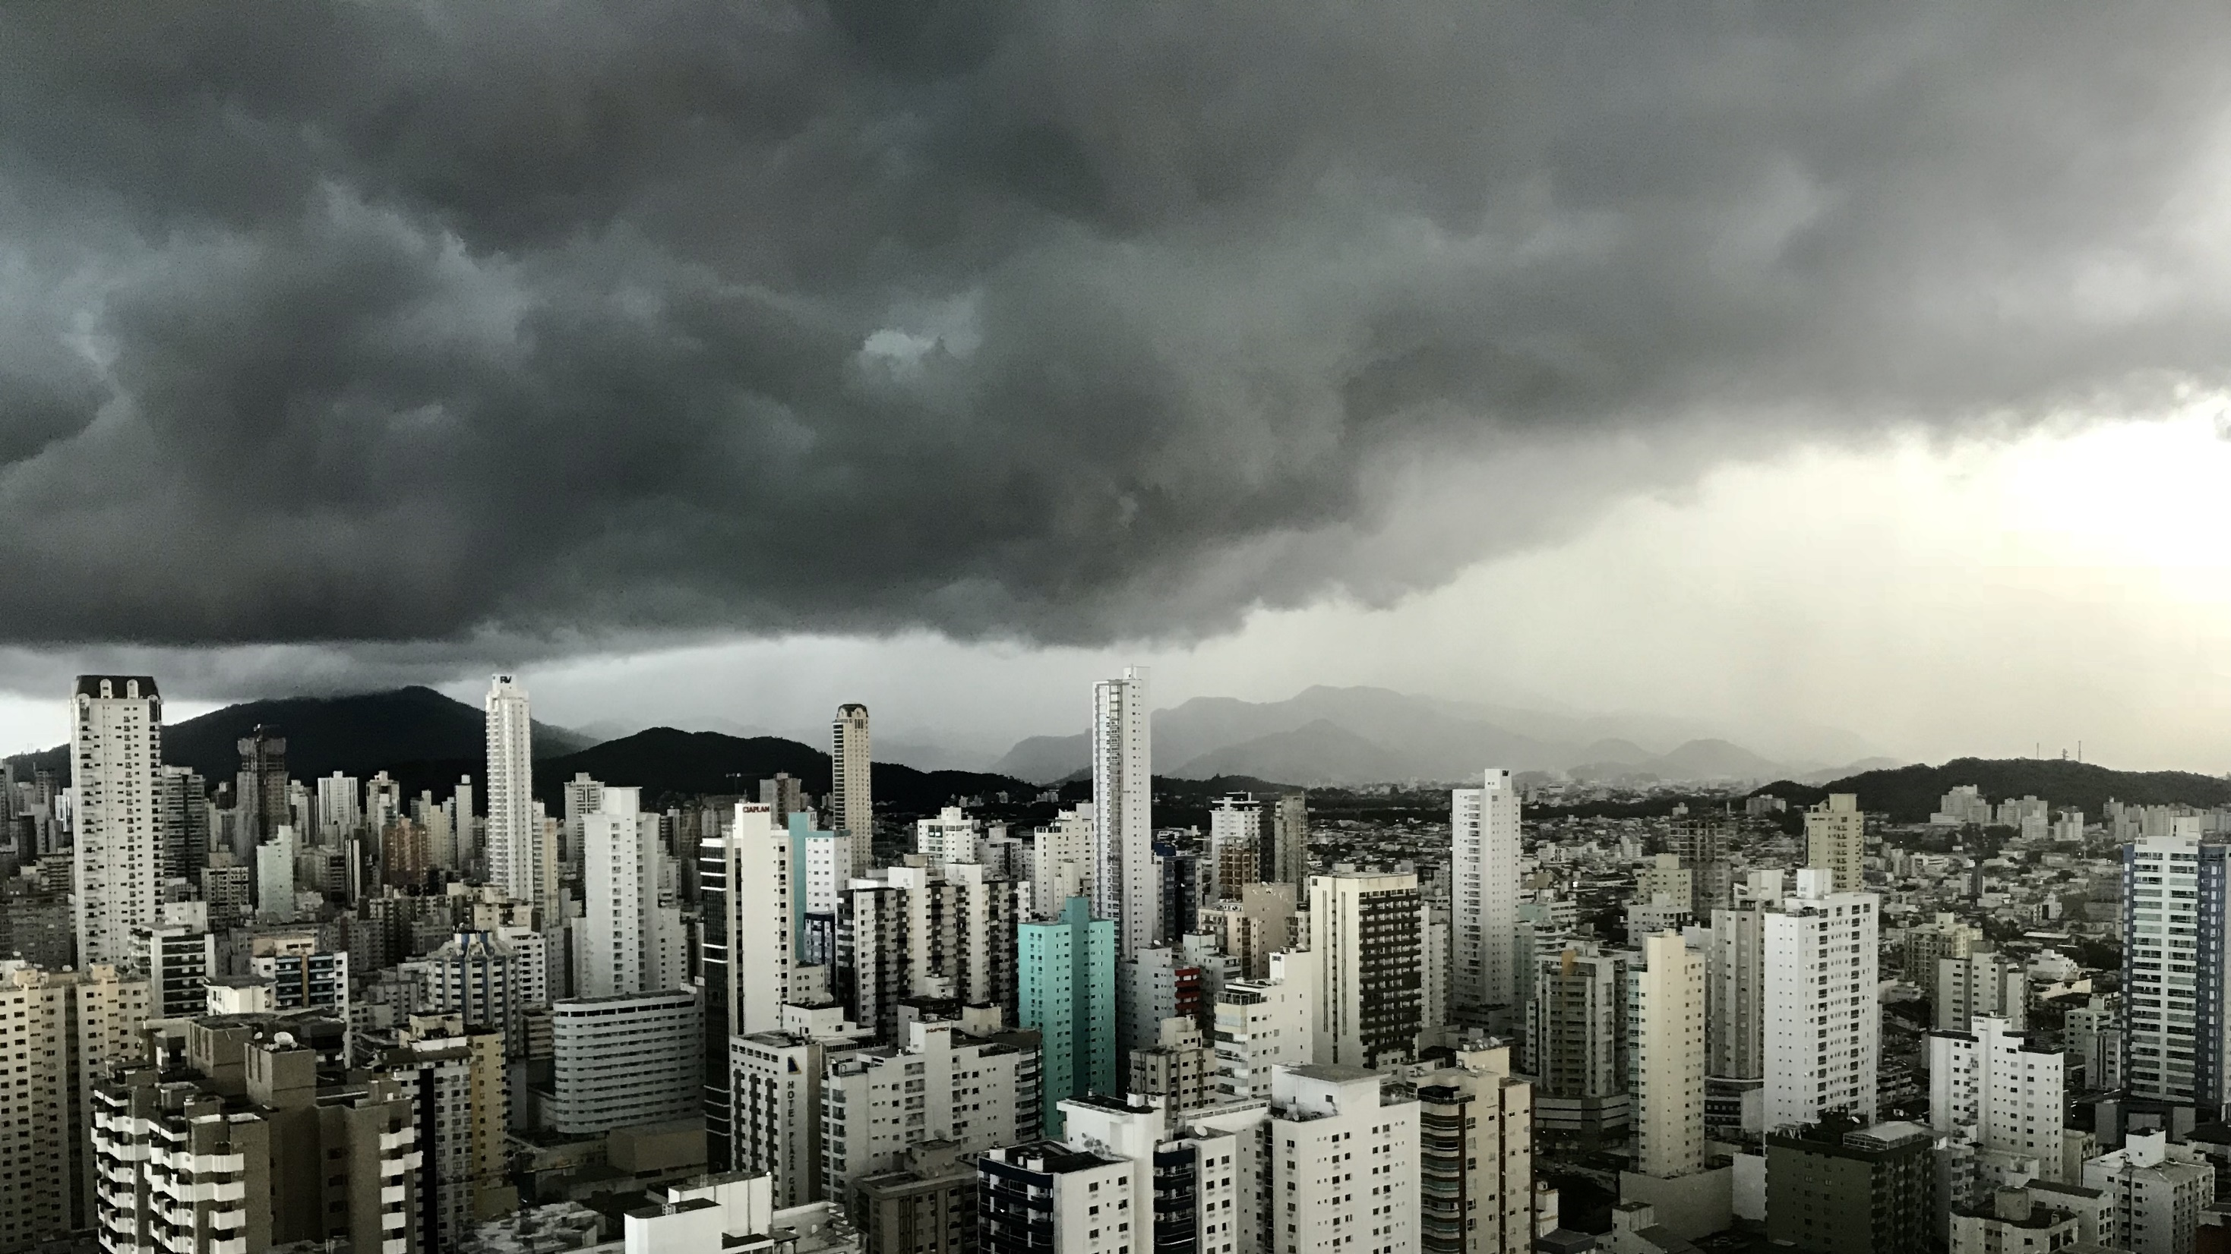
Slide 11
THANK YOU

