Slide 1





A New Unsupervised Approach to Automatic Topical Indexing of Scientific Documents According to Library Controlled Vocabularies
Arash Joorabchi & Abdulhussain E. Mahdi
Department of Electronic and Computer Engineering
University of Limerick, Ireland
ALISE 2013
Work Supported by:

Slide 2
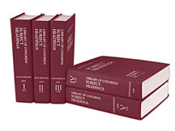
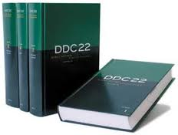
Subject (Topical) Metadata in Libraries
Un-controlled
  Unrestricted author and/or reader-assigned keywords and keyphrases, such as:
    Index Term-Uncontrolled (MARC-653)
Controlled
  Restricted cataloguer-assigned classes and subject headings, such as:
    DDC (MARC-082)
    LCC (MARC-050)
    LCSH/FAST (MARC-650)

Slide 3
The Case of Scientific Digital Libraries & Repositories
Archived Material Include: Journal articles, conference papers, technical reports, theses & dissertations, books chapters, etc.
Un-controlled Subject Metadata:
  Commonly available when enforced by editors, e.g., in case of published journal articles & conf. proceedings, but rare in unedited publications.
  Inconsistent
Controlled Subject Metadata:
  Rare due to the sheer volume of new materials published and high cost of cataloguing.
  High level of incompleteness and inaccuracy due to oversimplified classification rules, e.g., IF published by the Dept. of Computer Science THEN DDC: 004, LCSH: Computer science

Slide 4
Automatic Subject Metadata Generation in Scientific Digital Libraries & Repositories
Aims to provide a fully/semi automated alternative to manual classification.
1. Supervised (ML-based) Approach:
  utilizing generic machine learning algorithms for text classification (e.g., NB, SVM, DT).
  challenged by the large-scale & complexities of library classification schemes, e.g., deep hierarchy, skewed data distribution, data sparseness, and concept drift [Jun Wang ’09].
2. Unsupervised (String Matching-based) Approach:
  String-to-string matching between words in a term list extracted from library thesauri & classification schemes, and words in the text to be classified.
  Inferior performance compared to supervised methods [Golub et al. ‘06].

Slide 5
A New Unsupervised Concept-to-Concept Matching Approach - An Overview
Paper/Article
(Full Text)
Ranking
Wikipedia Concepts
Paper/Article
(MARC Rec.)
653: {…}
082: {…}
650: {…}
Key Concepts
WorldCat
Database
DDC
FAST
MARC records sharing a key concept(s) with the paper/article
Inference

Slide 6
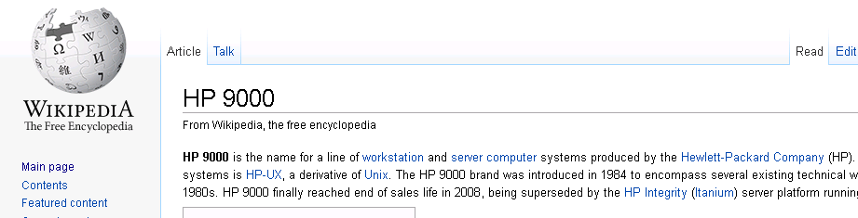

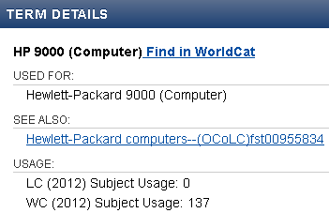

Wikipedia as a Crowd-Sourced Controlled Vocabulary
  Extensive topic/concept coverage (4m < English articles)
  Up-to-date (lags Twitter by ~3h on major events [Osborne et al.’12])
  Rich knowledge source for NLP (semantic relatedness, word sense disambiguation)
  Detailed description of concepts
Paper/Article
(MARC Rec.)
653: {Wikipedia: HP 9000}
650: {FAST: HP 9000 (Computer)}
Alternative Label
Related Term

Slide 7
Wikipedia Concepts – Detection In Text
Wikification using WikipediaMiner – an open source toolkit for mining Wikipedia [Milne, Witten ‘09]
Block Edit Models for Approximate String Matching
Abstract
In this paper we examine the concept of string block edit distance, where two strings A and B are compared by extracting collections of substrings and placing them into correspondence. This model accounts for certain phenomena encountered in important real-world applications, including pen computing and molecular biology. The basic problem admits a family of variations depending on whether the strings must be matched in their entireties, and whether overlap is permitted. We show that several variants are NP-complete, and give polynomial-time algorithms for solving….
.
.
Descriptor: String (computer science)
Non-descriptors:
  character string
  text string
  binary string
String (theory)
String (rope)
String (music)
…

Slide 8
Wikipedia Concepts – Ranking Features
1. Occurrence Frequency 2. First Occurrence 3. Last Occurrence 4. Occurrence Spread 5. Length 6. Lexical Diversity 7. Lexical Unity 8. Avg Link Probability 9. Max Link Probability 10. Generality 11. Speciality | 12. Distinct Links Count 13. Links Out Ratio 14. Links In Ratio 15. Avg Disambiguation Confidence 16. Max Disambiguation Confidence 17. Link-Based Relatedness to Other Topics 18. Link-Based Relatedness to Context 19. Cat-Based Relatedness to Other Topics 20. Translations Count

Slide 9
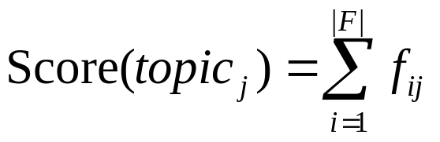
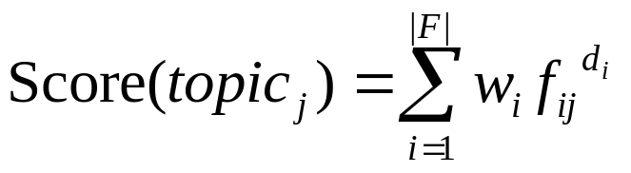
Key Wikipedia Concepts – Rank & Filtering
Un-supervised
  Pros:
    easy to implement & fast
    plug & play, i.e., no training needed
  Cons (naïve assumptions):
    Assumes all features carry the same weight
    Assumes all features contribute to the importance probability of candidates linearly
Supervised
  Initial population - a set of ranking functions with random weight and degree parameter values within a preset range
  Evaluate fitness of each ranking function.
  (selection, crossover, mutation) -> new generation
  Repeat steps 2 & 3 until threshold is passed
Genetic algorithm (ECJ) settings

Slide 10
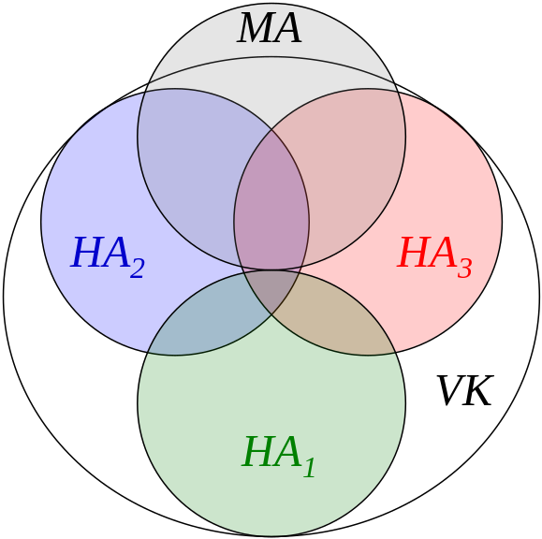
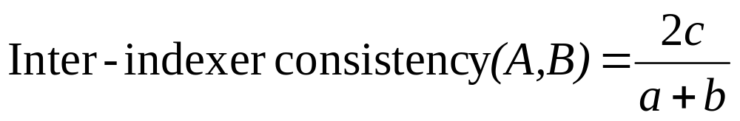
Key Wikipedia Concepts – Evaluation Dataset & Measure
Wiki-20 dataset [Medelyan, Witten ‘08]:
  20 Computer Science related papers/articles.
  Each annotated by 15 Human Annotator (HA) teams independently.
  HAs assigned an average of 5.7 topics per Doc.
  an Avg. of 35.5 unique topics assigned per Doc.
Rolling’s inter-indexer consistency (=F1) :

Slide 11
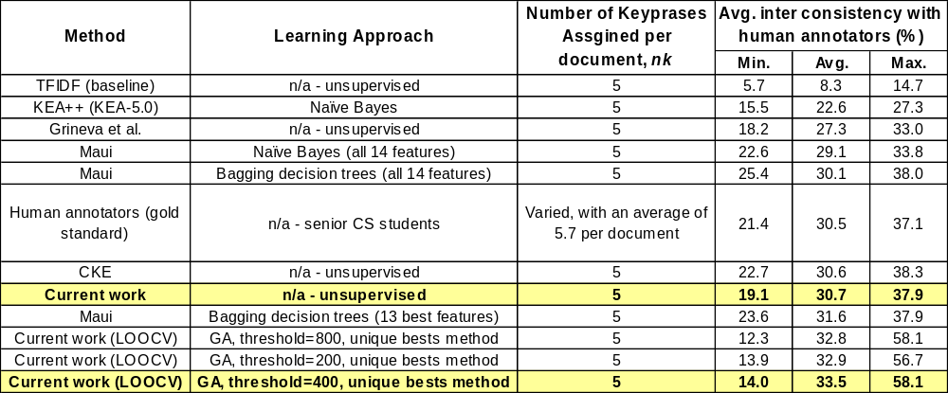
Key Wikipedia Concepts – Evaluation Results
Performance comparison with human annotators and rival machine annotators
Joorabchi, A. and Mahdi, A. Automatic Subject Metadata Generation for Scientific Documents Using Wikipedia and Genetic Algorithms. In Proceedings of the 18th International Conference on Knowledge Engineering and Knowledge Management (EKAW 2012)
Joorabchi, A. and Mahdi A. E., Automatic keyphrase annotation of scientific documents using Wikipedia and genetic algorithms. Journal of Information Science, 39, 3 (2013), 410-426.

Slide 12
Querying WorldCat Database
http://worldcat.org/webservices/catalog/search/sru?query=
  srw.kw = Doc_Key_Concept_Descriptor
  AND srw.ln exact eng //Language
  AND srw.la all eng //Language Code (Primary)
  AND srw.mt all bks //Material Type
  AND srw.dt exact bks //Document Type (Primary)
  &servicelevel = full
  &maximumRecords = 100
  &sortKeys = relevance,,0 //Descending order
  &wskey = [wskey]
Top
30
Key
Concepts
in the
document
WorldCat
Database
≤100 potentially related MARC records

Slide 13
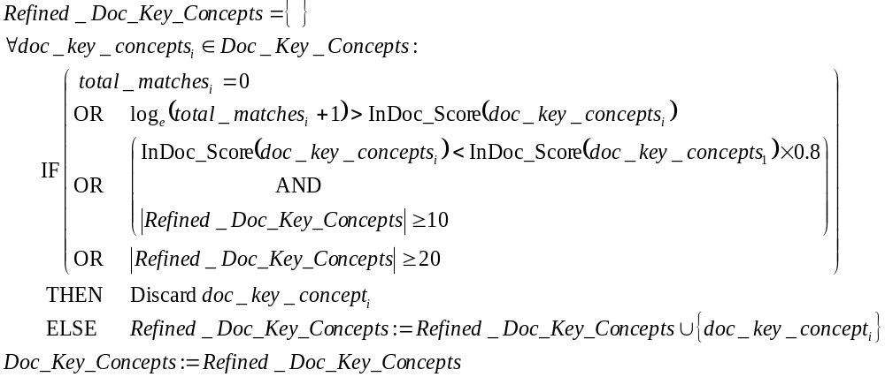
Refining Key Concepts Based on WorldCat Search Results
doc_key_concepts_{i ≤30}
Doc_Key_Concepts =
marc_recs_{i , j ≤100}
Marc_Recs_{i}=
total_matches_{i}
e.g., “Logic”(72,353): 13.7>10.3
vs. “Linear logic”(17): 2.83 < 8.6
e.g., “Logical conjunction”

Slide 14
MARC Records Parsing, Classification, Concept Detection
doc_key_concepts_{i ≤20}
total_matches_{i}
Doc_Key_Concepts=
marc_recs_{i , j ≤100}
Marc_Recs_{i}=
DDC_{i,j}
FAST_{i,j}
Marc_Concepts_{i,j}
OCLC
Classify
001 Control Number
245($a) Title Statement (Title)
505($a, $t) Formatted Contents Note
520($a, $b) Summary, Etc.
650($a) Subject Added Entry-Topical Term
653($a) Index Term-Uncontrolled
Wikipedia-Miner
*OCLC Classify finds the most popular DDC & FASTs for the work using the OCLC FRBR Work-Set algorithm.

Slide 15
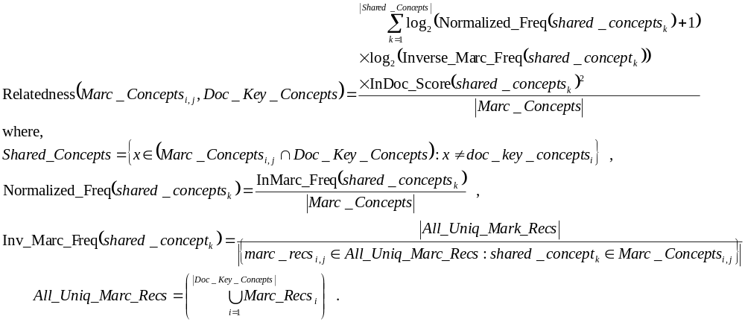
Measuring Relatedness Between MARC Records and the Article/Paper
doc_key_concepts _{i ≤20}
total_matches_{i}
marc_recs_{i , j ≤100}
Doc_Key_Concepts=
Marc_Recs_{i}=
Marc_Concepts_{i,j}
DDC_{i,j}
FAST_{i,j}
Relatedness?
Relatedness_{i,j}

Slide 16
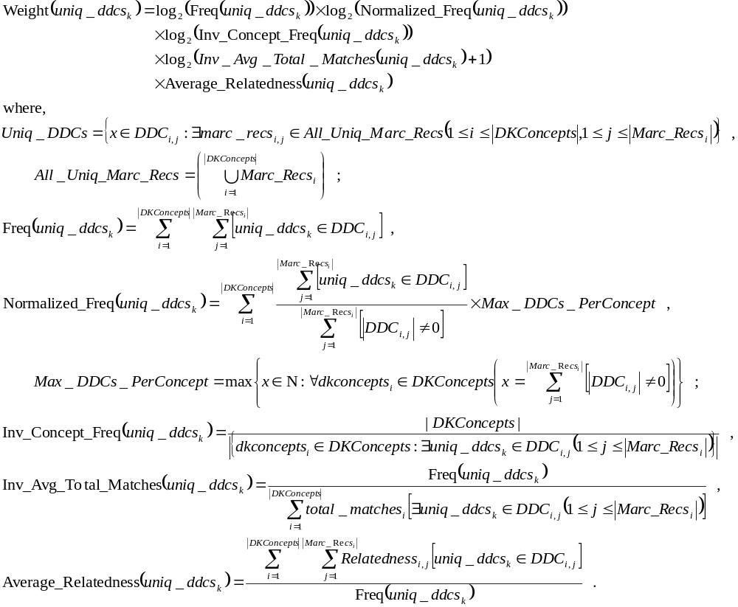
Weighting DDC Candidates

Slide 17
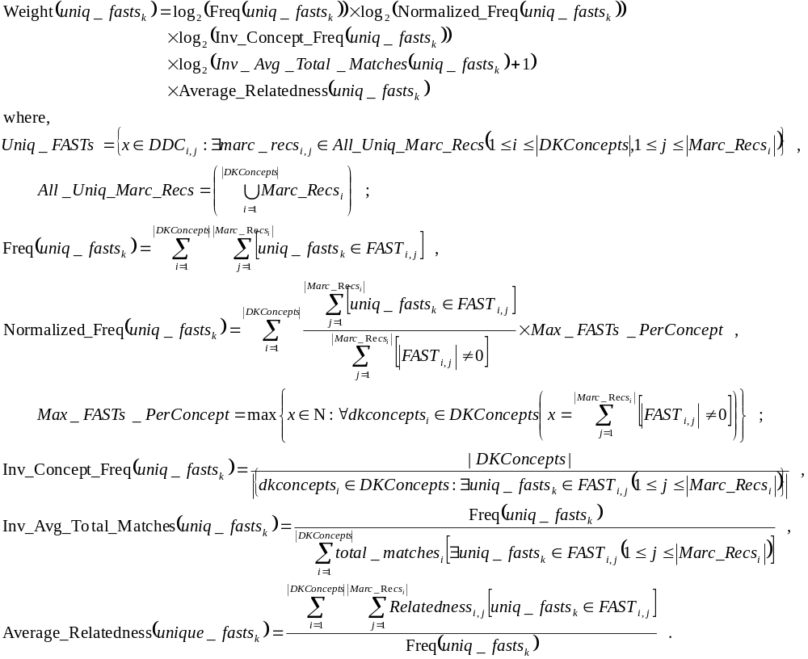
Weighting FAST Candidates

Slide 18
DDCs Weight Aggregation & Outlier Detection
  Sort Unique_DDCs set based on DDCs depth in descending order
  For each DDC_{i} ∈ Unique_DDCs Do :
  For each DDC_{j} ∈ Unique_DDCs Do :
  IF subclass(DDC_{i}, DDC_{j}) THEN
  IF weight(DDC_{i}) > highest_DDC_weight/10 THEN
  weight(DDC_{i}) = weight(DDC_{i}) + weight(DDC_{j})
  Discard DDC_{j}
  ELSE Discard DDC_{i}
Example:
DDC_{i} | DDC_{i+1}
*BoxPlot Outliers - DDCs whose weights lie an abnormal distance from the others’, i.e., mild and extreme outliers
Upper + 1
Outlier
s.t. weight(DDC_{i}) > (upper inner fence = Q3 + 1.5*IQ)

Slide 19
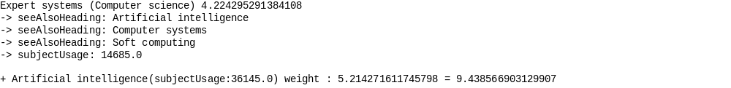
FASTs Weight Aggregation & Outlier Detection
  Unique_FASTs := {x ∈ Unique_FASTs : weight(x) > highest_FAST_weight/10}
  For each FAST_{i} ∈ Unique_FASTs Do :
  For each FAST_{j} ∈ Unique_FASTs Do :
  IF related(FAST_{i} , FAST_{j}) AND WC_SubjectUsage(FAST_{i}) < WC_SubjectUsage(FAST_{j})
  THEN weight(FAST_{i}) = weight(FAST_{i}) + weight(FAST_{j})
Example:
FAST_{i} | FAST_{i+1} | FAST_{i+2}
Outlier₁ + Outlier₂ + 1

Slide 20



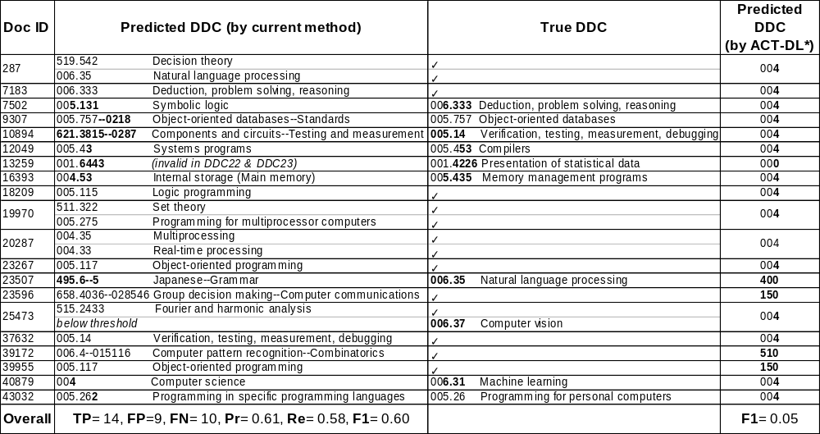
DDCs Binary Evaluation
Wiki-20 dataset [Medelyan, Witten ‘08] containing 20 Computer Science related papers/articles.
004: 78k
005: 100
006: 403
Imbalanced
Training
Set
*Automatic Classification Toolbox for Digital Libraries (ACT-DL) by Bielefeld University Library and deployed at Bielefeld Academic Search Engine (BASE)

Slide 21
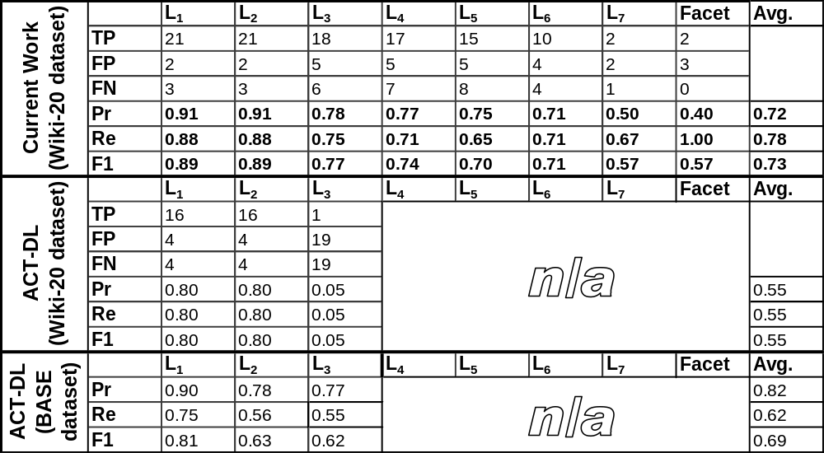
DDCs Hierarchical Evaluation

Slide 22
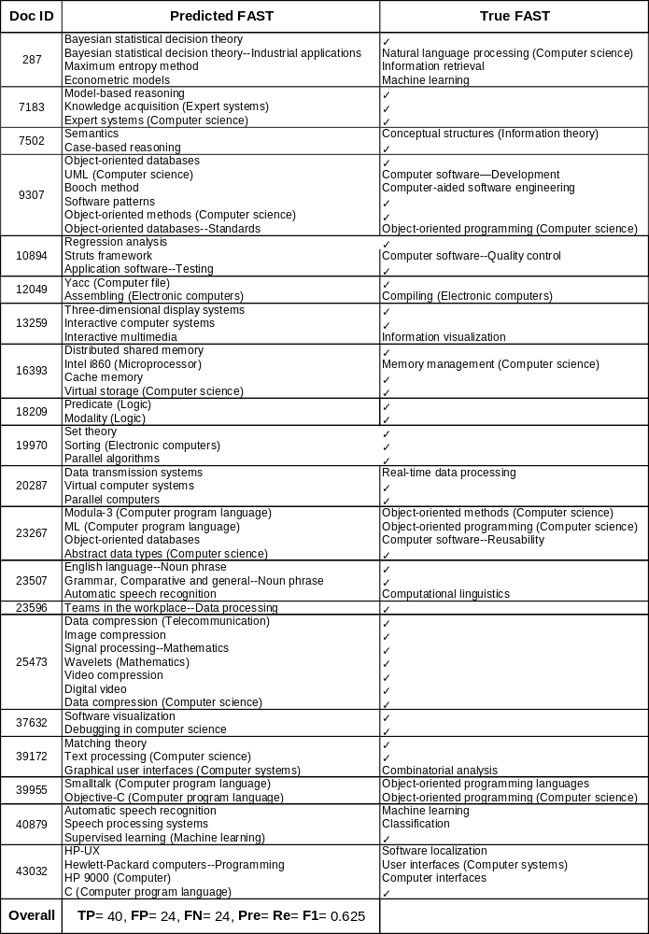
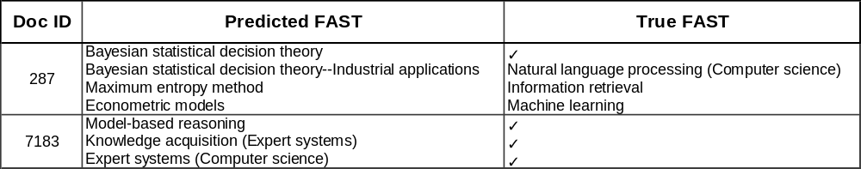
FASTs
Binary Evaluation
TP= 40, FP= 24, FN= 24
F1= 0.625

Slide 23
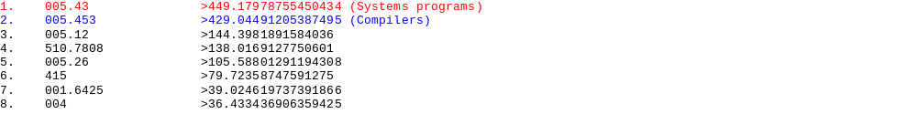
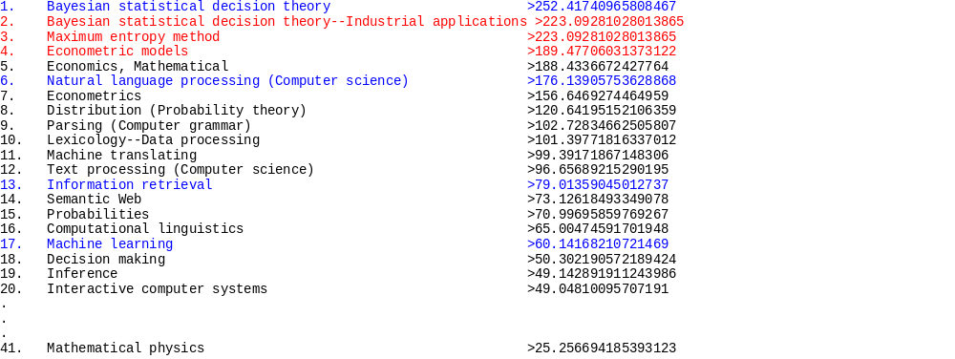
Semi-Supervised Classification
12049: Occam's Razor: The Cutting Edge for Parser Technology
287: Clustering Full Text Documents

Slide 24
Future Work
Detecting Wikipedia concepts in documents is computationally expensive.
Eliminating the need for sending queries to the WorldCat DB and repeating the process of concept detection on matching MARC records by performing a once-off concept detection on a locally held FRBRized version of the WorldCat DB.
Complementing concepts extracted from MARC records of works catalogued in the WorldCat DB with common terms and phrases from the content of those works (as extracted by Google Books Project).
Probabilistic Mapping of Wikipedia concepts/articles to their corresponding DDCs and FASTs (already initiated by the OCLC Research via developing VIAFbot for mapping Wikipedia biography articles to VIAF.org)

Slide 25


Thank You!
Questions…
For more information, please contact:
Arash.Joorabchi@ul.ie Hussain.Mahdi@ul.ie
This work is supported by:
  OCLC/ALISE Library & Information Science Research Grant Program
  Irish Research Council 'New Foundations' Scheme

