Slide 1

Department of Electronic and Computer Engineering Automatic Subject Classification of Textual Documents Using Limited or No Training Data Arash Joorabchi Supervised by Dr. Abdulhussain E. Mahdi Submitted for the degree of Doctor of Philosophy 10/11/2010

Slide 2
Outline
Introduction to ATC
Motivation, Aim, and Objectives
Bootstrapping ML-based ATC systems (Ch.3)
Bibliography-Based ATC method (BB-ATC) (Ch.4)
Enhanced BB-ATC for Automatic Classification of Scientific Literature in Digital Libraries (Ch.5)
Citation Based Keyphrase Extraction (CKE) (Ch.6)
Conclusion & Future Work

Slide 3
Introduction
Automatic Text Classification/Categorization (ATC)
  Automatic assignment of natural language text documents to one or more predefined classes/categories according to their contents.
Applications include:
  Spam filtering
  Web information retrieval, e.g., filtering, focused crawling, web directories, subject browsing
  Organising digital libraries
Common Methods:
  Rule-based Knowledge Engineering (until late 1980s)
  Machine Learning (since 1990s)

Slide 4
ML Approach to ATC
Common ML algorithms used for ATC
  Naïve Bayes (based on Bayes' theorem)
  k-Nearest Neighbors (k-NN)
  Support Vector Machines (SVM) [Vapnik, V 1995]
SVM is reported to yield the best prediction accuracy [Joachims, T 1998]. However, the accuracy of ML-based ATC systems depend on many parameters such as:
  Quantity and quality of training documents
  Document representation models, e.g., bag-of-words vs. bag-of-phrases
  Term weighting mechanisms, e.g., binary vs. multinomial (burstiness phenomenon)
  Feature reduction and selection methods, e.g., document frequency vs. information gain.
Therefore, the choice for the best classification algorithm highly depends on the characteristics of the ATC task at hand [Hand, D. J. 2006].

Slide 5
Motivation, Aim, and Objectives
What if there is limited/no training data?(e.g., 100 classes & 200 samples per class)
Our aim was to alleviate this problem by pursuing two lines of research:
  Investigating bootstrapping methods to automate the process of building labelled corpora for training ML-based ATC systems.
  Investigating a new unsupervised ATC algorithm which does not require any training data.
In order to realise this aim, we have focused on utilising two sources of data whose application in ATC had not been fully explored before:
  Conventional library organisation resources such as library classification schemes, controlled vocabularies, and catalogues (OPACs).
  Linkage among documents in form of citation networks.

Slide 6
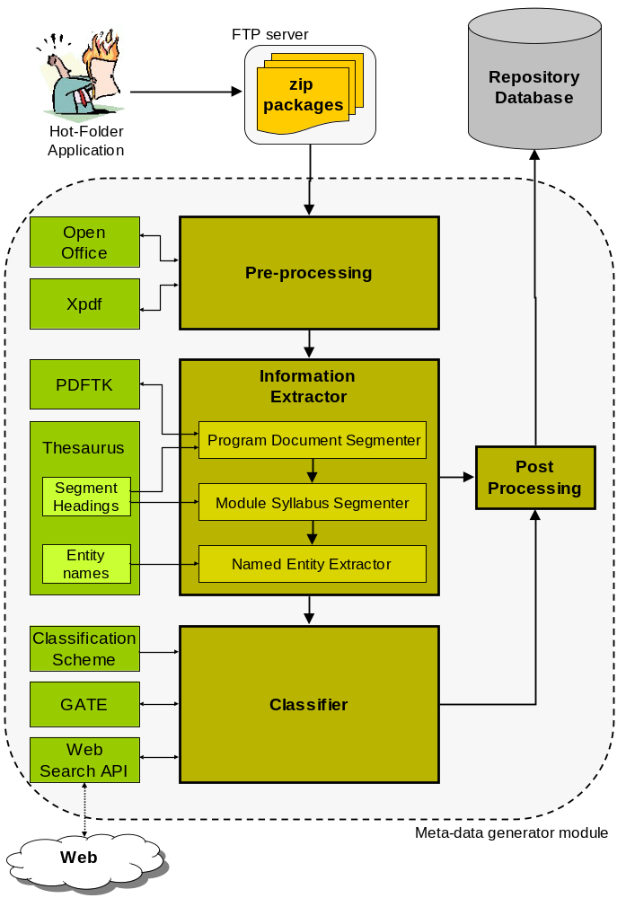
An Overview of Developed Syllabus Repository System
Development of a National Syllabus Repository for Higher Education in Ireland
Goal: Collecting unstructured electronic syllabus documents from participating higher education institutes into a metadata-rich central repository.
Extended the ISCED scheme
482B - Science, Mathematics and Computing/Computing/Information Systems/Databases
Naïve Bayes Classification algorithm [Tom Mitchell 1997]
A New Web-based bootstrapping method

Slide 7
Web-based Bootstapping process
Web-based Bootstrapping process
A list of subject fields (leaf nodes) in the classification scheme is compiled.
For each subject filed in the list a web search query is created including the caption of the subject field and the keyword “syllabus” and submitted to the Yahoo search engine using Yahoo search SDK.
The first hundred URL’s in the returned results for each query are passed to the Gate toolkit [Cunningham et al. 2002], which downloads all corresponding files (in HTML, TXT, PDF, or MS-word formats) and extracts and tokenizes their textual contents.
The tokenised texts are converted to feature/word vectors are then used to train the classifier for classifying syllabus documents at the subject-field level.
The subject-field word vectors are also used in a bottom-up fashion to construct word vectors for the fields which belong to the higher levels of hierarchy (p.52).

Slide 8
Evaluation and Experimental Results
Test dataset contains 100 undergraduate syllabus documents and 100 postgraduate syllabus documents from 5 participating HE institutes in Ireland
The micro-average precision achieved by the classifier for undergraduate syllabi is 0.75, compared to 0.60 for postgraduate syllabi.
 | Mico-avg. Precision | Mico-avg. Recall | Mico-avg. F1
Named Entities | 0.94 | 0.74 | 0.82
Topical Segments | 0.84 | 0.72 | 0.77
Results published in:
  The proceedings of the 12th European Conference on Research and Advanced Technology for Digital Libraries, ECDL 2008; and
  The Electronic Library, 27, 4 (2009).

Slide 9
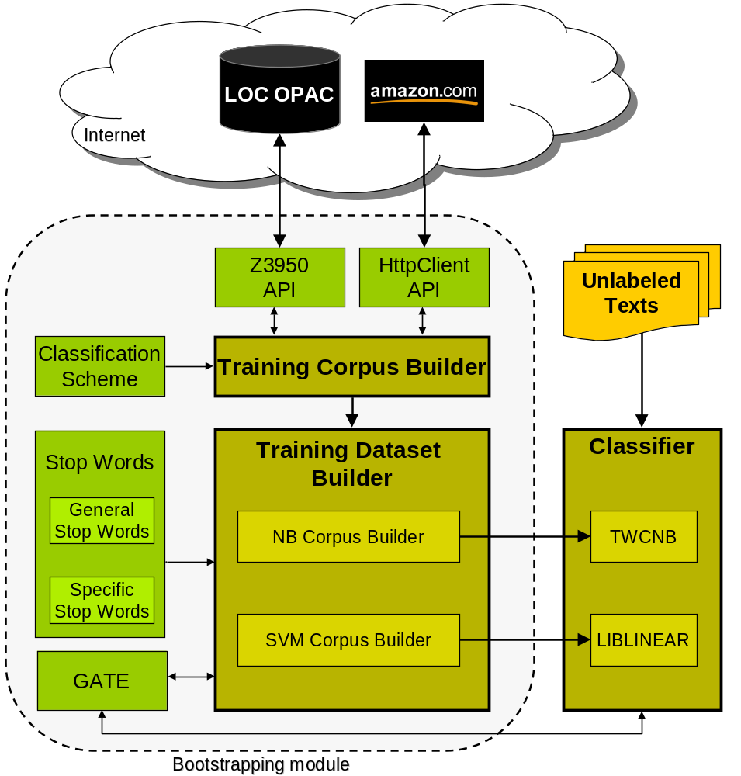
Overview of Developed ATC system
Bootstrapping ML-based ATC Systems Utilizing Public Library Resources
A dynamic ML-based ATC system that can be adopted for wide range a ATC tasks with minimum customization required.
Dewey Decimal Classification (DDC) scheme.
small parts of books such as back cover, and editorial reviews for training
Transformed Weight-normalized Complement Naive Bayes (TWCNB) [Rennie et al., 2003].
A linear SVM classifier called LIBLINEAR [Lin, C.-J et al., 2008]

Slide 10
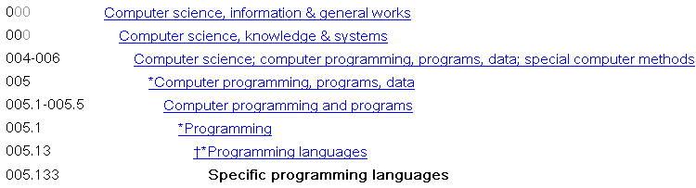
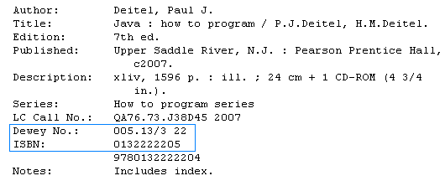
Data Mining Process
Retrieve a list of books from LOC’s catalogue which are Classified into this category.
Extract a list of ISBN’s and use them to retrieve the books descriptions from Azmazon.
http:/amazon.com/gp/product/ISBN-VALUE

Slide 11
Parsed Book Description Text
Product Description
  Editorial Reviews:
The Deitels' groundbreaking How to Program series offers unparalleled breadth and depth of object-oriented programming concepts and intermediate-level topics for further study. The Seventh Edition has been extensively fine-tuned and is completely up-to-date with Sun Microsystems, Inc.’s latest Java release — Java Standard Edition 6 (“Mustang”) and several Java Enterprise Edition 5 topics. Contains an extensive OOD/UML 2 case study on developing an automated teller machine. Takes a new tools-based approach to Web application development that uses Netbeans 5.5 and Java Studio Creator 2 to create and consume Web Services. Features new AJAX-enabled, Web applications built with JavaServer Faces (JSF), Java Studio Creator 2 and the Java Blueprints AJAX Components. Includes new topics throughout, such as JDBC 4, SwingWorker for multithreaded GUIs, GroupLayout, Java Desktop Integration Components (JDIC), and much more. A valuable reference for programmers and anyone interested in learning the Java programming language.
http:/amazon.com/gp/product/0132222205

Slide 12
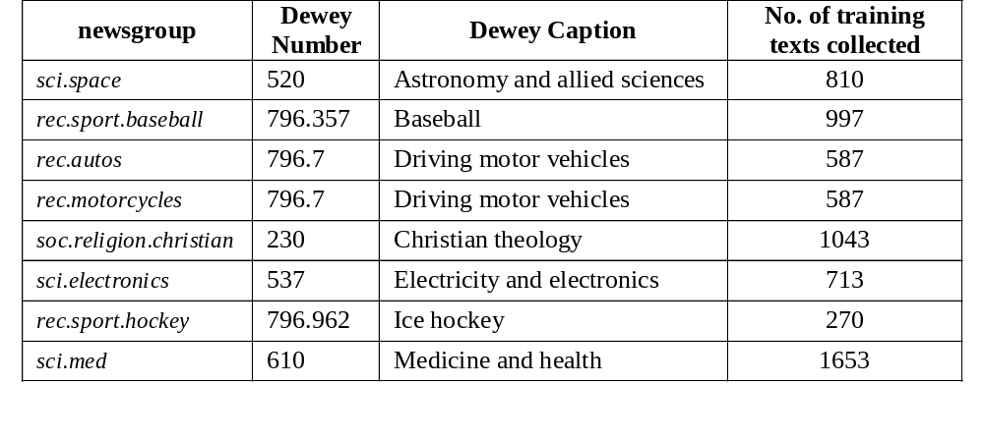
Evaluation and Experimental Results
20-Newsgroup-18828 dataset - a collection of 18,828 newsgroup articles, partitioned across 20 different newsgroups.
Eight classes in 20-Newsgroup were mapped to their corresponding classes in Dewey Decimal Classification scheme. (the remaining were inapplicable e.g., misellaneous.forsale)

Slide 13
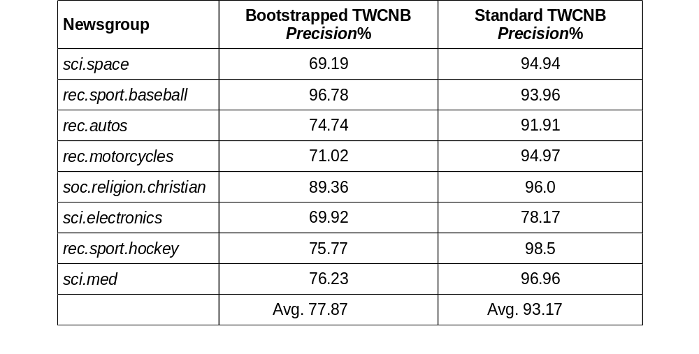
Evaluation and Experimental Results (Cont.)
Accuracy of Bootstrapped TWCNB is 15% Lower than standard TWCNB
The LIBLINEAR classifier with achieved average precision of 68% turned out to be considerably less accurate than TWCNB in this task.
Results published in:
  The proceedings of the 19th Irish Conference on Artificial Intelligence and Cognitive Science (AICS08).

Slide 14


Leveraging the Legacy of Conventional Libraries for Organizing Digital Libraries
Can we utilize the classification metadata of books referenced in a syllabus document to classify it?
They are already classified by expert library cataloguers according to DDC and LCC classification schemes.
Tapping into:
The intellectual work that has been put into developing and maintaining library classification systems over the last century.
The intellectual effort of expert cataloguers who have manually classified millions of books and other resources in libraries.

Slide 15
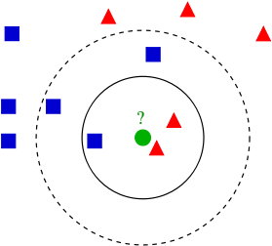
Bibliography-based ATC method
BB-ATC is based on Automating the following processes:
  Identifying and extracting references in a given document.
  Searching catalogues of physical libraries for the extracted references in order to retrieve their classification metadata.
  Allocating a class(es) to the document based on retrieved classification category(ies) of the references with the help of a weighting mechanism.
Similarities to the k Nearest Neighbour K-NN algorithm

Slide 16
Bibliography-based ATC
Advantages Over ML-based ATC systems:
  Library classification schemes are regularly updated and contain thousands of classes in every field of knowledge.
  No training data is needed.
  performance is not adversely affected by the large number of classes in DDC and LCC.
  New books are catalogued everyday and hence no concept drift.

Slide 17
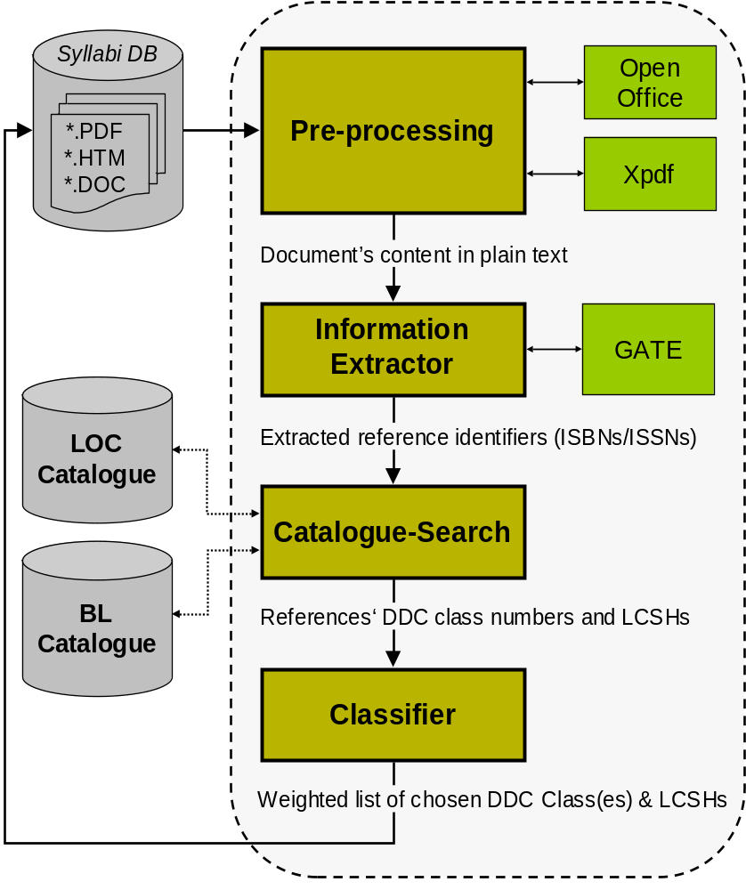
BB-ATC Implementation
DDC classification Scheme was adopted because of its worldwide usage and Hierarchical structure.
JZkit Java API is used to communicate with the libraries’ OPAC catalogues through Z39.50 protocol.
JRegex/JAPE for extracting ISBNs/ISSNs.
Multi-label classification by assigning weights (0<w≤1) to candidate DDC classes and LCSHs.

Slide 18
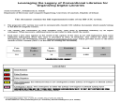
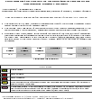
BB-ATC Evaluation
Test dataset: 100 computer science related syllabus documents.
Full results available online at: www.csn.ul.ie/~arash/PDFs/1.pdf
Micro-averaged performance measures
TP | FP | FN | Precision | Recall | F1
210 | 19 | 26 | 0.917 | 0.889 | 0.902
Author | Method | Data Set | Classification Scheme | F1
Pong et al. (2007) | K-NN | 505 training & 254 testing documents (web pages) | 67 classes from LCC | 0.80
Pong et al. (2007) | NB | 505 training & 254 testing documents(web pages) | 67 classes from LCC | 0.54
Chung et al. (2003) | K-NN | 1889 training & 623 test documents Economic related web pages | 575 subclasses of the DDC main class of economics | 0.92
 | BB-ATC | 100 computer science related Syllabi | Full DDC scheme | 0.90
Results published in:
  The proceedings of the 13th European Conference on Research and Advanced Technology for Digital Libraries, (ECDL 2009). (Granted the best student paper award)

Slide 19
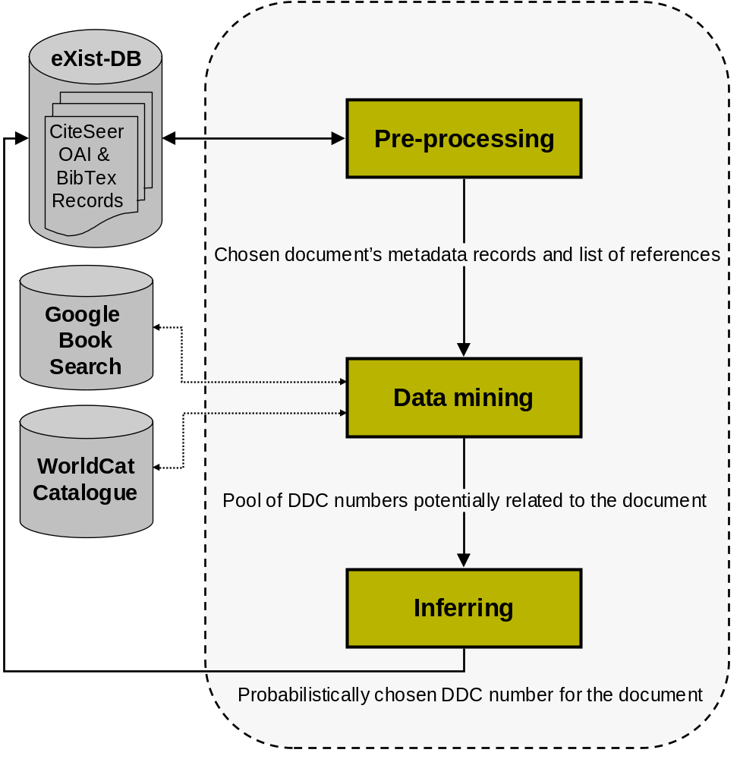
Enhanced BB-ATC method for Automatic Classification of Scientific Literature in Digital Libraries
1800 publication a day in biomedical science!
The CiteSeer digital library is used as the experimental platform (~1 million records).
CiteSeer infrastructure is fully open source and supports (OAI-PHM).
Using Google Book Search database for mining citations networks.
Using OCLC’s WorldCat - a union catalogue of 70,000 libraries around the world.

Slide 20
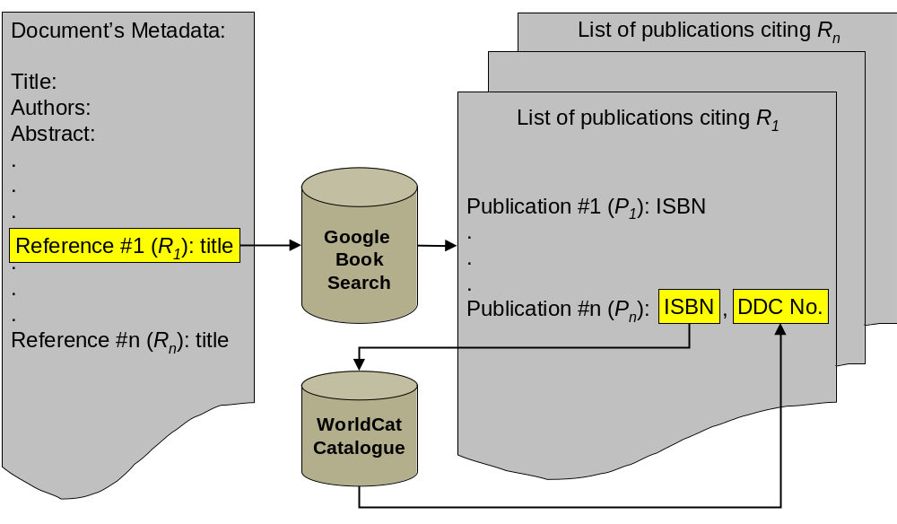
Data mining process

Slide 21
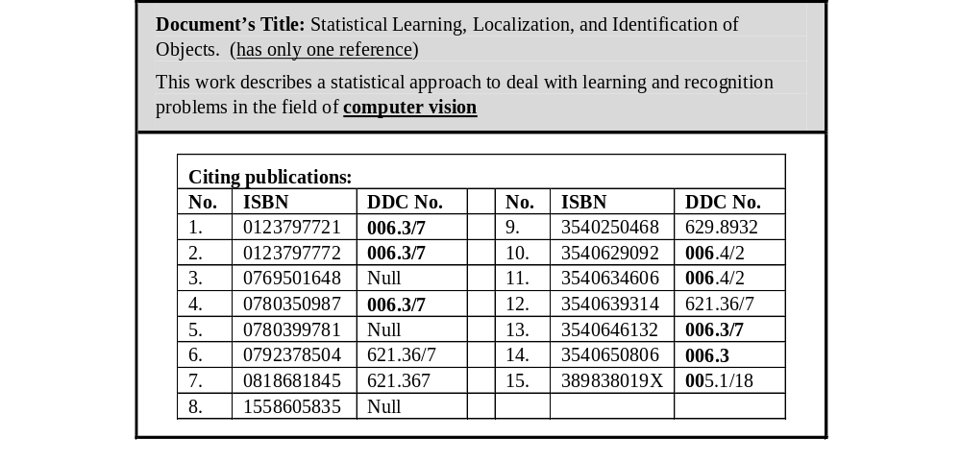
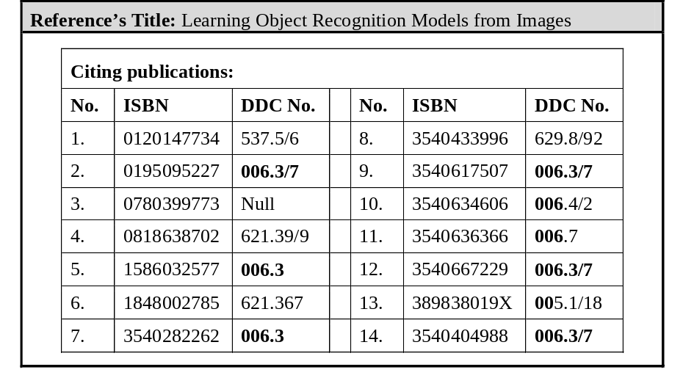
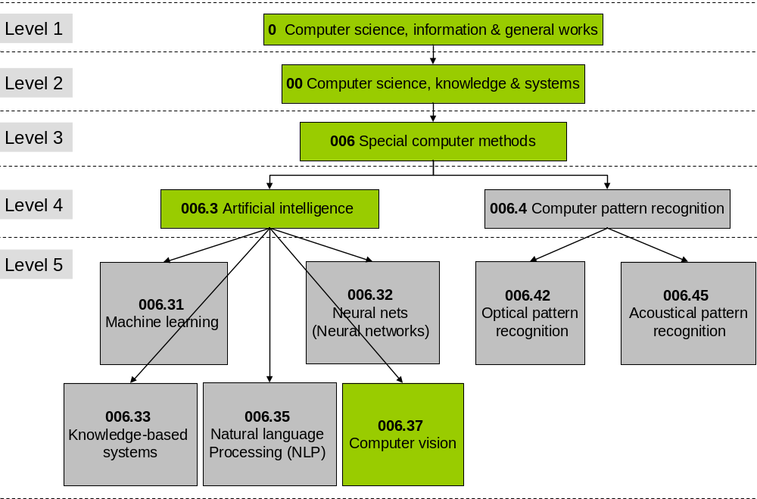
Sample Data mining Results (Cont.)
DDC No. | Freq
0 | 17
6 | 7
00 | 17
006 | 15
005 | 2
0063 | 11
0064 | 3
00637 | 8
621367 | 4

Slide 22
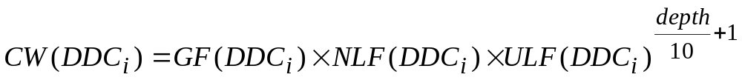
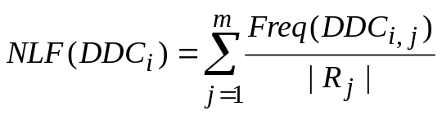
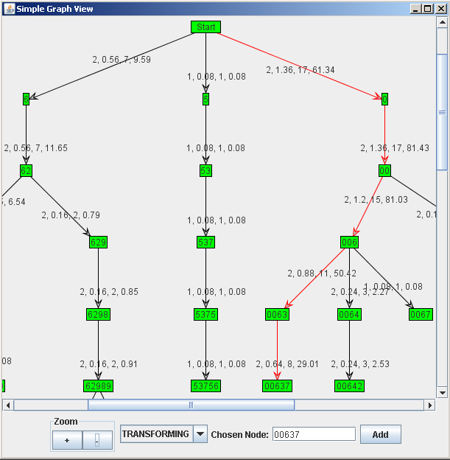
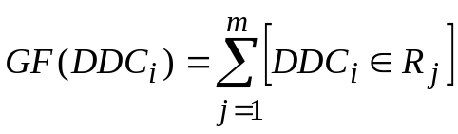
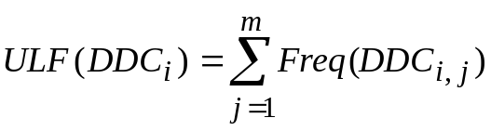

Inference & Visualization
The same concept as TFIDF weighting

Slide 23
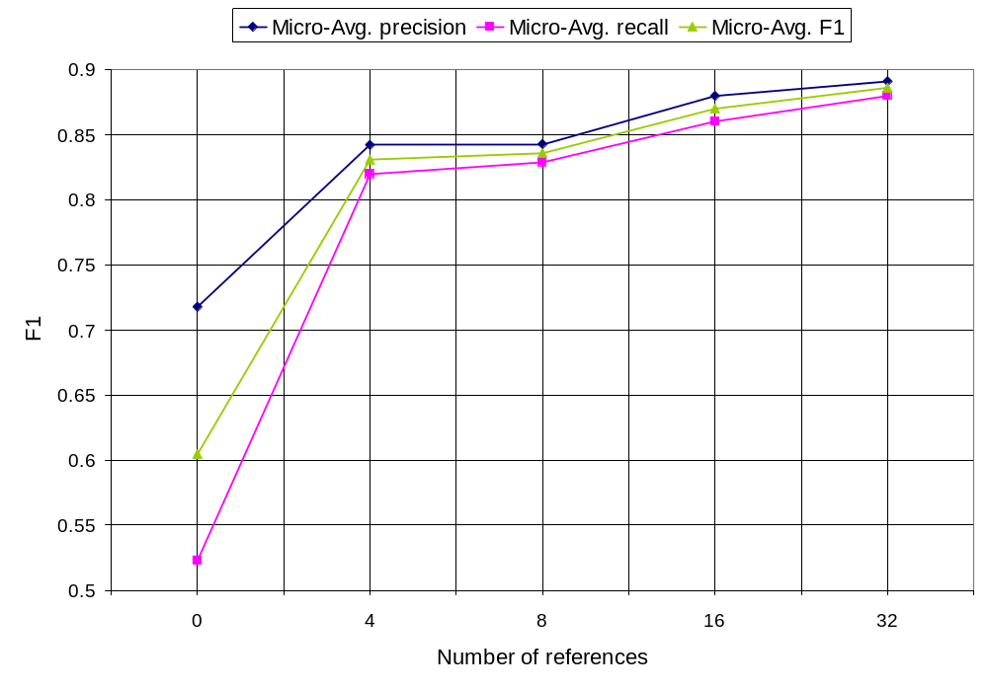
Evaluation Results
Test dataset contains 1000 research documents divided into 5 groups according to their number of references.
No. of references | Mico-avg. Pr | Mico-avg. Re | Mico-avg. F1
0 | 0.718 | 0.523 | 0.605
4 | 0.842 | 0.820 | 0.831
8 | 0.843 | 0.829 | 0.836
16 | 0.880 | 0.860 | 0.870
32 | 0.891 | 0.880 | 0.886
Mico-avg. Pr | Mico-avg. Re | Mico-avg. F1
0.84 | 0.78 | 0.81

Slide 24
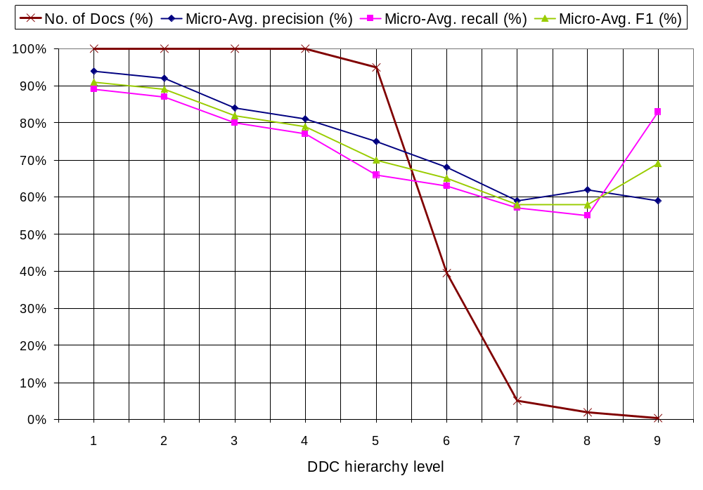
Evaluation Results (cont.)
Number of documents classified in each level of DDC hierarchy and corresponding averaged performance Measure.
Level | No. of Docs | % of Docs | Mico-avg. Pr | Mico-avg. F1 | Mico-avg. Re
1 | 1000 | 100% | 0.94 | 0.91 | 0.89
2 | 1000 | 100% | 0.92 | 0.89 | 0.87
3 | 1000 | 100% | 0.84 | 0.82 | 0.80
4 | 1000 | 100% | 0.81 | 0.79 | 0.77
5 | 950 | 95% | 0.75 | 0.70 | 0.66
6 | 394 | 39.4% | 0.68 | 0.65 | 0.63
7 | 50 | 5% | 0.59 | 0.58 | 0.57
8 | 20 | 2% | 0.62 | 0.58 | 0.55
9 | 4 | 0.4% | 0.59 | 0.69 | 0.83
http://www.skynet.ie/~arash/BB-ATC1/HTML/
Article under review in the journal Information Processing & Management - Elsevier

Slide 25
BB-ATC Approach Applied to the Problem of Keyphrase Extraction form Scientific Literature
keyphrases (multi-word units) describe the content of research documents and they are usually assigned by the authors.
The task of automatically assigning keyphrases to a document is called keyphrase indexing
Considered a form of ATC ((ML-based multi-label) and approached as such
Free indexing vs. indexing with a controlled vocabulary (e.g., LCSH , MeSH)
Extraction indexing vs. assignment indexing

Slide 26
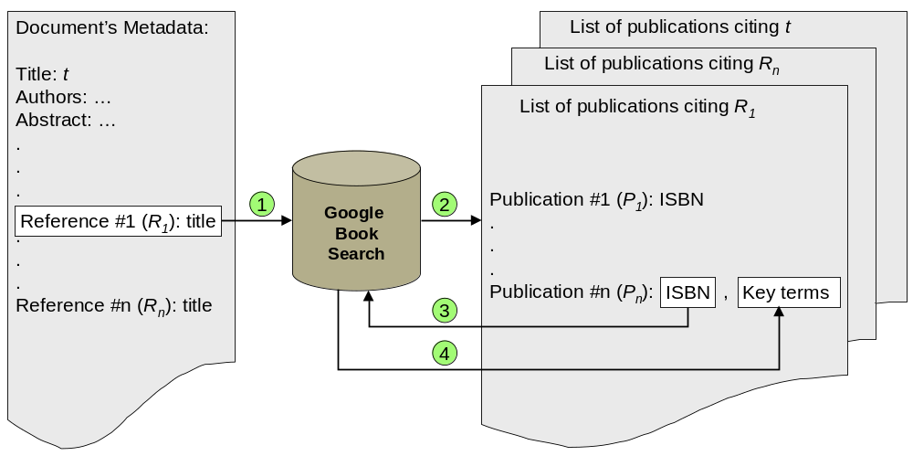
Citation Based Keyphrase Extraction (CKE)
Reference extraction using ParsCit [Councill, I. G, et al. 2008] (CRF,F1=0.93)
Mining the Google Book Search (GBS) database (>10 million archived items) for candidate terms (i.e., Google word clouds)
Term weighting & selection

Slide 27
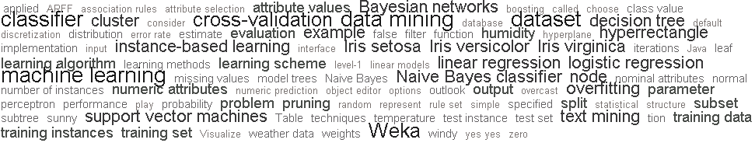
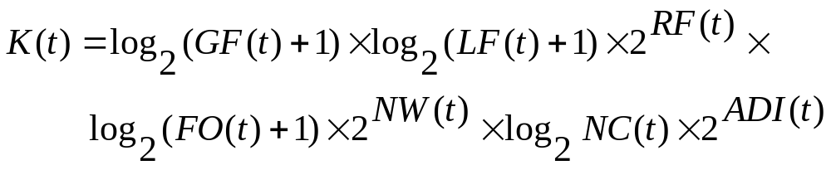
Term Weighting and Selection
Google Word Cloud (GWC): Google uses TFIDF + some heuristic rules to emphasize on proper nouns (names, locations, etc.)
GWC for a book titled: “Data mining: practical machine learning tools and techniques”:
Normalization including: stopword removal, punctuation removal, abbreviation expansion, case-folding, and stemming (Porter2 [Porter 2002])
Keyphraseness score of each candidate term measured using:

Slide 28
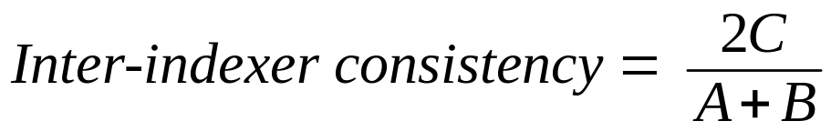
Evaluation & Experimental Results
wiki-20 Test dataset [Medelyan et al., 2009]
20 computer science research papers each manually indexed by 15 different human teams (teams of 2).
Rolling’s inter-indexer consistency formula adopted which is equivalent to F1 measure:

Slide 29
Evaluation & Experimental Results (cont.)
Performance of the CKE algorithm compared to human indexers and competitive methods.
Method |  | No. of keyphrases assigned to each document | Inter-consistency (%)
 |  |  | Min. | Avg. | Max.
Manual | Human indexing (gold standard) | Varied | 21.4 | 30.5 | 37.1
Supervised | KEA (Naïve Bayes) | Static - 5 | 15.5 | 22.6 | 27.3
 | Maui (Naïve Bayes & all features) | Static - 5 | 22.6 | 29.1 | 33.8
 | Maui (Bagged Decision Trees & all features) | Static - 5 | 25.4 | 30.1 | 38.0
 | Maui (Bagged Decision Trees & best features) | Static - 5 | 23.6 | 31.6 | 37.9
Unsupervised | Grineva et al. | Static - 5 | 18.2 | 27.3 | 33.0
 | CKE (condition A) | Static - 5 | 22.7 | 30.6 | 38.3
 | CKE (condition B) | Static - 6 | 26.0 | 31.1 | 39.3
 | CKE (condition C) | Varied - the same as assigned by human indexers | 22.0 | 30.5 | 38.7
To appear in Journal of Information Science 36, 6 ( December 2010). Published online before print November 5, 2010

Slide 30
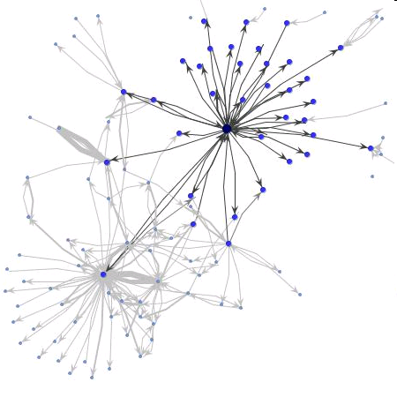
Conclusion & Future Work
The main contribution of this work is the design, development, and evaluation of an alternative approach to ATC by utilizing two new knowledge/data sources:
  i. Conventional library classification schemes.
  Citation networks among documents.
The proposed approach addresses two major issues
  Lack of a standard and comprehensive classification scheme for ATC
  Lack of training data
Future work includes:
  BB-ATC: Using mining the citing documents as well as the cited ones, Multi-label classification
  CKE: utilizing LCSH and user assigned keyphrases of cited and citing documents.
  Applying the underlying theory of BB-ATC to ACM DL and ACM’s Computing Classification System (ACM-CSS).
  BB-ATC & CKE as an automatic metadata generator plug-in for scientific DLs such as Ryan, Ireland’s National Research Portal and NDLTD (Networked Digital Library of Thesis and Dissertations)
Visualization

Slide 31
Development of a National Syllabus Repository for Higher Education in Ireland
Goal: Collecting unstructured electronic syllabus documents from participating higher education institutes into a metadata-rich central repository.
Challenges:
  Information Extraction:
    Syllabus documents have arbitrary sizes, formats, and layouts;
    contain multiple module descriptions (e.g., programme documents);
    contain complex layout features (e.g., hidden/nested tables).
  Automatic Classification:
    Lack of a suitable standard education classification scheme for higher education in Ireland.
    Lack of training data

Slide 32
Classifier
Classifier
Classification scheme:
  an enhanced version of International Standard Classification of Education (ISCED).
  3 levels of classification: broad field (9), narrow field (25), and detailed field (80) each represented by a digit in a hierarchical fashion.
  We have extended this by adding a forth level of classification, subject field, represented by a letter in the classification coding system from Australian Standard Classification of Education (ASCED).
  “482B” Science, Mathematics and Computing/Computing/Information Systems/Databases
Naïve Bayes Classification algorithm [Tom Mitchell 1997]
A Web-based bootstrapping method

Slide 33
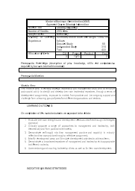
Programme Document Segmenter (PDS)
Definitive Programme Document
Module Syllabus
MSc in Business Management
Introduction
.
.
.
Programme Structure
.
.
.
Module 1: BM3222
Leadership Management
.
.
.

Slide 34
Module Syllabus Segmenter (MSS)
Extracting topical segments of each individual syllabus.
Module Syllabus
Header segment
Aim & Objectives
segment
Learning Outcomes
segment

Slide 35
Named Entity Extractor (NEE)
extracts a set of common named entities/attributes such as module code, module name, module level, number of credits, pre-requisites and co-requisites from the header segment of syllabi .
CODE: CE 4701 Module: Computer Software 1
GRADING TYPE Normal CREDITS 3
TYPE Core PRE_REQUISITES:None
AIMS/OBJECTIVES
To familiarise the student with the
use of a computer and typical applications software. To introduce a high-level language, typically Pascal, as a concrete formalism for the representation of algorithms in a machine-readable form.

Slide 36
Bootstrapping ML-based ATC Systems Utilizing Public Library Resources
Developing a dynamic ML-based ATC system that can be adopted for wide range a ATC tasks with minimum effort required from users.
Users will select a set of categories from a comprehensive standard classification scheme, and a bootstrapping method is used to automatically build a training dataset accordingly.
Three main components:
Universal Classification Scheme
Training Corpus Builder (bootstrapper)
ML-based Classification Algorithm

Slide 37
ATC System Components
Universal Classification Scheme
  Acts as a pool of categories/classes that can be selectively adopted by the users to create their own classification scheme.
  Dewey Decimal Classification (DDC) with thousands of classes has been used in conventional libraries for over a century to categorize library materials.
  DDC is used in about 80% of libraries around the world and has a fully hierarchical structure (vs. LCC)
Training Corpus Builder
  Textual item classified according to DDC are not available in an electronic format and/or are copyrighted.
  Alternatively, we use the small parts of books such as topics covered, the back cover, and editorial reviews publicly available on books sellers’ websites such as Amazon.
  Short text (~500 words) containing semantically-rich terms used to summarize the book.
Classification algorithms
  We implemented an optimized version of NB called Transformed Weight-normalized Complement Naive Bayes (TWCNB) [Rennie et al., 2003].
  A linear SVM classifier called LIBLINEAR [Lin, C.-J et al., 2008] which is an optimised implementation of SVM suitable for large linear classification tasks with thousands of features, such as ATC.

Slide 38
BB-ATC Performance Compared to Similar Reported Experiments
Author | Method | Data Set | Classification Scheme | F1
Pong et al. (2007) | K-NN | 505 training & 254 testing documents (web pages) | 67 classes from LCC | 0.80
Pong et al. (2007) | NB | 505 training & 254 testing documents(web pages) | 67 classes from LCC | 0.54
Chung et al. (2003) | K-NN | 1889 training & 623 test documents Economic related web pages | 575 subclasses of the DDC main class of economics | 0.92
 | BB-ATC | 100 computer science related Syllabi | Full DDC scheme | 0.90
Results published in:
  The proceedings of the 13th European Conference on Research and Advanced Technology for Digital Libraries, (ECDL 2009). (Granted the best student paper award)

Slide 39
Evaluation & Experimental Results
wiki-20 Test dataset [Medelyan et al., 2009]
20 computer science research papers each manually indexed by 15 different human teams (teams of 2).
Rolling’s inter-indexer consistency formula adopted which is equivalent to F1 measure:
The number of extracted references per document range between 10 to 79 with an average value of 25.9 references per document
The number of retrieved GWCs per document ranges between 62 to 766 with an average value of 271 GWCs per document.
In total, the data mining unit has retrieved the metadata records of 5,576 publications from GBS, which either cite one of the documents in the wiki-20 collection or one of their references, and almost all of these records (5421, 97.14%) contain a word cloud.

Slide 40
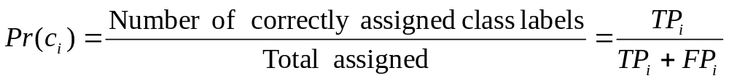
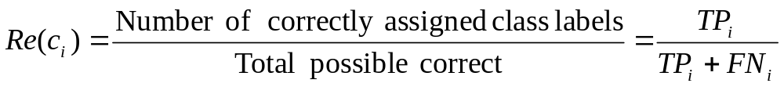
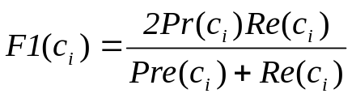

TP
0
TP
0
4
Assigned class 006.3
Correct class 006.4
TP
6
FP
3
4
FN
F-score
The weighted harmonic mean of precision and recall, the traditional F-measure or balanced F-score is:
This is also known as the F₁ measure, because recall and precision are evenly weighted.The general formula for non-negative real β is:

Slide 41
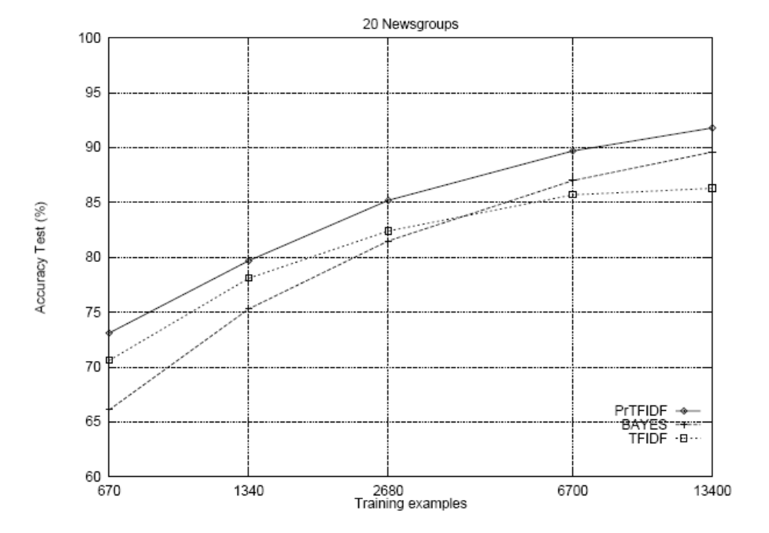
[Joachims, 1997]

Slide 42
Outline
Introduction to Automatic Text Classification (ATC)
Motivation, Aim, and Objectives
Bootstrapping ML-based ATC systems
Leveraging Conventional Library resources for Organizing Digital Libraries (BB-ATC)
Enhanced BB-ATC for Automatic Classification of Scientific Literature in Digital Libraries
BB-ATC Approach Applied to the Problem of Keyphrase Extraction form Scientific Literature
Conclusion & Future Work

