Slide 1
Directed Research Outlier Detection
02/01/2019
Muthulakshmi Chandrasekaran
USC ID : 4486180242
Masters in Electrical Engineering

Slide 2
Overview of the work done
Outlier Detection Methods
Z – Score
IQR
One Class SVM
Working with data files

Slide 3
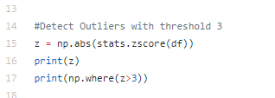
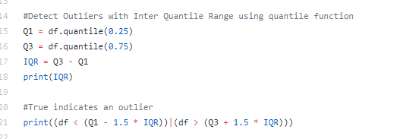
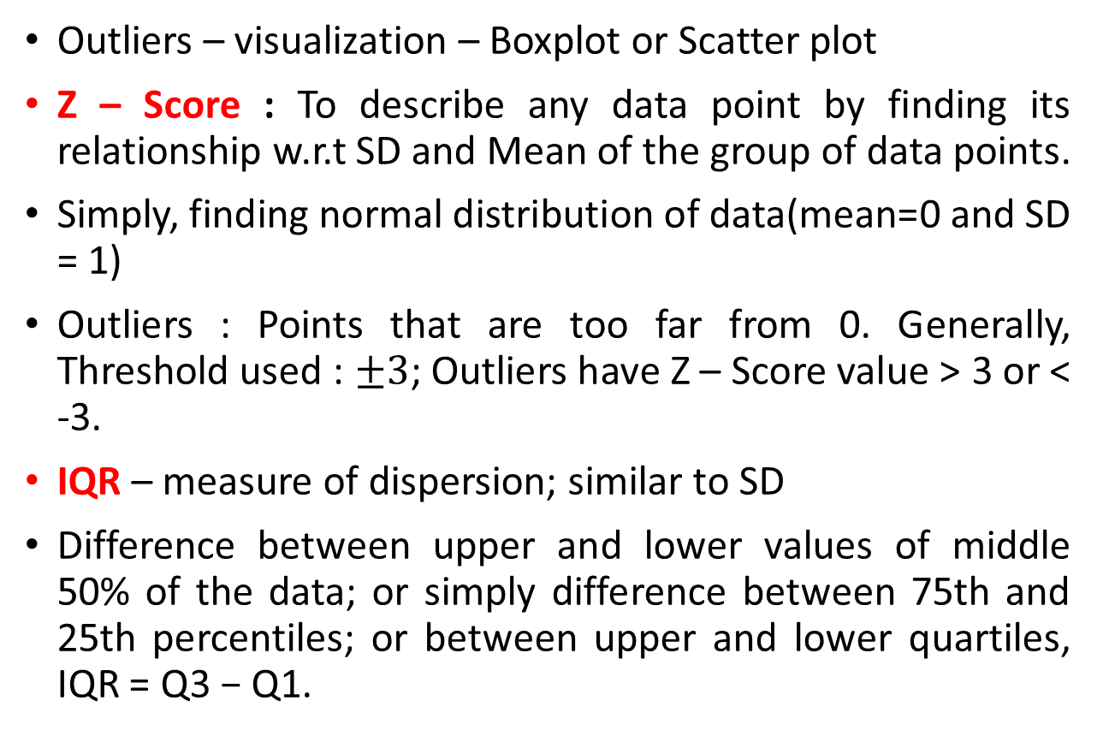
Outlier Detection – Z Score and IQR
Outliers – visualization – Boxplot or Scatter plot
Z – Score : To describe any data point by finding its relationship w.r.t SD and Mean of the group of data points.
Simply, finding normal distribution of data(mean=0 and SD = 1)
Outliers : Points that are too far from 0. Generally, Threshold used : $±3$; Outliers have Z – Score value > 3 or < -3.
IQR – measure of dispersion; similar to SD
Difference between upper and lower values of middle 50% of the data; or simply difference between 75th and 25th percentiles; or between upper and lower quartiles, IQR = Q3 − Q1.
Z – Score
IQR

Slide 4
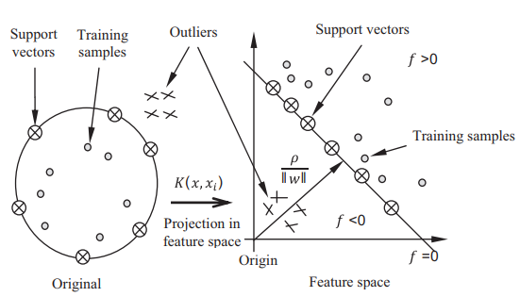
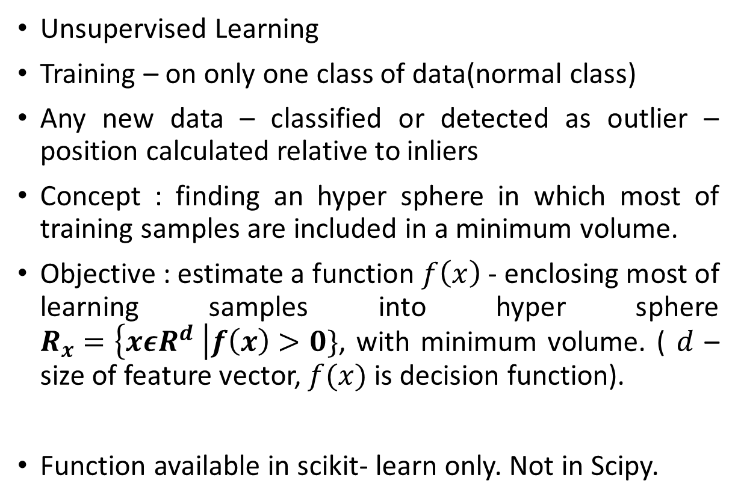
Outlier Detection – 1 class SVM
Unsupervised Learning
Training – on only one class of data(normal class)
Any new data – classified or detected as outlier – position calculated relative to inliers
Concept : finding an hyper sphere in which most of training samples are included in a minimum volume.
Objective : estimate a function $f\left(x\right)$ - enclosing most of learning samples into hyper sphere $R_{x}=\left\{xεR^{d} \right|f\left(x\right)>0\}$, with minimum volume. ( $d$ – size of feature vector, $f(x)$ is decision function).
Function available in scikit- learn only. Not in Scipy.
Sample classification based on 1-class SVM
Ref : Yasmine Guerbai , Youcef Chibani, Bilal Hadjadji, “The effective use of the one-class SVM classifier for handwritten signature verification based on writer-independent parameters”, https://doi.org/10.1016/j.patcog.2014.07.016

Slide 5
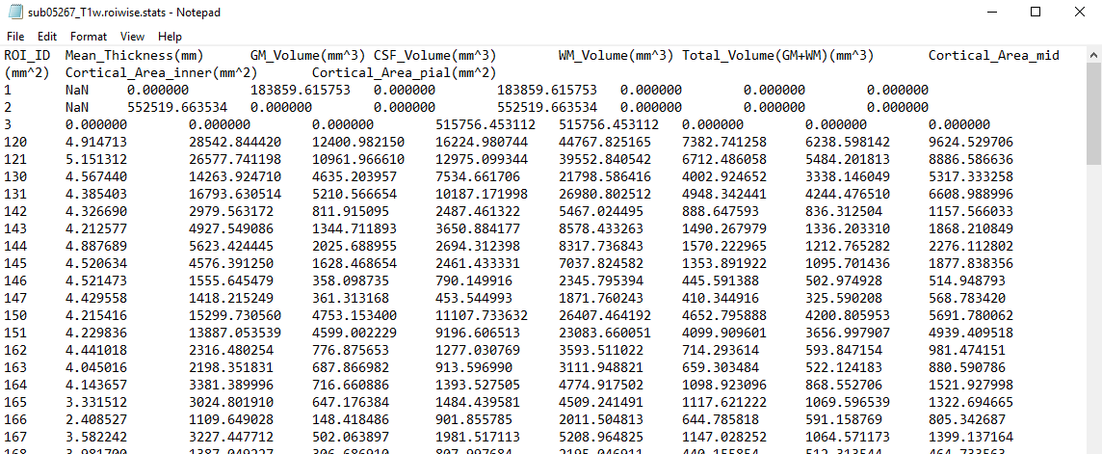
Data files – Sample data

Slide 6
Data files – Exploration
170 files in total containing statistics
9 columns in each file :
ROI_ID
Mean_Thickness(mm)
GM_Volume(mm^3)
CSF_Volume(mm^3)
WM_Volume(mm^3)
99 rows in each file, this means there are 99 ROIs
Most values are float, there are many values that are 0.0 and NaN as well.
Each row is separated by a new line, and each column by a tabspace.
Observation :
All these 170 files have same ROIs i.e all files have 99 rows, and 9 columns, and the data in each file is for same ROIs for each subject.
Total_Volume(GM+WM)(mm^3)
Cortical_Area_mid(mm^2)
Cortical_Area_inner(mm^2)
Cortical_Area_pial(mm^2)

Slide 7
What am I doing?
170 files
99 dataframes
99 rows
170 rows
9 columns
9 columns

Slide 8
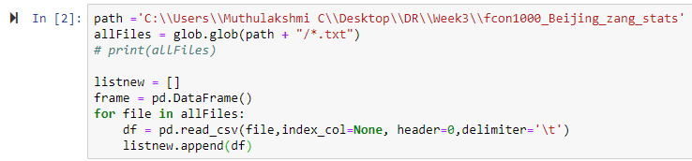
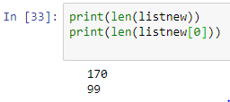
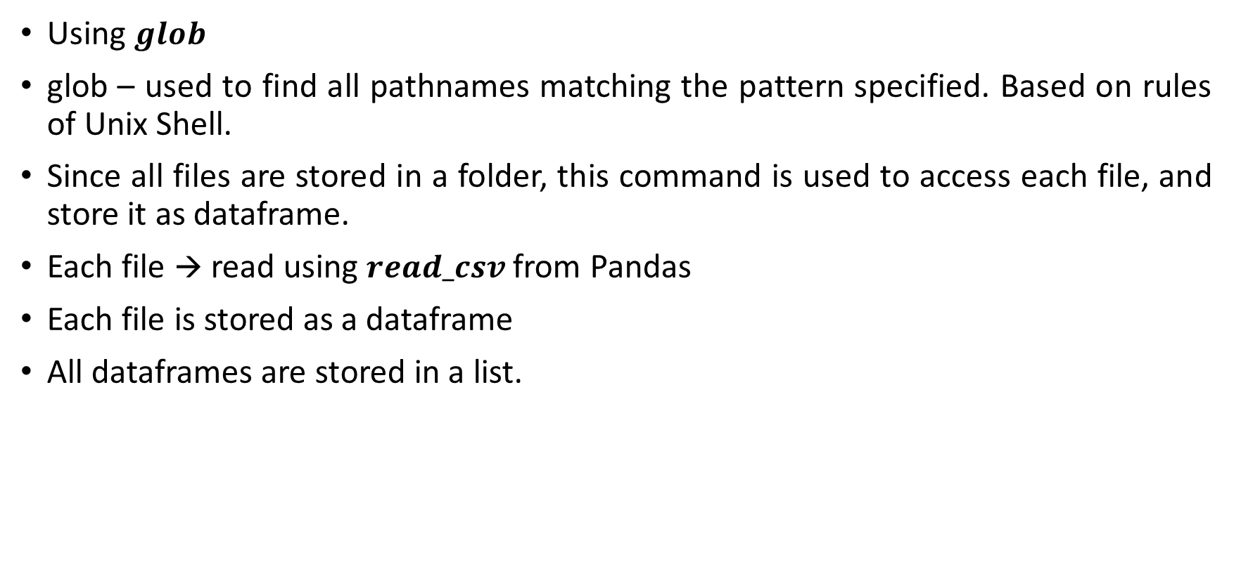
Reading in Python
Using $glob$
glob – used to find all pathnames matching the pattern specified. Based on rules of Unix Shell.
Since all files are stored in a folder, this command is used to access each file, and store it as dataframe.
Each file → read using $read_csv$from Pandas
Each file is stored as a dataframe
All dataframes are stored in a list.

Slide 9
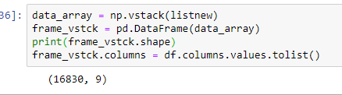
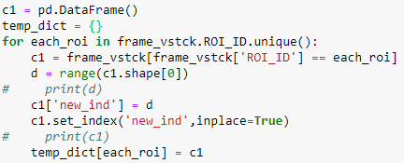

Converting Data into 3D dataframe using pd.panels
Data is first arranged as a 2D dataframe : containing 99*170 = 16830 rows and 9 columns.
Need : dataframes based on ROI.
Unique ROI_IDs are found.
All rows matching one ROI_ID are grouped together as a dataframe, and put in a dictionary, the key being ROI_ID.
This dictionary is converted to a panel.

Slide 10
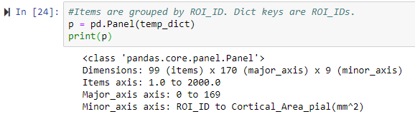

3D dataframe!
Panel Size : 99 * 170 * 9
Check! Number of Unique ROI_IDs : 99
Now, 3D dataframe, wherein each dataframe corresponds to one ROI_ID.

Slide 11
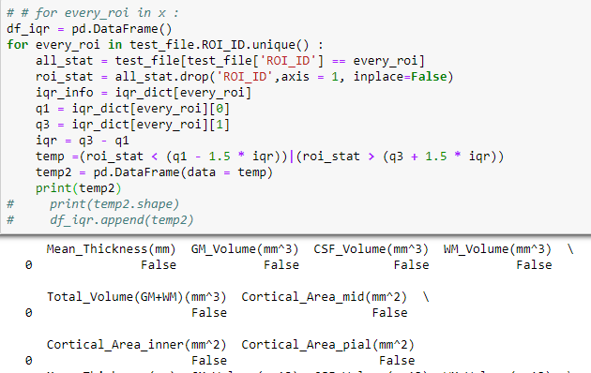
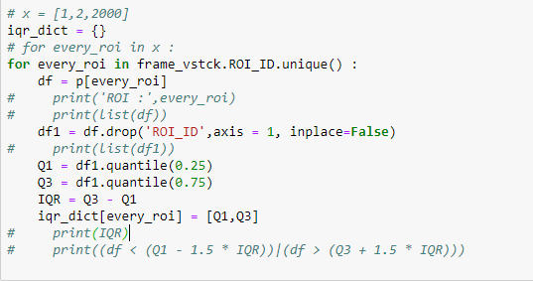
Trying Outlier Detection using IQR
For each ROI, find the IQR.
Store it in a dictionary.
For the test file, check with the saved IQR.

Slide 12
Working on…
Trying to put it in data frame
One class SVM – target
T test on pandas
Thank You!

