Slide 1
Directed Research Outlier Detection
02/08/2019
Summarizing the work of Week4
Muthulakshmi Chandrasekaran
USC ID : 4486180242
Masters in Electrical Engineering

Slide 2
Overview of the work done
Outlier Detection Methods
IQR
Working with data files

Slide 3
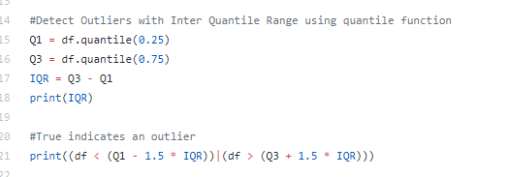
Outlier Detection – IQR
Outliers – visualization – Boxplot or Scatter plot
IQR – measure of dispersion; similar to SD
Difference between upper and lower values of middle 50% of the data; or simply difference between 75th and 25th percentiles; or between upper and lower quartiles, IQR = Q3 − Q1.
IQR

Slide 4
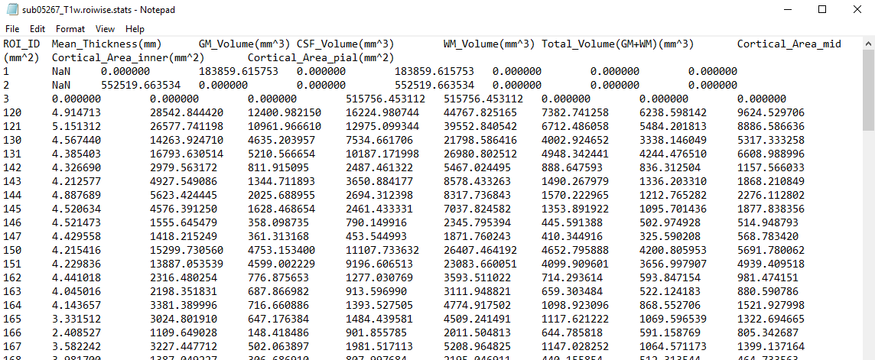
Input Data files – Sample

Slide 5
What am I doing?
INPUT FILES
OUTPUT FILES
170 files
99 dataframes
170 files
99 rows
99 rows
170 rows
Read each file as dataframe
Post – processing and write files
Convert data into 3D dataframe
Outlier Detection – IQR
Create Output Files
Step 1
Step 2
Step 3
Step 4
Step 5
9 columns
9 columns
9 columns

Slide 6
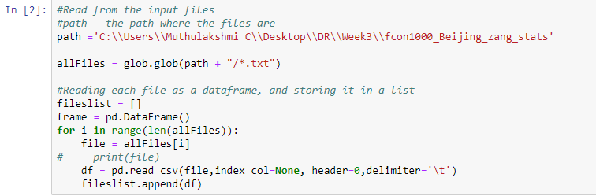

Step 1 : Reading in Python
Using $glob$
glob – used to find all pathnames matching the pattern specified. Based on rules of Unix Shell.

Slide 7
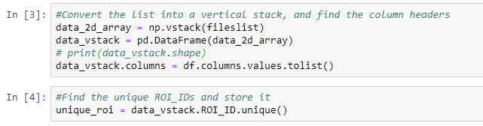
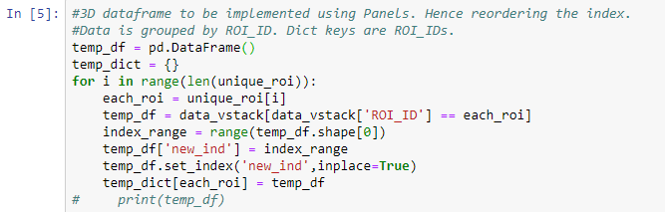

Step 2 : Converting Data into 3D dataframe using pd.panels
Data is first arranged as a 2D dataframe : containing 99*170 = 16830 rows and 9 columns. → Vertical Stack
All rows matching one ROI_ID are grouped together as a dataframe, and put in a dictionary, the key being ROI_ID.
This dictionary is converted to a panel.
Panel Size : 99 * 170 * 9

Slide 8
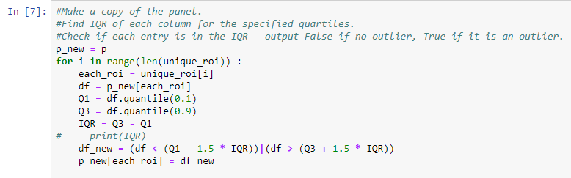
Step 3: Outlier Detection using IQR
Make a copy of the panel – to prevent the original data from being modified
Now each dataframe – corresponds to one ROI of all subjects – hence calculations are simpler
Set Quartile Limits – 10% and 90%
Find IQR of each column in each dataframe using quantile function
Find if each entry is in IQR → Not an Outlier.
Output : True/False

Slide 9
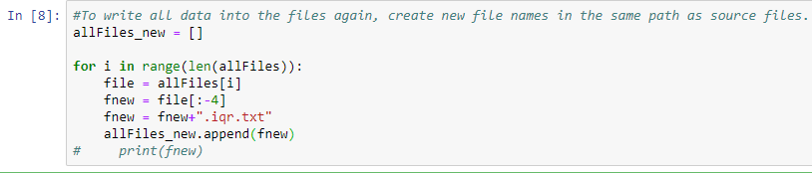
Step 4: Create output files of the same subject name
Create output files corresponding to each subject
Output is a text file separated by tabspace (format same as the input files)
Input file
sub07716_T1w.roiwise.stats.txt
Output file sub07716_T1w.roiwise.stats.iqr.txt

Slide 10
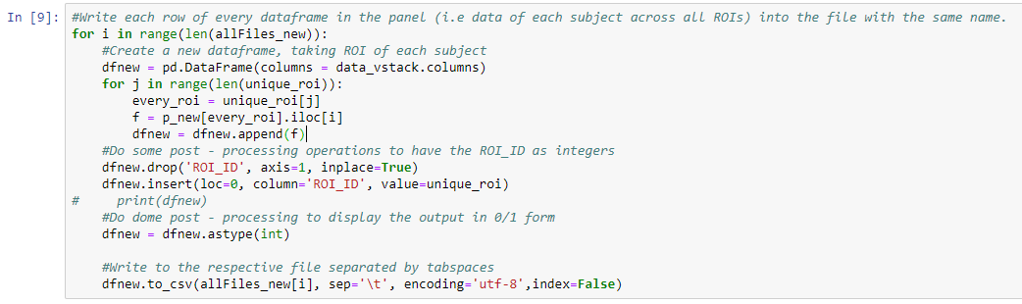
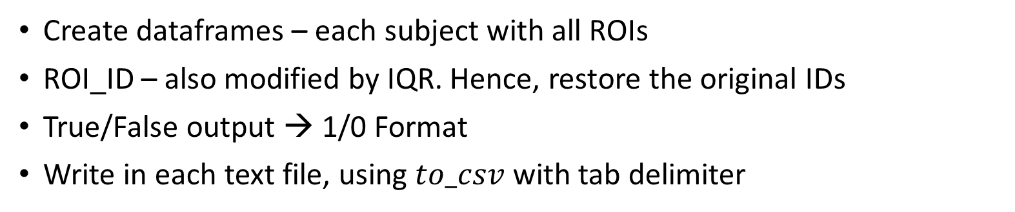
Step 5: Post – processing and write the output files
Create dataframes – each subject with all ROIs
ROI_ID – also modified by IQR. Hence, restore the original IDs
True/False output → 1/0 Format
Write in each text file, using $to_csv$with tab delimiter

Slide 11
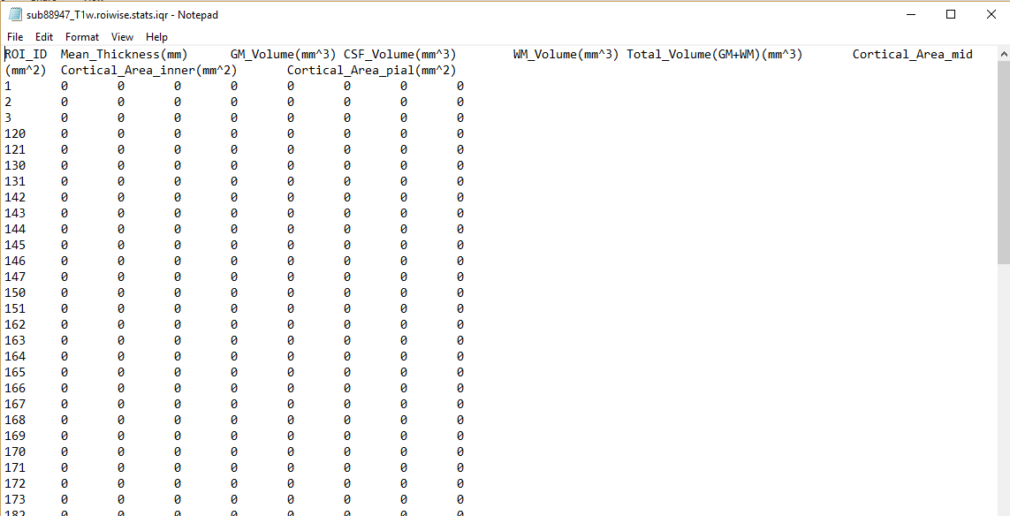
Output Data file – Sample

Slide 12
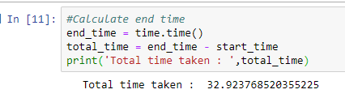
Some insights..
No problem of confusion in subjects – since coded in sequence
Quartile – 10% and 90% - Hence mostly no outliers
Time taken : close to 33 seconds for 170 files.
Files are read and written in the same folder – as text file. Hence need to delete the output files each time before reading them. If not, there are too many output files!

Slide 13
Working on…
Solving the problem of multiple output files
Thank You!

