Slide 1
Directed Research BrainSuite – SVReg Outlier Detection
01/25/2019
Muthulakshmi Chandrasekaran
USC ID : 4486180242
Masters in Electrical Engineering

Slide 2
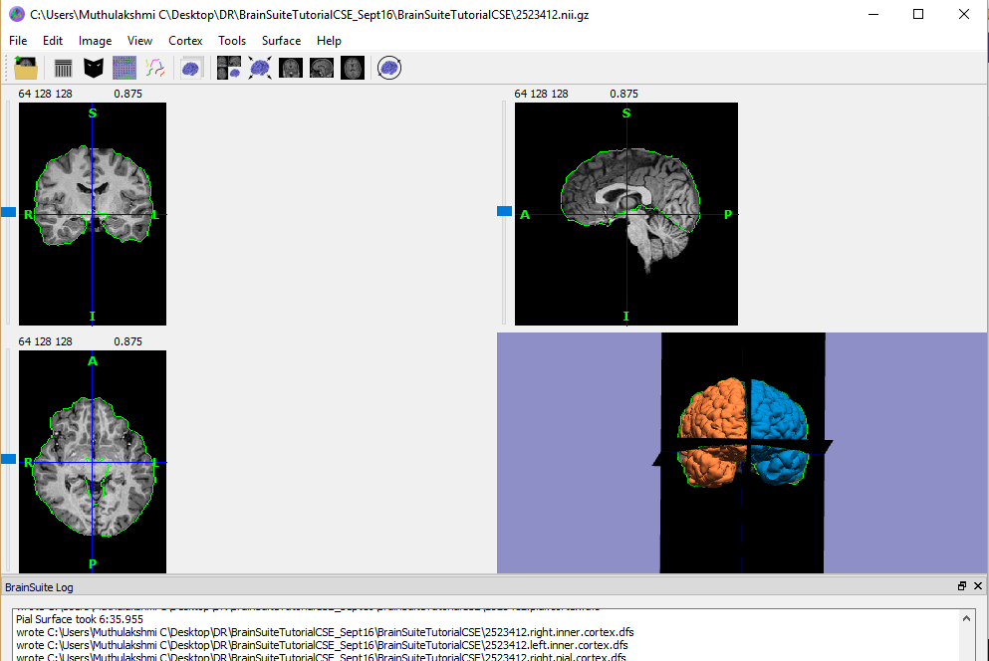
BrainSuite – Step 1 : Cortical Surface Extraction Sequence
Isolate the brain from the image
Input : T1 Weighted MRI Image
Output : 3D Models of inner cortical and pial surfaces
12 – step sequence
File Used : 2523412.nii.gz
(A part of the Beijing Enhanced dataset, released by Beijing Normal University)

Slide 3
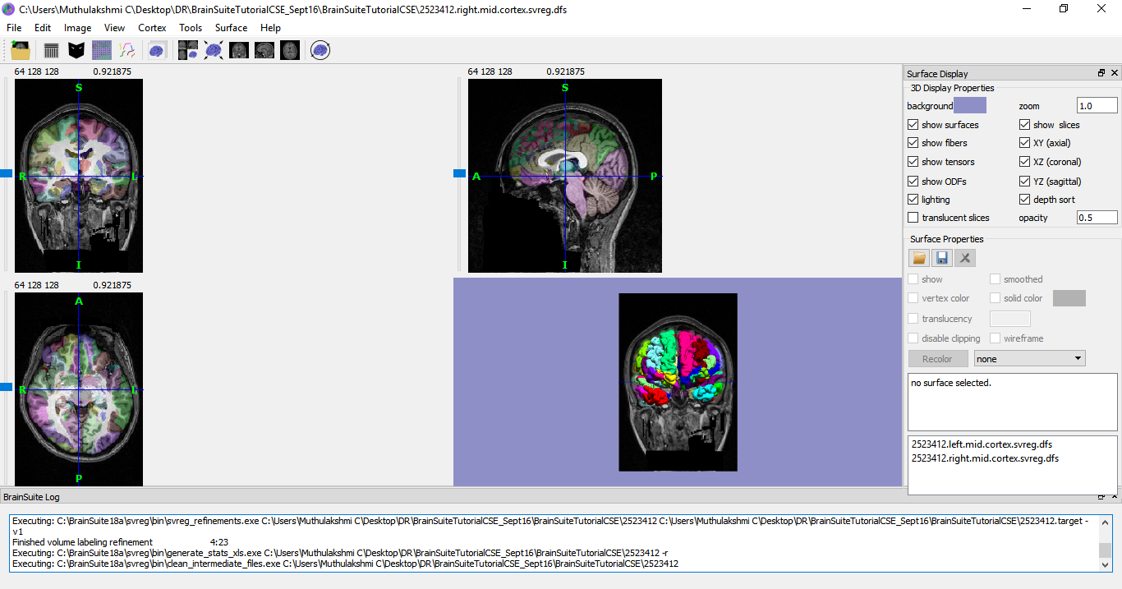
BrainSuite – Step 2 : Surface Volume Registration
SV Reg – co – registers Surface and Volume info from brain images – to map to labeled atlas
Atlas used : BrainSuiteAtlas1
Outputs : Labeled Brain Surfaces & Volumes, Statistics of GM, WM, CSF, Tot. Volume, Avg. Cortical Thickness, Surface Area for all ROIs

Slide 4
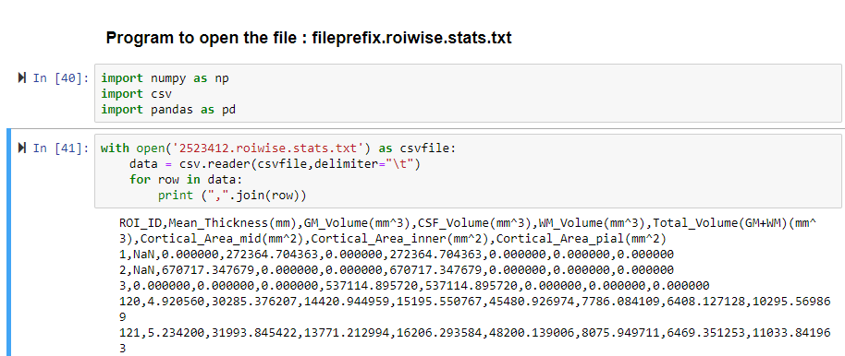
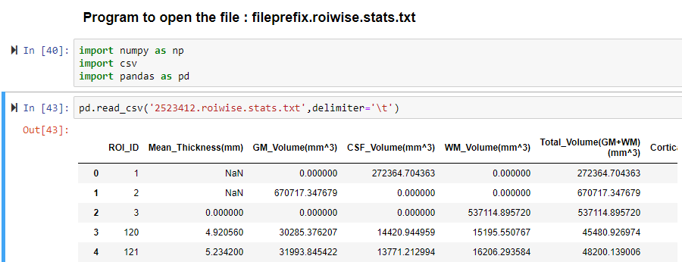
Statistics file – Opening in Python
fileprefix.roiwise.stats.txt - volume (mm³) and average cortical thickness (mm) of labeled structures.
Using csv.reader
Using Pandas

Slide 5
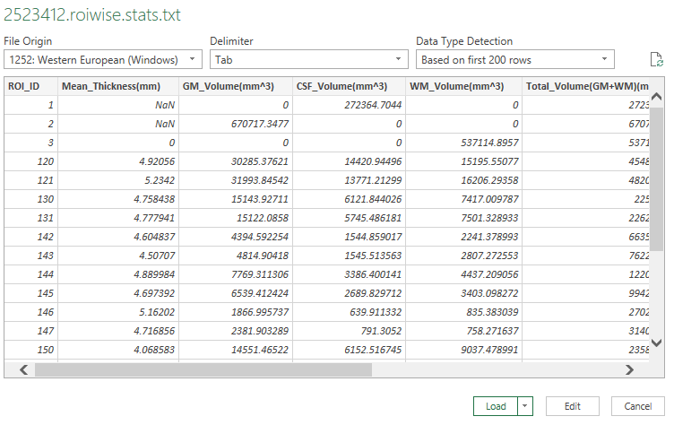
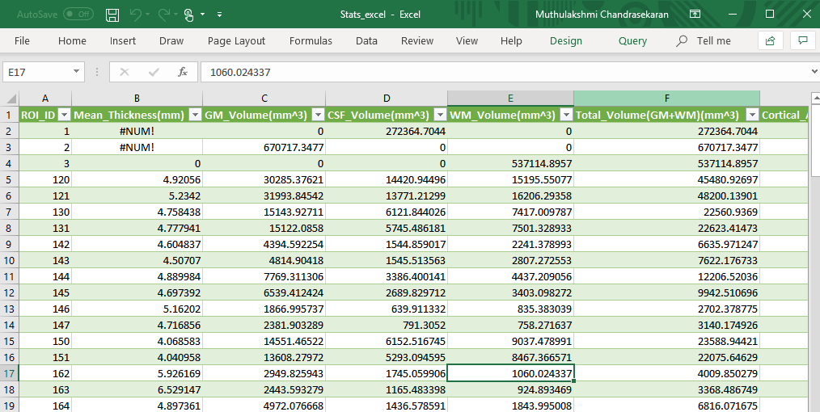
Statistics file – Opening in Excel
Data → Get Data → From File → From Text/CSV
NaN values are not displayed as NaN!

Slide 6
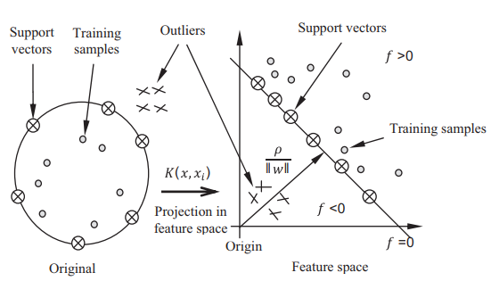
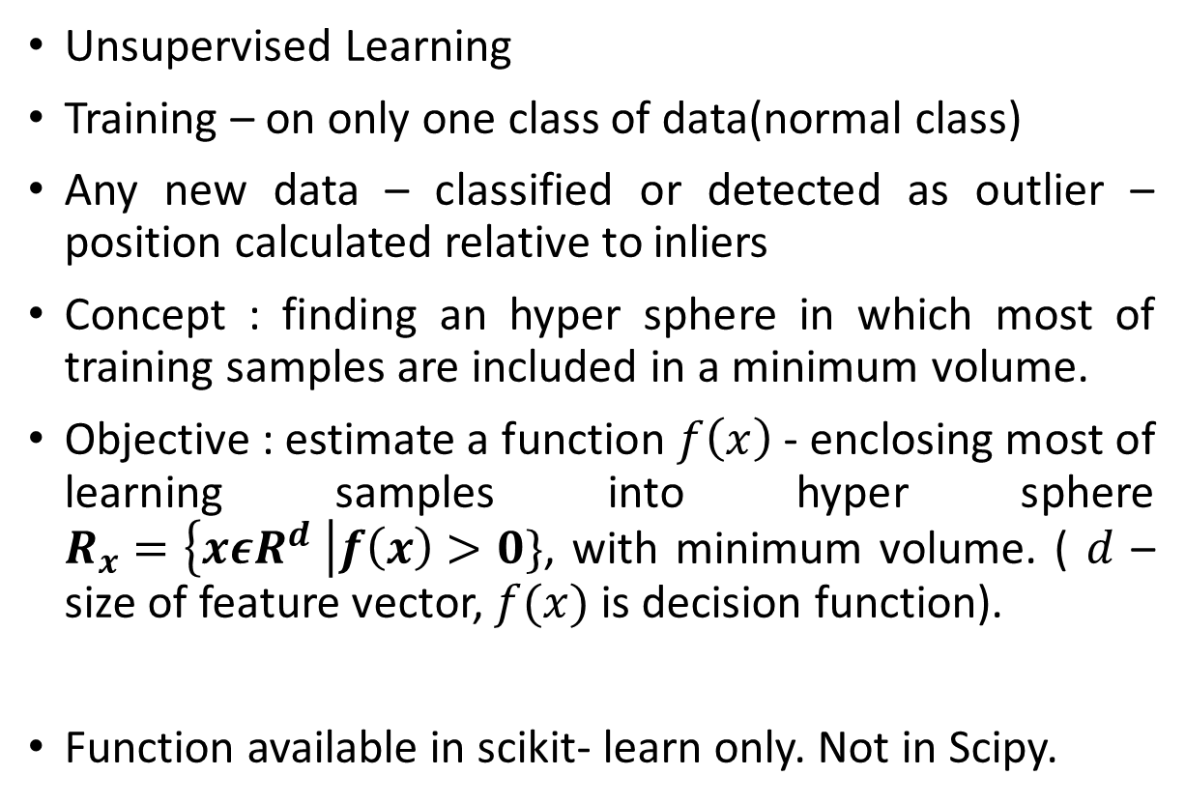
Outlier Detection – 1 class SVM
Unsupervised Learning
Training – on only one class of data(normal class)
Any new data – classified or detected as outlier – position calculated relative to inliers
Concept : finding an hyper sphere in which most of training samples are included in a minimum volume.
Objective : estimate a function $f\left(x\right)$ - enclosing most of learning samples into hyper sphere $R_{x}=\left\{xεR^{d} \right|f\left(x\right)>0\}$, with minimum volume. ( $d$ – size of feature vector, $f(x)$ is decision function).
Function available in scikit- learn only. Not in Scipy.
Sample classification based on 1-class SVM
Ref : Yasmine Guerbai , Youcef Chibani, Bilal Hadjadji, “The effective use of the one-class SVM classifier for handwritten signature verification based on writer-independent parameters”, https://doi.org/10.1016/j.patcog.2014.07.016

Slide 7
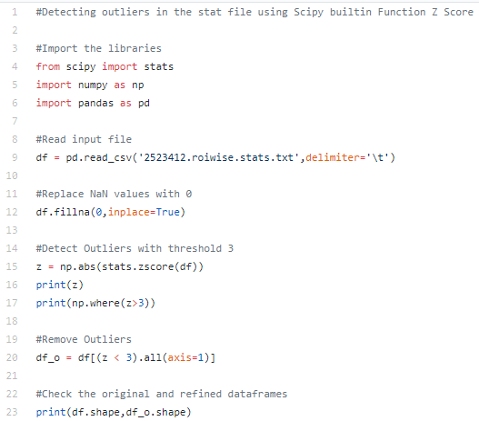
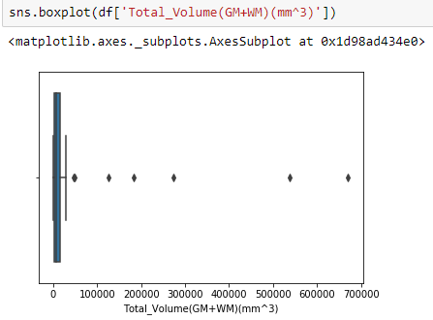
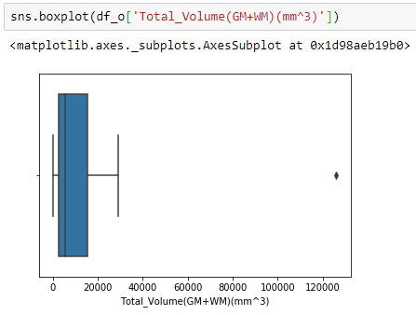
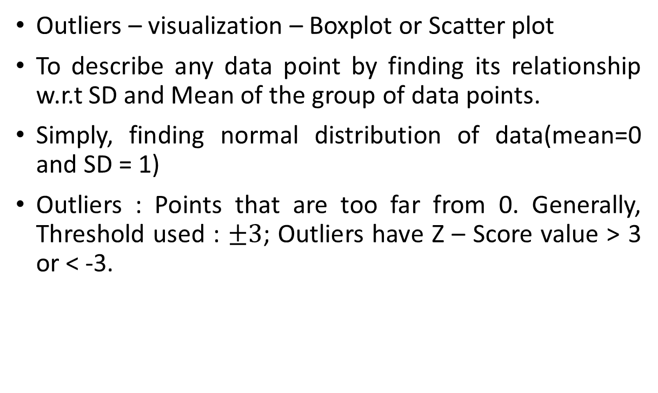
Outlier Detection – Scipy builtin – Z Score
Outliers – visualization – Boxplot or Scatter plot
To describe any data point by finding its relationship w.r.t SD and Mean of the group of data points.
Simply, finding normal distribution of data(mean=0 and SD = 1)
Outliers : Points that are too far from 0. Generally, Threshold used : $±3$; Outliers have Z – Score value > 3 or < -3.
Example : Outlier Removal using Z Score

Slide 8
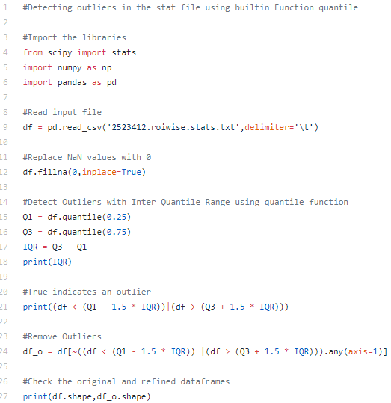
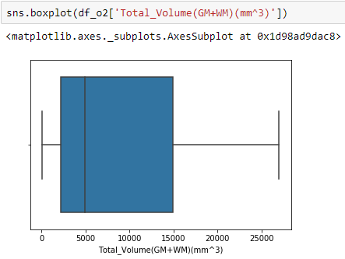
Outlier Detection – Numpy builtin – Quantile
IQR – measure of dispersion; similar to SD
Difference between upper and lower values of middle 50% of the data; or simply difference between 75th and 25th percentiles; or between upper and lower quartiles, IQR = Q3 − Q1.
Example : Outlier Removal using Quantile

Slide 9
Thank You!

