Slide 1
Directed Research Outlier Detection Nilearn - Intro
02/15/2019
Summarizing the work of Week5
Muthulakshmi Chandrasekaran
USC ID : 4486180242
Masters in Electrical Engineering

Slide 2
Overview of the work done
Output file formats :
Outputs in a different folder
Output as a Text file of only outliers
Implementation of One Class SVM
Other Outlier Detection Methods
Nilearn – some intro

Slide 3
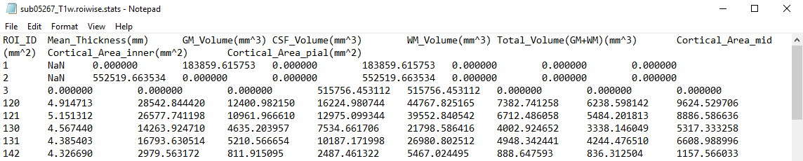
Input files and processing
INPUT FILES
OUTPUT FILES
170 files
99 dataframes
170files
99 rows
170 rows
99 rows
9 columns
9 columns
9 columns
Read each file as dataframe
Post – processing and write files
Convert data into 3D dataframe
Outlier Detection – IQR
Create Output Files
Step 1
Step 2
Step 3
Step 4
Step 5

Slide 4
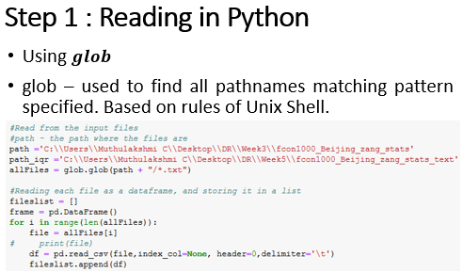
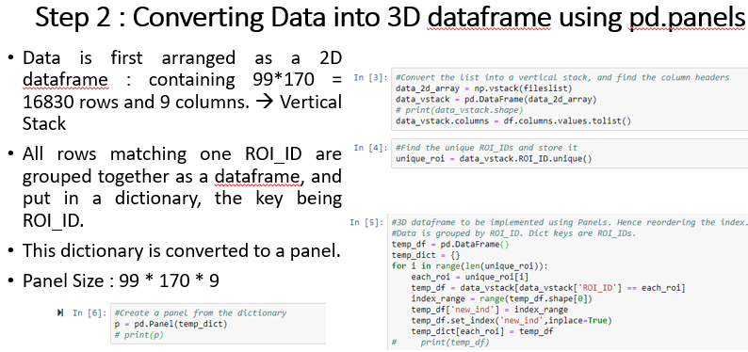
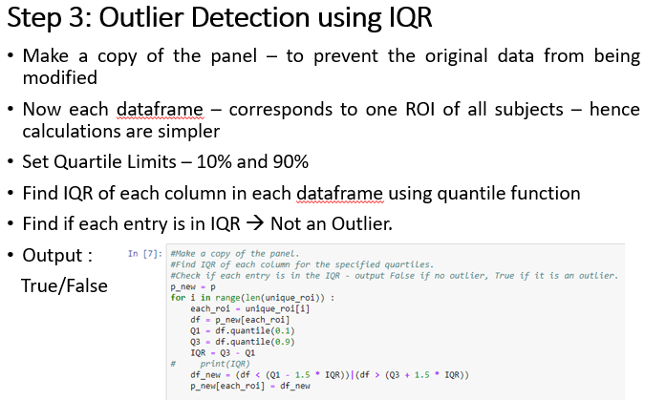

Slide 5
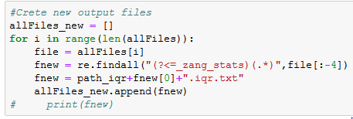
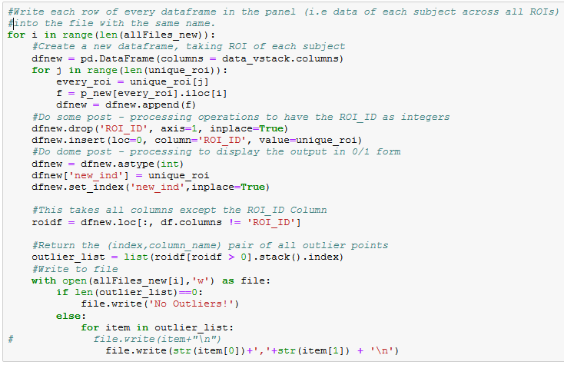
Step 4 & 5 : Post – processing and output files.
Create output files corresponding to each subject
Output is a text file that has only the outlier ROI_ID and Measure.
Create dataframes – each subject with all ROIs
ROI_ID – modified by IQR.Hence, restore original ROI_IDs and set the index as ROI_IDs
True/False output → 1/0 Format
Get (index,column_header) for all outliers
Write results only in each text file

Slide 6
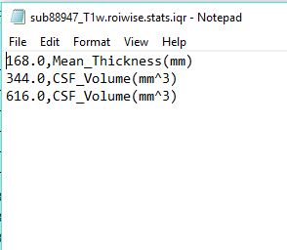
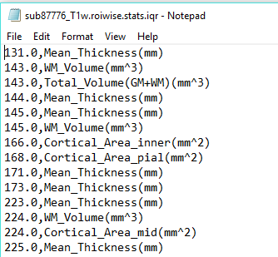
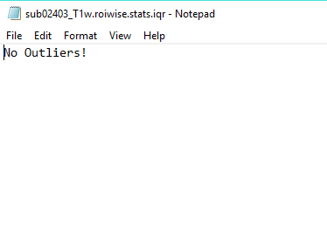
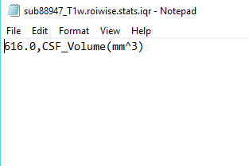
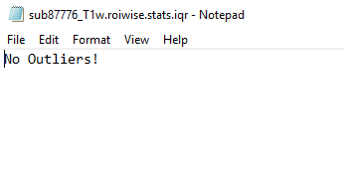
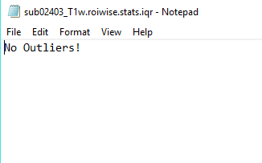
Output Data file – Sample
25% - 75 %
10% - 90 %

Slide 7
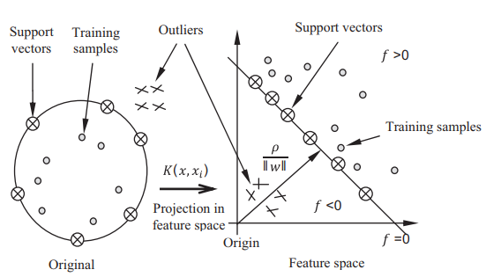
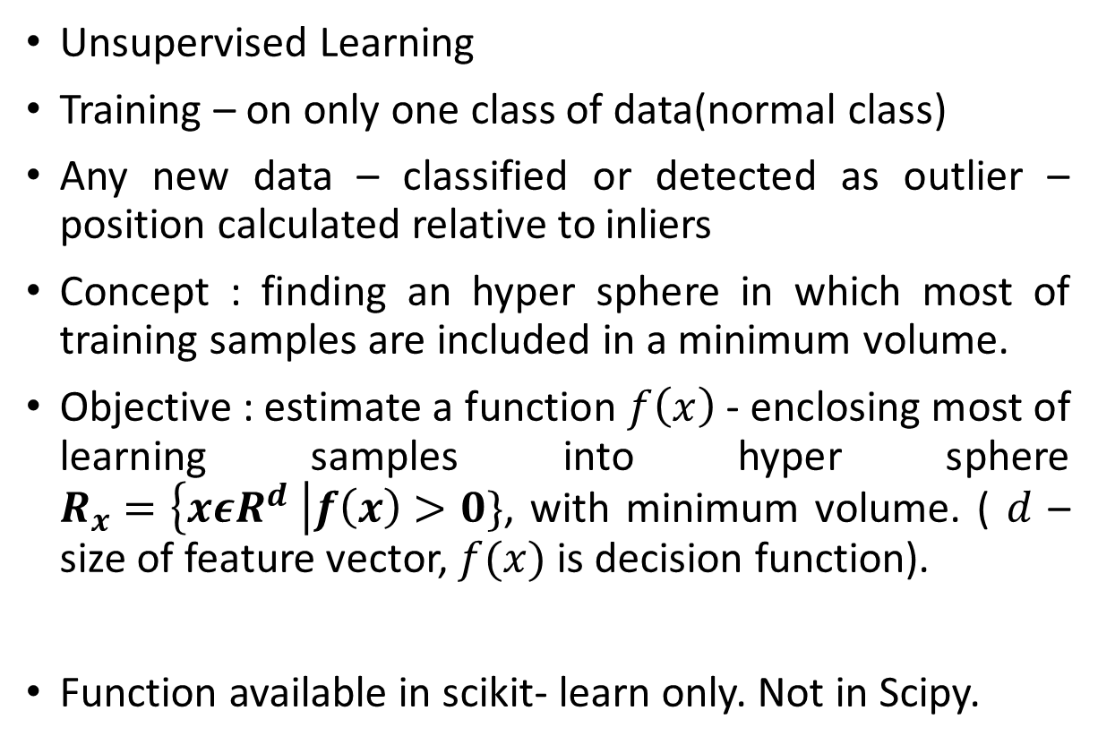
From prev. week : Outlier Detection – 1 class SVM
Unsupervised Learning
Training – on only one class of data(normal class)
Any new data – classified or detected as outlier – position calculated relative to inliers
Concept : finding an hyper sphere in which most of training samples are included in a minimum volume.
Objective : estimate a function $f\left(x\right)$ - enclosing most of learning samples into hyper sphere $R_{x}=\left\{xεR^{d} \right|f\left(x\right)>0\}$, with minimum volume. ( $d$ – size of feature vector, $f(x)$ is decision function).
Function available in scikit- learn only. Not in Scipy.
Sample classification based on 1-class SVM
Ref : Yasmine Guerbai , Youcef Chibani, Bilal Hadjadji, “The effective use of the one-class SVM classifier for handwritten signature verification based on writer-independent parameters”, https://doi.org/10.1016/j.patcog.2014.07.016

Slide 8
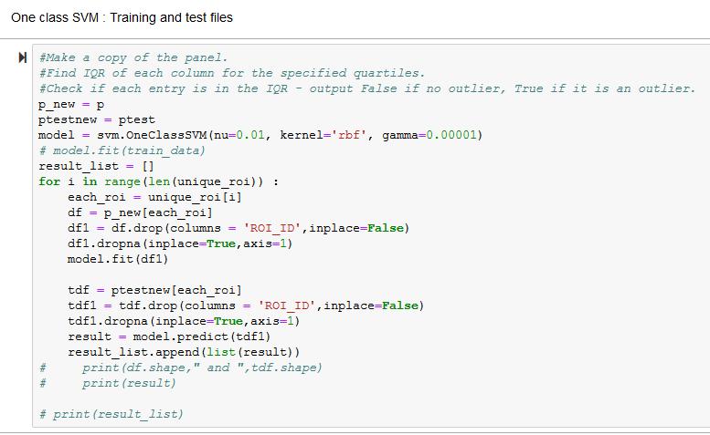
Implementation of one – class SVM
Test : Train split = 0.1 : 0.9
Do the same pre – processing for training and test files
Train the model on only the training files

Slide 9
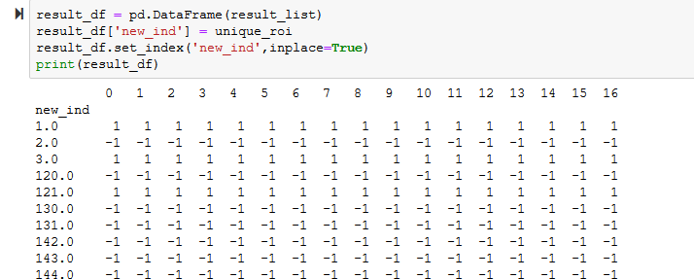
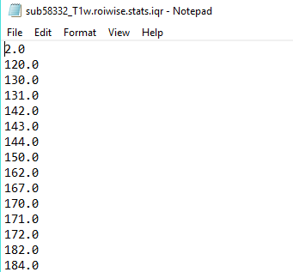
One Class SVM
Result = -1 → Outlier
For each ROI, the outlier for each file is obtained as an array
All measures are taken as features, hence the output is a single digit – telling if an outlier is present in the file or not.
Hence the output is just the ROI_ID.

Slide 10
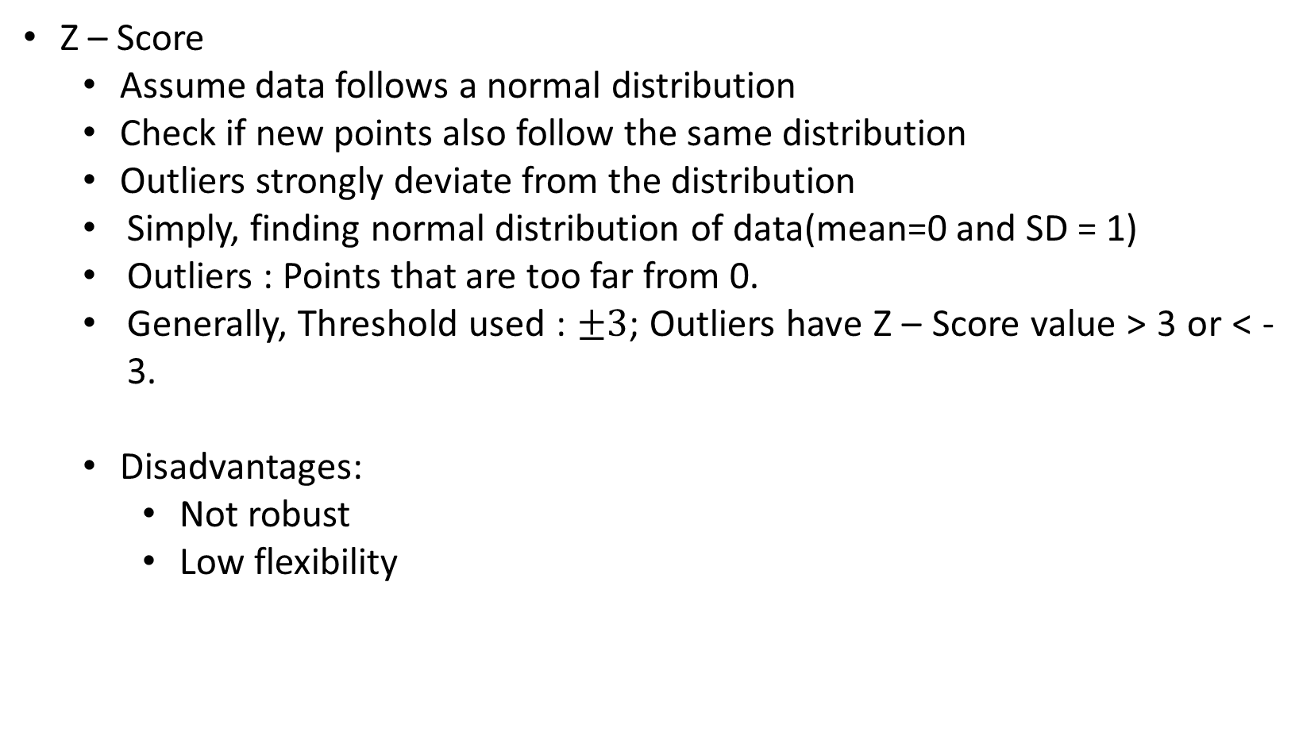
Outlier Detection Methods : Z - Score
Z – Score
Assume data follows a normal distribution
Check if new points also follow the same distribution
Outliers strongly deviate from the distribution
Simply, finding normal distribution of data(mean=0 and SD = 1)
Outliers : Points that are too far from 0.
Generally, Threshold used : $±3$; Outliers have Z – Score value > 3 or < -3.
Disadvantages:
Not robust
Low flexibility
Ref : Hans-Peter Kriegel, Peer Kröger, Arthur Zimek , “Outlier Detection Techniques”, The 2010 SIAM International Conference on Data Mining

Slide 11
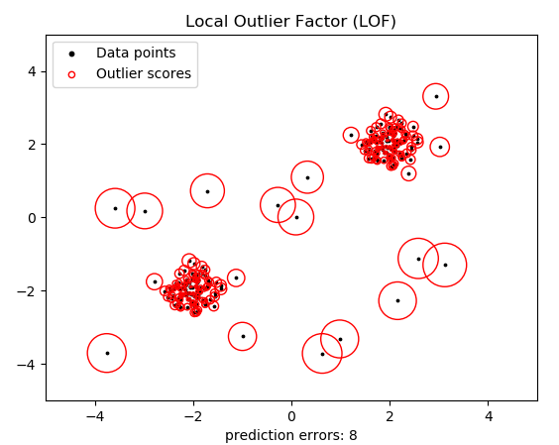

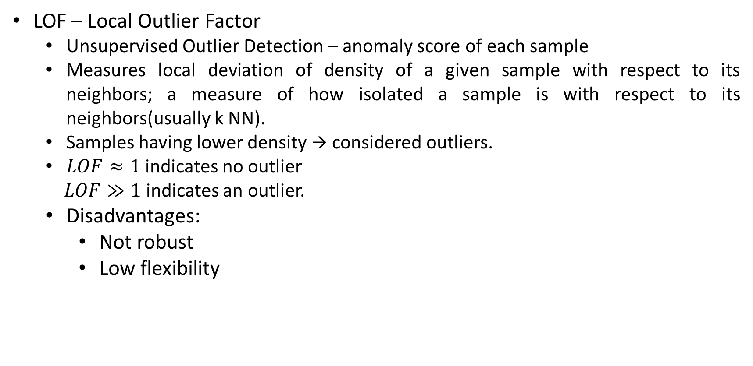
Outlier Detection Methods : LOF
LOF – Local Outlier Factor
Unsupervised Outlier Detection – anomaly score of each sample
Measures local deviation of density of a given sample with respect to its neighbors; a measure of how isolated a sample is with respect to its neighbors(usually k NN).
Samples having lower density → considered outliers.
$LOF≈1$ indicates no outlier
$LOF≫1$ indicates an outlier.
Disadvantages:
Not robust
Low flexibility
Ref : Hans-Peter Kriegel, Peer Kröger, Arthur Zimek , “Outlier Detection Techniques”, The 2010 SIAM International Conference on Data Mining
https://scikit-learn.org/stable/auto_examples/neighbors/plot_lof_outlier_detection.html

Slide 12
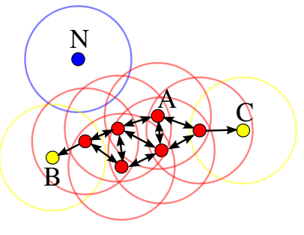
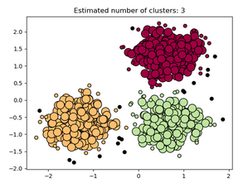

Outlier Detection Methods : Dbscan(parameter MinPts)
Density Based Spatial Clustering of Applications with Noise
Cluster – maximal set of densely connected points
Three types of points, Important parameters : MinPts, spatial metric for clustering, density of clustering
Good for any distribution and
multidimensional data
Disadvantages:
Scaling of data
Choosing parameters
Good for data that contains
clusters of similar density
Order of data input matters
Not memory efficient
Core Point
Outlier
Border Point
Ref : Hans-Peter Kriegel, Peer Kröger, Arthur Zimek , “Outlier Detection Techniques”, The 2010 SIAM International Conference on Data Mining; Scikit – learn documentation
https://towardsdatascience.com/a-brief-overview-of-outlier-detection-techniques-1e0b2c19e561

Slide 13
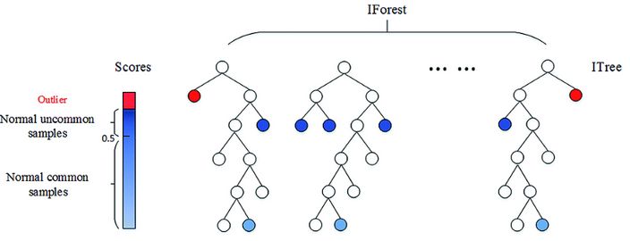
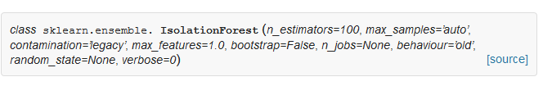
Outlier Detection Methods : Isolation Forests
Basic principle : Outliers are few and far from rest of samples
Based on binary decision trees
Algorithm : randomly picks a feature and a split value.
For prediction : compares the value against that splitting value in a node
Number of splits : path length
Outliers : shorter path lengths than the rest of the observations
Disadvantages :
Visulaization – difficult
Not correctly optimized → computationally expensive
Ref : Hans-Peter Kriegel, Peer Kröger, Arthur Zimek , “Outlier Detection Techniques”, The 2010 SIAM International Conference on Data Mining
https://towardsdatascience.com/a-brief-overview-of-outlier-detection-techniques-1e0b2c19e561

Slide 14
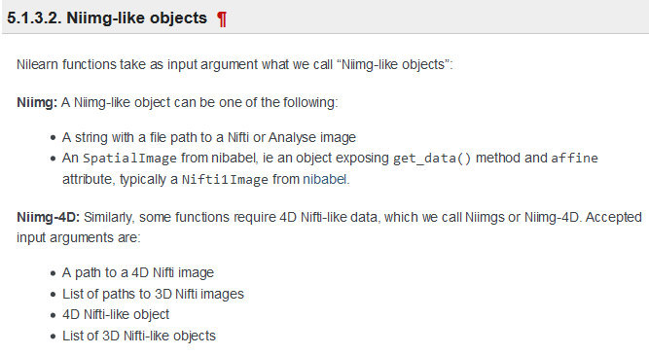
Nilearn - Introduction
Python package for neuroimaging applications
Works with data stored in Nifti structure
Input : either a filename or Niftiimage object
Nifti files
accessed through Nibabel
usually have the extension .nii or .nii.gz
Can be 3D or 4D files
Ref : http://nilearn.github.io/manipulating_images/input_output.html

Slide 15
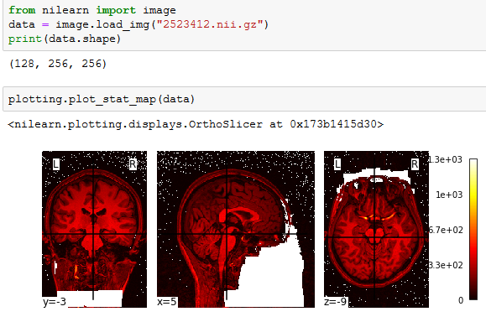
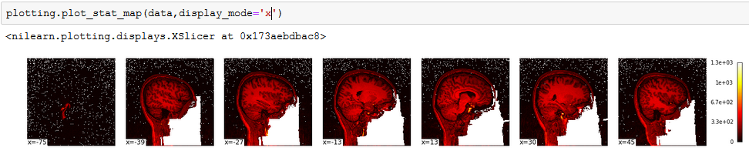
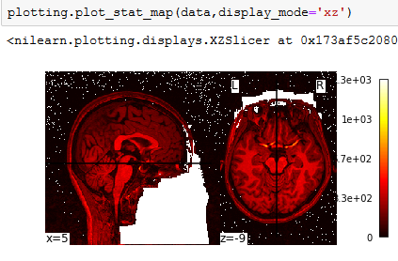
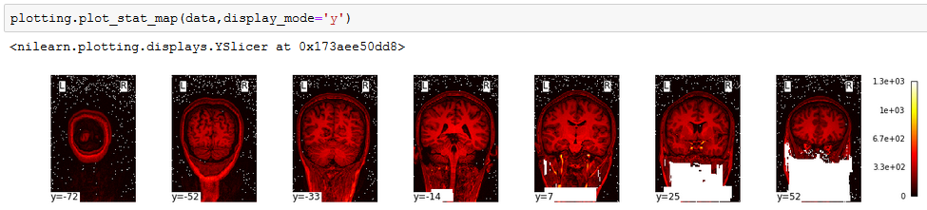

Nilearn – Working with files generated from Brainsuite
Input file :
2523412.nii.gz
3D volume, so use $plot_stat_map$

Slide 16
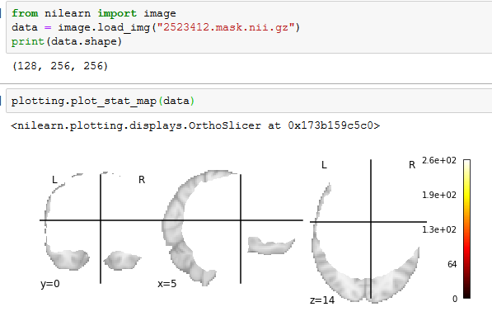
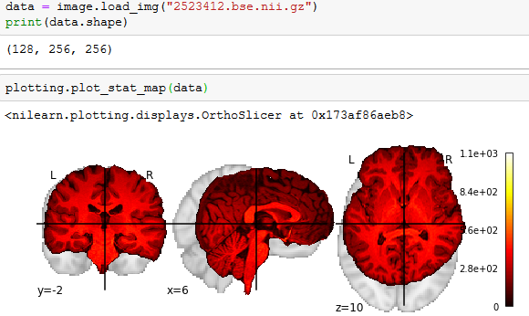


Nilearn – Working with files generated from CSE : Skull stripping
Mask file :
2523412.mask. nii.gz
3D volume, so use $plot_stat_map$
Skull stripped MRI Image: 2523412.bse.nii.gz
3D volume, so use $plot_stat_map$

Slide 17
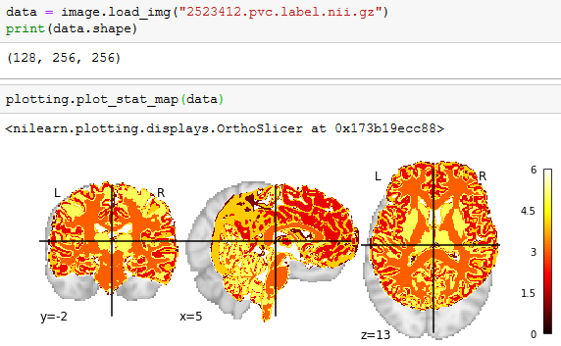
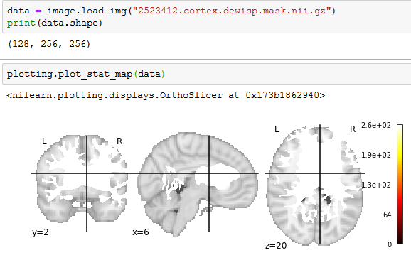


Nilearn – Working with files from CSE
Tissue classification :
2523412.pvc.label. nii.gz
3D volume, so use $plot_stat_map$
After wisp removal: 2523412.cortex.dewisp.mask.nii.gz
3D volume, so use $plot_stat_map$

Slide 18

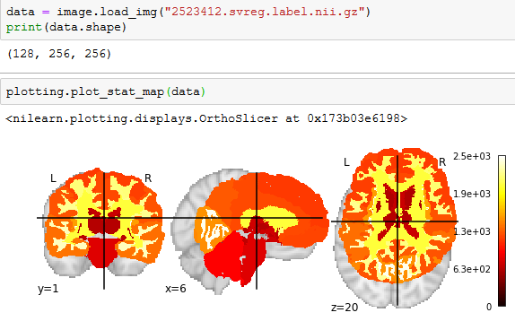
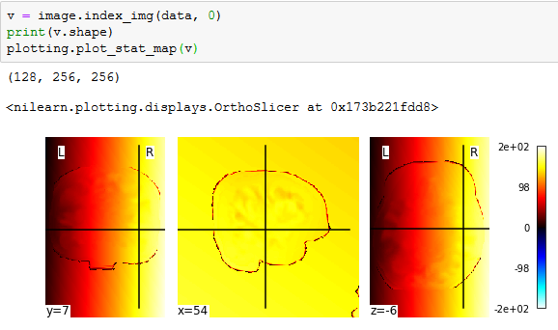

Nilearn – Working with files from SVReg
3D map from subject to atlas volume : 2523412.svreg.map.nii.gz
4D volume
Warped labels of atlas volume:
2523412.svreg.label. nii.gz
3D volume, so use $plot_stat_map$

Slide 19
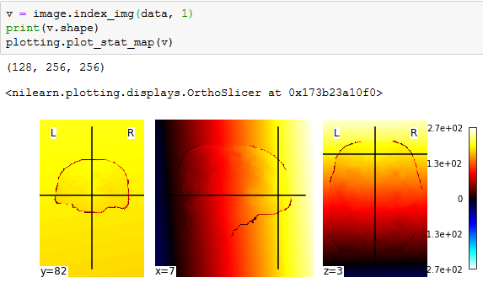
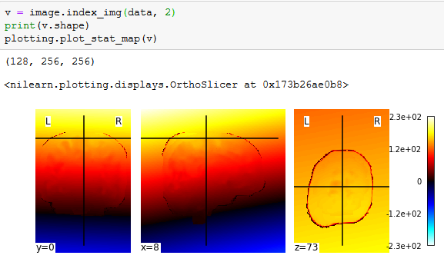
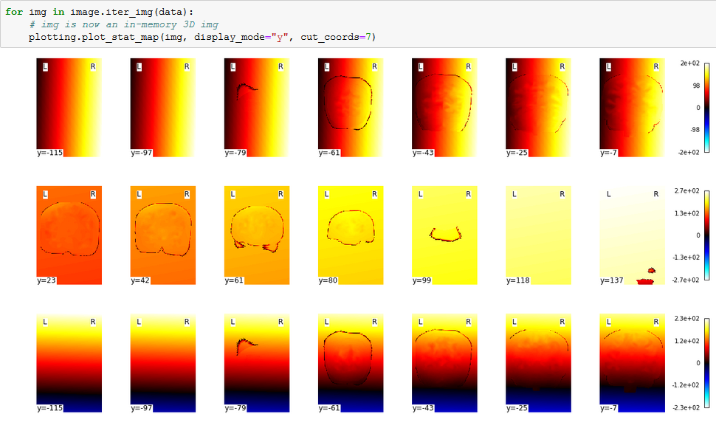

Slide 20
Thank You!

