Slide 1
BrainSync: Synchronizing Resting State fMRI for Clustering and Statistical Analysis
Anand A. Joshi and Richard M. Leahy

Slide 2
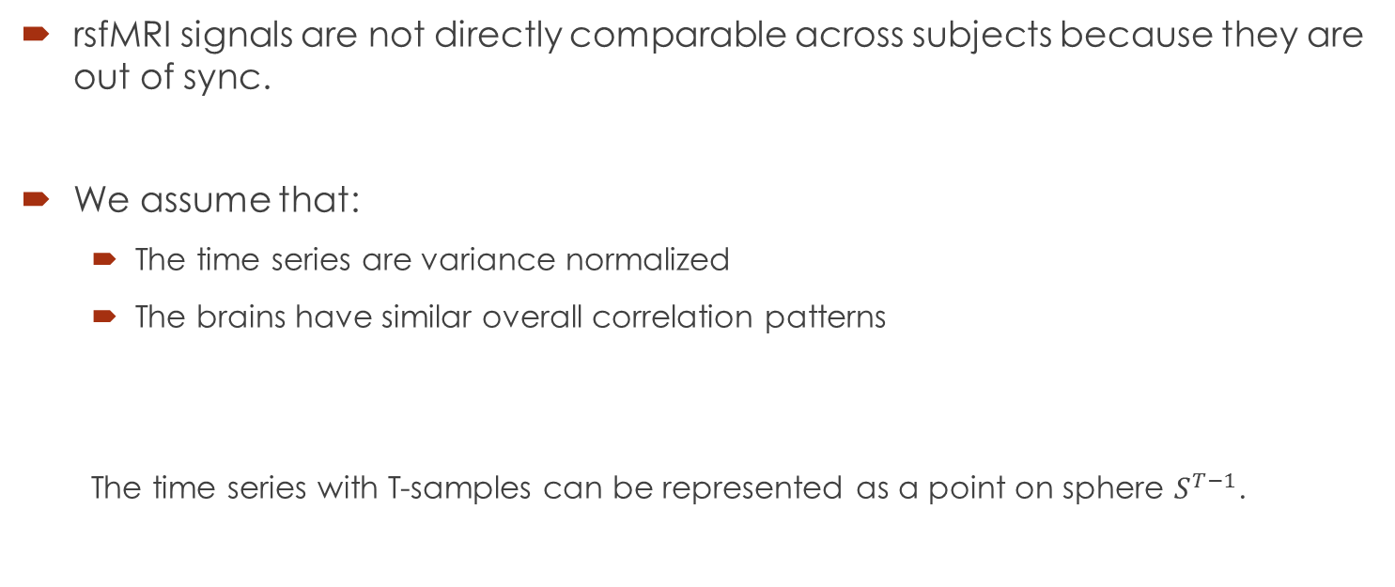
rsfMRI data
rsfMRI signals are not directly comparable across subjects because they are out of sync.
We assume that:
The time series are variance normalized
The brains have similar overall correlation patterns
The time series with T-samples can be represented as a point on sphere $S^{T−1}$.

Slide 3
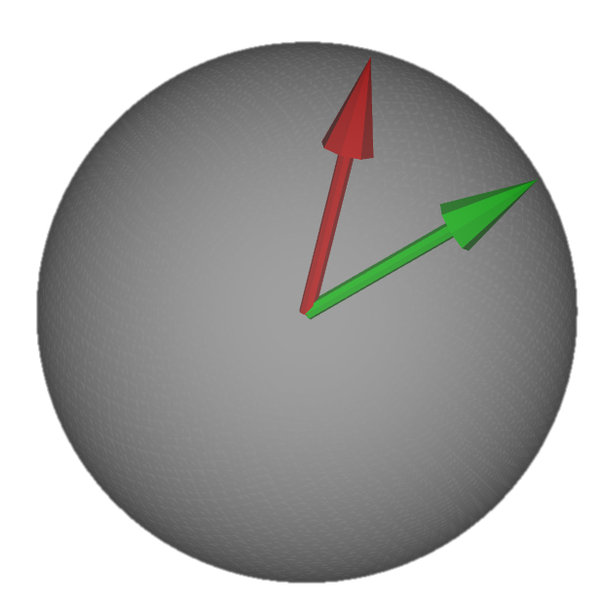


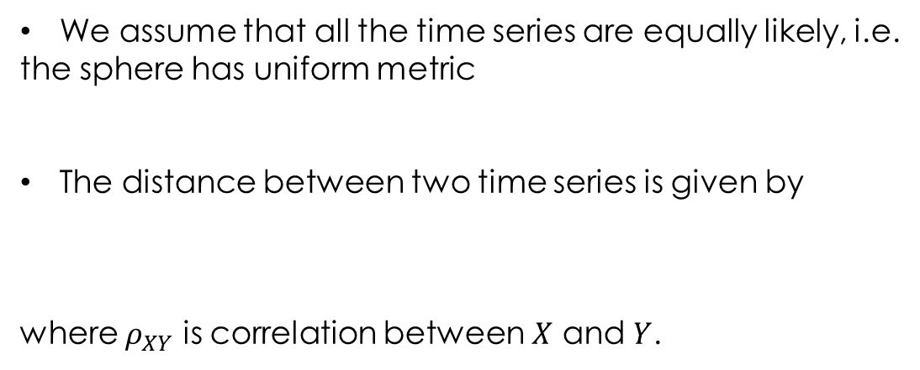
Metric on fMRI Signal
We assume that all the time series are equally likely, i.e.
the sphere has uniform metric
The distance between two time series is given by
where $ρ_{XY}$ is correlation between $X$ and $Y$.
$$S^{T−1}$$
d
$$d=|\cos^{−1}\left(ρ_{XY}\right)|$$
X
Y

Slide 4
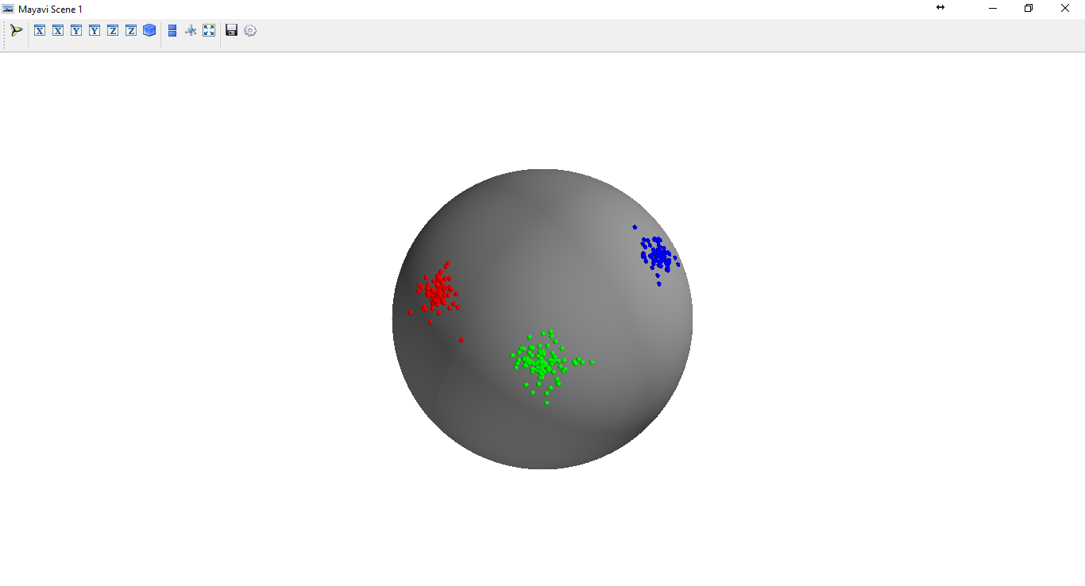
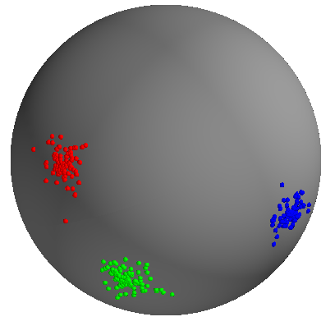
Time series of subjects are on spheres
…
Sub 1
Sub 2
Sub n
The assumption that “The brains have similar overall correlation patterns” means that individual scans are rotated/flipped spheres with respect to each other
We want optimal orthonormal transformation between spheres
Finding Optimal orthogonal transformation has a closed form solution based on SVD

Slide 5

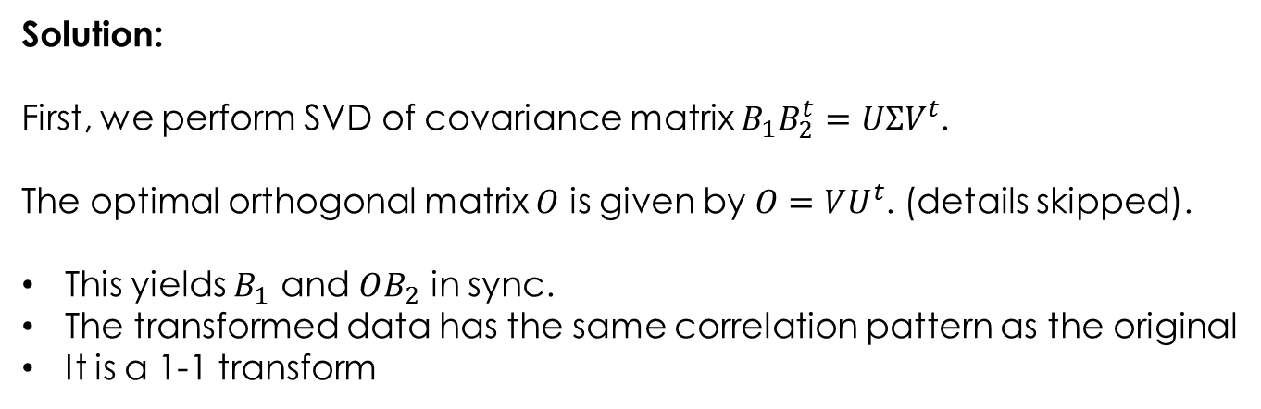
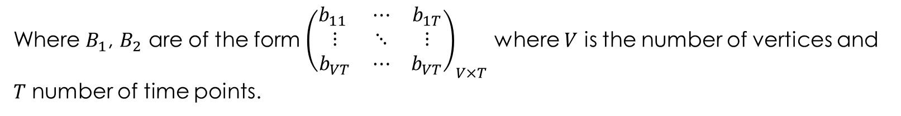
Finding Optimal Orthogonal Transformation
Problem: We want to find an orthogonal matrix $O$ that aligns data $B_{1}$ and $B_{2}$ of the two brains
$$\underset{O∈O^{T} }{arg min}{{\left\|B_{1}−OB_{2}\right\|}_{F}^{2}}$$
Where $B_{1}$, $B_{2}$ are of the form ${\left(\begin{matrix}b_{11} & ⋯ & b_{1T} \\ ⋮ & ⋱ & ⋮ \\ b_{VT} & ⋯ & b_{VT}\end{matrix}\right)}_{V×T}$ where $V$ is the number of vertices and
$T$ number of time points.
Solution:
First, we perform SVD of covariance matrix $B_{1}B_{2}^{t}=UΣV^{t}$.
The optimal orthogonal matrix $O$ is given by $O=VU^{t}$. (details skipped).
This yields $B_{1}$ and $OB_{2}$ in sync.
The transformed data has the same correlation pattern as the original
It is a 1-1 transform

Slide 6
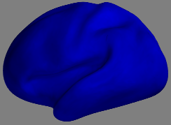
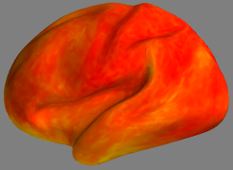
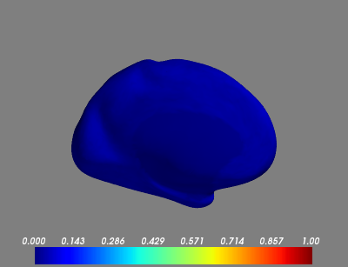

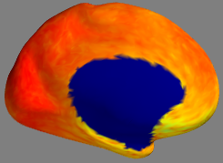
Correlation of Signals
Average Correlation in
rfMRIs of original Subjects
Average Correlation in
rfMRIs of BrainSynced Subjects
1
0

Slide 7
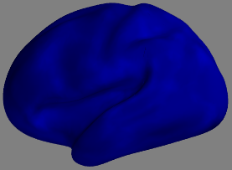
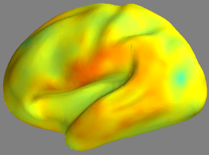
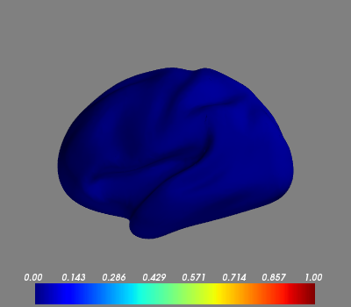
Task fMRI (language task)
2 Subjects were considered without tNLM
Correlation of time series from one subject to the other was computed
0.15
Before Sync
After Sync
0
Correlation of resting state to task fMRI (from different subjects)
are much lower even after Brain Sync

Slide 8
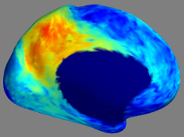

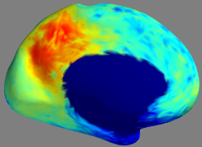
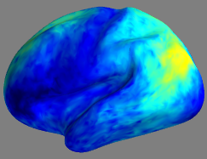
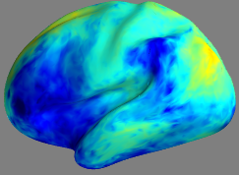
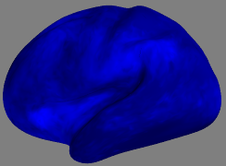
Correlation of Signals
Correlation of average signal in precuneus to the signals in brain
Sub 1 to Sub 1
Sub 1 to Sub 2 (orig)
Sub 1 to Sub 2 (synced)
1
0

Slide 9
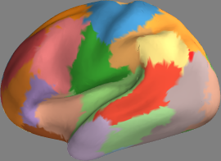
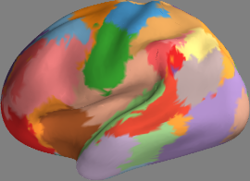
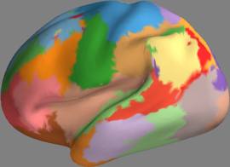
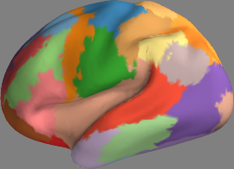
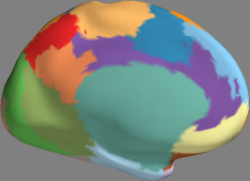
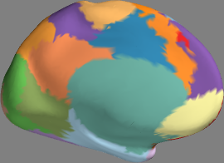
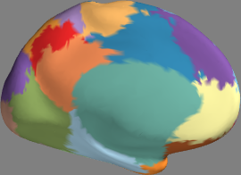
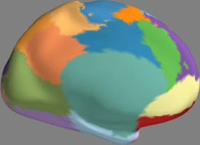
Parcellation Individually
Subjects were independently parcellated by k-means with nClusters=30
Sub 1
Sub 2
Sub 3
Sub 4
Parcellations are different for individual scans, probably because not enough samples
for finding correct boundaries

Slide 10
Group Parcellation
Since the data are comparable to each other after BrainSync, we can pool it and do joint parcellation
Clustering will work better when data is pooled, rather than doing clustering of one brain at a time
We can now directly pool the data together after synchronization

Slide 11
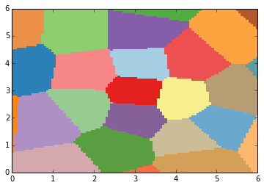
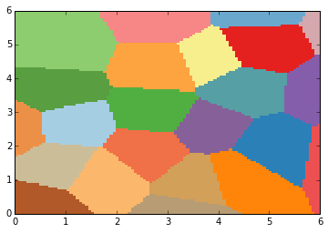
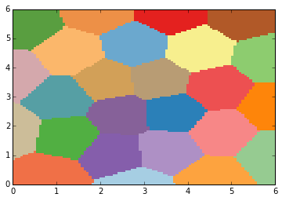
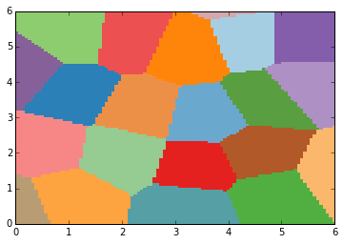
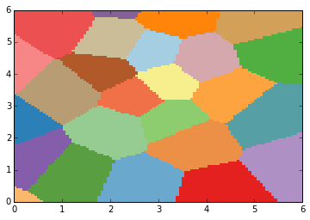
Clustering algorithms work better when data is pooled (Simulation) (not final results)
Gaussian data was generated on 5x5 uniform grid
K means clustering was done separately on 4 such datasets and then after pooling the data together
Clustering on pooled data
4 separate k-means clusterings

Slide 12
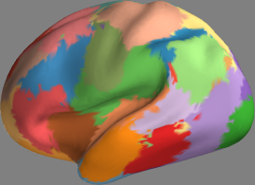
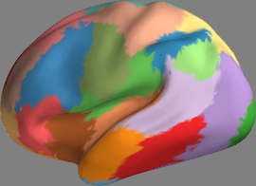
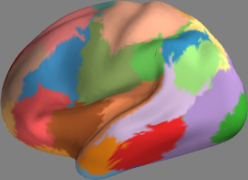
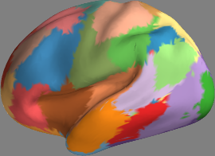
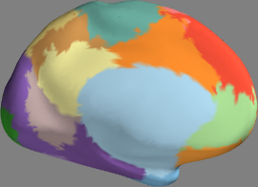
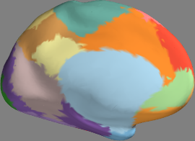
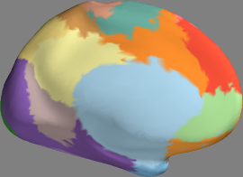
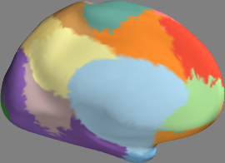
Joint Parcellation 2 independent groups of 20 subjects each
2 subjects from first group
2 subjects from second group
We get more consistent Parcellation even if two groups of 20 subjects are non-overlapping
Therefore Joint clustering must be helping in improving performance of clustering algorithm
since there is more data.

Slide 13
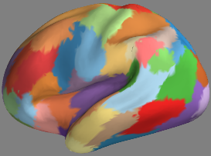
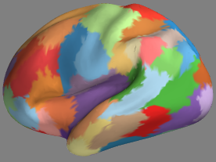
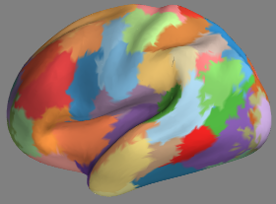
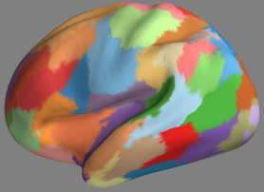
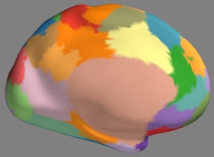
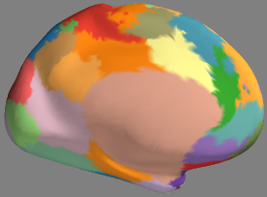
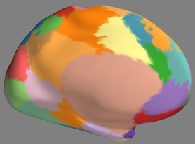
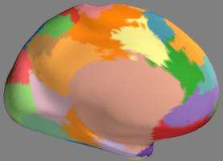
Joint Parcellation 2 independent groups of 20 subjects each (60 clusters)
2 subjects from first group
2 subjects from second group
We get more consistent Parcellation even if two groups of 20 subjects are non-overlapping
Therefore Joint clustering must be helping in improving performance of clustering algorithm
since there is more data.

Slide 14
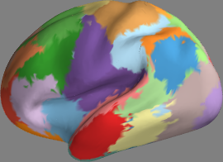
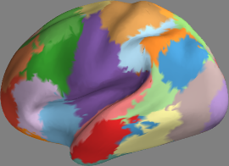






Session 1 and Session 2 labeled jointly
40 Subjects x 2 sessions = 80 scans were pooled together for labeling
Subject 1
Subject 2
Session 1
Session 2
Session 1
Session 2

Slide 15








100 ROIs Individual Clustering and recoloring
Sub 1 Sub 2 Sub 3 Sub 4
There is very little consistency across subjects

Slide 16








100 ROIs Joint Clustering
A large number of ROIs also show consistent parcellation when done in a group-wise manner
Sub 1, Session 1
Sub 1, Session 2
Sub 2, Session 1
Sub 2, Session 2
Consistent clustering is obtained even if we haven’t enforced any prior for
similarity across subjects or even boundary smoothness within subject

Slide 17
1 common subject in two groups

Slide 18
Silhoutte score

Slide 19
Conclusion
Parameter free approach
Depends on only 2 simple assumptions
No Spatial Prior or group prior is assumed, regions can be very different as possible, No constraint on topography of the labels
Purely data driven
Involves clustering of a large amount of data, so scalable algorithm is required (e.g. k-means)

Slide 20


Brain Registration using fMRI
We map each vertex of subject 1
to the closest vertex of subject 2 in
the spherical space
Original labeled brain for subject 2

Slide 21
Other Possibilities
Cortical Registration based on fMRI
The distance of sphere can be used to drive registration
Or the correspondence can be found directly on sphere using Hungarian Algorithm
Group Studies
We have developed framework for performing statistics on sphere
After BrainSync these signals are directly comparable
Group Differences and other studies can be performed easily
K-means tends to find spherical clusters of equal size. We should try DBSCAN which is also scalable wrt number of samples
Will the results be same if correlation is used as a feature ?
Sparsity priors can be used for fitting the orthonormal transformation

Slide 22




Random permutation of vertices
Correlation was computed between time series data of Brain 1 B1 and Brain 2 with permuted vertices.
It seems that the correlation only increases to average about .3. Note that after tNLM average correlation within subject is about that. So it seems to align the baseline signal only.
Sub 1 to Sub 2
(permuted vertices)
after Sync
Sub 1 to Sub 2
(permuted vertices)
Sub 1 to Sub 2
Sub 1 to Sub 2 after Sync

