Slide 1
Comparison of connectivity measures for fMRI

Slide 2
Method
Data: 100 subjects from HCP fMRI resting state.
tNLM filtering was applied, mean subtracted and variance normalized to 1.
Precuneus ROI was selected. Processed separately for each hemisphere.
Correlation of fMRI signal between voxels within precuneus was computed.
Precuneus subdivided based on spectral clustering algorithm.
Optimal number of clusters selected based on elbow method and Silhouette Score.

Slide 3
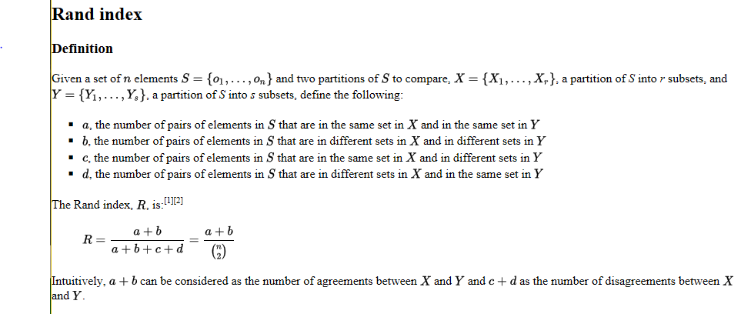

Slide 4
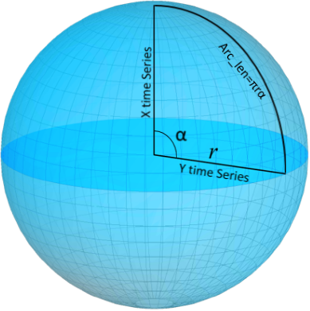
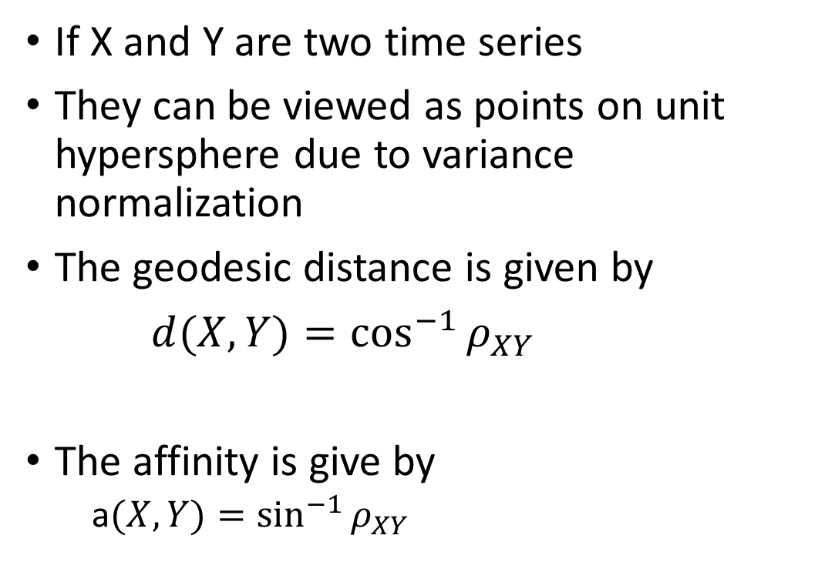
Geodesic Distance
If X and Y are two time series
They can be viewed as points on unit hypersphere due to variance normalization
The geodesic distance is given by
$d(X,Y)=\cos^{−1}{ρ_{XY}}$
The affinity is give by
a$(X,Y)=\sin^{−1}{ρ_{XY}}$

Slide 5


Correlation and $L^{2}$
Pearson’s correlation is given by $ρ_{XY}$.
We consider exponential formula
$a\left(X,Y\right)=\exp{\frac{−2(1−ρ_{XY})}{{0.72}^{2}}}$
$L^{2}$ distance
$$a\left(X,Y\right)=\left|X−Y\right|=\sqrt{2−2ρ_{XY}}$$

Slide 6
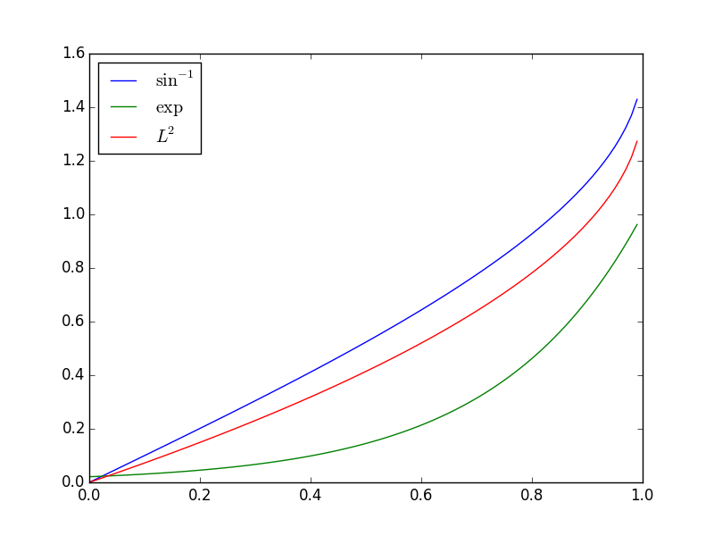
Different functions of correlation
correlation

Slide 7

Correlation of Correlation
Most researchers use correlation as a connectivity feature.
We compute Correlation followed by Fischer-Z and use that as a feature
Then use this as a feature.
To compute affinity, we again take correlation of this feature vector followed by exponential formula
Fischer-Z

Slide 8
Average Overlap
We measured average rand indices of subdivisions of (1) Precuneus (PRE); (2) Middle Temporal Gyrus (MTG);
(3) Middle Frontal Gyrus (MFG).
Average Rand Index was computed
- across subjects and averaged over 4 sessions
- across sessions and averaged over 100 subjects
 | Across Subjects |  |  | Across Scans
 | PRE | MTG | MFG | PRE | MTG | MFG
Geodesic | 0.790084 | 0.61303 | 0.803715 | 0.874016 | 0.771426 | 0.895363
Euclidean | 0.77514 | 0.563588 | 0.756416 | 0.866361 | 0.761751 | 0.873571
Exp | 0.77836 | 0.584081 | 0.777249 | 0.872586 | 0.778241 | 0.887982
Conn | 0.647769 | 0.298366 | 0.627897 | 0.756092 | 0.642676 | 0.752766

Slide 9
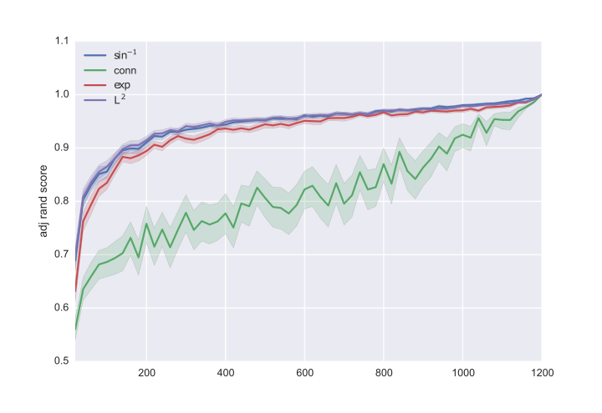
Performance vs number of samples
Rand score between full sample (1200) to subsample, repeated 100 times. The faint line is 95% confidence interval

Slide 10
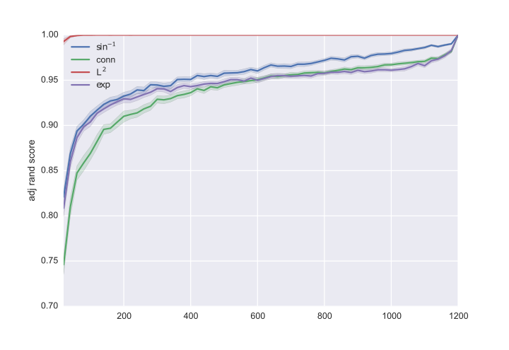
Same result with region growing
Rand score between full sample (1200) to subsample, repeated 100 times. The faint line is 95% confidence interval.
Please ignore the L2 case

Slide 11
Region Growing
Spectral Clustering
 | Across Subjects |  |  | Across Sessions
 | PRE | MTG | MFG | PRE | MTG | MFG
Geodesic | 0.790084 | 0.61303 | 0.803715 | 0.874016 | 0.771426 | 0.895363
Euclidean | 0.77514 | 0.563588 | 0.756416 | 0.866361 | 0.761751 | 0.873571
Exp | 0.77836 | 0.584081 | 0.777249 | 0.872586 | 0.778241 | 0.887982
Conn | 0.647769 | 0.298366 | 0.627897 | 0.756092 | 0.642676 | 0.752766
Across Subjects |  |  | Across Sessions
PRE | MTG | MFG | PRE | MTG | MFG
0.790084 | 0.61303 | 0.803715 | 0.874016 | 0.771426 | 0.895363
0.77514 | 0.563588 | 0.756416 | 0.866361 | 0.761751 | 0.873571
0.77836 | 0.584081 | 0.777249 | 0.872586 | 0.778241 | 0.887982
0.647769 | 0.298366 | 0.627897 | 0.756092 | 0.642676 | 0.752766

