Slide 1
BrainSync: Synchronizing Resting State Brains

Slide 2
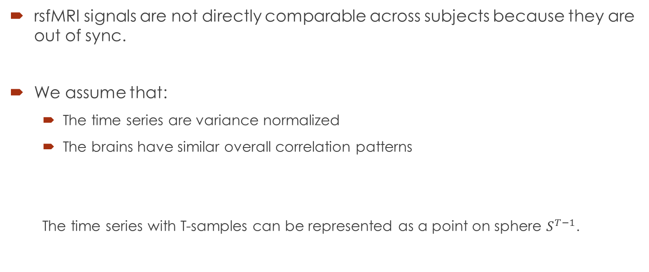
rsfMRI data
rsfMRI signals are not directly comparable across subjects because they are out of sync.
We assume that:
The time series are variance normalized
The brains have similar overall correlation patterns
The time series with T-samples can be represented as a point on sphere $S^{T−1}$.

Slide 3
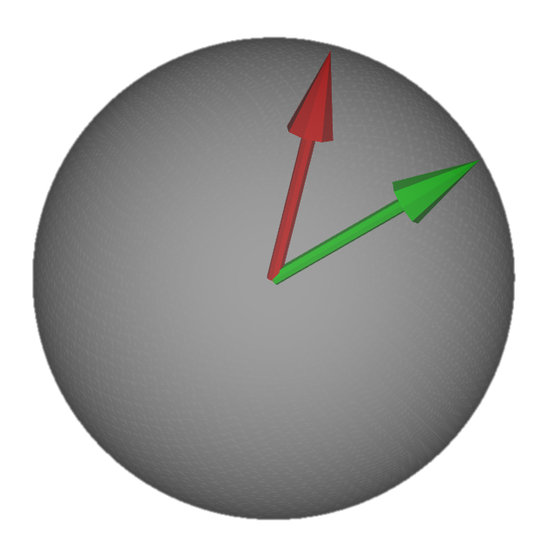


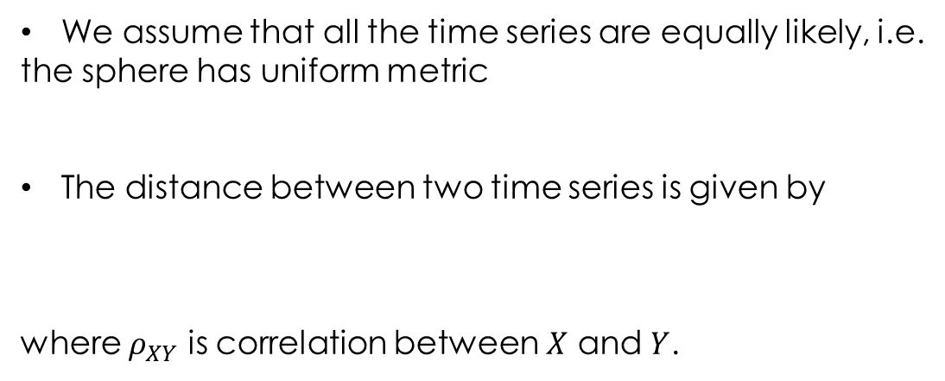
Metric on fMRI Signal
We assume that all the time series are equally likely, i.e.
the sphere has uniform metric
The distance between two time series is given by
where $ρ_{XY}$ is correlation between $X$ and $Y$.
$$S^{T−1}$$
d
$$d=\cos^{−1}{(ρ_{XY})}$$
X
Y

Slide 4
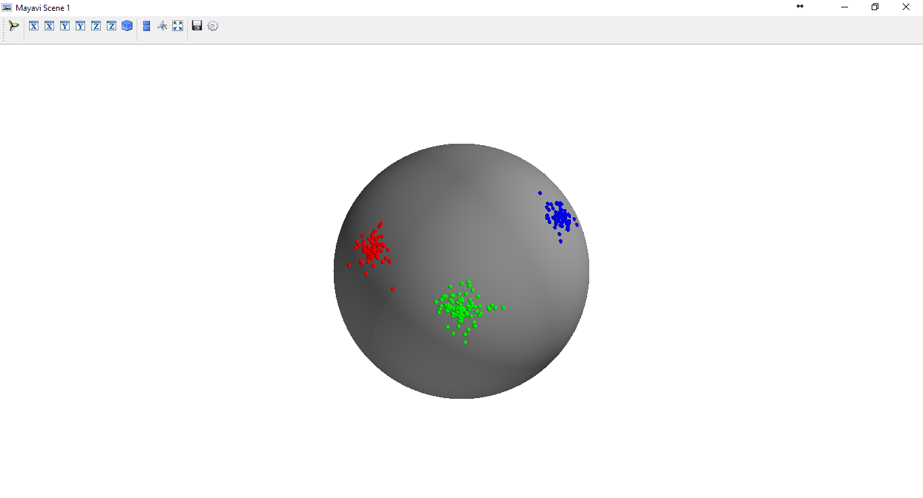
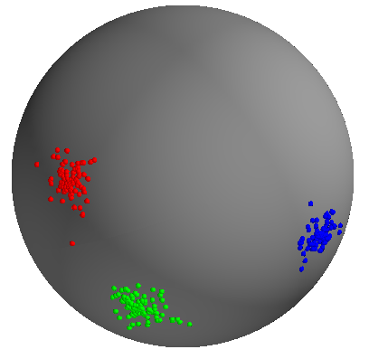
Finding Optimal Rotations
…
Individual scans are rotated spheres
Kabsch algorithm is used to find optimal rotations between spheres
Finding Optimal Rotation has a closed form solution based on SVD

Slide 5
Kabash Algorithm
A=X’Y
Optimal rotation minimizes |X-RY|
A=VSW’

Slide 6
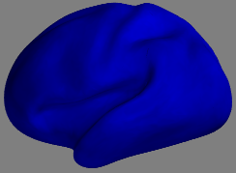
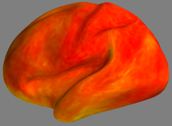
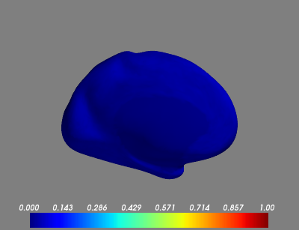

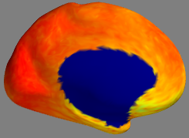
Correlation of Signals
Average Correlation in
rfMRIs of original Subjects
Average Correlation in
rfMRIs of BrainSynced Subjects
1
0

Slide 7
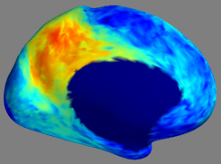

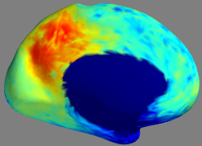
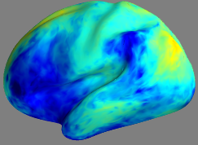
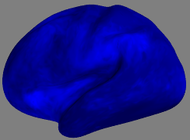
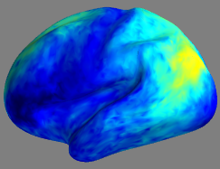
Correlation of Signals
Correlation of average signal in precuneus to the signals in brain
Sub 1 to Sub 1
Sub 1 to Sub 2 (orig)
Sub 1 to Sub 2 (rot)
1
0

Slide 8
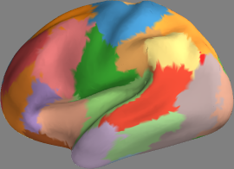
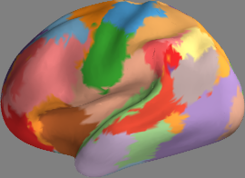
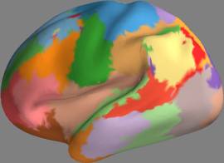
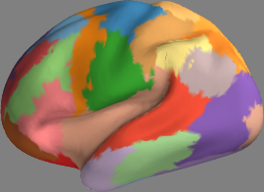
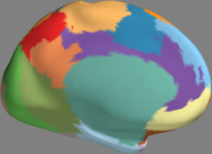
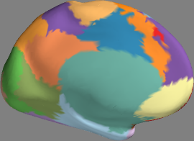
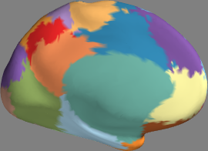
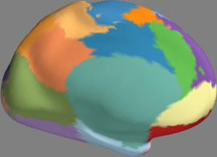
Parcellation Individually
Subjects were independently parcellated by k-means with nClusters=30
Sub 1
Sub 2
Sub 3
Sub 4
Parcellations are different for individual scans, probably because not enough samples
for finding correct boundaries

Slide 9
Group Parcellation
Since the data are comparable to each other after BrainSync, we can pool it and do joint parcellation
Clustering will work better when data is pooled, rather than doing clustering one by one

Slide 10
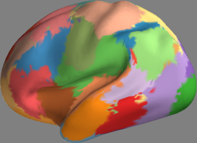
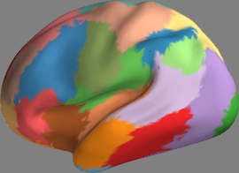
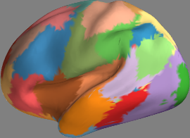
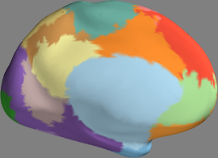
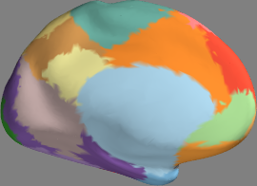
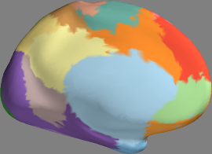
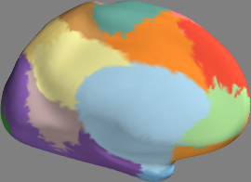
Joint Parcellation 2 independent groups of 20 subjects each
2 subjects from first group
2 subjects from second group
We get very consistent Parcellation even if two groups of 20 subjects are non-overlapping

Slide 11
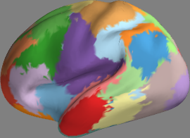
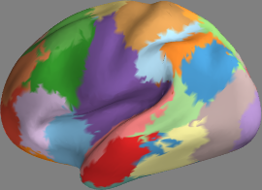
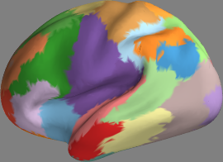
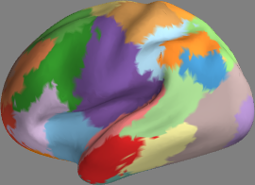
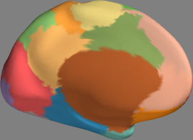
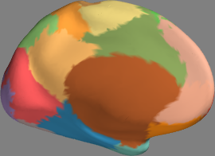
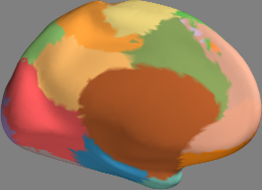
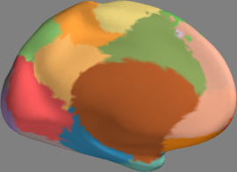
Session 1 and Session 2 labeled jointly
40 Subjects x 2 sessions = 80 scans were pooled together for labeling
Subject 1
Subject 2
Session 1
Session 2
Session 1
Session 2

Slide 12
Conclusion
Parameter free approach
Depends on only 2 simple assumptions
No Spatial Prior or group prior is assumed, regions can be very different as possible
Involves clustering of a large amount of data, so scalable algorithm is required (e.g. k-means)

Slide 13
Other Possibilities
Group Studies
We have developed framework for performing statistics on sphere
After BrainSync these signals are directly comparable
Group Differences and other studies can be performed easily
Will the results be same if correlation is used as a feature ?

