Slide 1
Recursive Nearest Agglomeration (ReNA) Clustering for Detecting Abnormal Brain Images
Anand Joshi and Sergul Aydore

Slide 2
Problem Statement and Hypothesis
Our goal is to detect abnormalities (lesion in particular) in brain images.
Hypothesis: abnormalities can occur in various regions of the brain and overall structure across multiple brain images from different subjects should capture a healthy structure of the brain.
If we perform an unsupervised learning algorithm that relies on the structure of the data, we can describe the data in lower dimension. By projecting back to the original dimension, we can compute approximated images.
We claim that the analysis of the error between original and approximated images should indicate “abnormality level” of the brain.

Slide 3
Overview of ReNA
Proposed by Hoyos-Idrobo 2016.
ReNA uses feature grouping , approximating a signal by partitioning its feature space into several subsets and replacing the value of each subset with a constant value.
Hence, it is a dimensionality reduction technique of structured signals using feature grouping.
It also has a denoising effect.
ReNA uses agglomerative clustering algorithm. This clustering algorithm finds clusters of roughly even size in linear time, maintaining meaningful information on the structure of the data.

Slide 4
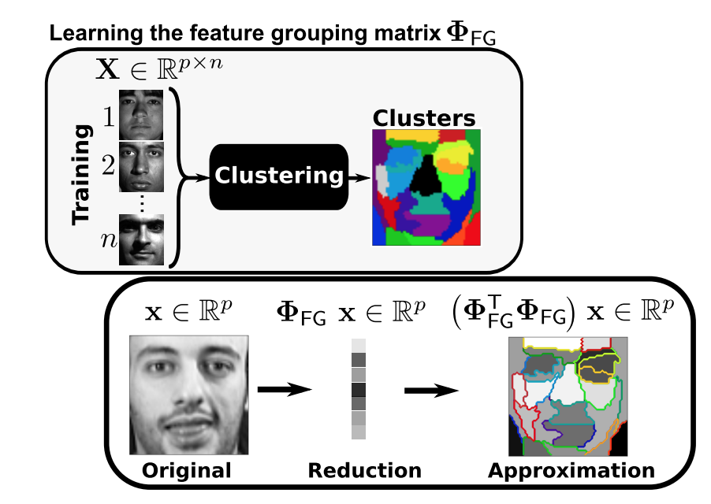
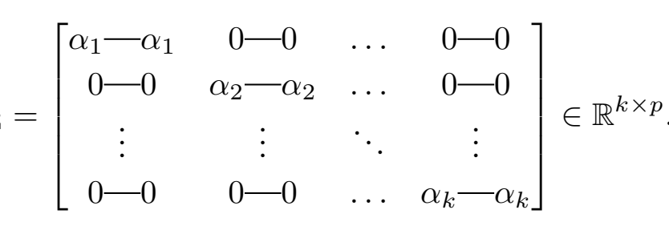
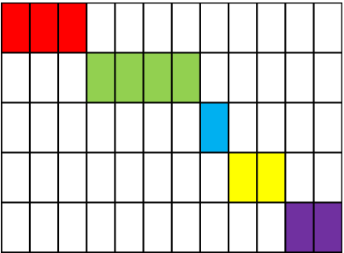
Dimensionality Reduction by Feature Grouping
Feature grouping defines a matrix that extracts piece- wise constant approximations of the data
Since the matrix is sparse, it speeds up the computational time.
Hoyos-Idrobo 2016

Slide 5
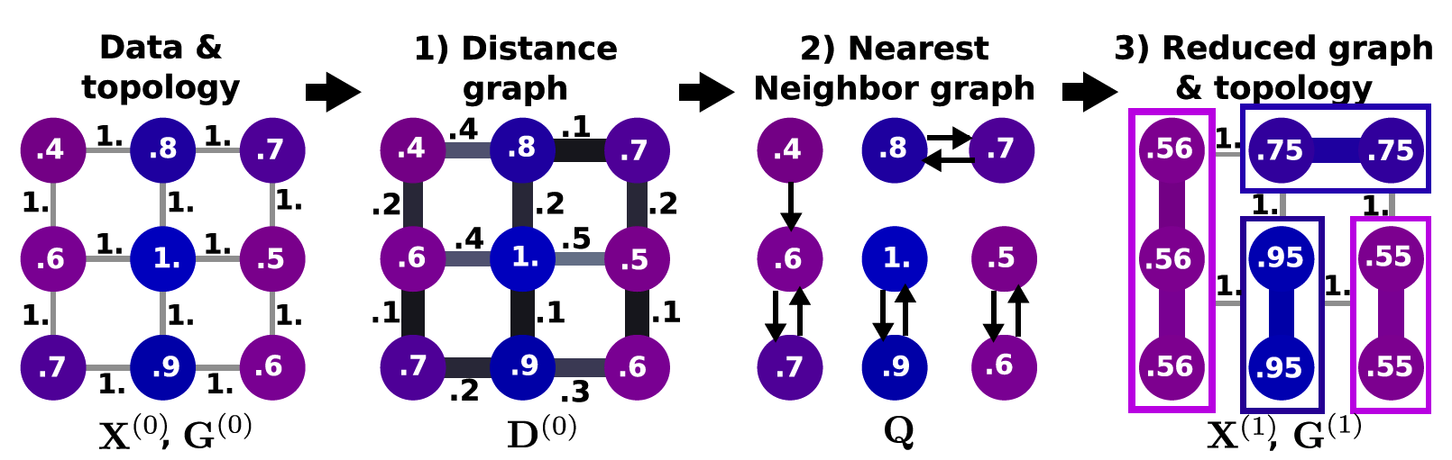
Recursive Nearest Agglomeration Clustering (ReNA)
Agglomerative clustering schemes start off by placing every data element in its own cluster.
They proceed by merging repeatedly the closest pair of connected clusters until finding the desired number of clusters.

Slide 6
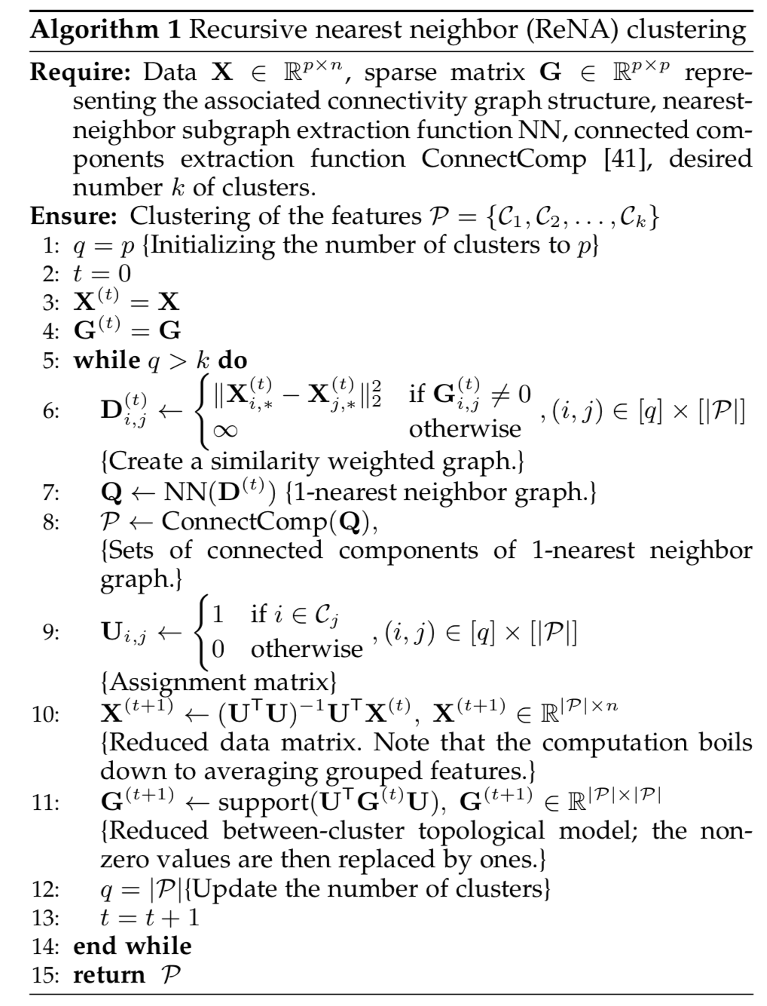
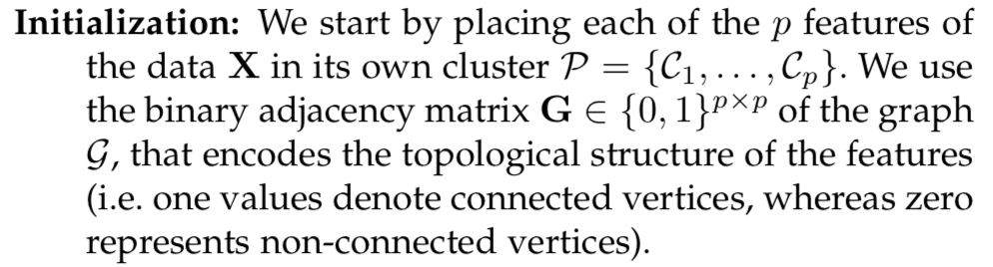
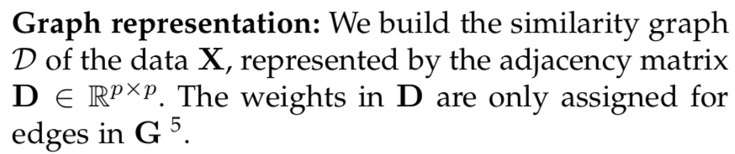
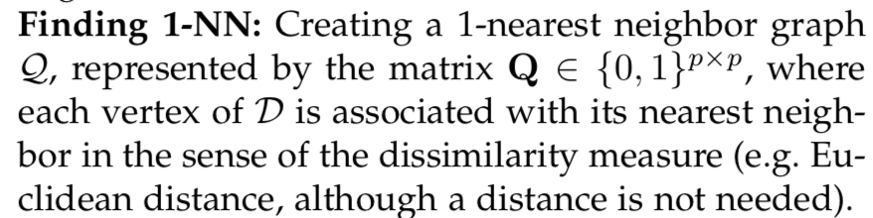
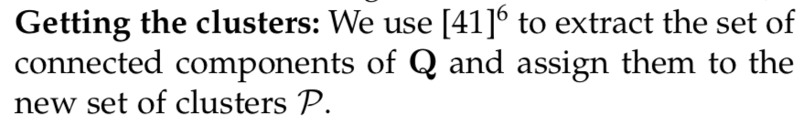
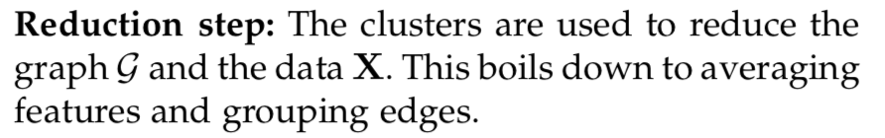
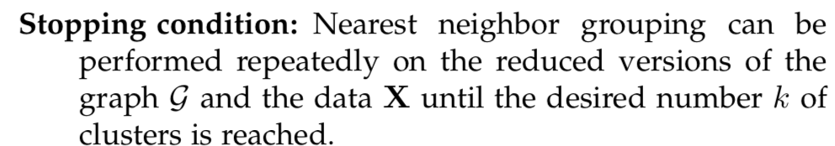
ReNA Algorithm

Slide 7

How we used it for detecting abnormal brain images
Computing Clusters Using ReNA
Voxels (dimension: 270806)
Preprocessing with nilearn:
Resample each image to a common space of 91 x 109 x 91 with 2mm isontropic voxels
Transform to 1D
FLAIR
Subject 1
T1
T2
Clusters
(dimension: 54160 - %20 of the number of voxels)
FLAIR
Subject 2
Concatenate
T1
ReNA
T2
FLAIR
Subject N
T1
T2

Slide 8

How we used it for detecting abnormal brain images
Computing Approximated Images
Voxels
(dimension: 54160)
Voxels (dimension: 270806)
Voxels (dimension: 270806)
FLAIR
Original Subject 1
FLAIR
Subject 1
FLAIR
Approximated Subject 1
T1
T1
T1
T2
T2
T2
FLAIR
Original Subject 2
Dimensionality Reduction
Using Clusters
FLAIR
Subject 2
Compute Approximated Images by projecting back
FLAIR
Approximated Subject 2
T1
T1
T1
T2
T2
T2
FLAIR
Original Subject N
FLAIR
Subject N
FLAIR
Approximated Subject N
T1
T1
T1
T2
T2
T2
Each image is represented by $x$

Slide 9
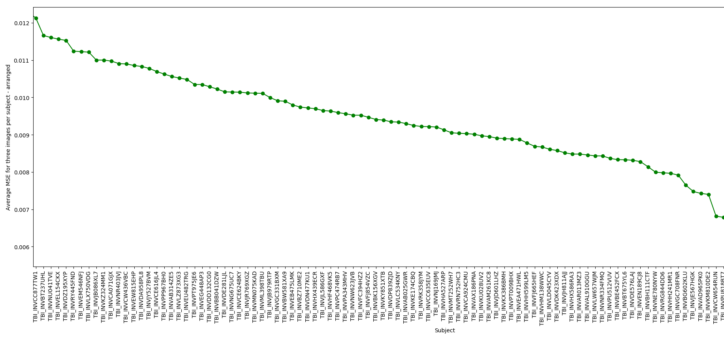
How we used it for detecting abnormal brain images
Computing MSE of the Approximation
2
Subjects that are most “likely” to have abnormal brain structure
Voxels (dimension: 270806)
Voxels (dimension: 270806)
FLAIR
Original Subject 1
FLAIR
Approximated Subject 1
T1
T1
T2
T2
Compute Average MSE across FLAIR, T1 and T2 for each subject
FLAIR
Original Subject 2
FLAIR
Approximated Subject 2
T1
T1
MSE
T2
T2
FLAIR
Subjects (sorted)
Original Subject N
FLAIR
Approximated Subject N
T1
T1
T2
T2
Note that the threshold needs to be determined via statistical analysis.
Each image is represented by $x$
Compute MSE over voxels for each image

