Slide 1
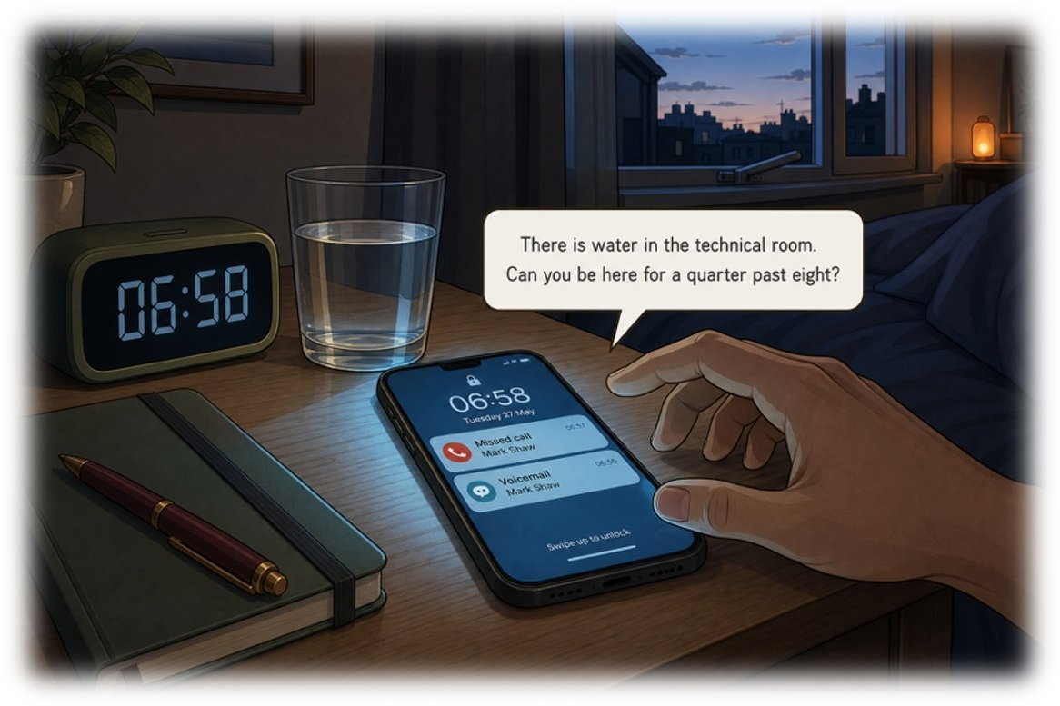
The message that wakes you
SÉANCE 02 / 19
SCENE 1
06.58
Your phone vibrates. You are not up yet.
Case File 01 — The night nobody heard
Livret p. 3–4
Notes:
Scène 1 : écoute du message vocal de Mark Shaw (à passer deux fois). Prévoir l’enregistrement audio. Le livret ne contient pas le script : les corrections de la prise de notes sont à ajuster à votre enregistrement.

Slide 2



Today's mission
BRIEFING
Livret p. 3–4
ROADMAP
≈ 90 min (indicatif)
BY THE END OF THE SESSION
Six lines on a notepad — and the one line that is not proved yet.
1
Warm-up: key words
10'
2
Scene 1: the phone (p. 3)
5'
3
Telling the time
15'
LANGUAGE FOCUS
4
Prepositions of time + practice
10'
Telling the time (a.m. / p.m., 24-hour clock) · prepositions of time (at, by, until, between…) · past simple of the dated fact: found, went off, heard
5
Note-taking toolkit
5'
6
Voicemail × 2 + your six lines
15'
SKILLS
7
Correction · what is not proved (p. 4)
15'
Listening for specific information · note-taking under pressure · separating a fact from a supposition
Field note: the verifiable time
10'
8
9
Wrap-up
5'
Notes:
Séance centrée sur la compréhension orale et l’heure, compétence indispensable pour tout le dossier (journal d’alarme, rapport).

Slide 3
Warm-up: the words of the case
WARM-UP
Séance 1
Two minutes. English, please — with the article.
1. un locataire → ……………
2. une entreprise générale → ………………………………
3. déclarer un sinistre → ……………………
4. des preuves → ……………
5. une fuite → ……………
6. un expert en sinistres → ………………………
7. rénover → …………………
8. le rez-de-chaussée → ………………………
Notes:
Réactivation du vocabulaire de la séance 1.

Slide 4
Warm-up: the words of the case
WARM-UP
✓ CORRECTION
Séance 1
Two minutes. English, please — with the article.
1. un locataire → a tenant
2. une entreprise générale → a (general) contractor
3. déclarer un sinistre → to file a claim
4. des preuves → evidence
5. une fuite → a leak
6. un expert en sinistres → a claims assessor
7. rénover → to refurbish
8. le rez-de-chaussée → the ground floor
Notes:
Rappeler : evidence est indénombrable (✗ an evidence, ✗ evidences) → a piece of evidence.

Slide 5
The message that wakes you
SCENE
Livret p. 3
SCENE 1
06.58
It is still dark. Your phone lights up on the table and vibrates twice.
One missed call, one voicemail. The number is Mark Shaw’s.
He never calls before eight.
ASK THE CLASS
Mark never calls before eight. What does that tell you — before you even listen?
Notes:
Faire décrire l’image (heure, objets, message affiché). La bulle donne déjà deux informations : water in the technical room / a quarter past eight. Anticipation : quelque chose de grave s’est produit.

Slide 6

Telling the time
GRAMMAR
Livret p. 3–4 · hors livret
06.58
08.15
23.41
19.58
six fifty-eight
eight fifteen
eleven forty-one p.m.
seven fifty-eight p.m.
= two minutes to seven
a.m. = between midnight and noon
= a quarter past eight
Can you be here for a quarter past eight?
in a log: twenty-three forty-one
p.m. = between noon and midnight
= two minutes to eight
≠ at eight: in a report, two minutes count!
Piège pour francophones — 8h15 ✗ → 8.15 (UK) / 8:15 (US) · o’clock only for full hours (at eight o’clock) · 12 a.m. is ambiguous: write midnight or noon.
Notes:
Faire répéter chaque heure de deux façons. Les logs (Exhibit A) utilisent le format 24 h : savoir lire « twenty-three forty-one ».

Slide 7
Prepositions of time
GRAMMAR
Livret p. 3–9
PREPOSITION | FRANÇAIS | IN THE FILE
at + a time | à (heure précise) | The cleaners found the water at 6.50.
by + a deadline | au plus tard, d’ici | I need a timeline on this board by nine.
until + an end | jusqu’à (ça continue) | The contractor’s team was working here until eight.
before / after | avant / après | He never calls before eight.
between … and … | entre … et … | Water ran between 23.41 and 06.47.
for + a duration | pendant | Mark spoke for 41 seconds.
in + a delay | dans (d’ici) | I can be there in twenty minutes.
⚠ jusqu’à 9 h : until nine (I’ll wait until nine) ≠ by nine (date limite : I need it by nine).
Notes:
Insister sur by / until, confusion classique des francophones, et sur for (pendant) — le « depuis » viendra en scène 6.

Slide 8
Say it, write it
+ EXTRA
Hors livret
A · Say each time in two ways.
1. 06.47 → ……………………………………
2. 20.04 → ……………………………………
3. 02.16 → ……………………………………
4. 11.30 → ……………………………………
5. 00.00 → ……………
B · at, by, until or between?
1. Mark wants the timeline …………… nine.
2. The cabling team worked …………… eight.
3. The alarm went off …………… 23.41.
4. The water ran …………… 23.41 and 06.47.
5. Can you be here …………… a quarter past eight?
Notes:
Oral d’abord (A), puis écrit (B). Pour B5 : « be here for + heure » = être là pour (une heure fixée) — tournure britannique de la bulle p. 3.

Slide 9
Say it, write it
+ EXTRA
✓ CORRECTION
Hors livret
A · Say each time in two ways.
1. 06.47 → six forty-seven / thirteen minutes to seven
2. 20.04 → eight-oh-four p.m. / four minutes past eight
3. 02.16 → two sixteen a.m. / sixteen minutes past two
4. 11.30 → eleven thirty / half past eleven
5. 00.00 → midnight
B · at, by, until or between?
1. Mark wants the timeline by nine.
2. The cabling team worked until eight.
3. The alarm went off at 23.41.
4. The water ran between 23.41 and 06.47.
5. Can you be here for a quarter past eight?
Notes:
Oral d’abord (A), puis écrit (B). Pour B5 : « be here for + heure » = être là pour (une heure fixée) — tournure britannique de la bulle p. 3.

Slide 10

Note-taking toolkit
METHOD
Livret p. 3
KEEP ONLY
ABBREVIATE
LEAVE A GAP
Who? What? Where? When?
Names, places, times in digits
No articles, no full sentences
@ = at · b4 = before · w/ = with
2F = second floor · tech rm
→ = causes / leads to · ≠ · ≈
Write ? when you are not sure
Never invent a time or a name
Check it in the 2nd listening
Astuce — Write the time as you hear it, then convert: a quarter past eight → 8.15.
Notes:
Donner 1 minute pour préparer le carnet : six lignes numérotées, comme p. 3–4.

Slide 11




Voicemail — listen twice
VOICEMAIL
Livret p. 3
Mark Shaw — 06.58
Voicemail · 41 seconds · played twice. Only take notes on the second listening.
Listening 1
Listening 2
After
Pens down. Listen for the situation: who, what, where. No notes.
Notes only now: keywords, numbers, times. Mark speaks fast — there is no third listening.
Two minutes to complete your six lines. Compare with a neighbour: same times?
Notes:
Passer l’enregistrement deux fois, sans pause. Ne pas répéter une 3e fois (consigne du livret : « You only have a notepad and a pen. Just like a real wake-up. »).

Slide 12

Take the message down
YOUR MOVE
Livret p. 3–4
What you do not note down now will be lost for the whole day.
EXPECTED
1. Who called and when?
2. What has happened?
3. Where exactly?
4. Who found it and at what time?
5. What does Mark want you to bring?
6. Where and when must you be?
Six short lines: keywords, not sentences.
Every time in digits.
A ? where you are not sure.
Notes:
Laisser les élèves comparer avant de projeter la correction.

Slide 13
Take the message down
YOUR MOVE
✓ CORRECTION
Livret p. 3–4
What you do not note down now will be lost for the whole day.
EXPECTED
1. Who called and when?
→ Mark Shaw — at 06.58 (voicemail, 41 seconds).
2. What has happened?
→ There is water in the technical room — a leak.
3. Where exactly?
→ In the technical room, on the second floor of Atlas House.
4. Who found it and at what time?
→ The cleaners — at 6.50 a.m.
5. What does Mark want you to bring?
→ (as said in the recording — check your audio script)
6. Where and when must you be?
→ At Atlas House, in the technical room, at 8.15 (a quarter past eight).
Six short lines: keywords, not sentences.
Every time in digits.
A ? where you are not sure.
Notes:
Lignes 1–4 et 6 vérifiables dans le livret (bulle p. 3, field note p. 4, scène 2). Ligne 5 : dépend de votre enregistrement — compléter la diapositive si besoin. Typographie : en anglais, pas d’espace avant « ? » (le livret en met une).

Slide 14
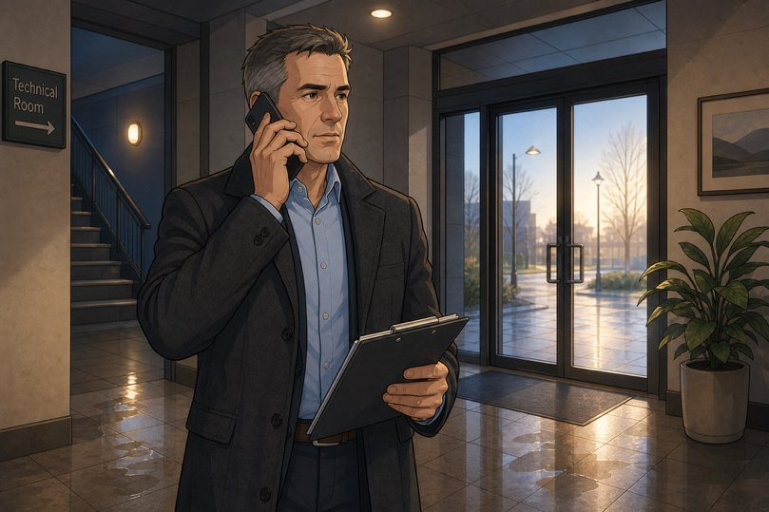
One question before you leave the house
YOUR MOVE
Livret p. 4
Mark said one thing that is not a fact but a supposition. A report that confuses the two is rejected.
1. Read your six lines again. Which one is not yet proved? Underline it.
2. In one line: what would be needed to prove it?
3. Write the honest sentence.
EXPECTED
A fact has a source.
A supposition needs proof.
Notes:
Le script n’est pas dans le livret : identifier avec les élèves la phrase de Mark qui relève de la supposition (marqueurs : probably, I think, it looks like, must have…).

Slide 15
One question before you leave the house
YOUR MOVE
✓ CORRECTION
Livret p. 4
Mark said one thing that is not a fact but a supposition. A report that confuses the two is rejected.
1. Read your six lines again. Which one is not yet proved? Underline it.
→ The line about the cause or the duration of the leak (e.g. a pipe has burst / it has been running all night): Mark supposes it — nobody has checked yet.
2. In one line: what would be needed to prove it?
→ A verifiable source: the alarm log (times), photographs of the ceiling, a technician’s report.
3. Write the honest sentence.
→ We do not know yet whether …; the alarm log and an inspection would show it.
EXPECTED
A fact has a source.
A supposition needs proof.
Notes:
Réponse à adapter à l’enregistrement. Le livret donne une piste à la fin de la scène 1 : ce que Mark n’a pas dit, c’est « how long the water had been running ».

Slide 16


The first thing an assessor looks for
FIELD NOTE
Livret p. 4
An insurance assessor reads a report looking for a verifiable time. Not a remembered time.
REMEMBERED — rejected
VERIFIABLE — accepted
around eleven
just before eight
late last night
a time somebody thinks he saw
taken from an alarm log
taken from a camera (CCTV)
taken from a ticket / a badge record
a timestamped photograph
→
À retenir — In English, that time is always written in the past simple, the form of the dated fact: the cleaners found the water at 6.50 · the alarm went off at 11.40.
Notes:
Lien avec la séance 1 : fact = source. Préparer la scène 3 où le journal d’alarme contredira les heures « de mémoire ».

Slide 17
Three verbs that will come back all day
FIELD NOTE
Livret p. 4
FIND → FOUND
GO OFF → WENT OFF
HEAR → HEARD
/faʊnd/
/went ɒf/
/hɜːd/
The cleaners found the water at 6.50.
trouver, découvrir
The alarm went off at 11.40 p.m.
se déclencher (alarme)
Nobody heard it.
entendre — ≠ heart /hɑːt/
Piège pour francophones — Une heure précise → past simple, jamais le present perfect : ✗ The cleaners have found the water at 6.50. → ✓ found.
Notes:
Le livret : « Note them down now — you will write them before this evening. » Faire écrire les 3 verbes dans le carnet.

Slide 18
Remembered or verifiable?
+ EXTRA
Hors livret
A · Remembered (R) or verifiable (V)?
1. The alarm went off around eleven. → ……………
2. Badge 0771 entered at 06:47. → …………………
3. Unit 3 shut down at 02:16 (server log). → ……………
4. It happened late last night. → ……………
5. Mark called at 06.58 (phone log). → ……………
6. The team left just before eight. → ……………
B · Write the dated fact.
1. cleaners / find / water / 6.50 → ……………………………………
2. alarm / go off / 11.40 p.m. → ……………………………………
3. nobody / hear / it → ………………………
Notes:
A : repérage ; B : production. Exiger la majuscule, le point et l’heure.

Slide 19
Remembered or verifiable?
+ EXTRA
✓ CORRECTION
Hors livret
A · Remembered (R) or verifiable (V)?
1. The alarm went off around eleven. → R
2. Badge 0771 entered at 06:47. → V — badge log
3. Unit 3 shut down at 02:16 (server log). → V
4. It happened late last night. → R — vague
5. Mark called at 06.58 (phone log). → V
6. The team left just before eight. → R
B · Write the dated fact.
1. cleaners / find / water / 6.50 → The cleaners found the water at 6.50.
2. alarm / go off / 11.40 p.m. → The alarm went off at 11.40 p.m.
3. nobody / hear / it → Nobody heard it.
Notes:
A : repérage ; B : production. Exiger la majuscule, le point et l’heure.

Slide 20

Before you close the file
END OF SESSION
NEXT IN THE FILE
BEFORE NEXT SESSION
Mark is waiting for you at a quarter past eight. Before you walk into the technical room, check your verbs: every line of your report will stand on them.
Say any time in two ways (practise with Exhibit-style times: 19.58, 20.04, 23.41, 02.16).
Learn: find → found · go off → went off · hear → heard.
Read p. 5 (the past simple poster).
Revise: go, see, have, come, know, begin, leave, shut.
EXIT TICKET
Say 06.58 and 23.41 in two ways — and name one verifiable source for a time.
Notes:
Ticket de sortie à l’oral, deux ou trois élèves.

