Slide 1
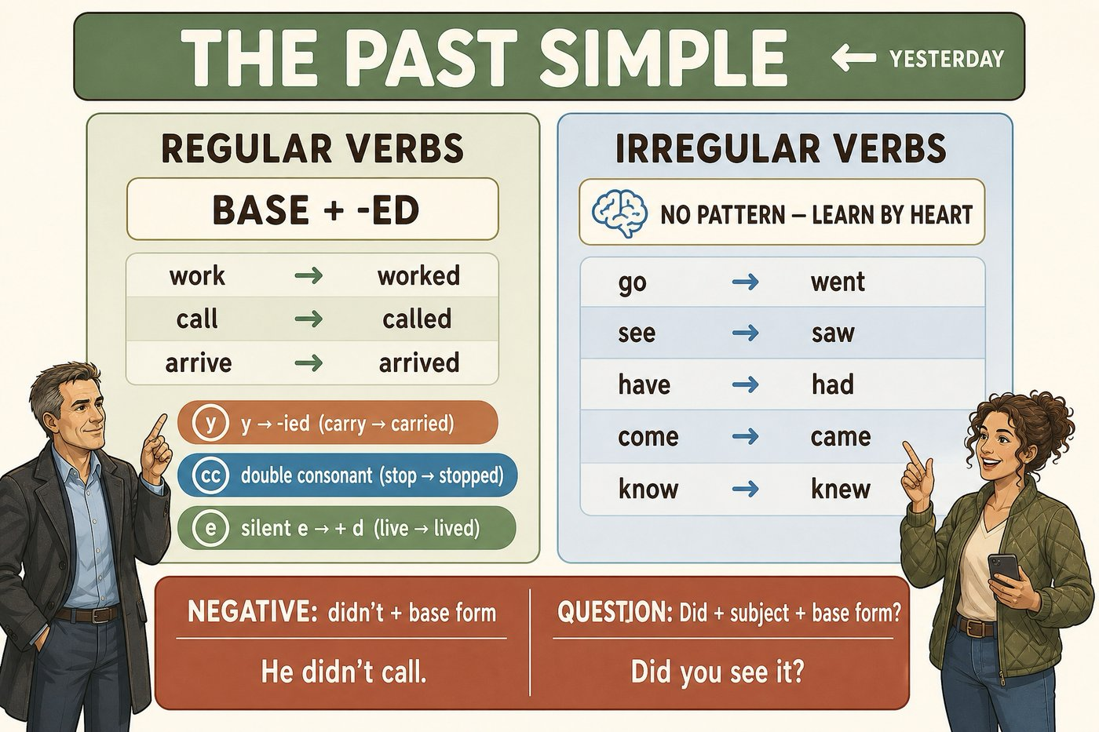
The forms every line will stand on
SÉANCE 03 / 19
SCENE 1
06.58
Past simple · the verbs an incident is made of
Case File 01 — The night nobody heard
Livret p. 5–7
Notes:
Séance de consolidation grammaticale : prétérit (formes, prononciation, orthographe) et verbes à particule du Word file p. 7.

Slide 2



Today's mission
BRIEFING
Livret p. 5–7
ROADMAP
≈ 90 min (indicatif)
BY THE END OF THE SESSION
The past forms of the report — fast and without mistakes — and the eight phrasal verbs an incident is made of.
1
Warm-up: times and three verbs
10'
2
The past simple poster (p. 5)
10'
3
Four forms + one trap
10'
LANGUAGE FOCUS
4
Pronouncing -ed
10'
Past simple: regular / irregular, negative, question, subject question · pronouncing -ed · phrasal verbs (go off, break down, shut down…)
5
Dry run A–C (p. 6)
15'
6
Correction
5'
SKILLS
7
Word file: phrasal verbs (p. 7)
15'
Accuracy under time pressure (Dry run) · using phrasal verbs in a professional context
Extra practice
10'
8
9
Wrap-up
5'
Notes:
Rythme soutenu : les Dry runs sont chronométrés (3 minutes).

Slide 3
Warm-up: times and dated facts
WARM-UP
Séance 2
1. 06.58 → ……………………………………
2. 08.15 → ……………………………………
3. 23.41 → ………………………………
4. I need the timeline …………… nine. → ……………
5. find → ……………
6. go off → ……………
7. hear → ……………
8. The alarm …………… at 23.41. (go off)
Notes:
Oral rapide.

Slide 4
Warm-up: times and dated facts
WARM-UP
✓ CORRECTION
Séance 2
1. 06.58 → six fifty-eight / two minutes to seven
2. 08.15 → eight fifteen / a quarter past eight
3. 23.41 → eleven forty-one p.m.
4. I need the timeline …………… nine. → by
5. find → found
6. go off → went off
7. hear → heard
8. The alarm went off at 23.41. (go off)
Notes:
Oral rapide.

Slide 5

The past simple
FIELD NOTE
Livret p. 5
THE RULES
Regular: base + -ed — work → worked
Spelling: carried · stopped · lived
Irregular: no pattern — learn by heart
Negative: didn’t + base form
Question: Did + subject + base form?
Notes:
Projeter le poster (p. 5 du livret, ici remis à l’endroit). Faire formuler les règles par les élèves avant de montrer la colonne de droite.

Slide 6

Past simple: four forms
GRAMMAR
Livret p. 5–6
AFFIRMATIVE
NEGATIVE
QUESTION
SUBJECT QUESTION
subject + V-ed / V2
didn’t + base
Did + subject + base?
Who / What + V2?
The alarm went off at 23.41.
The cleaners called Mark.
The guard didn’t hear the alarm.
✗ didn’t heard
Did the guard hear the alarm?
✗ Did he heard?
Who found the water?
What happened? — no did
Piège pour francophones — Après did / didn’t, le verbe revient à la base : la marque du passé n’apparaît qu’une seule fois. Did you saw ✗ → Did you see ✓
Notes:
La 4e carte (question sujet) sera reprise en séance 7 (Dry run p. 14 : « Who entered at 20.04? »).

Slide 7

Pronouncing -ed: three sounds
PRONUNCIATION
Hors livret
/t/
/d/
/ɪd/
locked · checked
called · opened
started · recorded
after voiceless sounds: p, k, f, s, sh, ch
stopped · noticed · washed
after voiced sounds (vowels, b, g, l, m, n, v…)
arrived · cleaned · logged
only after t or d: one extra syllable
inspected · flooded · reported
Astuce — Only t and d add a syllable: lock-ed ✗ → /lɒkt/ ✓ · record-ed /rɪˈkɔːdɪd/ ✓
Notes:
Faire répéter en chœur ; mains sur la gorge pour sentir la vibration (voiced / voiceless).

Slide 8
/t/, /d/ or /ɪd/?
+ EXTRA
Hors livret
Say each verb aloud, then write the sound of the ending.
1. locked → ……………
2. recorded → ……………
3. called → ……………
4. noticed → ……………
5. started → ……………
6. opened → ……………
7. checked → ……………
8. flooded → ……………
9. arrived → ……………
10. reported → ……………
Notes:
Correction orale, en insistant sur les /t/ (locked, noticed) souvent prononcés /ɪd/.

Slide 9
/t/, /d/ or /ɪd/?
+ EXTRA
✓ CORRECTION
Hors livret
Say each verb aloud, then write the sound of the ending.
1. locked → /t/
2. recorded → /ɪd/
3. called → /d/
4. noticed → /t/
5. started → /ɪd/
6. opened → /d/
7. checked → /t/
8. flooded → /ɪd/
9. arrived → /d/
10. reported → /ɪd/
Notes:
Correction orale, en insistant sur les /t/ (locked, noticed) souvent prononcés /ɪd/.

Slide 10

Three minutes on the forms you will write today
DRY RUN
Livret p. 6
A · Write the past form. Six are irregular; two are traps.
EXPECTED
1. find → ……………
2. go off → ……………
3. hear → ……………
4. begin → ……………
5. leave → ……………
6. lock → ………………………
7. notice → …………………………
8. shut → ……………
Irregular = learn by heart.
A trap = a regular verb you expect to be irregular.
Three minutes, alone.
Notes:
Chronométrer 3 minutes pour A, B et C (comme dans le livret).

Slide 11
Three minutes on the forms you will write today
DRY RUN
✓ CORRECTION
Livret p. 6
A · Write the past form. Six are irregular; two are traps.
WATCH OUT
1. find → found
2. go off → went off
3. hear → heard
4. begin → began
5. leave → left
6. lock → locked — regular!
7. notice → noticed — regular!
8. shut → shut
lock, notice: regular → locked, noticed (/t/).
shut → shut: same form (like put, cut, set).
begin → began (≠ begun).
Notes:
Chronométrer 3 minutes pour A, B et C (comme dans le livret).

Slide 12
Put the clock in the sentence
DRY RUN
Livret p. 6
B · Rewrite each as a full sentence with the time.
1. cleaners / water / 6.50 → ……………………………………
2. alarm / go off / 11.41 p.m. → ……………………………………
3. team / leave / 7.58 p.m. → ……………………………………
Notes:
Exiger phrase complète : sujet + verbe au prétérit + at + heure.

Slide 13
Put the clock in the sentence
DRY RUN
✓ CORRECTION
Livret p. 6
B · Rewrite each as a full sentence with the time.
WATCH OUT
1. cleaners / water / 6.50 → The cleaners found the water at 6.50 a.m.
2. alarm / go off / 11.41 p.m. → The alarm went off at 11.41 p.m.
3. team / leave / 7.58 p.m. → The team left at 7.58 p.m.
at + a precise time.
A time → past simple (✗ has gone off at…).
Notes:
Exiger phrase complète : sujet + verbe au prétérit + at + heure.

Slide 14
Turn each fact into a negative, then a question
DRY RUN
Livret p. 6
C · Two facts, two negatives, two questions.
1 · The guard heard the alarm.
negative → ……………………………………
question → ……………………………………
2 · The cleaners found the leak at midnight.
negative → ……………………………………
question → ……………………………………
Notes:
Erreur attendue : « didn’t heard », « Did they found ».

Slide 15
Turn each fact into a negative, then a question
DRY RUN
✓ CORRECTION
Livret p. 6
C · Two facts, two negatives, two questions.
WATCH OUT
1 · The guard heard the alarm.
negative → The guard didn’t hear the alarm.
question → Did the guard hear the alarm?
2 · The cleaners found the leak at midnight.
negative → The cleaners didn’t find the leak at midnight.
question → Did the cleaners find the leak at midnight?
did / didn’t + base: hear, find.
Formal report: did not (no contraction).
Notes:
Erreur attendue : « didn’t heard », « Did they found ».

Slide 16
The verbs an incident is made of
WORD FILE
Livret p. 7
An incident is told through phrasal verbs. The verb alone is not enough, and the particle changes everything.
PHRASAL VERB | FRANÇAIS | DANS CE DOSSIER
to go off | se déclencher | The alarm went off at 11.41.
to break down | tomber en panne | Two units broke down during the night.
to shut down | s’arrêter, s’éteindre | Rack A2 shut down automatically.
to turn up | arriver, se présenter | Nobody turned up before 6.47.
to look into | examiner | I will look into the log this morning.
to sort out | régler, démêler | We must sort this out before Friday.
to call out | faire venir (un technicien) | Should we call out an engineer today?
to put off | reporter | We cannot put off the decision.
Notes:
Lecture, répétition, puis faire produire une phrase par verbe à propos de l’incident.

Slide 17
How phrasal verbs work
GRAMMAR
Livret p. 7
INSEPARABLE
SEPARABLE
look into + the log
sort out the claim / sort it out
I will look into the log. ✗ look the log into
No object at all: the alarm went off · two units broke down · nobody turned up
We must sort out the claim = sort the claim out.
With a pronoun, the pronoun goes in the middle: sort it out ✓ — ✗ sort out it
Also: call out an engineer · put off the decision · shut down the rack
Astuce — The particle changes the meaning: go off (se déclencher) · go out (s’éteindre, sortir) · go on (continuer) · go down (baisser, tomber en panne).
Notes:
Approfondissement : position de l’objet.

Slide 18
Say it like an incident report
+ EXTRA
Hors livret
Replace the verb in bold with a phrasal verb from the Word file, in the right form.
1. The engineer arrived at 9.30. → The engineer …………… at 9.30.
2. We postponed the meeting. → We …………… the meeting.
3. The server stopped automatically. → The server …………… automatically.
4. Legal will examine the badge log. → Legal will …………… the badge log.
5. Two cooling units failed. → Two cooling units ……………….
6. We must solve this before Friday. → We must ………………… before Friday.
7. Should we ask a plumber to come today? → Should we …………… a plumber today?
Notes:
Exercice ajouté. Variante orale : un élève dit la phrase « simple », l’autre la reformule.

Slide 19
Say it like an incident report
+ EXTRA
✓ CORRECTION
Hors livret
Replace the verb in bold with a phrasal verb from the Word file, in the right form.
1. The engineer arrived at 9.30. → The engineer turned up at 9.30.
2. We postponed the meeting. → We put off the meeting.
3. The server stopped automatically. → The server shut down automatically.
4. Legal will examine the badge log. → Legal will look into the badge log.
5. Two cooling units failed. → Two cooling units broke down.
6. We must solve this before Friday. → We must sort this out before Friday.
7. Should we ask a plumber to come today? → Should we call out a plumber today?
Notes:
Exercice ajouté. Variante orale : un élève dit la phrase « simple », l’autre la reformule.

Slide 20

Before you close the file
END OF SESSION
NEXT IN THE FILE
BEFORE NEXT SESSION
You leave without breakfast. On the tram, you realise you do not know one thing Mark did not say: how long the water had been running.
Learn the 8 phrasal verbs of the Word file (p. 7).
Learn by heart: begin, break, leave, send, shut, take, see, hear, find.
Read Scene 2 (p. 8): who says what?
EXIT TICKET
Tell the night in three sentences with went off, broke down and turned up.

