Slide 1
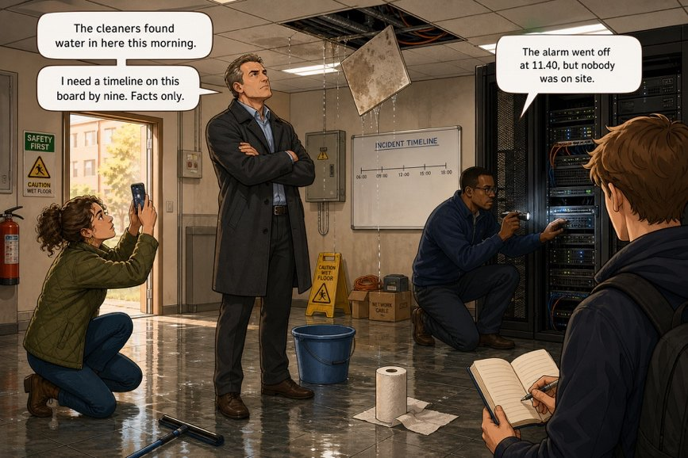
The room with water in it
SÉANCE 04 / 19
SCENE 2
08.15
Four people, a wet floor and nobody knows
Case File 01 — The night nobody heard
Livret p. 8–9
Notes:
Scène 2 : lecture du dialogue dans le local technique. Objectif grammatical : le past continuous (arrière-plan) face au prétérit (événement).

Slide 2



Today's mission
BRIEFING
Livret p. 8–9
ROADMAP
≈ 90 min (indicatif)
BY THE END OF THE SESSION
A list of who said what in the room — and how sure each speaker was.
1
Warm-up: phrasal verbs
10'
2
Describe the picture
5'
3
Words of the room
10'
LANGUAGE FOCUS
4
Read the scene (p. 8–9)
15'
Past continuous (was / were + -ing) vs past simple · certainty markers (I think, may, might) · vocabulary of the room
5
Who said what — how sure?
15'
6
Past continuous
15'
SKILLS
7
Extra practice
10'
Describing a picture · reading a dialogue for facts · acting out a scene
Act it out
5'
8
9
Wrap-up
5'

Slide 3
Warm-up: phrasal verbs
WARM-UP
Séance 3
1. The alarm …………… at 23.41. (se déclencher)
2. Two units ……………… during the night. (tomber en panne)
3. Nobody …………… before 6.47. (arriver)
4. I will …………… the log this morning. (examiner)
5. We cannot …………… the decision. (reporter)

Slide 4
Warm-up: phrasal verbs
WARM-UP
✓ CORRECTION
Séance 3
1. The alarm went off at 23.41. (se déclencher)
2. Two units broke down during the night. (tomber en panne)
3. Nobody turned up before 6.47. (arriver)
4. I will look into the log this morning. (examiner)
5. We cannot put off the decision. (reporter)

Slide 5
The room with water in it
SCENE
Livret p. 8
SCENE 2
08.15
The technical room smells of wet plaster.
Iris is photographing the ceiling. Samuel is on his knees behind the server rack with a torch. Mark is standing in the doorway with his coat still on.
Nobody sits down.
ASK THE CLASS
Look at the picture: who is doing what? Answer with is / are + -ing.
Notes:
Description au présent continu (is photographing, is kneeling, is standing) : tremplin vers le past continuous (was photographing…). Faire lire les bulles de l’image.

Slide 6
Words of the room
VOCABULARY
Livret p. 8–9
ENGLISH | FRANÇAIS | IN THE SCENE
the ceiling · a ceiling tile | le plafond · une dalle | Iris is photographing the ceiling.
wet plaster | du plâtre mouillé | The room smells of wet plaster.
soaked | trempé | The floor is soaked.
a pipe · to leak | une canalisation · fuir | The pipe above the ceiling was leaking.
a server rack · a unit | une baie · un serveur (module) | Two units have already stopped.
a torch (UK) / a flashlight (US) | une lampe torche | Samuel is behind the rack with a torch.
the doorway | l’embrasure de la porte | Mark is standing in the doorway.
cabling | le câblage | They were installing the new cabling.
Notes:
Prononciation : ceiling /ˈsiːlɪŋ/, soaked /səʊkt/, plaster /ˈplɑːstə/.

Slide 7
Technical room, second floor (1/2)
SCENE
Livret p. 8
01 MARK: « Thanks for coming so early. We have a problem. »
02 YOU: « I got your message at seven. What exactly happened? »
03 MARK: « The cleaners found water in here this morning. It was still running when they arrived. »
04 YOU: « Do we know when it started? »
05 MARK: « Not yet. Samuel was checking the server rack when I called him. He says two units have already stopped. »
06 IRIS: « I’ve just come back from the second floor. The pipe above the ceiling was leaking all night, I think. »
07 MARK: « Was anyone in the building yesterday evening? »
08 IRIS: « The contractor’s team was working here until eight. They were installing the new cabling. »
09 SAMUEL: « I’ve looked at the logs. The temperature alarm went off at 11.40 p.m., but nobody was on site. »
10 YOU: « Has anyone told the insurer yet? »
Notes:
Lecture à voix haute par 4 élèves. Questions flash : Who found the water? When did it start? (Not yet known.)

Slide 8

Technical room, second floor (2/2)
SCENE
Livret p. 9
12 IRIS: « And it may be worse than it looks. The floor is soaked. »
13 SAMUEL: « It might be the same pipe as last November. We have had trouble with it since the summer. »
14 MARK: « We should get to the bottom of this before we file a claim. »
15 MARK: « Right. I need a timeline of last night on this board by nine. Facts only. »
LISTEN FOR
I think · may · might = how sure?
was …-ing = the background
have / has … = where we stand now
to get to the bottom of = tirer l’affaire au clair
Notes:
Le livret passe de la ligne 10 à la ligne 12 : la réplique 11 (réponse à « Has anyone told the insurer yet? ») manque. Faire deviner : « Not yet. » (cf. image p. 19).

Slide 9
Read the scene for facts
+ EXTRA
Livret p. 8–9 · hors livret
1. When did you get Mark’s message?
2. What did the cleaners find?
3. Do they know when it started?
4. What has Samuel found?
5. What does Iris think about the pipe?
6. Who was in the building yesterday evening?
7. When did the temperature alarm go off?
8. What does Mark want by nine?

Slide 10
Read the scene for facts
+ EXTRA
✓ CORRECTION
Livret p. 8–9 · hors livret
1. When did you get Mark’s message?
→ At seven.
2. What did the cleaners find?
→ Water — it was still running when they arrived.
3. Do they know when it started?
→ Not yet.
4. What has Samuel found?
→ Two units have already stopped.
5. What does Iris think about the pipe?
→ It was leaking all night — “I think”.
6. Who was in the building yesterday evening?
→ The contractor’s team, until eight (installing cabling).
7. When did the temperature alarm go off?
→ At 11.40 p.m. — according to Samuel.
8. What does Mark want by nine?
→ A timeline of last night — facts only.

Slide 11
Who said what — and how sure?
YOUR MOVE
Livret p. 8–9
For each statement: who said it, which word shows how sure they are, and is it a fact or a supposition?
STATEMENT | WHO | MARKER | FACT OR SUPPOSITION?
It was still running when they arrived. | Mark | …………………………………… | ………………………
The pipe was leaking all night. | Iris | …………… | ………………
The alarm went off at 11.40 p.m. | Samuel | …………………………………… | ………………………………
Nobody was on site. | Samuel | …………… | ……………………
It may be worse than it looks. | Iris | …………… | ………………
It might be the same pipe as last November. | Samuel | …………… | ………………
Notes:
Activité ajoutée qui prépare la scène 3 (« Sort the witnesses », p. 16).

Slide 12
Who said what — and how sure?
YOUR MOVE
✓ CORRECTION
Livret p. 8–9
For each statement: who said it, which word shows how sure they are, and is it a fact or a supposition?
STATEMENT | WHO | MARKER | FACT OR SUPPOSITION?
It was still running when they arrived. | Mark | none — the cleaners saw it | fact (witnessed)
The pipe was leaking all night. | Iris | “I think” | supposition
The alarm went off at 11.40 p.m. | Samuel | “I’ve looked at the logs” | fact? — check the log!
Nobody was on site. | Samuel | none | not proved yet
It may be worse than it looks. | Iris | may | supposition
It might be the same pipe as last November. | Samuel | might | supposition
Notes:
Ligne 3 : Samuel cite les logs, mais la scène 3 montrera 23:41 et non 11.40. Ligne 4 : rien ne le prouve — la scène 3 montrera une entrée de badge à 20:04.

Slide 13
One scene, four grammar tools
GRAMMAR
Livret p. 8–9
Scene 2 contains every tool you will need for the report. Today: the past continuous.
PAST SIMPLE — the dated fact
PAST CONTINUOUS — the background (today)
The cleaners found water.
The alarm went off at 11.40 p.m.
It was still running when they arrived.
Samuel was checking the rack when I called him.
PRESENT PERFECT — where we stand (Scene 4)
MODALS — how sure (Scene 7)
Two units have already stopped.
Has anyone told the insurer yet?
It may be worse than it looks.
It might be the same pipe.
Notes:
Vue d’ensemble : ce dialogue annonce toute la progression grammaticale du dossier.

Slide 14

The past continuous
GRAMMAR
Livret p. 8–9
FORM
USE 1 — IN PROGRESS
USE 2 — BACKGROUND + EVENT
was / were + V-ing
at a given time
was -ing … when + V2
I / he / she / it was working
we / you / they were working
Neg: wasn’t / weren’t · Q: Was it running?
At 7.55 p.m. the team was still working.
At 23.41, water was running behind the ceiling.
Samuel was checking the rack when I called him.
The water was still running when the cleaners arrived.
Piège pour francophones — L’imparfait ne se traduit pas toujours par -ing : Il y avait de l’eau → There was water (✗ there was being) · Personne ne savait → Nobody knew (✗ was knowing). Les verbes d’état (be, have, know, think, want) refusent -ing.

Slide 15
Background and event: the night on a line
GRAMMAR
Livret p. 8–9
A bar is something in progress (past continuous). A dot is an event at a point in time (past simple).
the team was working
water was running behind the ceiling
everybody was sleeping
18.00
20.00
22.00
00.00
02.00
04.00
06.00
the team left
the cleaners found the water
the alarm went off
bar = background → was / were + -ing
dot = event → past simple
Notes:
Faire verbaliser : « While everybody was sleeping, the alarm went off. » / « The water was still running when the cleaners found it. » Les heures exactes viendront de l’Exhibit A (scène 3).

Slide 16
Past simple or past continuous?
+ EXTRA
Hors livret
1. Samuel ………………… (check) the rack when Mark …………… (call) him.
2. At 23.41 the water ……………………… (still run).
3. The cleaners …………… (open) the door and …………… (see) the water.
4. While Iris ……………… (take) photos, Samuel ……………… (read) the log.
5. Nobody …………… (know) about the leak. (state verb)
6. The team …………………… (install) cabling when the manager …………… (arrive).

Slide 17
Past simple or past continuous?
+ EXTRA
✓ CORRECTION
Hors livret
1. Samuel was checking (check) the rack when Mark called (call) him.
2. At 23.41 the water was still running (still run).
3. The cleaners opened (open) the door and saw (see) the water.
4. While Iris was taking (take) photos, Samuel was reading (read) the log.
5. Nobody knew (know) about the leak. (state verb)
6. The team was installing (install) cabling when the manager arrived (arrive).
WATCH OUT
Two actions in a row (open, see) → past simple ×2.
Two parallel backgrounds → past continuous ×2.
know = state verb → knew.

Slide 18
Act it out
SPEAKING
Livret p. 8–9
ROUND 1 — READ
ROUND 2 — PROMPTS ONLY
PRONUNCIATION
Groups of four: Mark · You · Iris · Samuel
Read lines 01–15 aloud, then swap roles.
Close the booklet.
Replay the scene from these prompts: early · seven · water · not yet · two units · all night · until eight · 11.40 · insurer · worse · November · nine
I’ve looked · We’ve had — contract!
Yes/no questions go up ↗: Has anyone told the insurer yet?
soaked /səʊkt/ · ceiling /ˈsiːlɪŋ/

Slide 19

Before you close the file
END OF SESSION
NEXT IN THE FILE
BEFORE NEXT SESSION
“Right. I need a timeline of last night on this board by nine. Facts only.” It is 8.20. You have forty minutes and an empty whiteboard.
Learn the past continuous (form + two uses).
Learn the words of the room.
Read the text p. 9 and underline the twelve verbs in brackets.
EXIT TICKET
Finish the sentence: When the cleaners arrived, … (use the past continuous).

