Slide 1
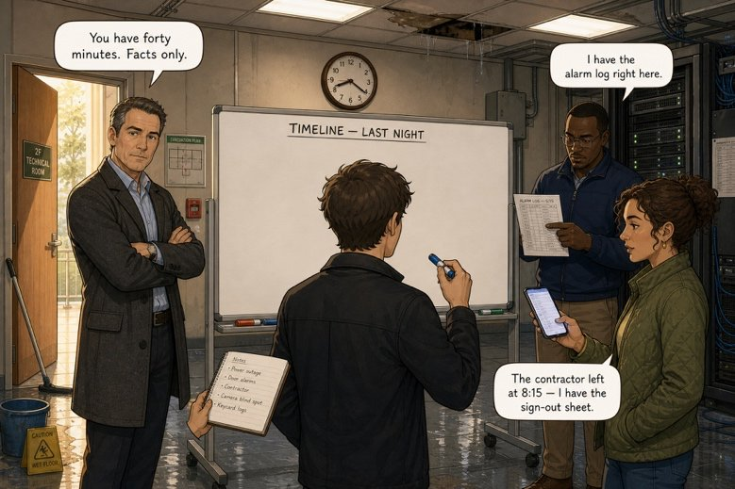
Build the timeline Mark asked for
SÉANCE 05 / 19
SCENE 2
08.20
It is 8.20. Forty minutes and an empty whiteboard.
Case File 01 — The night nobody heard
Livret p. 9–10
Notes:
Production de la chronologie (p. 9) et Dry run (p. 10). Les heures de ce texte (8.15, 11.40) seront contredites par le journal d’alarme en scène 3 : ne pas les corriger maintenant.

Slide 2



Today's mission
BRIEFING
Livret p. 9–10
ROADMAP
≈ 90 min (indicatif)
BY THE END OF THE SESSION
The timeline Mark asked for — twelve verbs, no mistakes.
1
Warm-up
10'
2
When or while?
10'
3
Build the timeline (p. 9)
20'
LANGUAGE FOCUS
Past simple vs past continuous · when / while · spelling of -ing and -ed forms
4
Correction: the night on a line
10'
5
Dry run A–C (p. 10)
15'
6
Spelling rules
5'
SKILLS
Writing a factual narrative · checking your work like a hurried reader
7
Speaking: the alibi game
15'
8
Wrap-up
5'

Slide 3
Warm-up: bar or dot?
WARM-UP
Séance 4
1. Samuel ………………… (check) the rack when Mark …………… (call).
2. At 23.41 water ……………… (run) behind the ceiling.
3. Nobody …………… (know) about the leak.
4. The cleaners …………… (open) the door and …………… (see) the water.

Slide 4
Warm-up: bar or dot?
WARM-UP
✓ CORRECTION
Séance 4
1. Samuel was checking (check) the rack when Mark called (call).
2. At 23.41 water was running (run) behind the ceiling.
3. Nobody knew (know) about the leak.
4. The cleaners opened (open) the door and saw (see) the water.

Slide 5

When or while?
GRAMMAR
Livret p. 9–10
WHILE — a period
WHEN — a point
while + past continuous
when + past simple
= pendant que: the background, the bar
While they were packing their tools, the site manager carried out his last inspection.
= quand, lorsque: the event, the dot
The water was still running when the cleaners arrived.
Astuce — Comma rule: When the cleaners arrived, the water was still running. — No comma when the main clause comes first: The water was still running when the cleaners arrived.

Slide 6

Build the timeline Mark asked for
YOUR MOVE
Livret p. 9
It is 8.20. You have forty minutes and an empty whiteboard. Without this timeline, nobody can write a report.
EXPECTED
At 7.55 p.m. the contractor’s team (1) ……………………… (still work) on the second floor.
They (2) …………… (leave) at 8.15 and (3) …………… (lock) the door behind them.
While they (4) ………………… (pack) their tools, the site manager (5) ……………… (carry out) his last inspection.
He (6) …………………… (not notice) anything. Later, water (7) …………… (begin) to run behind the ceiling.
At 11.40 p.m., while everybody (8) ………………… (sleep), the temperature alarm (9) …………… (go off).
Nobody (10) …………… (hear) it. The cleaners (11) …………… (find) the water at 6.50, when they (12) …………… (open) the room.
Dot (event) → past simple
Bar (background) → was / were + -ing
while → bar · when → dot
Notes:
Travail individuel 10 min, puis comparaison en binôme.

Slide 7

Build the timeline Mark asked for
YOUR MOVE
✓ CORRECTION
Livret p. 9
It is 8.20. You have forty minutes and an empty whiteboard. Without this timeline, nobody can write a report.
WATCH OUT
At 7.55 p.m. the contractor’s team (1) was still working (still work) on the second floor.
They (2) left (leave) at 8.15 and (3) locked (lock) the door behind them.
While they (4) were packing (pack) their tools, the site manager (5) carried out (carry out) his last inspection.
He (6) did not notice (not notice) anything. Later, water (7) began (begin) to run behind the ceiling.
At 11.40 p.m., while everybody (8) was sleeping (sleep), the temperature alarm (9) went off (go off).
Nobody (10) heard (hear) it. The cleaners (11) found (find) the water at 6.50, when they (12) opened (open) the room.
(5) was carrying out is also correct: two actions in progress at the same time.
(6) Formal report: did not rather than didn’t.
(7) began ≠ begun.
Notes:
Ces heures (8.15, 11.40) sont celles « de la salle ». L’Exhibit A (scène 3) donnera 19:58 et 23:41 : c’est tout l’enjeu de la scène suivante.

Slide 8

The night on a line — your timeline
YOUR MOVE
✓ CORRECTION
Livret p. 9
(1) was still working · (4) were packing
(8) everybody was sleeping
(7) water began → was running behind the ceiling
20.00
22.00
00.00
02.00
04.00
06.00
(2) left · (3) locked
(11) found · (12) opened
(9) the alarm went off · (10) nobody heard
Attention — These are the times people remembered (8.15, 11.40). In Scene 3, the alarm log will tell a different story.

Slide 9
Before you hand the board to Mark
DRY RUN
Livret p. 10
A · One form is impossible in each line. Cross it out.
EXPECTED
1. At 8.15 the team left / was leaving the site.
2. While they packed / were packing, the manager checked / was checking the floor.
3. The alarm went off / was going off at 11.41.
4. Water ran / was running behind the ceiling all night.
These are exactly the three errors a hurried reader spots first.
Two minutes.
Notes:
Nuancer : la consigne parle de forme « impossible » ; en anglais courant, « was leaving » et « ran » ne sont pas agrammaticaux, mais inadaptés à un rapport factuel.

Slide 10
Before you hand the board to Mark
DRY RUN
✓ CORRECTION
Livret p. 10
A · One form is impossible in each line. Cross it out.
WATCH OUT
1. At 8.15 the team left / was leaving the site.
2. While they packed / were packing, the manager checked / was checking the floor.
3. The alarm went off / was going off at 11.41.
4. Water ran / was running behind the ceiling all night.
Line 1: was leaving is possible in a story, but a report gives the dated event: left.
Line 2: while + background → were packing; checked and was checking are both correct.
Line 4: ran all night is not wrong English, but the report describes a background.
Notes:
Nuancer : la consigne parle de forme « impossible » ; en anglais courant, « was leaving » et « ran » ne sont pas agrammaticaux, mais inadaptés à un rapport factuel.

Slide 11
Join with when or while
DRY RUN
Livret p. 10
B · Join these sentences with when or while.
1. The cleaners arrived. + The water was still running. → ……………………………………
2. Iris was photographing the ceiling. + She noticed the crack. → ……………………………………

Slide 12
Join with when or while
DRY RUN
✓ CORRECTION
Livret p. 10
B · Join these sentences with when or while.
WATCH OUT
1. The cleaners arrived. + The water was still running. → When the cleaners arrived, the water was still running.
2. Iris was photographing the ceiling. + She noticed the crack. → While Iris was photographing the ceiling, she noticed the crack.
Also correct: The water was still running when the cleaners arrived.
Iris noticed the crack while she was photographing the ceiling.

Slide 13
Spelling: -ing form and past form
DRY RUN
Livret p. 10
C · Write the -ing form and the past form.
1. run → …………………
2. plan → …………………………
3. lie → ……………………………………
4. travel → ……………………………………
5. notice → …………………………
6. carry → …………………………

Slide 14
Spelling: -ing form and past form
DRY RUN
✓ CORRECTION
Livret p. 10
C · Write the -ing form and the past form.
WATCH OUT
1. run → running / ran
2. plan → planning / planned
3. lie → lying / lied (mentir) — lay (être allongé)
4. travel → travelling / travelled (UK)
5. notice → noticing / noticed
6. carry → carrying / carried
US spelling: traveling, traveled.
lie (mentir) → lied · lie (être allongé) → lay, lain.

Slide 15
Four spelling rules for -ing
GRAMMAR
Livret p. 10
DROP THE -E
DOUBLE
IE → Y
Y STAYS
notice → noticing
run → running
lie → lying
carry → carrying
leave → leaving
✗ noticeing
short stressed vowel + one consonant
plan → planning · stop → stopping
die → dying · tie → tying
but carried in the past
study → studying / studied
Astuce — UK doubles a final -l after a short vowel: travel → travelling, cancel → cancelled. US does not: traveling, canceled. Choose one and stay consistent.

Slide 16

The alibi game
SPEAKING
Hors livret
Two “suspects” must prove where they were yesterday between 7 and 11 p.m. The class looks for contradictions.
1
2
3
4
Prepare
Questioned alone
Compare
Language
Pairs, 3 minutes.
Agree on your story: where, what, who, when.
Suspect A goes out. The class questions B (2 min), then A.
What were you doing at 9 p.m.? What happened when…?
The class lists the contradictions.
Two contradictions = the alibi is broken.
I was watching… (bar)
Then we left at… (dot)
when / while
Notes:
Activité orale ajoutée : réemploi du past continuous / prétérit en interaction, et préfiguration de la scène 3 (comparer deux récits).

Slide 17

Before you close the file
END OF SESSION
NEXT IN THE FILE
BEFORE NEXT SESSION
Samuel stands up behind the rack. “There is something else,” he says. “The log does not say what you think it says.”
Copy the corrected timeline (p. 9).
Learn the four spelling rules for -ing.
Write 5 sentences: what were you doing yesterday at 8 p.m., 10 p.m. and 7 a.m.?
EXIT TICKET
One sentence with while, one with when, about the night at Atlas House.

