Slide 1
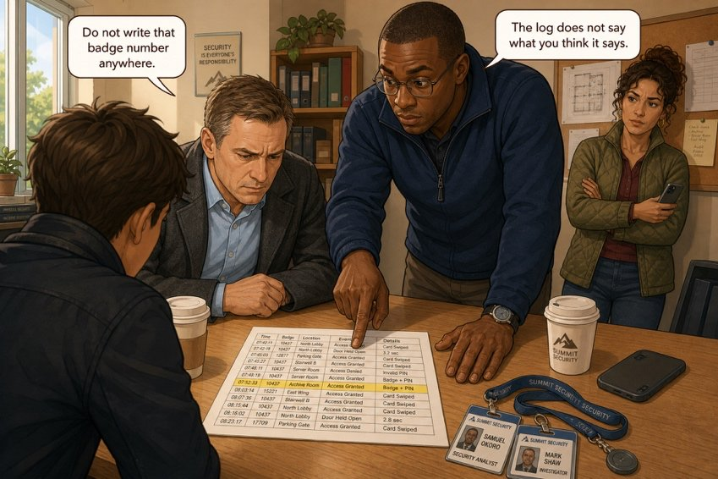
What the log really says
SÉANCE 06 / 19
SCENE 3
09.05
A printed sheet, eight lines, and one contradiction.
Case File 01 — The night nobody heard
Livret p. 11–12
Notes:
Scène 3 : l’Exhibit A (journal de la GTB) contredit ce qui a été dit dans la salle. Compétences : lire des données, comparer deux sources, nommer sans accuser.

Slide 2



Today's mission
BRIEFING
Livret p. 11–12
ROADMAP
≈ 90 min (indicatif)
BY THE END OF THE SESSION
A reading of the log against the room — six answers the insurer cannot contest.
1
Warm-up: spelling
5'
2
Scene 3 + Exhibit A (p. 11)
10'
3
Reading a log aloud
10'
LANGUAGE FOCUS
Reading 24-hour times aloud · durations (from… to, between… and, for) · comparing sources (matches, contradicts, one minute later) · reporting verbs
4
Your move Q1–Q3 (p. 12)
15'
5
Your move Q4–Q6
20'
6
The room vs the log
10'
SKILLS
Reading data critically · cross-checking two sources · naming nobody
7
Reporting verbs
15'
8
Wrap-up
5'

Slide 3
Warm-up: -ing and past forms
WARM-UP
Séance 5
1. run → …………………
2. stop → …………………………
3. notice → …………………………
4. carry → …………………………
5. leave → ……………………
6. lie (mentir) → …………………

Slide 4
Warm-up: -ing and past forms
WARM-UP
✓ CORRECTION
Séance 5
1. run → running / ran
2. stop → stopping / stopped
3. notice → noticing / noticed
4. carry → carrying / carried
5. leave → leaving / left
6. lie (mentir) → lying / lied

Slide 5
What the log really says
SCENE
Livret p. 11
SCENE 3
09.05
Samuel puts a printout on the table. It is the building management system log for the night.
Eight lines. He taps the fourth one with his finger and says nothing.
ASK THE CLASS
Why would someone say nothing — and just tap a line?
Notes:
Bulles de l’image : « Do not write that badge number anywhere. » / « The log does not say what you think it says. » Faire émettre des hypothèses avant de projeter l’Exhibit.

Slide 6

Exhibit A — the night log
EXHIBIT
Livret p. 11
EXHIBIT A
Building management — night log, Monday to Tuesday
READ IT LIKE AN ASSESSOR
19:58 Zone 2F — cabling works — access badge 0447 — exit
20:04 Zone 2F — access badge 0102 — entry — site manager
20:19 Zone 2F — access badge 0102 — exit
23:41 Zone 2F technical room — TEMPERATURE ALARM — threshold 28 °C
23:42 Alarm notification sent — mobile 0470 22 14 09 — status: delivered
23:44 Zone 2F technical room — HUMIDITY ALARM — threshold 85 %
02:16 Server rack A2 — unit 3 — automatic shutdown
06:47 Zone GF — access badge 0771 — entry — cleaning team
Which line is one minute off what Samuel said?
Which line shows somebody in 2F after the works?
Which line shows somebody could have known?
Notes:
Lecture à voix haute de chaque ligne (heures en deux façons). Laisser 2 minutes de lecture silencieuse avec les trois questions de droite.

Slide 7
The words of a log
VOCABULARY
Livret p. 11
ENGLISH | FRANÇAIS | IN EXHIBIT A
a threshold | un seuil | TEMPERATURE ALARM — threshold 28 °C
an access badge | un badge d’accès | access badge 0447
an entry · an exit | une entrée · une sortie | badge 0102 — entry … — exit
a notification | une alerte, une notification | Alarm notification sent
delivered | remis (au destinataire) | status: delivered
humidity | l’humidité | HUMIDITY ALARM — threshold 85 %
an automatic shutdown | un arrêt automatique | unit 3 — automatic shutdown
GF · 2F | rez-de-chaussée · 2e étage | Zone GF — cleaning team

Slide 8

Reading a log aloud
GRAMMAR
Livret p. 11–12
READ THE TIME
GIVE A DURATION
COMPARE
23:41
from 20:04 to 20:19
one minute later than
twenty-three forty-one
or eleven forty-one p.m.
20:04 → twenty oh four · 02:16 → two sixteen a.m.
= fifteen minutes
between 23:41 and 06:47 = seven hours and six minutes
The water ran for about seven hours.
23:41 is one minute later than Samuel said.
The humidity alarm came three minutes after the temperature alarm.
The log matches / contradicts / confirms …
Piège pour francophones — pendant sept heures → for seven hours (✗ during seven hours) · during + a noun: during the night.

Slide 9
Read the log against the room — Q1
YOUR MOVE
Livret p. 12
1. Samuel said the alarm went off at 11.40 p.m. What does the log actually show?
The same time, to the minute — Samuel read it from the log.
23:41 — one minute later than he remembered, so his figure came from memory.
A
B
23:44 — he confused the temperature alarm with the humidity alarm.
The log gives no time for the alarm, only for the notification.
C
D
Notes:
Demander un vote à main levée avant la correction.

Slide 10

Read the log against the room — Q1
YOUR MOVE
✓ CORRECTION
Livret p. 12
1. Samuel said the alarm went off at 11.40 p.m. What does the log actually show?
The same time, to the minute — Samuel read it from the log.
23:41 — one minute later than he remembered, so his figure came from memory.
A
B
23:44 — he confused the temperature alarm with the humidity alarm.
The log gives no time for the alarm, only for the notification.
C
D
Why? Samuel said 11.40 p.m.; the log says 23:41. One minute is nothing — unless the assessor notices that the figure came from memory. In the report, every time comes from Exhibit A.
Notes:
Demander un vote à main levée avant la correction.

Slide 11
Read the log against the room — Q2 · Q4 · Q5
YOUR MOVE
Livret p. 12
2. Samuel said that nobody was on site that night. Which line shows that somebody was in zone 2F after the cabling team had gone, and for how long?
4. Between which two lines did the water run without anyone knowing? Give the length of that period.
5. What happened at 02:16, and what does it prove about the water?

Slide 12
Read the log against the room — Q2 · Q4 · Q5
YOUR MOVE
✓ CORRECTION
Livret p. 12
2. Samuel said that nobody was on site that night. Which line shows that somebody was in zone 2F after the cabling team had gone, and for how long?
→ Lines 20:04 (badge 0102 — entry) and 20:19 (exit): somebody was in zone 2F for fifteen minutes after the cabling team left at 19:58.
4. Between which two lines did the water run without anyone knowing? Give the length of that period.
→ Between 23:41 (temperature alarm) and 06:47 (cleaning team entry): about seven hours (7 h 06).
5. What happened at 02:16, and what does it prove about the water?
→ Unit 3 of rack A2 shut down automatically: the damage was still spreading more than two hours after the alarm. It does not prove where the water came from.
Notes:
Q4 : accepter aussi 23:42 → 06:47 (7 h 05), si l’élève part de la notification. Q5 : insister sur la limite de la preuve.

Slide 13
Read the log against the room — Q3
YOUR MOVE
Livret p. 12
3. One line shows that somebody could have known during the night. Which one?
23:41 — the temperature alarm reached its threshold.
23:42 — a notification was sent to a mobile and marked delivered.
A
B
02:16 — a server unit shut down automatically.
06:47 — the cleaning team entered the ground floor.
C
D

Slide 14
Read the log against the room — Q3
YOUR MOVE
✓ CORRECTION
Livret p. 12
3. One line shows that somebody could have known during the night. Which one?
23:41 — the temperature alarm reached its threshold.
23:42 — a notification was sent to a mobile and marked delivered.
A
B
02:16 — a server unit shut down automatically.
06:47 — the cleaning team entered the ground floor.
C
D
Why? 23:42: a notification was sent and delivered to a mobile — the phone received it, so somebody could have known. It does not prove that anybody read it (see the IT expert, next session).

Slide 15

Read the log against the room — Q6
YOUR MOVE
Livret p. 12
6. Which single line of this log is the most dangerous for us, and who does it point at? Answer in two lines — and be careful how you name that person.
EXPECTED
Name the line, not the person.
Use an impersonal subject: an access was recorded…

Slide 16
Read the log against the room — Q6
YOUR MOVE
✓ CORRECTION
Livret p. 12
6. Which single line of this log is the most dangerous for us, and who does it point at? Answer in two lines — and be careful how you name that person.
→ 20:04 — badge 0102, entry, “site manager”: it places one identifiable person in zone 2F after the works, a few hours before the alarm. Careful wording: An access to zone 2F was recorded at 20:04. — no badge number, no job title.
WATCH OUT
Also acceptable: 23:42 (the mobile that received the alert) — if justified.
✗ The site manager entered the room at 20:04. = an accusation.
Notes:
Prépare la scène 9 (« the fact stays, the number goes »). Le livret fait dire à Mark à la fin de la scène 3 : « Do not write that badge number anywhere. Not yet. »

Slide 17
The room vs the log
+ EXTRA
Livret p. 8–12
What was said at 08.15 — what Exhibit A shows — your verdict.
IN THE ROOM (08.15) | IN THE LOG | VERDICT
Samuel: the alarm went off at 11.40 p.m. | …………… | ……………………………………
Iris: the team was working until eight | ………………… | ……………………………………
Samuel: nobody was on site | …………………………………… | ……………………………………
Mark: two units have stopped | ………………………… | ……………………………………
Briefing: nobody heard it | …………………………………… | ……………………………………
Notes:
Synthèse ajoutée : elle prépare directement « Sort the witnesses » (p. 16, séance 8).

Slide 18
The room vs the log
+ EXTRA
✓ CORRECTION
Livret p. 8–12
What was said at 08.15 — what Exhibit A shows — your verdict.
IN THE ROOM (08.15) | IN THE LOG | VERDICT
Samuel: the alarm went off at 11.40 p.m. | 23:41 | one minute off — from memory
Iris: the team was working until eight | exit at 19:58 | roughly matches — write 19:58
Samuel: nobody was on site | badge entry 20:04 → 20:19 | contradicted (until 20:19)
Mark: two units have stopped | only unit 3 (02:16) | partly confirmed — check unit 2
Briefing: nobody heard it | notification delivered 23:42 | not proved — somebody could have known
Notes:
Synthèse ajoutée : elle prépare directement « Sort the witnesses » (p. 16, séance 8).

Slide 19
Reporting verbs: how much do they commit you?
GRAMMAR
Hors livret
SAID / TOLD
CLAIMED
REPORTED / STATED
CONFIRMED
neutral
doubt
formal
certainty
Samuel said (that) the alarm went off at 11.40.
He told us (that) nobody was on site.
Verdier claims the pipe is old.
= he says so; nothing proves it
The cleaners reported water in the room.
The log states 23:41.
The log confirms that unit 3 shut down at 02:16.
Piège pour francophones — dire à quelqu’un → tell somebody (✗ say somebody) · He said me ✗ → He told me ✓ / He said to me ✓

Slide 20
Report it — at the right level of certainty
+ EXTRA
Hors livret
Rewrite each statement with a reporting verb that shows how much you trust it.
1. Samuel: “The alarm went off at 11.40.” (the log says 23:41) → ……………………………………
2. Verdier: “The pipe is old.” (nothing supports it) → ……………………………………
3. The log: unit 3 shut down at 02:16. → ……………………………………
4. Iris to Mark: “The floor is soaked.” → ……………………………………

Slide 21
Report it — at the right level of certainty
+ EXTRA
✓ CORRECTION
Hors livret
Rewrite each statement with a reporting verb that shows how much you trust it.
1. Samuel: “The alarm went off at 11.40.” (the log says 23:41) → Samuel said that the alarm went off at 11.40, but the log shows 23:41.
2. Verdier: “The pipe is old.” (nothing supports it) → Verdier claims that the pipe is old.
3. The log: unit 3 shut down at 02:16. → The log confirms that unit 3 shut down at 02:16.
4. Iris to Mark: “The floor is soaked.” → Iris told Mark that the floor was soaked.

Slide 22

Before you close the file
END OF SESSION
NEXT IN THE FILE
BEFORE NEXT SESSION
The log does not say what Samuel remembered. Before ten o’clock, you will need eight verbs — and two forms of each: the dated fact, and the result.
Learn the words of a log.
Read Exhibit A aloud at home: every time, two ways.
Learn the reporting verbs: say, tell, claim, report, confirm.
EXIT TICKET
In one sentence: what does line 23:42 prove — and what does it not prove?

