Slide 1
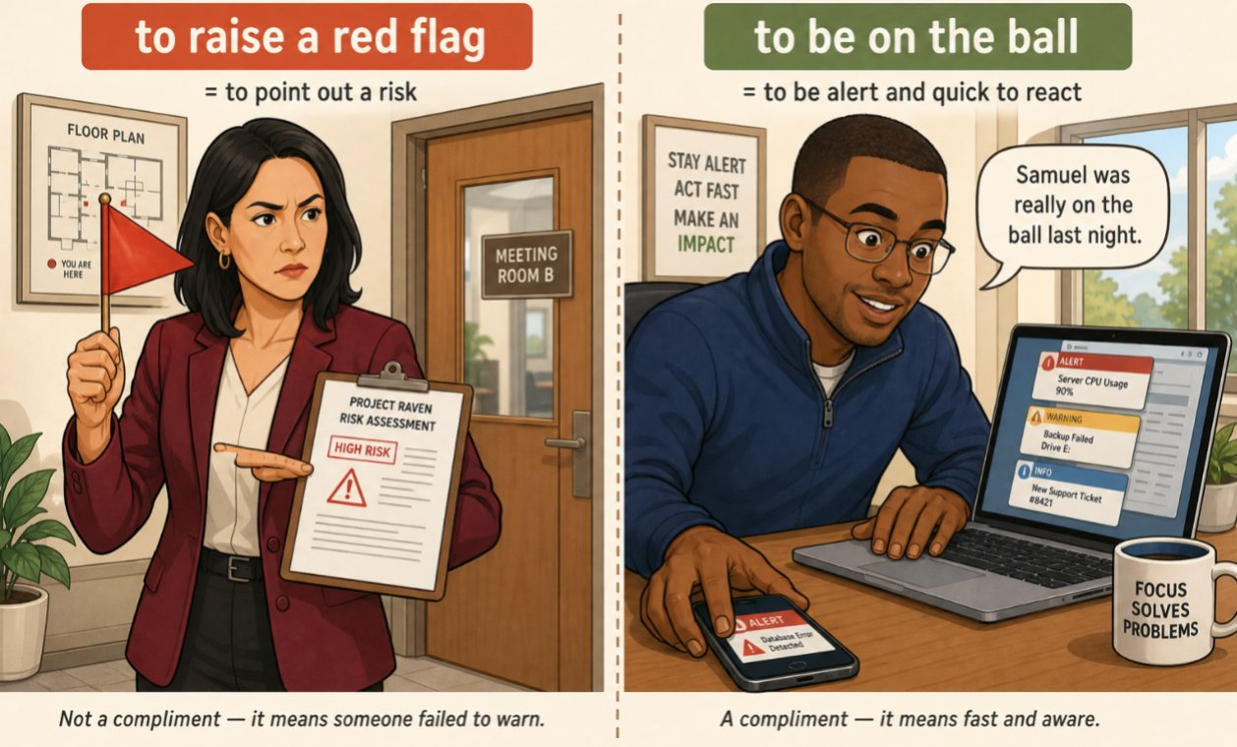
The verbs you will need before ten o’clock
SÉANCE 07 / 19
SCENE 3
09.05
Past simple, past participle — and what professionals say
Case File 01 — The night nobody heard
Livret p. 13–15
Notes:
Consolidation : prétérit / participe passé (préparation du present perfect de la scène 4), questions sujet, collocations professionnelles.

Slide 2



Today's mission
BRIEFING
Livret p. 13–15
ROADMAP
≈ 90 min (indicatif)
BY THE END OF THE SESSION
The verb table (dated fact / result) and the collocations a professional report uses.
1
Warm-up: reporting verbs, durations
10'
2
Field note: two forms of each verb (p. 13)
15'
3
22 irregular verbs for a report
10'
LANGUAGE FOCUS
Irregular verbs: past simple vs past participle · subject questions (Who entered…?) · verb + noun collocations (raise the alarm, file a claim…) · two idioms
4
Dry run A (p. 14)
10'
5
Who…? questions + Dry run B–C
15'
6
Word file: collocations (p. 15)
15'
SKILLS
Accuracy · sounding like a professional, not like a translation
7
Extra practice
10'
8
Wrap-up
5'

Slide 3
Warm-up: report it, time it
WARM-UP
Séance 6
1. Samuel …………… that the alarm went off at 11.40.
2. He …………… us that nobody was on site.
3. Verdier …………… the pipe is old — nothing proves it.
4. The log …………… that unit 3 shut down at 02:16.
5. From 23:41 to 06:47 = ……………………………………

Slide 4
Warm-up: report it, time it
WARM-UP
✓ CORRECTION
Séance 6
1. Samuel said that the alarm went off at 11.40.
2. He told us that nobody was on site.
3. Verdier claims the pipe is old — nothing proves it.
4. The log confirms that unit 3 shut down at 02:16.
5. From 23:41 to 06:47 = seven hours and six minutes

Slide 5
The verbs you will need before ten o’clock
FIELD NOTE
Livret p. 13
Fill in the two missing forms: the past simple, for something that happened at a given time, and the past participle, for the result you report later.
BASE | PAST SIMPLE — a dated fact | PAST PARTICIPLE — the result | CONTEXT
find | …………… | …………… | the water, at 6.50 a.m.
go off | …………… | …………… | the alarm, at 11.41 p.m.
leave | …………… | …………… | the team, at 7.58 p.m.
hear | …………… | …………… | nobody, that night
break down | ……………… | ……………… | unit 3, at 2.16 a.m.
send | …………… | …………… | the notification, at 11.42 p.m.
take | …………… | …………… | the photographs, this morning
see | …………… | …………… | the damage, which you have not seen yet

Slide 6
The verbs you will need before ten o’clock
FIELD NOTE
✓ CORRECTION
Livret p. 13
Fill in the two missing forms: the past simple, for something that happened at a given time, and the past participle, for the result you report later.
BASE | PAST SIMPLE — a dated fact | PAST PARTICIPLE — the result | CONTEXT
find | found | found | the water, at 6.50 a.m.
go off | went off | gone off | the alarm, at 11.41 p.m.
leave | left | left | the team, at 7.58 p.m.
hear | heard | heard | nobody, that night
break down | broke down | broken down | unit 3, at 2.16 a.m.
send | sent | sent | the notification, at 11.42 p.m.
take | took | taken | the photographs, this morning
see | saw | seen | the damage, which you have not seen yet

Slide 7



Two forms, two jobs
GRAMMAR
Livret p. 13
PAST SIMPLE — the dated fact
PAST PARTICIPLE — the result
Something happened at a given time.
The alarm went off at 23.41.
The cleaners found the water at 6.50.
Signals: at, yesterday, last night, in November
With have: Iris has taken the photographs. (Scene 4)
In the passive: the water was found at 6.50. (Scene 8)
Signals: already, yet, just, so far — no date
≠
Astuce — Many verbs have the same two forms (found / found, left / left). Learn the ones that differ: went / gone · took / taken · saw / seen · broke / broken · wrote / written.

Slide 8
22 irregular verbs for an incident report
VOCABULARY
Hors livret
BASE | PAST | PARTICIPLE | BASE | PAST | PARTICIPLE
be | was / were | been | begin | began | begun
break | broke | broken | bring | brought | brought
come | came | come | find | found | found
get | got | got | go | went | gone
have | had | had | hear | heard | heard
know | knew | known | leave | left | left
make | made | made | ring | rang | rung
run | ran | run | see | saw | seen
send | sent | sent | shut | shut | shut
speak | spoke | spoken | take | took | taken
tell | told | told | write | wrote | written
Notes:
Liste de référence à apprendre pour la scène 4 (present perfect). Les participes sont en vert.

Slide 9
Two minutes with Exhibit A in front of you
DRY RUN
Livret p. 14
A · Complete from the log. Use the past form.
1. The cabling team …………… (leave) zone 2F at 19.58.
2. The site manager …………… (enter) at 20.04 and …………… (leave) fifteen minutes later.
3. The temperature alarm …………… (go off) at 23.41.
4. A notification …………… (be) delivered one minute later.
5. Unit 3 …………… (shut down) at 02.16.

Slide 10
Two minutes with Exhibit A in front of you
DRY RUN
✓ CORRECTION
Livret p. 14
A · Complete from the log. Use the past form.
1. The cabling team left (leave) zone 2F at 19.58.
2. The site manager entered (enter) at 20.04 and left (leave) fifteen minutes later.
3. The temperature alarm went off (go off) at 23.41.
4. A notification was (be) delivered one minute later.
5. Unit 3 shut down (shut down) at 02.16.

Slide 11

Who entered? — questions without did
GRAMMAR
Livret p. 14
SUBJECT QUESTION
OBJECT QUESTION
HOW LONG
Who / What + V2 …?
Who / What + did + S + base?
How long did … + base?
The answer is the subject: Somebody entered at 20.04.
→ Who entered zone 2F at 20.04?
→ What happened at 02.16?
No did!
The answer is the object: The guard called somebody.
→ Who did the guard call?
→ What did the log show?
→ How long did the water run?
→ How long was the water running?
(present perfect version: Scene 6)
Piège pour francophones — Qui est entré ? → Who entered? (✗ Who did enter?) · Que s’est-il passé ? → What happened? (✗ What did happen?)

Slide 12
Ask the building manager — and fix the forms
DRY RUN
Livret p. 14
B · Write the question you would ask the building manager.
(who / enter / 20.04) → ……………………………………
(how long / the water / run) → ……………………………………
C · One word is wrong in each sentence. Correct it.
The alarm was going off at 23.41 exactly.
Nobody did heard the notification.
The team was leave at 19.58.

Slide 13
Ask the building manager — and fix the forms
DRY RUN
✓ CORRECTION
Livret p. 14
B · Write the question you would ask the building manager.
(who / enter / 20.04) → Who entered zone 2F at 20.04?
(how long / the water / run) → How long did the water run?
C · One word is wrong in each sentence. Correct it.
The alarm was going off went off at 23.41 exactly.
Nobody did heard heard the notification.
The team was leave left at 19.58.
WATCH OUT
B1: the answer is the subject → no did.
C2: did + past form = double past. Emphatic did hear exists, but not in a report.

Slide 14
What professionals do with an alarm
WORD FILE
Livret p. 15
These verb + noun pairs are not a matter of choice: you learn them as one block.
PROFESSIONALS SAY | THEY NEVER SAY | FRANÇAIS
to raise the alarm | to lift the alarm | donner l’alerte
to assess the damage | to count the damage | évaluer les dégâts
to file a claim | to make a claim file | déclarer un sinistre
to take steps | to do steps | prendre des mesures
to draw up a report | to put up a report | rédiger / établir un rapport
to carry out an inspection | to run an inspection | effectuer une inspection
to meet a deadline | to respect a deadline | respecter un délai
to make good the floor | to repair back the floor | remettre le sol en état

Slide 15

Two idioms: a warning and a compliment
WORD FILE
Livret p. 15
IDIOMS
to raise a red flag = to point out a risk — not a compliment: someone failed to warn
to be on the ball = alert and quick to react — a compliment
+ to drop the ball = to make a mistake by not paying attention
+ to keep an eye on = to monitor

Slide 16
Use the block, not the translation
+ EXTRA
Hors livret
Complete with the right collocation (verb + noun), in the right form.
1. The cleaners ……………………… at 6.50.
2. An expert will ……………………… this afternoon.
3. We should not ………………… before the cause is established.
4. Legal has already ……………… to protect the file.
5. You must ……………………… by 5 p.m.
6. A final inspection …………………… at 20.04.
7. If the estimate arrives late, we will not ……………………….
8. The property manager must ………………………… before the handover.
Notes:
Item 6 : passif — annonce la phrase « sans nom » de la scène 9.

Slide 17
Use the block, not the translation
+ EXTRA
✓ CORRECTION
Hors livret
Complete with the right collocation (verb + noun), in the right form.
1. The cleaners raised the alarm at 6.50.
2. An expert will assess the damage this afternoon.
3. We should not file a claim before the cause is established.
4. Legal has already taken steps to protect the file.
5. You must draw up a report by 5 p.m.
6. A final inspection was carried out at 20.04.
7. If the estimate arrives late, we will not meet the deadline.
8. The property manager must make good the floor before the handover.
Notes:
Item 6 : passif — annonce la phrase « sans nom » de la scène 9.

Slide 18

Before you close the file
END OF SESSION
NEXT IN THE FILE
BEFORE NEXT SESSION
At nine o’clock Mark will ask you what holds up. Six statements were made in the room. Which ones can you prove today?
Learn the 22 irregular verbs (three forms).
Learn the 8 collocations of the Word file (p. 15).
Prepare p. 16: decide P, N or C for each statement.
EXIT TICKET
Ask the two questions you would ask the building manager — one Who…?, one How long…?

