Slide 1
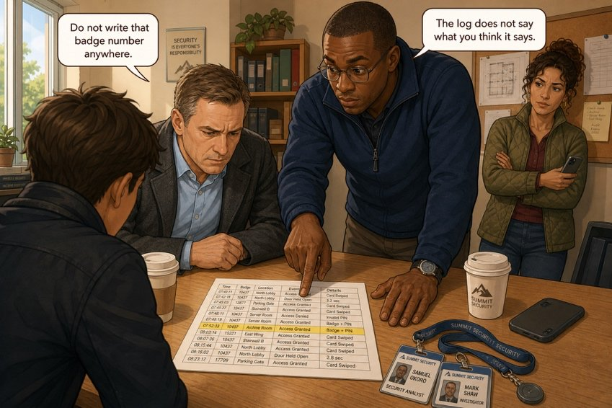
Sort the witnesses
SÉANCE 08 / 19
SCENE 3
09.05
At nine o’clock Mark will ask you what holds up.
Case File 01 — The night nobody heard
Livret p. 16–17
Notes:
Tri des déclarations (P / N / C) et premières questions d’experts : chaque firme explique, en anglais simple, ce que la preuve établit ou non.

Slide 2



Today's mission
BRIEFING
Livret p. 16–17
ROADMAP
≈ 90 min (indicatif)
BY THE END OF THE SESSION
A sorted list of what can be proved (P / N / C) — and one expert answer per firm.
1
Warm-up: collocations
10'
2
The language of evidence
15'
3
Sort the witnesses (p. 16)
15'
LANGUAGE FOCUS
The language of evidence: prove, confirm, show, suggest, does not establish · delivered / received / acknowledged · explaining your field in plain English
4
Correction
10'
5
Your expert: four questions (p. 16–17)
20'
6
Report back to the group
15'
SKILLS
Critical thinking · explaining an expert point to non-experts
Wrap-up
5'
7

Slide 3
Warm-up: the professional block
WARM-UP
Séance 7
1. to …………… the alarm
2. to …………… a claim
3. to …………… the damage
4. to …………… an inspection
5. to …………… a deadline
6. to …………… the floor
7. to …………… a report
8. to …………… steps

Slide 4
Warm-up: the professional block
WARM-UP
✓ CORRECTION
Séance 7
1. to raise the alarm
2. to file a claim
3. to assess the damage
4. to carry out an inspection
5. to meet a deadline
6. to make good the floor
7. to draw up a report
8. to take steps

Slide 5


From proof to doubt: the evidence ladder
GRAMMAR
Hors livret
100 %
✓
≈
?
✗
proves
confirms
shows
suggests
does not establish
The badge log proves that badge 0102 was used at 20:04.
The log confirms that unit 3 shut down at 02:16.
The photos show a soaked floor at 8.20.
The humidity alarm suggests water near the sensors.
The log does not establish who carried the badge.
Piège pour francophones — la preuve → (the) proof (singulier) ou evidence (indénombrable) — ✗ an evidence, ✗ proofs. prouver que → prove that.

Slide 6
Sort the witnesses before Mark asks you to
YOUR MOVE
Livret p. 16
Six statements were made in this room. Mark them P (provable today), N (not yet provable) or C (contradicted by another speaker).
STATEMENT | P / N / C | WHY?
The water was still running at 6.50 a.m. | …………… | ……………………………………
The pipe was leaking all night. | …………… | ……………………………………
The contractor’s team left at eight. | …………… | ……………………………………
Two IT units have stopped working. | ……………… | ……………………………………
It is the same pipe as last November. | …………… | ……………………………………
Nobody was on site at 11.40 p.m. | …………… | ……………………………………

Slide 7
Sort the witnesses before Mark asks you to
YOUR MOVE
✓ CORRECTION
Livret p. 16
Six statements were made in this room. Mark them P (provable today), N (not yet provable) or C (contradicted by another speaker).
STATEMENT | P / N / C | WHY?
The water was still running at 6.50 a.m. | P | The cleaners saw it; their entry is logged (06:47).
The pipe was leaking all night. | N | Iris: “I think” — a supposition; nothing yet on the pipe.
The contractor’s team left at eight. | C | The log shows the exit at 19:58.
Two IT units have stopped working. | P (partly) | Samuel checked; the log shows only unit 3 (02:16).
It is the same pipe as last November. | N | Samuel: “It might be” — needs maintenance records.
Nobody was on site at 11.40 p.m. | N | No badge after 20:19 — but a log only records badges.
Notes:
Accepter d’autres justifications si elles s’appuient sur le dossier. Ligne 3 : « until eight » est approximativement juste (19:58) — l’important est d’écrire l’heure du journal. Ligne 6 : transition vers l’idée-clé suivante.

Slide 8

What a log cannot say
KEY IDEA
Livret p. 16
The absence of a record is not proof of absence.
The log shows no badge between 20:19 and 06:47. It does not show that nobody was in the building.
In a report: No access was recorded between 20:19 and 06:47. ✓ — Nobody was on site. ✗

Slide 9

Sent, delivered, read, acknowledged
YOUR EXPERT
Livret p. 16 · IT
1
2
3
4
sent
delivered / received
read
acknowledged
The system sent the alert (23:42).
Proves: the alarm worked.
The network delivered it; the phone received it.
Proves: somebody could have known.
Somebody opened it.
Not in Exhibit A.
Somebody confirmed it (pressed OK, replied).
Proves: somebody knew.
À retenir — Only acknowledged proves that somebody knew. Delivered proves that somebody could have known.
Notes:
Support pour l’expert IT. Selon les systèmes, « received » désigne parfois la réception par l’appareil (≈ delivered) : laisser l’étudiant IT nuancer.

Slide 10




Your eye on Exhibit A
YOUR EXPERT
Livret p. 16–17
The notification at 23:42 was delivered. What is the difference between delivered, received and acknowledged — and which would the insurer accept as proof that somebody knew?
Line 20:04 shows a badge entry after the works ended. What does an access log establish, and what does it not establish? Would you put badge number 0102 in a written report today?
IT
LAW
Unit 3 shut down at 02:16. Before anything is repaired, what figure do you need and from whom? Name two documents you would ask for this morning.
A humidity alarm followed the temperature alarm three minutes later. What does that sequence usually mean about where the water came from — above the ceiling or below the floor?
ACC
RE
Notes:
Chaque expert prépare sa réponse (5 min) puis l’explique au groupe en 1 minute. Les réponses proposées sont des pistes : valoriser toute réponse argumentée issue du domaine de l’étudiant.

Slide 11
Your eye on Exhibit A
YOUR EXPERT
✓ CORRECTION
Livret p. 16–17
The notification at 23:42 was delivered. What is the difference between delivered, received and acknowledged — and which would the insurer accept as proof that somebody knew?
→ Delivered / received = the message reached the phone. Acknowledged = a person confirmed it. Only acknowledged proves that somebody knew.
Line 20:04 shows a badge entry after the works ended. What does an access log establish, and what does it not establish? Would you put badge number 0102 in a written report today?
→ It establishes that a badge was used at a given time — not who carried it, nor what they did. No: a badge number identifies a person and reads as an accusation.
IT
LAW
Unit 3 shut down at 02:16. Before anything is repaired, what figure do you need and from whom? Name two documents you would ask for this morning.
→ The repair or replacement cost of unit 3 (+ cost of downtime), from the IT provider. Documents: a written estimate and the insurance policy (cover, excess).
A humidity alarm followed the temperature alarm three minutes later. What does that sequence usually mean about where the water came from — above the ceiling or below the floor?
→ A fast sequence suggests water coming from above (ceiling pipework) onto the equipment. A hypothesis — to be checked on site, and in the basement.
ACC
RE
Notes:
Chaque expert prépare sa réponse (5 min) puis l’explique au groupe en 1 minute. Les réponses proposées sont des pistes : valoriser toute réponse argumentée issue du domaine de l’étudiant.

Slide 12
Explain your field in plain English
SPEAKING
Livret p. 16–17
DEFINE
LIMIT
ADVISE
In my field, delivered means …
Put simply, …
It’s a bit like …
What it shows is … What it doesn’t show is …
It proves that … but not who / why …
I would / wouldn’t … because …
Before …, we need … from …
If I were you, I’d ask for …

Slide 13
Proof or not?
+ EXTRA
Hors livret
Say exactly what each piece of evidence proves — and what it does not.
1. A badge entry at 20:04 → ……………………………………
2. A notification marked “delivered” at 23:42 → ……………………………………
3. Photographs timestamped 8.20 → ……………………………………
4. Samuel’s memory of “11.40” → ……………………………………
5. An automatic shutdown at 02:16 → ……………………………………
6. The cleaners’ oral account → ……………………………………

Slide 14
Proof or not?
+ EXTRA
✓ CORRECTION
Hors livret
Say exactly what each piece of evidence proves — and what it does not.
1. A badge entry at 20:04 → proves a badge was used — not who used it
2. A notification marked “delivered” at 23:42 → the phone received it — not that anyone read it
3. Photographs timestamped 8.20 → the state of the room at 8.20
4. Samuel’s memory of “11.40” → not a proof — check it against the log
5. An automatic shutdown at 02:16 → unit 3 stopped — consistent with water damage
6. The cleaners’ oral account → a testimony — ask for a written, signed statement

Slide 15

Before you close the file
END OF SESSION
NEXT IN THE FILE
BEFORE NEXT SESSION
Mark looks at the fourth line for a long moment. Then he says: “Do not write that badge number anywhere. Not yet.”
Learn the evidence ladder: prove · confirm · show · suggest · does not establish.
Write your expert answer in three sentences (your firm).
Revise the past participles (p. 13).
EXIT TICKET
Complete: The badge log proves that … but it does not prove …

