Slide 1
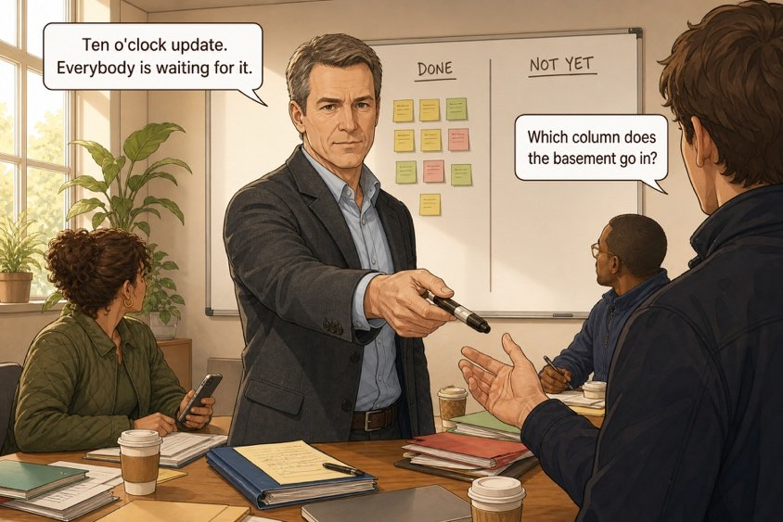
The board
SÉANCE 09 / 19
SCENE 4
09.40
Two columns, one marker and nine people waiting for your update
Case File 01 — The night nobody heard
Livret p. 18–19
Notes:
Scène 4 : le tableau DONE / NOT YET. Objectif grammatical : present perfect (résultat présent) vs prétérit (fait daté) ; already / yet / just.

Slide 2



Today's mission
BRIEFING
Livret p. 18–19
ROADMAP
≈ 90 min (indicatif)
BY THE END OF THE SESSION
The DONE / NOT YET board — every line in the form that says where we stand now.
1
Warm-up: past participles
10'
2
Scene 4 (p. 18)
5'
3
Present perfect: form and use
15'
LANGUAGE FOCUS
Present perfect (have / has + past participle) · already, yet, just · present perfect vs past simple
4
Fill the board (p. 18)
15'
5
Already · yet · just
10'
6
Dry run A–C (p. 19)
15'
SKILLS
Reporting progress clearly · choosing between yesterday and now
7
Yesterday or now? Extra practice
15'
8
Wrap-up
5'

Slide 3
Warm-up: past participles
WARM-UP
Séance 7
1. take → ……………
2. write → ……………
3. send → ……………
4. see → ……………
5. break → ……………
6. go → ……………
7. tell → ……………
8. be → ……………

Slide 4
Warm-up: past participles
WARM-UP
✓ CORRECTION
Séance 7
1. take → taken
2. write → written
3. send → sent
4. see → seen
5. break → broken
6. go → gone
7. tell → told
8. be → been

Slide 5
The board
SCENE
Livret p. 18
SCENE 4
09.40
Mark draws a vertical line down the middle of the whiteboard. On the left he writes DONE. On the right he writes NOT YET.
Then he hands you the marker. “Ten o’clock update,” he says. “Everybody is waiting for it.”
ASK THE CLASS
The board will be photographed and sent to nine people. Must each line say what happened yesterday, or where we stand now?

Slide 6

The present perfect
GRAMMAR
Livret p. 18–19
FORM
USE
NEVER WITH
have / has + past participle
a past action → a result now
a finished time
Iris has taken the photographs.
We haven’t received the estimate.
Has anyone told the insurer?
No date: what matters is now.
The photos exist → has taken.
The estimate is still missing → haven’t received.
✗ has taken at 8.20
✗ have received yesterday
A date → past simple.
Piège pour francophones — Le passé composé ≠ present perfect : J’ai pris les photos à 8 h 20 → I took the photos at 8.20 (date). J’ai pris les photos (résultat, sans date) → I have taken the photos.

Slide 7
Looking at the night from 09.40
GRAMMAR
Livret p. 18–19
The board looks at everything from now (09.40).
insurer still not told
photos taken → result now
20.00
00.00
04.00
08.00
NOW
the alarm went off (23.41)
the cleaners found the water (6.50)
dot with a time → past simple
up to NOW, no time → present perfect
Notes:
Verbaliser : « Iris has taken the photographs » (résultat visible à 09.40) ; « Nobody has told the insurer yet » (situation encore ouverte) ; « The alarm went off at 23.41 » (point daté).

Slide 8

Fill the board
YOUR MOVE
Livret p. 18
You are holding the marker. Complete each line with the form that says where we stand now — not what happened yesterday.
EXPECTED
1. Iris …………… (take) the photographs.
2. Samuel ……………… (look) at the logs, but he …………………… (not check) the basement.
3. Nobody …………… (tell) the insurer.
4. The contractor ……………… (not send) a written statement.
5. Two units ……………… (break) down.
6. We ……………………… (not receive) the estimate.
7. I ………………… (write) to the site manager twice.
8. The humidity alarm …………… (go) off three times this month.
has after he / she / it / a singular noun
Negative: hasn’t / haven’t + participle
Irregular: taken, broken, written, gone

Slide 9
Fill the board
YOUR MOVE
✓ CORRECTION
Livret p. 18
You are holding the marker. Complete each line with the form that says where we stand now — not what happened yesterday.
WATCH OUT
1. Iris has taken (take) the photographs.
2. Samuel has looked (look) at the logs, but he hasn’t checked (not check) the basement.
3. Nobody has told (tell) the insurer.
4. The contractor hasn’t sent (not send) a written statement.
5. Two units have broken (break) down.
6. We haven’t received (not receive) the estimate.
7. I have written (write) to the site manager twice.
8. The humidity alarm has gone (go) off three times this month.
Nobody has told — nobody is already negative.
this month = period not finished → present perfect.

Slide 10
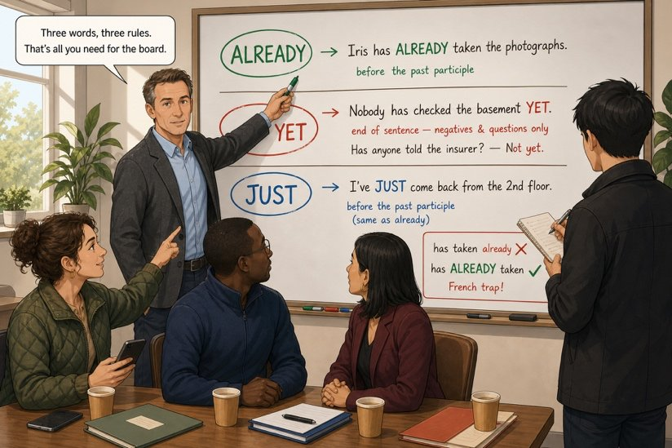

Already, yet, just
FIELD NOTE
Livret p. 19
THREE WORDS, THREE RULES
ALREADY — between have and the participle: Iris has already taken the photographs.
YET — at the end; negatives and questions: Nobody has checked the basement yet. Has anyone told the insurer yet?
JUST — between have and the participle (= very recently): I’ve just come back.
✗ has taken already — French trap

Slide 11
The board will not accept a wrong form
DRY RUN
Livret p. 19
A · Build the form: have or has + participle.
1. The site manager …………………… (not answer) my two messages.
2. We …………… (be) here since seven o’clock.
3. The insurer …………… (send) a first acknowledgement.
B · Put the adverb where it belongs.
1. Iris has photographed the ceiling. (already) → ……………………………………
2. Has the contractor answered? (yet) → ……………………………………
3. Samuel has come back from the basement. (just) → ……………………………………
4. We have not received the estimate. (yet) → ……………………………………

Slide 12
The board will not accept a wrong form
DRY RUN
✓ CORRECTION
Livret p. 19
A · Build the form: have or has + participle.
1. The site manager hasn’t answered (not answer) my two messages.
2. We have been (be) here since seven o’clock.
3. The insurer has sent (send) a first acknowledgement.
B · Put the adverb where it belongs.
1. Iris has photographed the ceiling. (already) → Iris has already photographed the ceiling.
2. Has the contractor answered? (yet) → Has the contractor answered yet?
3. Samuel has come back from the basement. (just) → Samuel has just come back from the basement.
4. We have not received the estimate. (yet) → We have not received the estimate yet.

Slide 13
Yesterday or now?
DRY RUN
Livret p. 19
C · Choose. Three minutes: a false form will remain on nine phones.
1. The alarm went off / has gone off at 11.41 p.m.
2. Nobody told / has told the insurer — she is still waiting.
3. The team left / has left the site at 19.58.
4. I saw / have seen the damage, so I can describe it.

Slide 14
Yesterday or now?
DRY RUN
✓ CORRECTION
Livret p. 19
C · Choose. Three minutes: a false form will remain on nine phones.
WATCH OUT
1. The alarm went off / has gone off at 11.41 p.m.
2. Nobody told / has told the insurer — she is still waiting.
3. The team left / has left the site at 19.58.
4. I saw / have seen the damage, so I can describe it.
A time (at 11.41, at 19.58) → past simple.
A result now (she is still waiting; I can describe it) → present perfect.

Slide 15


Signal words: finished time or up to now?
GRAMMAR
Livret p. 18–19
PAST SIMPLE — finished time
PRESENT PERFECT — up to now
at 11.41 p.m. · at 19.58
yesterday · last night · last November
two hours ago
When did…?
already · yet · just
ever · never · so far
this morning (still morning) · this month
twice · three times
Have you… yet?
≠

Slide 16
Past simple or present perfect?
+ EXTRA
Hors livret
1. Samuel …………… (restore) the backup at 9 a.m.
2. We ……………………… (not receive) the estimate yet.
3. The insurer ……………… (call) twice this morning.
4. I …………… (write) to the site manager yesterday.
5. …………… you ever …………… (see) a leak like this?
6. The cleaners …………… (find) the water at 6.50.

Slide 17
Past simple or present perfect?
+ EXTRA
✓ CORRECTION
Hors livret
1. Samuel restored (restore) the backup at 9 a.m.
2. We haven’t received (not receive) the estimate yet.
3. The insurer has called (call) twice this morning.
4. I wrote (write) to the site manager yesterday.
5. Have you ever seen (see) a leak like this?
6. The cleaners found (find) the water at 6.50.
WATCH OUT
3: this morning — it is 09.40, the morning is not over → present perfect.
5: ever → present perfect.

Slide 18

Before you close the file
END OF SESSION
NEXT IN THE FILE
BEFORE NEXT SESSION
“Ten o’clock update. Everybody is waiting for it.” Five lines, continuous text, no bullet points. Nine people will read it on their phones.
Learn the present perfect (form + already / yet / just).
Write 3 DONE and 3 NOT YET lines about your own week.
Read p. 21 (Word file: progress expressions).
EXIT TICKET
One line for DONE, one for NOT YET — about the case.

