Slide 1
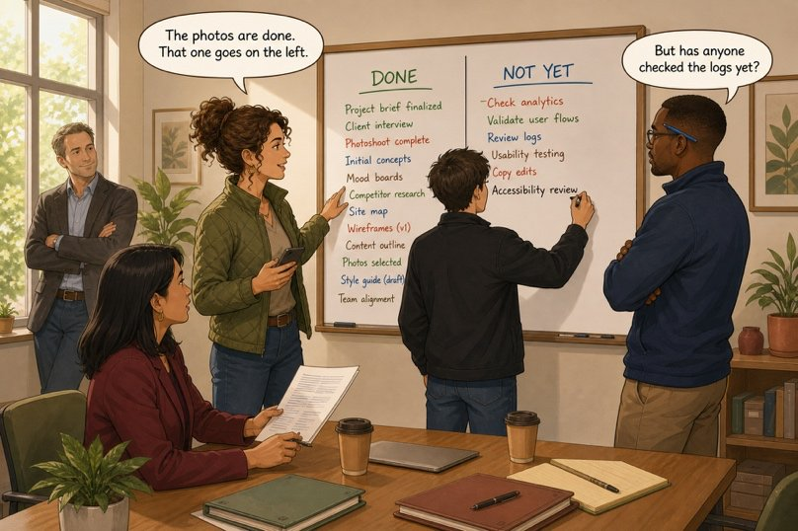
Write the ten o’clock update
SÉANCE 10 / 19
SCENE 4
10.00
Nine people will read this on their phones. Five lines, not six.
Case File 01 — The night nobody heard
Livret p. 20–22
Notes:
Production écrite courte (update de 5 lignes) et travail d’équipe sur le tableau. Vocabulaire : expressions d’avancement + mots de chaque domaine.

Slide 2



Today's mission
BRIEFING
Livret p. 20–22
ROADMAP
≈ 90 min (indicatif)
BY THE END OF THE SESSION
The ten o’clock update (five lines) and your team’s DONE / NOT YET board.
1
Warm-up: already / yet / just
10'
2
Word file: progress expressions (p. 21)
15'
3
Write the update (p. 20)
15'
LANGUAGE FOCUS
Present perfect in context · progress expressions (on track, fall behind, keep in the loop, touch base, up to speed, bottleneck, chase) · your field’s key words
4
Model + common errors
10'
5
Your field’s words (p. 21–22)
10'
6
Team call: the board (p. 20)
20'
SKILLS
Writing a short status update · explaining your field to colleagues
7
Taboo game
5'
8
Wrap-up
5'

Slide 3
Warm-up: where does the adverb go?
WARM-UP
Séance 9
1. Iris has taken the photographs. (already) → ……………………………………
2. Has anyone called the insurer? (yet) → ……………………………………
3. I’ve come back from the basement. (just) → ……………………………………
4. The alarm (go off) at 23.41. → ……………

Slide 4
Warm-up: where does the adverb go?
WARM-UP
✓ CORRECTION
Séance 9
1. Iris has taken the photographs. (already) → Iris has already taken the photographs.
2. Has anyone called the insurer? (yet) → Has anyone called the insurer yet?
3. I’ve come back from the basement. (just) → I’ve just come back from the basement.
4. The alarm (go off) at 23.41. → went off

Slide 5
Talking about progress without saying “it is going well”
WORD FILE
Livret p. 21
Nine people will read your status update. These expressions are better than everything is ok.
EXPRESSION | FRANÇAIS | EXEMPLE
to be on track | être dans les temps | The photographs are on track for ten o’clock.
to fall behind | prendre du retard | The estimate has fallen behind.
to keep somebody in the loop | tenir informé | Please keep me in the loop about the basement.
to touch base with somebody | faire un point rapide | I will touch base with the insurer at noon.
to be up to speed | être au courant | Is everybody up to speed on the log?
a bottleneck | un goulet d’étranglement | The contractor’s statement is the bottleneck.
to chase somebody | relancer quelqu’un | I have chased him twice this morning.

Slide 6
Progress, in context
+ EXTRA
Hors livret
Complete with an expression from the Word file.
1. Don’t worry: the photographs are …………….
2. Can you ………………………… about the basement?
3. The contractor still hasn’t answered — I’ll …………… him again.
4. The estimate is the real ………………: nothing can move without it.
5. Let’s ……………… at noon, before the insurer calls.
6. Is the new colleague ……………… on the log?

Slide 7
Progress, in context
+ EXTRA
✓ CORRECTION
Hors livret
Complete with an expression from the Word file.
1. Don’t worry: the photographs are on track.
2. Can you keep me in the loop about the basement?
3. The contractor still hasn’t answered — I’ll chase him again.
4. The estimate is the real bottleneck: nothing can move without it.
5. Let’s touch base at noon, before the insurer calls.
6. Is the new colleague up to speed on the log?

Slide 8

Write the ten o’clock update
YOUR MOVE
Livret p. 20
Five lines, continuous text, no bullet points. Opening you may use: « Here is where we stand at ten o’clock. »
2 × already
2 progress expressions from the Word file (on track, chase…)
2 × not … yet
No clock time with the present perfect
1 × just
Five lines — nine people read it on a phone

Slide 9

One possible update
YOUR MOVE
✓ CORRECTION
Livret p. 20
Here is where we stand at ten o’clock. Iris has already taken the photographs of the ceiling and the floor, and Samuel has already checked the alarm log, so the timeline is on track. Samuel has just confirmed that unit 3 shut down during the night. However, we have not inspected the basement yet, and the contractor has not sent his written statement yet — I have chased him twice this morning.
IN THE MODEL
already × 2
not … yet × 2
just × 1
on track · chase = Word file
5 sentences, no clock time
Notes:
Modèle à projeter après la production des élèves (pas avant).

Slide 10

Five errors the board will not forgive
PITFALL
Livret p. 19–20
Iris has taken already the photos.
Iris has already taken the photos.
adverb between have and the participle
We didn’t inspect the basement yet.
We haven’t inspected the basement yet.
yet → present perfect (UK)
Samuel has checked the log at 9.05.
Samuel checked the log at 9.05.
a clock time → past simple
Nobody has not told the insurer.
Nobody has told the insurer yet.
nobody is already negative
Everything is ok.
The photographs are on track.
say what is done, not how you feel

Slide 11
Words your colleagues need from you (1/2)
YOUR EXPERT
Livret p. 21
 | WORD | FRANÇAIS | ON THE BOARD
ACC | a damage claim | une déclaration de sinistre | We have opened a damage claim file.
ACC | to write off | passer en pertes, sortir de l’actif | Unit 3 may have to be written off.
ACC | a provision | une provision | We have made a provision of €12,000.
ACC | an insurance premium | une prime d’assurance | The premium has not been recalculated yet.
ACC | a cost centre | un centre de coûts | The repair will go to the site cost centre.
IT | a server rack | une baie de serveurs | Two units in rack A2 have stopped.
IT | a power failure | une panne de courant | There has been no power failure.
IT | a backup | une sauvegarde | The last backup ran at midnight.
IT | to restore | restaurer, rétablir | We have restored the service.
IT | downtime | temps d’arrêt, indisponibilité | Nine hours of downtime so far.

Slide 12
Words your colleagues need from you (2/2)
YOUR EXPERT
Livret p. 21–22
 | WORD | FRANÇAIS | ON THE BOARD
LAW | negligence | la négligence (faute) | We have not raised negligence.
LAW | force majeure | la force majeure | We have reviewed the force majeure clause.
LAW | to notify | notifier, aviser officiellement | We have notified the landlord in writing.
LAW | damages | des dommages-intérêts | ≠ damage (des dégâts) !
LAW | a breach of contract | une violation du contrat | No breach of contract has been established.
RE | a burst pipe | une canalisation éclatée | We have not confirmed a burst pipe yet.
RE | structural damage | des dommages structurels | No structural damage has been found so far.
RE | drainage | l’évacuation des eaux | The drainage has not been checked yet.
RE | an inventory of fixtures | un état des lieux (équipements) | The inventory has not been updated.
RE | to make good | remettre en état | The floor has not been made good yet.

Slide 13

The board is not yours alone
TEAM CALL
Livret p. 20
Groups of four — one representative of each firm. Ten minutes.
1
2
3
4
Two lines each
Your word
Agree
Say why
From your field: one under DONE, one under NOT YET.
Use one word from your list — the others must understand it without a dictionary.
Which single item under NOT YET is blocking all the others?
It’s the bottleneck because… Until we have…, we can’t…

Slide 14
One possible team board
TEAM CALL
Livret p. 20 & 45–46
FIRM | UNDER DONE | UNDER NOT YET
ACC | We have opened a claim file and made a provision of €12,000. | We haven’t received a repair estimate yet.
IT | We have examined the logs and restored the service. | Nobody has inspected the basement yet.
LAW | We have notified the landlord in writing. | The contractor hasn’t signed his statement yet.
RE | We have taken photographs and closed the second floor. | We haven’t updated the inventory of fixtures yet.
Blocking item? Most groups choose the basement inspection or the repair estimate — accept any choice that is justified.
Notes:
Modèle construit à partir des fiches des firmes (p. 45–46). À projeter après le travail de groupe.

Slide 15




Taboo: explain it without saying it
SPEAKING
Hors livret
Each expert explains two words of their field. The others guess. Forbidden: the word itself and its French translation.
Make them guess a provision and an insurance premium.
Make them guess a backup and downtime.
ACC
IT
Make them guess negligence and to notify.
Make them guess a burst pipe and to make good.
LAW
RE

Slide 16

Before you close the file
END OF SESSION
NEXT IN THE FILE
BEFORE NEXT SESSION
At 10.18 your phone buzzes. An e-mail from the contractor. Subject line: “About yesterday evening”.
Learn the 7 progress expressions.
Learn your field’s 5 words + recognise the other 15.
Rewrite your update without looking at the model.
EXIT TICKET
Say your update in 30 seconds — with one already and one yet.

