Slide 1
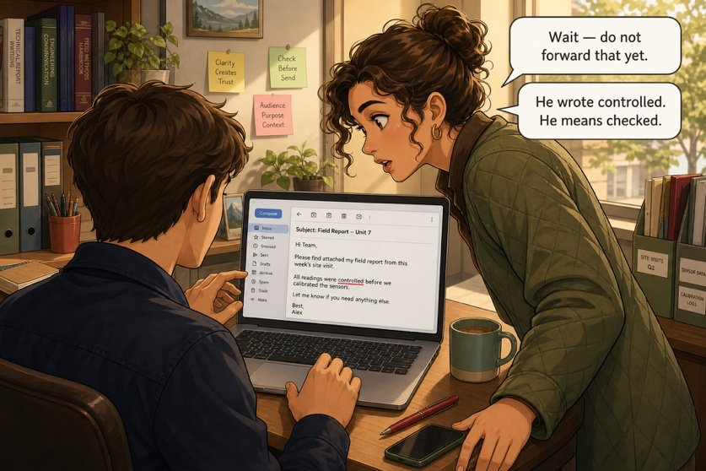
The e-mail you must not forward as it is
SÉANCE 11 / 19
SCENE 5
10.20
The general contractor defends itself. Poorly, and in broken English.
Case File 01 — The night nobody heard
Livret p. 23–24
Notes:
Scène 5 : l’e-mail de Paul Verdier (Exhibit B). Repérer les 7 faux amis et les 2 formes verbales qui placent la soirée dans le mauvais temps. Principe déontologique : on corrige l’anglais, pas le contenu.

Slide 2



Today's mission
BRIEFING
Livret p. 23–24
ROADMAP
≈ 90 min (indicatif)
BY THE END OF THE SESSION
A document fit to be forwarded: seven false friends and two verb forms corrected.
1
Warm-up: progress expressions
10'
2
Scene 5 + Exhibit B (p. 23)
10'
3
Hunt the seven words (p. 24)
20'
LANGUAGE FOCUS
False friends (control, actually, assist, demand, delay, eventually, resume) · past simple with a finished time (yesterday, at 19.58) · e-mail register
4
Correction
10'
5
The two verb forms
10'
6
The clean e-mail
10'
SKILLS
Proofreading for meaning · protecting a file without changing its content
7
E-mail toolkit + covering note
15'
8
Wrap-up
5'

Slide 3
Warm-up: progress, in English
WARM-UP
Séance 10
1. être dans les temps → to be ……………
2. prendre du retard → to ………………
3. tenir informé → to keep somebody ………………
4. faire un point rapide → to ………………
5. relancer quelqu’un → to …………… somebody
6. un goulet d’étranglement → a ………………

Slide 4
Warm-up: progress, in English
WARM-UP
✓ CORRECTION
Séance 10
1. être dans les temps → to be on track
2. prendre du retard → to fall behind
3. tenir informé → to keep somebody in the loop
4. faire un point rapide → to touch base
5. relancer quelqu’un → to chase somebody
6. un goulet d’étranglement → a bottleneck

Slide 5
The e-mail you must not forward as it is
SCENE
Livret p. 23
SCENE 5
10.20
Paul Verdier runs the cabling team. His English is enthusiastic and unreliable.
Mark wants this e-mail forwarded to the insurer within the hour — but not in this state.
An assessor who reads I have controlled the room will wonder what else has been mistranslated.
ASK THE CLASS
What does I have controlled the room mean in English — and what did Verdier want to say?
Notes:
Bulles : « Wait — do not forward that yet. » / « He wrote controlled. He means checked. » En anglais, control = maîtriser, diriger.

Slide 6
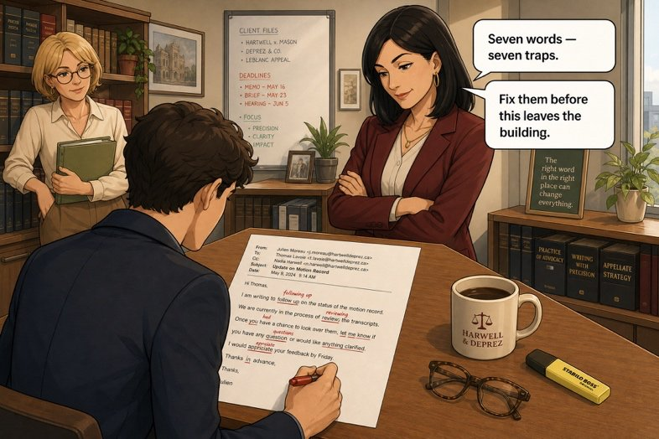

Exhibit B — the contractor’s e-mail
EXHIBIT
Livret p. 23
EXHIBIT B
From: p.verdier@verdier-construction.be
Dear Mr Shaw,
I have controlled the second floor yesterday evening before we go. Actually, we are still waiting for the humidity report.
Two of my men will assist the meeting this afternoon if you want. I have demanded them to come.
We have a delay of two days to finish the cabling, so we are not late. Eventually, we can send you our own report.
I have resumed our position in three lines below. I don’t think it would be sensible to blame my team: the pipe is old and it is not our work. Everything was dry when my team leaves at 19.58.
Kind regards, P. Verdier
YOUR MOVE
7 words used with their French meaning
2 verb forms in the wrong time
sensible = reasonable here: don’t touch it

Slide 7

Clean it before it leaves the building
YOUR MOVE
Livret p. 24
Underline the seven words a French speaker has used with their French meaning, and write what Verdier actually meant. Hint — in the order of the text:
EXPECTED
1. a verb of verification → ……………………………
2. an adverb of time → ……………………………………
3. a verb of help → ……………………
4. a verb of requirement → ………………………
5. a noun of duration → ……………………………………
6. an adverb of conclusion → ……………………………………
7. a verb of summary → ……………………………
You are not correcting homework: you are protecting a file.
Change the words, never the position of the author.

Slide 8

Clean it before it leaves the building
YOUR MOVE
✓ CORRECTION
Livret p. 24
Underline the seven words a French speaker has used with their French meaning, and write what Verdier actually meant. Hint — in the order of the text:
WATCH OUT
1. a verb of verification → controlled → checked
2. an adverb of time → Actually → Currently / At the moment
3. a verb of help → assist → attend
4. a verb of requirement → demanded → asked
5. a noun of duration → a delay → a deadline (two days to finish)
6. an adverb of conclusion → Eventually → If necessary
7. a verb of summary → resumed → summarised
sensible = raisonnable: correct here. (FR sensible = sensitive)
a delay of two days = un retard de deux jours: it says they are late!

Slide 9
Seven words, seven traps — corrected
YOUR MOVE
✓ CORRECTION
Livret p. 24
I have controlled checked the second floor yesterday evening before we go. Actually Currently, we are still waiting for the humidity report.
Two of my men will assist attend the meeting this afternoon if you want. I have demanded asked them to come.
We have a delay a deadline of two days to finish the cabling, so we are not late. Eventually If necessary, we can send you our own report.
I have resumed summarised our position in three lines below. I don’t think it would be sensible to blame my team: the pipe is old and it is not our work. Everything was dry when my team leaves at 19.58.
NOT YET DONE
Two verb forms still put the evening in the wrong time.
Can you find them?

Slide 10
What he wrote, what he meant
WORD FILE
Livret p. 24 & 26
IN THE E-MAIL | VERDIER THOUGHT… | IN ENGLISH IT MEANS… | WRITE INSTEAD
controlled | contrôlé = vérifié | maîtrisé, dirigé | checked
actually | actuellement | en fait, en réalité | currently / at the moment
assist | assister à | aider | attend
demanded | demandé | exigé | asked
a delay | un délai | un retard | a deadline / a time limit
eventually | éventuellement | finalement, à la fin | if necessary / possibly
resumed | résumé | repris | summarised

Slide 11

The two verb forms that matter most to the insurer
YOUR MOVE
Livret p. 24
Now correct the two verb forms that place the evening in the wrong time.
1 · A FINISHED TIME
2 · A PAST EVENT
I have controlled … yesterday evening
when my team leaves at 19.58
→ I checked the second floor yesterday evening.
A finished time (yesterday, last night, at 19.58) → past simple, never have + participle.
→ Everything was dry when my team left at 19.58.
leaves = present: it sounds like a habit, or the future.
Bonus: before we go → before we left.
Pourquoi ces deux-là — They fix when the room was checked and when it was dry: the start of the window the assessor will look at.

Slide 12
The e-mail, fit to be forwarded
YOUR MOVE
✓ CORRECTION
Livret p. 23–24
Dear Mr Shaw,
I checked the second floor yesterday evening before we left. We are currently still waiting for the humidity report.
Two of my men will attend the meeting this afternoon if you wish. I have asked them to come.
We have two days left to finish the cabling, so we are not late. If necessary, we can send you our own report.
I have summarised our position in three lines below. I don’t think it would be sensible to blame my team: the pipe is old and it is not our work. Everything was dry when my team left at 19.58.
Kind regards, P. Verdier
BEFORE YOU FORWARD
Meaning: 7 words fixed
Time: 2 verb forms fixed
His position unchanged: you correct the English, not the content

Slide 13
E-mail toolkit
WRITING
Hors livret
OPENING
BODY
CLOSING
Dear Mr Shaw, / Dear Ms Marsh,
Following our call this morning, …
Please find attached / below …
I am writing to inform you that …
We are currently waiting for …
Could you please confirm … ?
I would be grateful if you could …
Please do not hesitate to contact me if …
I look forward to hearing from you.
Kind regards, / Best regards,
Yours sincerely, (formal)
Piège pour francophones — Je vous prie d’agréer… n’a pas d’équivalent : une formule courte suffit. I look forward to hear ✗ → to hearing ✓

Slide 14
Mark forwards it: the covering note
+ EXTRA
Hors livret
Write the two-line note Mark adds when he forwards the corrected e-mail to the insurer.
EXPECTED
Say what you send and when you received it.
Say that only the English was corrected — transparency protects the file.

Slide 15
Mark forwards it: the covering note
+ EXTRA
✓ CORRECTION
Hors livret
Write the two-line note Mark adds when he forwards the corrected e-mail to the insurer.
→ Dear Ms Marsh, Please find below the contractor’s account of yesterday evening, received at 10.18. Only the English has been corrected; the content is unchanged. Kind regards, Mark Shaw
EXPECTED
Say what you send and when you received it.
Say that only the English was corrected — transparency protects the file.

Slide 16

Before you close the file
END OF SESSION
NEXT IN THE FILE
BEFORE NEXT SESSION
An insurer does not read what an e-mail claims. She reads what it unintentionally concedes.
Learn the 7 false friends (both directions).
Learn the e-mail toolkit (opening, body, closing).
Prepare p. 25: five questions on what the e-mail admits.
EXIT TICKET
Translate: Je vais assister à la réunion. — Nous avons un délai de deux jours.

