Slide 1
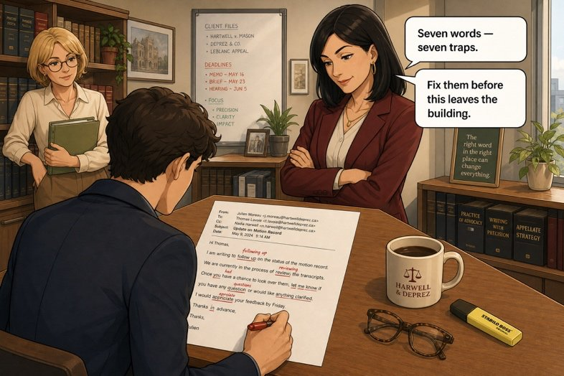
What does this e-mail actually admit?
SÉANCE 12 / 19
SCENE 5
10.20
An insurer reads what an e-mail unintentionally concedes.
Case File 01 — The night nobody heard
Livret p. 25–27
Notes:
Lecture inférentielle de l’Exhibit B, faux amis du dossier (Word file p. 26) et Dry run p. 27 (dont un aperçu de for / since, traité en séance 13).

Slide 2



Today's mission
BRIEFING
Livret p. 25–27
ROADMAP
≈ 90 min (indicatif)
BY THE END OF THE SESSION
Five answers on what the e-mail concedes — and a last check before you press forward.
1
Warm-up: seven false friends
10'
2
Q1–Q2: the time and the excuse (p. 25)
15'
3
Q3–Q5: what helps, what worries
20'
LANGUAGE FOCUS
Fact vs opinion · ten false friends of a claim file · escalate, get to the bottom of, chase · for / since (preview)
4
Word file: ten false friends (p. 26)
10'
5
Dry run A–B (p. 27)
15'
6
Dry run C: for or since? (preview)
15'
SKILLS
Reading between the lines · justifying an answer with the file
Wrap-up
5'
7

Slide 3
Warm-up: what Verdier meant
WARM-UP
Séance 11
1. controlled → ……………
2. Actually → ……………
3. assist → ……………
4. demanded → ……………
5. a delay → ………………
6. Eventually → …………………
7. resumed → ………………
8. when my team leaves → ………………………

Slide 4
Warm-up: what Verdier meant
WARM-UP
✓ CORRECTION
Séance 11
1. controlled → checked
2. Actually → Currently
3. assist → attend
4. demanded → asked
5. a delay → a deadline
6. Eventually → If necessary
7. resumed → summarised
8. when my team leaves → when my team left

Slide 5
What does this e-mail actually admit? — Q1
YOUR MOVE
Livret p. 25
1. Verdier gives one time. How does it compare with Exhibit A?
It contradicts the log by about twenty minutes.
It matches the log exactly, which makes the rest of his e-mail harder to dismiss.
A
B
It matches the badge entry at 20:04, not the cabling team’s exit.
He gives no time at all; he only says “yesterday evening”.
C
D

Slide 6

What does this e-mail actually admit? — Q1
YOUR MOVE
✓ CORRECTION
Livret p. 25
1. Verdier gives one time. How does it compare with Exhibit A?
It contradicts the log by about twenty minutes.
It matches the log exactly, which makes the rest of his e-mail harder to dismiss.
A
B
It matches the badge entry at 20:04, not the cabling team’s exit.
He gives no time at all; he only says “yesterday evening”.
C
D
Why? Verdier writes 19.58; Exhibit A: 19:58 — cabling works — access badge 0447 — exit. A precise, verifiable time: the assessor will take the rest of his e-mail seriously.

Slide 7
What does this e-mail actually admit? — Q2
YOUR MOVE
Livret p. 25
2. He denies responsibility for one reason. Which one, and what is its status?
His team left before eight — a fact, confirmed by the log.
The floor was dry when they left — a fact, but confirmed by nobody else.
A
B
The pipe is old and is not his work — an opinion, supported by nothing in the file.
He has never seen the pipe — an opinion, contradicted by Exhibit C.
C
D

Slide 8
What does this e-mail actually admit? — Q2
YOUR MOVE
✓ CORRECTION
Livret p. 25
2. He denies responsibility for one reason. Which one, and what is its status?
His team left before eight — a fact, confirmed by the log.
The floor was dry when they left — a fact, but confirmed by nobody else.
A
B
The pipe is old and is not his work — an opinion, supported by nothing in the file.
He has never seen the pipe — an opinion, contradicted by Exhibit C.
C
D
Why? “The pipe is old and it is not our work” is his only argument against blame. Nothing in the file supports it yet: it is an opinion.
Notes:
L’option D et la question 5 citent « I have never seen this pipe before », phrase absente de l’Exhibit B tel qu’imprimé p. 23 : à ajouter au texte de l’e-mail ou à reformuler dans le livret.

Slide 9
What does this e-mail actually admit? — Q3 · Q4 · Q5
YOUR MOVE
Livret p. 25
3. One sentence in this e-mail helps our case more than it helps his. Which one, and why?
4. He offers something for this afternoon. Should we accept it today? One line, with your reason.
5. He writes “I have never seen this pipe before.” Why should that sentence make you uncomfortable, given what Samuel said at 8.15?
Notes:
Discussion en binôme avant correction. Q3 et Q4 admettent plusieurs réponses : exiger une justification tirée du dossier.

Slide 10
What does this e-mail actually admit? — Q3 · Q4 · Q5
YOUR MOVE
✓ CORRECTION
Livret p. 25
3. One sentence in this e-mail helps our case more than it helps his. Which one, and why?
→ “Everything was dry when my team left at 19.58.” It matches Exhibit A and gives a dry reference point: the leak started after 19.58 — a sudden event, the kind an insurer covers.
4. He offers something for this afternoon. Should we accept it today? One line, with your reason.
→ Not today: first get his signed written statement — his team is an interested party and the cause is not established. (Accept any justified answer.)
5. He writes “I have never seen this pipe before.” Why should that sentence make you uncomfortable, given what Samuel said at 8.15?
→ Samuel: “It might be the same pipe as last November. We have had trouble with it since the summer.” A known, repeated problem — and a team working next to it says it has never seen it: the denial draws attention to the pipe.
Notes:
Q5 : la phrase citée n’apparaît pas dans l’Exhibit B imprimé (voir note de la diapositive précédente).

Slide 11
Fact, opinion or contradiction?
GRAMMAR
Livret p. 25
IT IS A FACT
IT IS AN OPINION
IT IS CONTRADICTED
The log shows that …
This is confirmed by Exhibit A.
It matches the log exactly.
This is only his opinion.
Nothing in the file supports this.
He claims that … / According to him, …
This is contradicted by …
It does not match …
The two accounts differ on …

Slide 12
Ten words that do not mean what they look like
WORD FILE
Livret p. 26
Verdier’s e-mail contains seven of them. Here are ten, the ones that come up most often in a claim file.
WORD | CE N’EST PAS | C’EST
to control | contrôler = vérifier | maîtriser, piloter. Vérifier = to check.
actually | actuellement | en fait. Actuellement = currently, at present.
eventually | éventuellement | finalement. Éventuellement = possibly, if necessary.
a delay | un délai | un retard. Un délai = a deadline, a time limit.
to assist | assister à | aider. Assister à = to attend.
to demand | demander | exiger. Demander = to ask for.
sensible | sensible | raisonnable. Sensible = sensitive.
to resume | résumer | reprendre. Résumer = to summarise.
an issue | une issue | un problème, une question. Une issue = an exit, an outcome.
to achieve | achever | atteindre, réussir. Achever = to complete, to finish.

Slide 13
Eight more false friends of the office
+ EXTRA
Hors livret
French → English. Beware of the word that looks the same.
1. une formation → ……………
2. prétendre → ……………
3. sympathique → ……………………
4. une librairie → ………………
5. réaliser (un projet) → …………………
6. un agenda → ……………………………
7. supporter quelqu’un → …………………………
8. une location → ……………

Slide 14

Eight more false friends of the office
+ EXTRA
✓ CORRECTION
Hors livret
French → English. Beware of the word that looks the same.
WATCH OUT
1. une formation → training
2. prétendre → to claim
3. sympathique → friendly, nice
4. une librairie → a bookshop
5. réaliser (un projet) → to carry out
6. un agenda → a diary / a calendar
7. supporter quelqu’un → to stand / to bear
8. une location → a rental
to pretend = faire semblant · sympathetic = compatissant
a library = une bibliothèque · to realise = se rendre compte
an agenda = un ordre du jour · to support = soutenir · a location = un emplacement

Slide 15
Two minutes before you press forward
DRY RUN
Livret p. 27
A · Choose. One word is right in each line.
1. We must control / check the basement this afternoon.
2. Actually / Currently the second floor is closed.
3. There was a two-day delay / deadline before we were told.
4. Three colleagues will assist / attend the meeting.
5. The insurer demanded / asked for the alarm log.

Slide 16
Two minutes before you press forward
DRY RUN
✓ CORRECTION
Livret p. 27
A · Choose. One word is right in each line.
WATCH OUT
1. We must control / check the basement this afternoon.
2. Actually / Currently the second floor is closed.
3. There was a two-day delay / deadline before we were told.
4. Three colleagues will assist / attend the meeting.
5. The insurer demanded / asked for the alarm log.
Line 3 is the trap: a two-day delay before we were told = un retard → delay is right here!
Line 5: demanded is English (= exigé), but too aggressive for a neutral report.

Slide 17
Give the English
DRY RUN
Livret p. 27
B · Give the English for each French expression.
1. faire remonter le problème → ……………………………………
2. tirer l’affaire au clair → ……………………………………
3. relancer quelqu’un → ……………………………………

Slide 18
Give the English
DRY RUN
✓ CORRECTION
Livret p. 27
B · Give the English for each French expression.
1. faire remonter le problème → to escalate the problem / to raise the issue
2. tirer l’affaire au clair → to get to the bottom of it (Mark, Scene 2)
3. relancer quelqu’un → to chase somebody (up) / to follow up with somebody

Slide 19
For or since? — a first look
GRAMMAR
Livret p. 27 & 30
FOR
SINCE
THE VERB
for + a duration
since + a starting point
have / has been …
for two days
for eight months
for about three months
since June
since the summer
since seven o’clock
It has been faulty since June.
I have worked on this site for eight months.
Piège pour francophones — depuis + présent en français → present perfect en anglais : Il est fermé depuis ce matin → It has been closed since this morning (✗ It is closed since).

Slide 20
Answer with for or since
DRY RUN
Livret p. 27
C · Write your answers with for or since.
1. How long has this joint been faulty?
2. How long have you worked on this site?
3. How long has the second floor been closed?

Slide 21
Answer with for or since
DRY RUN
✓ CORRECTION
Livret p. 27
C · Write your answers with for or since.
1. How long has this joint been faulty?
→ It has been faulty since June / for about three months.
2. How long have you worked on this site?
→ I have worked here for eight months / since March.
3. How long has the second floor been closed?
→ It has been closed since seven o’clock this morning / for three hours.
Notes:
Réponses libres : vérifier la cohérence for + durée / since + point de départ et le present perfect.

Slide 22

Before you close the file
END OF SESSION
NEXT IN THE FILE
BEFORE NEXT SESSION
11.30. Mark puts his phone on the table and presses speaker. The claims assessor has left a message. She is not asking what you believe. She is asking since when.
Learn the 10 false friends (p. 26).
Learn for (duration) / since (starting point) + present perfect.
Prepare a notepad: second voicemail next session.
EXIT TICKET
Correct: We have a delay of two days. — It is closed since Monday.

