Slide 1
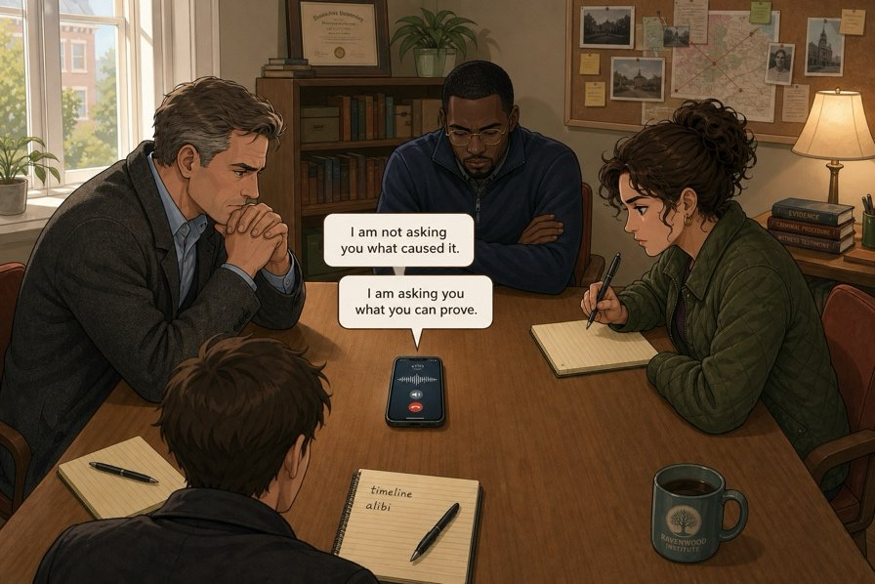
The insurer calls back
SÉANCE 13 / 19
SCENE 6
11.30
She is not asking what you believe. She is asking since when.
Case File 01 — The night nobody heard
Livret p. 28–31
Notes:
Scène 6 : message vocal d’Helen Marsh (à passer deux fois). Le script n’est pas dans le livret : les réponses aux questions 2, 3, 5 et 6 sont des réponses probables à vérifier avec l’enregistrement.

Slide 2



Today's mission
BRIEFING
Livret p. 28–31
ROADMAP
≈ 90 min (indicatif)
BY THE END OF THE SESSION
Three sentences and a deadline: your call back to the assessor.
1
Warm-up: false friends
5'
2
Scene 6 + voicemail × 2
15'
3
Questions 1–6 (p. 29)
15'
LANGUAGE FOCUS
Present perfect + for / since · How long…? · honest answers: not … yet, so far, still · saying it without naming anyone (passive)
4
For or since? (p. 30)
15'
5
Dry run A–C (p. 30)
15'
6
Saying it without naming anyone
5'
SKILLS
Listening for a deadline and a prohibition · a short professional phone call
7
Call her back (p. 31)
15'
8
Wrap-up
5'

Slide 3
Warm-up: choose
WARM-UP
Séance 12
1. We must control / check the basement.
2. Actually / Currently the second floor is closed.
3. Three colleagues will assist / attend the meeting.
4. It is / has been closed since this morning.

Slide 4
Warm-up: choose
WARM-UP
✓ CORRECTION
Séance 12
1. We must control / check the basement.
2. Actually / Currently the second floor is closed.
3. Three colleagues will assist / attend the meeting.
4. It is / has been closed since this morning.

Slide 5
The insurer calls back
SCENE
Livret p. 28
SCENE 6
11.30
Mark puts his phone on the table and presses speaker. The claims assessor has left a message.
She does not sound unfriendly. She sounds like somebody who has heard a great many stories before lunch.
ASK THE CLASS
What do you think an assessor wants first: a cause, or evidence?
Notes:
Bulles : « I am not asking you what caused it. » / « I am asking you what you can prove. »

Slide 6




Voicemail — listen twice
VOICEMAIL
Livret p. 28
Helen Marsh, claims assessor — 11.26
Voicemail · 55 seconds · two listenings. Take notes during the second one only.
Listening 1
Listening 2
Watch out
Pens down. Listen for her tone and her two demands.
Notes: a deadline (day + time), a prohibition (what NOT to write), a question.
She gives you a deadline and a prohibition. Missing either of the two costs the case.

Slide 7
What she wants — Q1
YOUR MOVE
Livret p. 29
1. What does Ms Marsh want from you first?
A full report with a stated cause.
The alarm log and the photographs.
A
B
The contractor’s written statement.
A telephone call from Mr Shaw himself.
C
D

Slide 8

What she wants — Q1
YOUR MOVE
✓ CORRECTION
Livret p. 29
1. What does Ms Marsh want from you first?
A full report with a stated cause.
The alarm log and the photographs.
A
B
The contractor’s written statement.
A telephone call from Mr Shaw himself.
C
D
Why? She wants evidence before explanations: the log (verifiable times) and the photographs (the state of the room). To be checked against your recording.

Slide 9
What she warns you about — Q2 · Q3 · Q5 · Q6
YOUR MOVE
Livret p. 29
2. She gives a deadline. What is it exactly, and what happens if you miss it?
3. She warns you about one thing you must not put in the report. What, and why?
5. She asks one question that nobody in the room can answer yet. Which one?
6. “I am not asking you what caused it. I am asking you what you can prove.” What does that change about the report?

Slide 10
What she warns you about — Q2 · Q3 · Q5 · Q6
YOUR MOVE
✓ CORRECTION
Livret p. 29
2. She gives a deadline. What is it exactly, and what happens if you miss it?
→ Day + time as said in the recording — note it in full. If you miss it, the claim is delayed — or refused.
3. She warns you about one thing you must not put in the report. What, and why?
→ A cause that has not been proved (and no names): an unproved cause stated as a fact gives her grounds to refuse.
5. She asks one question that nobody in the room can answer yet. Which one?
→ How long has this been going on? — since when has the pipe been faulty?
6. “I am not asking you what caused it. I am asking you what you can prove.” What does that change about the report?
→ The report is built on verifiable facts (times, log, photos); the cause may only appear as a hypothesis (may / might).
Notes:
Réponses probables, déduites du livret (titre de la scène, bulles, p. 30–31, p. 43). À ajuster à l’enregistrement, en particulier l’échéance exacte (Q2).

Slide 11
What she wants — Q4
YOUR MOVE
Livret p. 29
4. Is it correct to say that she has already decided to refuse the claim?
Yes: she says the file looks weak.
Yes: she mentions a previous refusal.
A
B
No: she asks for evidence before deciding.
No: she has already accepted it in principle.
C
D

Slide 12
What she wants — Q4
YOUR MOVE
✓ CORRECTION
Livret p. 29
4. Is it correct to say that she has already decided to refuse the claim?
Yes: she says the file looks weak.
Yes: she mentions a previous refusal.
A
B
No: she asks for evidence before deciding.
No: she has already accepted it in principle.
C
D
Why? She has not decided anything: she asks for evidence first. An assessor neither refuses nor accepts before reading the file.

Slide 13
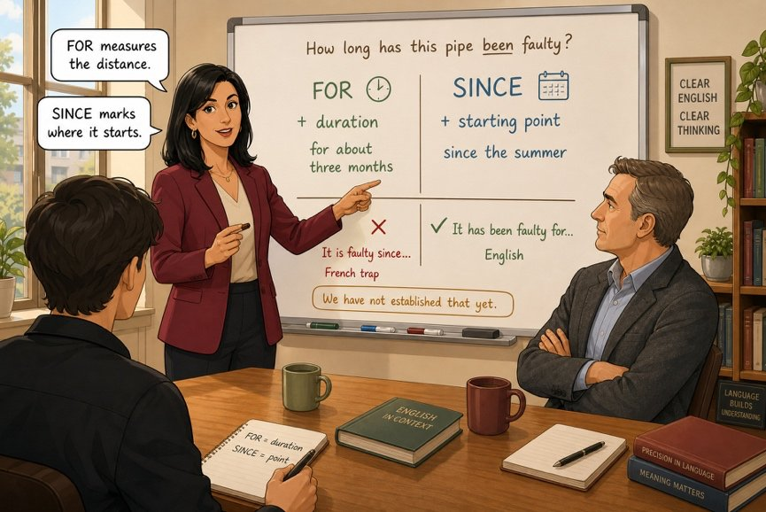

How long has this pipe been faulty?
FIELD NOTE
Livret p. 30
ON THE BOARD
FOR measures the distance: for about three months
SINCE marks where it starts: since the summer
Question: How long has this pipe been faulty?
✗ It is faulty since… — French trap
✓ It has been faulty for…

Slide 14
Since = the starting point · for = the length
GRAMMAR
Livret p. 30
it has been faulty — for about five months
June
July
August
September
October
November
NOW
since 14 June
since + a starting point: since June, since 7 a.m., since Monday
for + a duration: for five months, for two days, for an hour
Piège pour francophones — il y a trois mois = three months ago (past simple: It started three months ago.) ≠ depuis trois mois = for three months (present perfect).
Notes:
Frise générique (le mois de l’incident n’est pas précisé dans le livret) : l’important est la logique point de départ / durée.

Slide 15
One minute before you dial
DRY RUN
Livret p. 30
A · for or since?
1. The joint has been faulty …………… June.
2. We have worked on this site …………… eight months.
3. Nobody has used the basement …………… the summer.
4. She has had the file …………… two days.
B · Build the question the assessor will ask.
(how long / this / go on) → ……………………………………
(how long / you / know / about the joint) → ……………………………………

Slide 16
One minute before you dial
DRY RUN
✓ CORRECTION
Livret p. 30
A · for or since?
1. The joint has been faulty since June.
2. We have worked on this site for eight months.
3. Nobody has used the basement since the summer.
4. She has had the file for two days.
B · Build the question the assessor will ask.
(how long / this / go on) → How long has this been going on?
(how long / you / know / about the joint) → How long have you known about the joint?

Slide 17
Say the honest sentence
DRY RUN
Livret p. 30
C · You do not know the answer. Write it in English, three ways.
1. (not … yet) → ……………………………………
2. (so far) → ……………………………………
3. (we are still) → ……………………………………

Slide 18
Say the honest sentence
DRY RUN
✓ CORRECTION
Livret p. 30
C · You do not know the answer. Write it in English, three ways.
WATCH OUT
1. (not … yet) → We have not identified the cause yet.
2. (so far) → So far, we have found no evidence of when it started.
3. (we are still) → We are still waiting for the basement inspection.
not … yet, so far → present perfect.
still → before the main verb, after be: We are still waiting.

Slide 19

Name the fact, not the person
GRAMMAR
Livret p. 31 & 42
PASSIVE
IMPERSONAL SUBJECT
WE / THE FILE
be + past participle
Badge 0102 entered… →
An access was recorded at 20.04.
The log shows that …
We have not established the cause yet.
The file does not show who …
The site manager checked the room. →
A final inspection was carried out at 20.04.
Astuce — Keep the time, the place, the action — drop the name, the badge number and the job title.

Slide 20

Call her back
YOUR MOVE
Livret p. 31
Three questions to handle, one minute before she takes on another file. Write the three sentences you will say.
EXPECTED
1. One with for or since.
2. One with not … yet.
3. One that avoids naming anybody.
Short sentences, no hesitation.
Open: Ms Marsh, this is … from …, calling about Atlas House.
Close: You will have the report by …

Slide 21
Call her back
YOUR MOVE
✓ CORRECTION
Livret p. 31
Three questions to handle, one minute before she takes on another file. Write the three sentences you will say.
EXPECTED
1. One with for or since.
→ We have had trouble with this section of pipework since the summer.
2. One with not … yet.
→ We have not established the cause yet: the basement has not been inspected yet.
3. One that avoids naming anybody.
→ An access to zone 2F was recorded between 20.04 and 20.19.
Short sentences, no hesitation.
Open: Ms Marsh, this is … from …, calling about Atlas House.
Close: You will have the report by …

Slide 22
Role play: one minute on the phone
SPEAKING
Livret p. 31
STUDENT A — the representative
STUDENT B — the assessor
Open: Ms Marsh, this is … from …
Give your three sentences.
If you don’t know: I’m afraid I can’t confirm that at this stage.
Close: You will have the report by …
Ask: How long has this been going on?
Ask: Who was in the room last night?
Ask: So what caused it?
Hang up after one minute — exactly.

Slide 23

Before you close the file
END OF SESSION
NEXT IN THE FILE
BEFORE NEXT SESSION
As you hang up, Samuel says quietly: “Before you write anything — nobody has been down to the basement.”
Learn for / since + present perfect.
Learn three ways to say I don’t know yet: not … yet · so far · still.
Write your three call-back sentences again, from memory.
EXIT TICKET
How long have you been studying English? Answer with for, then with since.

