Slide 1
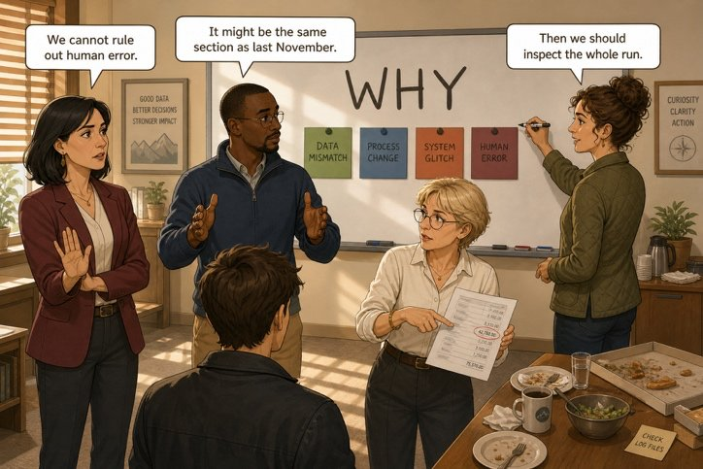
Four experts, one whiteboard
SÉANCE 14 / 19
SCENE 7
13.00
Nobody knows. Yet something must be written.
Case File 01 — The night nobody heard
Livret p. 32–34
Notes:
Scène 7 : le tableau des hypothèses (team call en 3 rounds). Grammaire : modaux de certitude (must / may / might / can’t) et should.

Slide 2



Today's mission
BRIEFING
Livret p. 32–34
ROADMAP
≈ 90 min (indicatif)
BY THE END OF THE SESSION
A hypothesis board: two hypotheses, one ruled out, one recommendation (draft).
1
Warm-up: for / since
10'
2
Scene 7 (p. 32)
5'
3
Field note: how sure are you? (p. 34)
15'
LANGUAGE FOCUS
Modals of certainty: must, may, might, can’t · should for advice · questions that test a hypothesis
4
Three rules, two traps
10'
5
Your cards (p. 33)
5'
6
Team call: rounds 1–2
25'
SKILLS
Presenting a hypothesis in 90 seconds · questioning without interrupting · reaching a group decision
7
Round 3: the board
10'
8
Wrap-up
10'

Slide 3
Warm-up: since when?
WARM-UP
Séance 13
1. The joint has been faulty …………… June.
2. We have worked here …………… eight months.
3. (how long / the floor / be / closed) → ……………………………………
4. Honest answer with so far → ……………………………………

Slide 4
Warm-up: since when?
WARM-UP
✓ CORRECTION
Séance 13
1. The joint has been faulty since June.
2. We have worked here for eight months.
3. (how long / the floor / be / closed) → How long has the floor been closed?
4. Honest answer with so far → So far, we have not found the cause.

Slide 5
Four experts, one whiteboard
SCENE
Livret p. 32
SCENE 7
13.00
After lunch, Mark rubs out the timeline and writes a single word at the top of the board: WHY.
Then he says the sentence that makes everyone uncomfortable: “Nobody leaves this room until we have three hypotheses and one recommendation. Not four hypotheses. Not zero.”
ASK THE CLASS
Why exactly three hypotheses — not four, not zero?
Notes:
Bulles : « We cannot rule out human error. » / « It might be the same section as last November. » / « Then we should inspect the whole run. » Les trois hypothèses = deux retenues + une écartée.

Slide 6
How to be certain that you are not certain
FIELD NOTE
Livret p. 34
How sure are you?
can’t
might
may
must
0 % impossible
certain 100 %
can’t
≈ 5 %
might
≈ 40 %
may
≈ 50 %
must
≈ 95 %
should
advice
It can’t be the cabling team — they left at 19:58.
c’est impossible
It might be the same section as last November.
il se pourrait que
The damage may be worse than it looks.
il est possible que
The pipe must be the cause — nothing else was wet.
c’est sûrement
We should inspect the whole run before the handover.
il faudrait
Notes:
Le livret : « Mark’s board only accepts sentences that state their own degree of certainty. In English, that degree is set by a single word, placed before the verb. »Le livret : « Mark’s board only accepts sentences that state their own degree of certainty. In English, that degree is set by a single word, placed before the verb. »

Slide 7
Three rules, two traps
FIELD NOTE
Livret p. 34
NO -S
NO TO
NO DO
She might be right.
✗ She mights
We should wait.
✗ should to wait
(but ought to, have to)
Should we call her?
✗ Do we should…?
Neg: can’t, shouldn’t, mustn’t
TRAP 1 — MUSTN’T
TRAP 2 — THE PAST
THE RISK
must be = sûrement (deduction)
mustn’t = interdiction!
The opposite of must be is can’t be.
modal + have + participle
It might have been the same joint.
It can’t have been the team.
One categorical sentence about the cause = grounds to refuse.
Write might: same idea, no exposure.

Slide 8




Your card
YOUR EXPERT
Livret p. 33
Your card. Last November a comparable claim was settled at 80 %. A provision of €12,000 has been opened this morning. No budget line exists for an excess above €5,000. Your question to the group: if the cause is never established, who carries the difference — and in which financial year does it land?
Your card. The last backup ran at midnight, sixteen minutes after the temperature alarm. Unit 3 shut down at 02:16. Total downtime: nine hours. Your question to the group: the notification was delivered at 23:42 to a mobile number. Does “delivered” mean somebody was warned?
ACC
IT
Your card. The lease runs for nine years. The maintenance clause places routine inspection with the property manager and structural works with the landlord. A badge entry at 20:04 is logged. Your question to the group: at what point does a repeated fault stop being an accident and start being negligence — and who would have to prove it?
Your card. The humidity alarm followed the temperature alarm by three minutes. The same section of pipework failed last November. The handover to the tenant is on 1 March. Your question to the group: if the second floor is unusable for three weeks, what does the tenant become entitled to, and from what date?
LAW
RE
Notes:
Chaque élève ne lit que la carte de sa firme (information asymétrique) : c’est ce qui rend le team call nécessaire.

Slide 9


The hypothesis board
TEAM CALL
Livret p. 32
Groups of four — one representative of each firm. Twenty-five minutes.
5′
12′
8′
Round 1 — alone
Round 2 — together
Round 3 — decide
Write one hypothesis that only somebody from your field would think of.
Add one fact you can already prove to support it.
90 seconds each, no interruptions.
Then each listener asks one question: What would prove that? or What would rule that out?
In writing and out loud: 2 hypotheses, 1 ruled out, 1 recommendation.
Nobody may name a person.
Astuce — Mark’s board only accepts sentences that state their own degree of certainty.

Slide 10
Present, test, decide
SPEAKING
Livret p. 32
PRESENT
TEST
DECIDE
My hypothesis is that the water might have come from …
What supports it is … (a fact from the file).
I’m about 40 % sure.
What would prove that?
What would rule that out?
Where does that figure come from?
How sure are you?
I think we can rule out …, because …
We should keep … and …
So we agree that … ?

Slide 11
Your group’s board
TEAM CALL
Livret p. 32
 | OUR HYPOTHESIS | WHAT SUPPORTS IT
Hypothesis 1
Hypothesis 2
Ruled out
We recommend
Notes:
Grille vierge à projeter pendant le round 3 (ou à remplir en direct avec un groupe).

Slide 12
One possible board
TEAM CALL
Livret p. 32–34
 | OUR HYPOTHESIS | WHAT SUPPORTS IT
Hypothesis 1 | The water might come from the same section of pipework as last November. | Same section failed last November; humidity alarm 3 min after the temperature alarm.
Hypothesis 2 | The cabling works may have disturbed the pipework. | Works in zone 2F until 19:58.
Ruled out | The leak can’t have started while the team was in the room. | Room dry at 19:58; first alarm at 23:41.
We recommend | We should inspect the whole run, basement included, before the handover. | Handover on 1 March; nobody has been to the basement.
Notes:
Un exemple parmi d’autres : à projeter après les productions des groupes. Vérifier qu’aucune phrase ne nomme une personne.

Slide 13
Rate it, then write it
+ EXTRA
Hors livret
Rewrite each categorical sentence with the modal that matches the certainty in brackets.
1. The joint caused the leak. (95 %) → ……………………………………
2. The drainage is blocked. (50 %) → ……………………………………
3. The works damaged the pipe. (40 %) → ……………………………………
4. The alarm system failed. (5 %) → ……………………………………
5. Inspect the basement. (advice) → ……………………………………

Slide 14
Rate it, then write it
+ EXTRA
✓ CORRECTION
Hors livret
Rewrite each categorical sentence with the modal that matches the certainty in brackets.
1. The joint caused the leak. (95 %) → The joint must have caused the leak.
2. The drainage is blocked. (50 %) → The drainage may be blocked.
3. The works damaged the pipe. (40 %) → The works might have damaged the pipe.
4. The alarm system failed. (5 %) → The alarm system can’t have failed: it sent a notification at 23:42.
5. Inspect the basement. (advice) → We should inspect the basement today.

Slide 15

Before you close the file
END OF SESSION
NEXT IN THE FILE
BEFORE NEXT SESSION
Mark will photograph your board. What is on it will go, word for word, into tonight’s report.
Learn the certainty scale: can’t · might · may · must (+ should).
Learn the three rules: no -s, no to, no do.
Bring your group’s draft board next session.
EXIT TICKET
One sentence about the leak with might, one with can’t.

