Slide 1
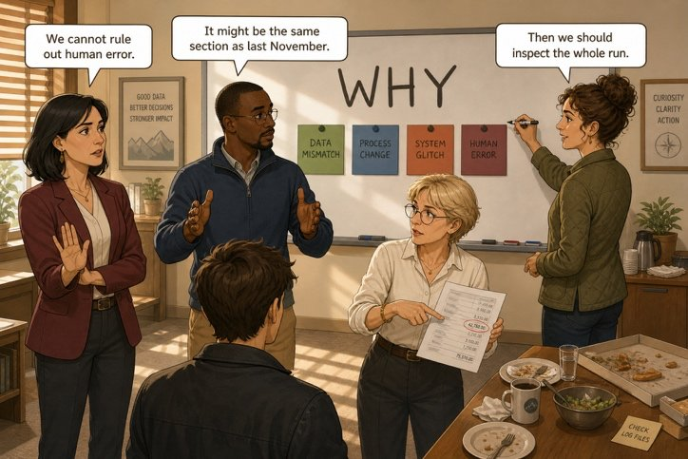
Saying what you think without committing yourself
SÉANCE 15 / 19
SCENE 7
13.00
A poorly formed modal, and the sentence loses all authority.
Case File 01 — The night nobody heard
Livret p. 35–37
Notes:
Consolidation des modaux (Dry run p. 35), expressions de prudence (Word file p. 36) et rédaction des quatre phrases du tableau (p. 37), qui serviront au rapport.

Slide 2



Today's mission
BRIEFING
Livret p. 35–37
ROADMAP
≈ 90 min (indicatif)
BY THE END OF THE SESSION
Your group’s four sentences for the board — and for tonight’s report.
1
Warm-up: the certainty scale
5'
2
Dry run A (p. 35)
10'
3
Dry run B–C (p. 35)
15'
LANGUAGE FOCUS
Modal forms (no -s, no to, no do) · should / had better / must · hedging idioms (rule out, long shot, educated guess…)
4
Should, had better, must
10'
5
Word file: idioms (p. 36)
15'
6
Hedging toolkit
5'
SKILLS
Diplomatic language · giving and receiving peer feedback
7
Your four sentences (p. 37)
20'
8
Gallery walk + wrap-up
10'

Slide 3
Warm-up: which word?
WARM-UP
Séance 14
1. ≈ 95 % → ……………
2. ≈ 50 % → ……………
3. ≈ 40 % → ……………
4. ≈ 5 % → ……………
5. advice → ……………
6. interdiction → ……………

Slide 4
Warm-up: which word?
WARM-UP
✓ CORRECTION
Séance 14
1. ≈ 95 % → must
2. ≈ 50 % → may
3. ≈ 40 % → might
4. ≈ 5 % → can’t
5. advice → should
6. interdiction → mustn’t

Slide 5
Two minutes on the four words that will be on the board
DRY RUN
Livret p. 35
A · Correct the form: five of these six are wrong.
1. She mights be right.
2. We should to wait .
3. It may be the same joint.
4. They must to notify the landlord.
5. Do we should call her?
6. We had better to decide today.

Slide 6

Two minutes on the four words that will be on the board
DRY RUN
✓ CORRECTION
Livret p. 35
A · Correct the form: five of these six are wrong.
WATCH OUT
1. She mights might be right.
2. We should to wait should wait.
3. It may be the same joint. ✓ correct
4. They must to notify must notify the landlord.
5. Do we should Should we call her?
6. We had better to decide had better decide today.
No -s, no to, no do after a modal.
had better + base form (no to).

Slide 7
Match the modal to the percentage
DRY RUN
Livret p. 35
B · Rewrite with the modal that matches the percentage.
1. Perhaps the alarm was faulty. (40 %) → ……………………………………
2. It is impossible: they left at 19.58. (0 %) → ……………………………………
3. I am almost sure the joint caused it. (95 %) → ……………………………………

Slide 8
Match the modal to the percentage
DRY RUN
✓ CORRECTION
Livret p. 35
B · Rewrite with the modal that matches the percentage.
WATCH OUT
1. Perhaps the alarm was faulty. (40 %) → The alarm might have been faulty.
2. It is impossible: they left at 19.58. (0 %) → It can’t have been the cabling team: they left at 19.58.
3. I am almost sure the joint caused it. (95 %) → The joint must have caused it.
A past situation → modal + have + participle.
Present forms (might be, can’t be, must be) are fine when the sentence is about now.

Slide 9
Turn the fear into a recommendation
DRY RUN
Livret p. 35
C · One sentence with should, one with had better.
1. Nobody has inspected the basement. → ……………………………………
2. The landlord has not been told. → ……………………………………

Slide 10
Turn the fear into a recommendation
DRY RUN
✓ CORRECTION
Livret p. 35
C · One sentence with should, one with had better.
1. Nobody has inspected the basement. → We should inspect the basement today.
2. The landlord has not been told. → We had better notify the landlord in writing today.

Slide 11
Should, had better, must
GRAMMAR
Livret p. 34–35
SHOULD
HAD BETTER
MUST / HAVE TO
should + base
’d better + base
must · have to + base
= advice, recommendation
We should inspect the whole run.
Neg: shouldn’t
= strong advice, a warning (or else…)
We’d better tell the landlord today.
Neg: had better not (✗ hadn’t better)
= obligation
We must notify the insurer.
have to = an external rule
Piège pour francophones — Nous ferions mieux de → We had better (✗ We would better) · malgré had, le sens est présent / futur.

Slide 12
Saying what you think without committing yourself
WORD FILE
Livret p. 36
A professional who is guessing says so. These expressions protect you while allowing you to speak.
IDIOM | FRENCH | EXAMPLE
to jump to conclusions | conclure trop vite | Let us not jump to conclusions before the survey.
to give somebody the benefit of the doubt | accorder le bénéfice du doute | I would give the team the benefit of the doubt.
to be on the safe side | par précaution | To be on the safe side, close the room today.
a long shot | une hypothèse peu probable | It is a long shot, but the drainage may be blocked.
to rule out | écarter une hypothèse | We cannot rule out human error.
to point the finger at | accuser | Nobody wants to point the finger at the contractor.
an educated guess | une hypothèse fondée | At this stage it is an educated guess, no more.

Slide 13
Idioms in a new context
+ EXTRA
Hors livret
Complete with an idiom from the Word file.
1. Samuel thinks it is the same joint, but we have no record yet — let’s not ………………………….
2. The badge entry looks bad, but I would ……………………………………: it lasted fifteen minutes.
3. The floor may not be safe. To be ………………………, nobody goes in without boots.
4. A blocked drain? It’s ………………, but Iris will check.
5. The room was dry at 19.58, so we can …………… a leak during the works.
6. Legal says: never ………………………… anyone in writing.
7. It is not a certainty — it is ……………………… based on the alarm sequence.

Slide 14
Idioms in a new context
+ EXTRA
✓ CORRECTION
Hors livret
Complete with an idiom from the Word file.
1. Samuel thinks it is the same joint, but we have no record yet — let’s not jump to conclusions.
2. The badge entry looks bad, but I would give the site staff the benefit of the doubt: it lasted fifteen minutes.
3. The floor may not be safe. To be on the safe side, nobody goes in without boots.
4. A blocked drain? It’s a long shot, but Iris will check.
5. The room was dry at 19.58, so we can rule out a leak during the works.
6. Legal says: never point the finger at anyone in writing.
7. It is not a certainty — it is an educated guess based on the alarm sequence.

Slide 15
Hedging toolkit
WRITING
Hors livret
SOFTEN
LIMIT
PROTECT
It seems that …
It appears that …
This would suggest that …
At this stage, …
So far, there is no evidence that …
It is too early to say whether …
We cannot rule out …
Pending the basement inspection, …
Subject to confirmation, …

Slide 16
Put your four sentences on the board
YOUR MOVE
Livret p. 37
That is what Mark will photograph — and what will go, word for word, into tonight’s report. Rewrite your group’s four sentences with the right modal.
1. Ruled out — start here: it is the only one where you have proof (can’t).
2. Hypothesis 1 (may / might)
3. Hypothesis 2 (may / might)
4. Recommendation (should / had better)

Slide 17
Put your four sentences on the board
YOUR MOVE
✓ CORRECTION
Livret p. 37
That is what Mark will photograph — and what will go, word for word, into tonight’s report. Rewrite your group’s four sentences with the right modal.
1. Ruled out — start here: it is the only one where you have proof (can’t).
→ The leak can’t have started during the cabling works: the room was dry when the team left at 19.58.
2. Hypothesis 1 (may / might)
→ The water might have come from the same section of pipework as last November.
3. Hypothesis 2 (may / might)
→ The leak may have started above the ceiling, since the humidity alarm followed the temperature alarm by three minutes.
4. Recommendation (should / had better)
→ We should inspect the whole run, including the basement, before the handover.
Notes:
Exemples de formulations : chaque groupe garde ses propres hypothèses ; vérifier modal, forme et absence de nom.

Slide 18

Gallery walk: check another group’s board
SELF-CHECK
Livret p. 37
Read two other boards. Tick, then leave one sticky note: one thing that works, one thing to fix.
Each sentence states its degree of certainty (can’t · might · may · should).
The modal is well formed: no -s, no to, no do.
Each hypothesis is backed by one fact from the file.
No person is named — no name, no badge, no job title.
The recommendation says what, and before when.

Slide 19

Before you close the file
END OF SESSION
NEXT IN THE FILE
BEFORE NEXT SESSION
At 15.20, Iris comes back up from the basement with a wet sheet of paper in a plastic sleeve. She does not say anything. She just puts it on the table.
Learn the 7 idioms (p. 36).
Learn should · had better · must + their negatives.
Copy your group’s four sentences: you will need them tonight.
EXIT TICKET
Rewrite with a modal: The pipe caused the leak. (you are 40 % sure)

