Slide 1
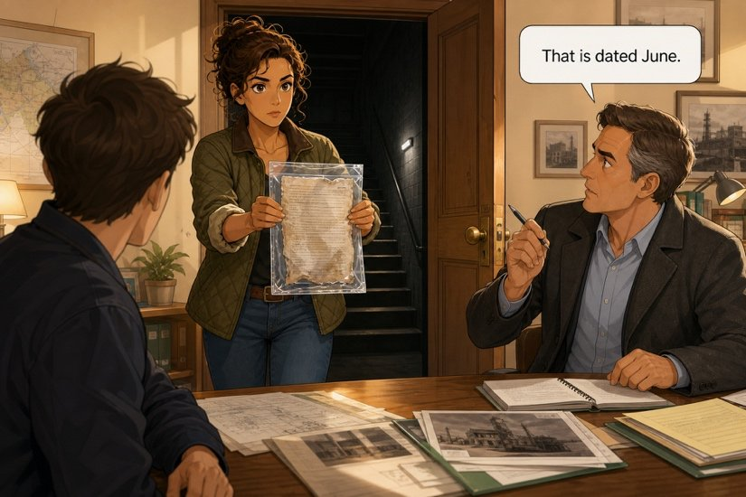
The sheet in the basement
SÉANCE 16 / 19
SCENE 8
15.40
This document changes the question — and therefore the tenses of your report.
Case File 01 — The night nobody heard
Livret p. 38–41
Notes:
Scène 8 : l’Exhibit C (registre de maintenance préventive) montre que le défaut du joint 4 est connu depuis juin. Grammaire : fermé et daté (prétérit) vs encore ouvert (present perfect), passif, « This is the second time we have had… ».

Slide 2



Today's mission
BRIEFING
Livret p. 38–41
ROADMAP
≈ 90 min (indicatif)
BY THE END OF THE SESSION
Four sentences rewritten in the light of Exhibit C — and a group decision: do we attach it?
1
Warm-up: idioms
5'
2
Scene 8 + Exhibit C (p. 38)
10'
3
Read it before Mark does (p. 39)
20'
LANGUAGE FOCUS
Closed & dated (past simple) vs still open (present perfect) · since + present perfect · the passive (was inspected, has been carried out) · This is the second time we have had… · provided that
4
Field note: closed or still open? (p. 40)
10'
5
Dry run A–C (p. 40)
15'
6
Rewrite your noon draft (p. 41)
10'
SKILLS
Re-reading your own draft against new evidence · arguing for a decision with a condition
7
Team call: attach Exhibit C? (p. 41)
15'
8
Wrap-up
5'

Slide 3
Warm-up: careful idioms
WARM-UP
Séance 15
1. conclure trop vite → to …………………………
2. écarter une hypothèse → to ……………
3. par précaution → to be ………………………
4. une hypothèse peu probable → ………………
5. une hypothèse fondée → ………………………

Slide 4
Warm-up: careful idioms
WARM-UP
✓ CORRECTION
Séance 15
1. conclure trop vite → to jump to conclusions
2. écarter une hypothèse → to rule out
3. par précaution → to be on the safe side
4. une hypothèse peu probable → a long shot
5. une hypothèse fondée → an educated guess

Slide 5
The sheet in the basement
SCENE
Livret p. 38
SCENE 8
15.40
The paper is a maintenance record. It has been pinned to a board in the basement for months, behind a cupboard nobody moves.
The ink has run at the bottom, but the top is perfectly legible.
“That is dated June.”
ASK THE CLASS
Why does a date in June change the tenses of your report?

Slide 6

Exhibit C — the maintenance record
EXHIBIT
Livret p. 38
EXHIBIT C
Preventive maintenance record — Atlas House — 2F
MAINTENANCE WORDS
14 June Riser 2F — visual inspection — minor seepage at joint 4 — MONITOR
19 July Riser 2F — joint 4 — seepage confirmed — repair recommended — quotation requested
06 September Riser 2F — joint 4 — no change — quotation not received — MONITOR
08 November Riser 2F — joint 4 — temporary repair carried out — permanent repair still required
Signed: technical services — no further entry after 08 November
seepage = un suintement
a riser = une colonne montante
a joint = un raccord
to monitor = surveiller
a quotation = un devis
temporary ≠ permanent repair

Slide 7
Read it before Mark does — Q1 · Q2 · Q3
YOUR MOVE
Livret p. 39
You have a forty-second head start on everyone. Use it.
1. When was the problem first written down and by whom?
2. What was recommended in July, and what happened to that recommendation?
3. The November entry uses two words that matter: temporary and still required. What do they establish, taken together?

Slide 8
Read it before Mark does — Q1 · Q2 · Q3
YOUR MOVE
✓ CORRECTION
Livret p. 39
You have a forty-second head start on everyone. Use it.
1. When was the problem first written down and by whom?
→ On 14 June, by technical services (visual inspection: minor seepage at joint 4).
2. What was recommended in July, and what happened to that recommendation?
→ A repair was recommended and a quotation requested (19 July). The quotation was never received (6 Sept.); only a temporary repair was carried out, on 8 November.
3. The November entry uses two words that matter: temporary and still required. What do they establish, taken together?
→ That the defect was known and never permanently fixed: on 8 November the problem was still open.

Slide 9
Read it before Mark does — Q4 · Q5
YOUR MOVE
Livret p. 39
4. This morning, Samuel said the trouble had lasted “since the summer”. Does Exhibit C confirm him, correct him, or extend him?
5. One line of this record is worse for us than the badge entry in Exhibit A. Which one, and why?

Slide 10

Read it before Mark does — Q4 · Q5
YOUR MOVE
✓ CORRECTION
Livret p. 39
4. This morning, Samuel said the trouble had lasted “since the summer”. Does Exhibit C confirm him, correct him, or extend him?
→ It extends him (and confirms him): the trouble is documented since 14 June, in writing — not just remembered.
5. One line of this record is worse for us than the badge entry in Exhibit A. Which one, and why?
→ 08 November — permanent repair still required (+ no further entry): the defect was known and left unrepaired. An insurer can call that a maintenance failure, not a sudden accident — and it points at an organisation, in writing.
WATCH OUT
Also defensible: 19 July (repair recommended, never done) or 06 September (quotation not received — MONITOR).

Slide 11
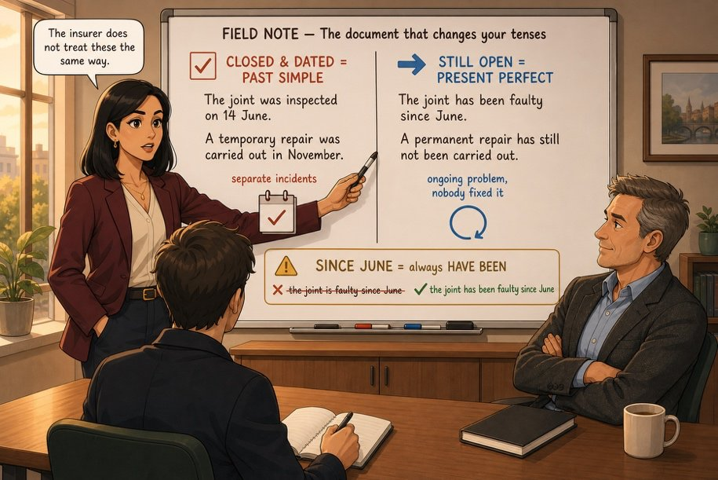

The document that changes your tenses
FIELD NOTE
Livret p. 40
ON THE BOARD
CLOSED & DATED → PAST SIMPLE: The joint was inspected on 14 June. A temporary repair was carried out in November.
STILL OPEN → PRESENT PERFECT: The joint has been faulty since June. A permanent repair has still not been carried out.
SINCE JUNE = always have been: ✗ the joint is faulty since June

Slide 12
Closed and dated, or still open?
GRAMMAR
Livret p. 40
the joint has been faulty since June — still open
June
July
August
September
October
November
NOW
14 June: was inspected
6 Sept.: quotation was not received
19 July: repair was recommended
8 Nov.: temporary repair was carried out
closed & dated → past simple
still open, up to now → present perfect

Slide 13
The passive: the report’s favourite form
GRAMMAR
Livret p. 38–40
FORM
WHY IN A REPORT
BY + AGENT
be + past participle
The doer is unknown or unimportant.
It names nobody: A final inspection was carried out at 20.04.
Only if it matters: The record was signed by technical services.
Usually left out in a report.
The joint was inspected. (past)
A repair has been carried out. (present perfect)
A repair is required. (present)
Piège pour francophones — On a réparé le joint → The joint was repaired (✗ One repaired the joint). On nous a dit → We were told.

Slide 14
Three minutes before you touch your draft
DRY RUN
Livret p. 40
A · Choose the form, then write in three words why.
1. The joint was inspected / has been inspected on 14 June.
2. A permanent repair was never carried out / has never been carried out.
3. We had / have had two failures on this riser this year.
4. The temporary repair held / has held in November.

Slide 15
Three minutes before you touch your draft
DRY RUN
✓ CORRECTION
Livret p. 40
A · Choose the form, then write in three words why.
1. The joint was inspected / has been inspected on 14 June. → a date
2. A permanent repair was never carried out / has never been carried out. → still open
3. We had / have had two failures on this riser this year. → year not finished
4. The temporary repair held / has held in November. → a date

Slide 16
New marker, new tense
DRY RUN
Livret p. 40
B · Rewrite with the new marker.
We had a problem with this joint in November. (since June) → ……………………………………
Nobody repaired it permanently. (and it is still not repaired) → ……………………………………
C · The structure that will win you a mark.
This is the second time we …………… (have) a failure on riser 2F.
It is the worst leak I …………………… (ever / see) in this building.

Slide 17
New marker, new tense
DRY RUN
✓ CORRECTION
Livret p. 40
B · Rewrite with the new marker.
We had a problem with this joint in November. (since June) → We have had a problem with this joint since June.
Nobody repaired it permanently. (and it is still not repaired) → Nobody has repaired it permanently.
C · The structure that will win you a mark.
This is the second time we have had (have) a failure on riser 2F.
It is the worst leak I have ever seen (ever / see) in this building.

Slide 18
“This is the second time we have had…”
GRAMMAR
Livret p. 40–41
THE FIRST / SECOND TIME
THE WORST … EVER
This is the second time + present perfect
the worst … I have ever + participle
This is the second time we have had a failure.
✗ we had · ✗ we have
It is the first time I have seen this.
It is the worst leak I have ever seen.
It is the most serious incident we have had this year.
Piège pour francophones — C’est la première fois que je vois ça → This is the first time I have seen this (✗ I see).

Slide 19
Rewrite what you had already written
YOUR MOVE
Livret p. 41
Four sentences from your noon draft have become incorrect. Correct them before 5 p.m.
1. The pipe failed last night. → (with Exhibit C in front of you)
2. We had a problem with this joint in November. → (since June)
3. Nobody repaired the joint permanently. → (and it is still not repaired)
4. This is the first incident on riser 2F. → (second time, this year)

Slide 20
Rewrite what you had already written
YOUR MOVE
✓ CORRECTION
Livret p. 41
Four sentences from your noon draft have become incorrect. Correct them before 5 p.m.
1. The pipe failed last night. → (with Exhibit C in front of you)
→ The joint, which has been under observation since 14 June, failed last night.
2. We had a problem with this joint in November. → (since June)
→ We have had a problem with this joint since June.
3. Nobody repaired the joint permanently. → (and it is still not repaired)
→ The joint has not been permanently repaired.
4. This is the first incident on riser 2F. → (second time, this year)
→ This is the second time we have had an incident on riser 2F this year.

Slide 21




Team call: do we attach Exhibit C tonight?
TEAM CALL
Livret p. 41
Exhibit C protects you against one accusation and exposes you to another. Argue for 90 seconds from your field.
What does Exhibit C protect you against — and expose you to?
What does Exhibit C protect you against — and expose you to?
ACC
IT
What does Exhibit C protect you against — and expose you to?
What does Exhibit C protect you against — and expose you to?
LAW
RE

Slide 22
Team call: do we attach Exhibit C tonight?
TEAM CALL
✓ CORRECTION
Livret p. 41
Exhibit C protects you against one accusation and exposes you to another. Argue for 90 seconds from your field.
What does Exhibit C protect you against — and expose you to?
→ Protects: the problem was monitored. Exposes: a known defect may reduce the payout. We should attach it, provided that the provision is reviewed.
What does Exhibit C protect you against — and expose you to?
→ Protects: the IT equipment did not cause the leak. Exposes: the rack sat under a known leak. …provided that we recommend moving the rack.
ACC
IT
What does Exhibit C protect you against — and expose you to?
→ Protects: against the charge of hiding evidence. Exposes: documented knowledge = possible negligence. …provided that legal reviews it first.
What does Exhibit C protect you against — and expose you to?
→ Protects: inspections did take place. Exposes: the permanent repair was never done. …provided that we commit to inspecting the whole run.
LAW
RE
Notes:
Pistes d’arguments : chaque groupe rédige ensuite UNE phrase de décision et UNE phrase de condition.

Slide 23
Decide — with a condition
GRAMMAR
Livret p. 41
The group writes one sentence giving its decision and one sentence giving the condition attached to it.
PROVIDED THAT
AS LONG AS
UNLESS
ON CONDITION THAT
We should attach it, provided that legal reviews it first.
… as long as the report states only dated facts.
We should attach it unless the landlord objects in writing.
… on condition that we recommend a full inspection.
Piège pour francophones — After provided that, as long as, unless: present tense, not will: ✗ provided that legal will review it.

Slide 24

Before you close the file
END OF SESSION
NEXT IN THE FILE
BEFORE NEXT SESSION
Mark reads Exhibit C twice. Then he looks at the clock: 16.05. “Right,” he says. “You have an hour.”
Learn: closed & dated → past simple · still open → present perfect.
Learn the passive in three tenses: was / has been / is + participle.
Bring your firm’s file (p. 45–46) and all your notes: you write the report next session.
EXIT TICKET
Complete: This is the second time we … and The joint has been … since …

