Slide 1
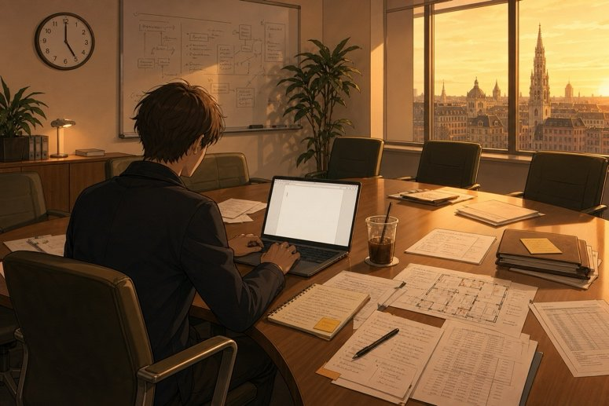
The report: sections one to three
SÉANCE 17 / 19
SCENE 9
17.00
One page. It will be read by someone who is looking for a reason to refuse.
Case File 01 — The night nobody heard
Livret p. 42–44
Notes:
Scène 9, première partie : la phrase « badge » (ne nommer personne) et les sections 1 à 3 du rapport, dans l’ordre de lecture de l’expert.

Slide 2



Today's mission
BRIEFING
Livret p. 42–44
ROADMAP
≈ 90 min (indicatif)
BY THE END OF THE SESSION
The badge sentence and the first three sections of your report.
1
Warm-up: closed or open?
5'
2
16.30 — Mark explains (p. 42)
10'
3
Write the badge sentence (p. 43)
15'
LANGUAGE FOCUS
Neutral reporting: passive, impersonal subjects · while / when · already, not … yet · since / for + a dated fact
4
What the assessor looks for (p. 43)
5'
5
Section one — the night
15'
6
Section two — where we stand
15'
SKILLS
Writing for a hostile reader · following the assessor’s reading order
7
Section three — how long
15'
8
Wrap-up
10'

Slide 3
Warm-up: closed or still open?
WARM-UP
Séance 16
1. The joint ………………… (inspect) on 14 June.
2. It …………… (be) faulty since June.
3. This is the second time we …………… (have) a leak.
4. A temporary repair …………………… (carry out) on 8 November.

Slide 4
Warm-up: closed or still open?
WARM-UP
✓ CORRECTION
Séance 16
1. The joint was inspected (inspect) on 14 June.
2. It has been (be) faulty since June.
3. This is the second time we have had (have) a leak.
4. A temporary repair was carried out (carry out) on 8 November.

Slide 5
The report
SCENE
Livret p. 42
SCENE 9
17.00
Everybody has left the technical room. There is a laptop, a cold coffee, and eleven hours of notes.
What you write in the next sixty minutes decides whether this incident costs your firm nothing or a great deal.
ASK THE CLASS
Before you write a single word: what must not appear in this report?

Slide 6

16.30 — Mark answers the question you did not ask
BRIEFING
Livret p. 42
MARK: « You want to know why I stopped you writing that badge number. Here it is. Badge 0102 is the site manager. He came in at 20.04 and left at 20.19 — fifteen minutes, which is exactly a last inspection round. »
MARK: « If we put his number in the report, the insurer reads it as a lead. Legal reads it as a name. And the man himself reads it as an accusation, three weeks before he signs off the handover. »
MARK: « So: the fact stays, the number goes. Write that somebody carried out a final inspection at 20.04 and that the room was reported dry. That is true, it is verifiable, and it accuses nobody. »
THE RULE
The fact stays: time, place, action.
The number goes: no name, no badge, no job title.
A lead · a name · an accusation = three ways to lose.

Slide 7
Write the badge sentence
YOUR MOVE
Livret p. 43
A single sentence. It must contain the time from Exhibit A, the word inspection, and no name, no number, no job title.
1. The sentence for the report.
2. The sentence you would have written this morning, before Mark stopped you.
3. Compare with your neighbour: what exactly did you lose, and what did you gain?

Slide 8
Write the badge sentence
YOUR MOVE
✓ CORRECTION
Livret p. 43
A single sentence. It must contain the time from Exhibit A, the word inspection, and no name, no number, no job title.
1. The sentence for the report.
→ A final inspection of zone 2F was carried out between 20.04 and 20.19, and the room was reported dry.
2. The sentence you would have written this morning, before Mark stopped you.
→ The site manager (badge 0102) entered the technical room at 20.04, after the cabling team had left.
3. Compare with your neighbour: what exactly did you lose, and what did you gain?
→ Lost: a name, a lead, a suspect. Gained: a verifiable, neutral fact — no accusation, no personal data.

Slide 9


This morning’s sentence, tonight’s sentence
YOUR MOVE
Livret p. 42–43
THIS MORNING — a lead
TONIGHT — a fact
The site manager (badge 0102) entered the technical room at 20.04.
Names a job title and a badge
Reads as an accusation
Personal data in a document sent outside
A final inspection was carried out at 20.04, and the room was reported dry.
Passive: no doer
Time taken from Exhibit A
True, verifiable, accuses nobody
→

Slide 10

Helen Marsh reads in this order
WHAT THE ASSESSOR WILL LOOK FOR
Livret p. 43
1
2
3
4
5
The times
The position
The history
The cause
The commitment
Two verifiable hours, taken from a log, not from a memory.
What is done, what is not done yet — and no gaps.
How long, and since when. She reads June, not last night.
Stated as a fact and not proved → she stops reading and refuses.
A date, in full, and a name to contact — yours.
Length — 180 to 220 words, continuous text. One page. No bullet points, no headings.

Slide 11

Section one — the night
YOUR MOVE
Livret p. 44
She will read these sentences before all the others. Three or four sentences: what was going on, what happened, at what verifiable time.
EXPECTED
Write section one.
while or when × 1
two times from Exhibit A
past simple for dated events
no name, no badge

Slide 12
Section one — the night
YOUR MOVE
✓ CORRECTION
Livret p. 44
She will read these sentences before all the others. Three or four sentences: what was going on, what happened, at what verifiable time.
EXPECTED
Write section one.
→ On Monday evening, the cabling team left zone 2F at 19.58, and a final inspection was carried out between 20.04 and 20.19; the room was reported dry. While the building was empty, the temperature alarm went off at 23.41, followed by a humidity alarm at 23.44. The cleaning team found water in the technical room when they arrived at 06.47.
while or when × 1
two times from Exhibit A
past simple for dated events
no name, no badge

Slide 13
Section two — where we stand
YOUR MOVE
Livret p. 44
It’s the 9.40 board, put into sentences. Two or three sentences.
EXPECTED
Write section two.
already × 1
not … yet × 1
one irregular past participle (taken, shut, written…)
adapt to your firm’s file (p. 45–46)

Slide 14
Section two — where we stand
YOUR MOVE
✓ CORRECTION
Livret p. 44
It’s the 9.40 board, put into sentences. Two or three sentences.
EXPECTED
Write section two.
→ We have already taken photographs and closed the second floor. However, the basement has not been inspected yet, and we have not received a repair estimate yet. Unit 3 of rack A2 has shut down.
already × 1
not … yet × 1
one irregular past participle (taken, shut, written…)
adapt to your firm’s file (p. 45–46)

Slide 15
Section three — how long
YOUR MOVE
Livret p. 44
This is where Exhibit C enters the file. One or two sentences.
EXPECTED
Write section three.
since or for × 1 (+ present perfect)
one dated fact in the past simple
bonus: This is the second time we have had…

Slide 16
Section three — how long
YOUR MOVE
✓ CORRECTION
Livret p. 44
This is where Exhibit C enters the file. One or two sentences.
EXPECTED
Write section three.
→ The same joint has been under observation since 14 June, and a temporary repair was carried out on 8 November. This is the second time we have had a leak on this riser.
since or for × 1 (+ present perfect)
one dated fact in the past simple
bonus: This is the second time we have had…

Slide 17
Five errors that cost a section
PITFALL
Livret p. 43–44
The alarm has gone off at 23.41.
The alarm went off at 23.41.
a clock time → past simple
Since June the joint is faulty.
The joint has been faulty since June.
since → present perfect
We didn’t inspect the basement yet.
We have not inspected the basement yet.
yet → present perfect
The site manager checked the room at 20.04.
A final inspection was carried out at 20.04.
name the fact, not the person
While the alarm went off, nobody was there.
When the alarm went off, the building was empty.
while + background · when + event

Slide 18

Before you close the file
END OF SESSION
NEXT IN THE FILE
BEFORE NEXT SESSION
Section four is the one she counts: no categorical sentences. Section five is the one you sign.
Finish sections one to three (clean copy).
Re-read your group’s four sentences (Scene 7).
Read your firm’s file (p. 45–46): choose four facts only you have.
EXIT TICKET
Read your section one to your neighbour: did you give two verifiable times?

