Slide 1
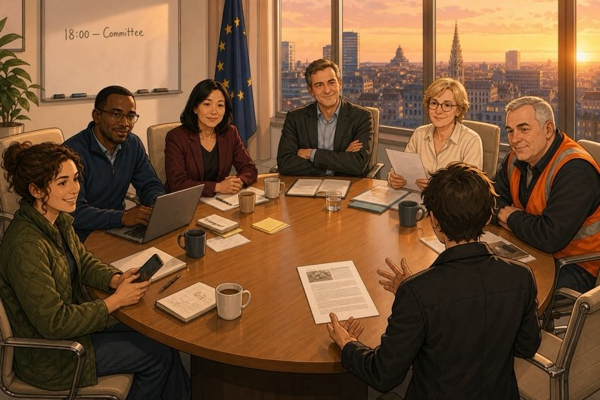
18.00 — The committee
SÉANCE 19 / 19
TEAM CALL
18.00
Two minutes each. Without reading.
Case File 01 — The night nobody heard
Livret p. 49
Notes:
Dernière séance : présentation orale du rapport en comité (groupes de 4), phrase commune, bilan grammatical du dossier et ouverture sur la suite (« Two quotations »).

Slide 2



Today's mission
BRIEFING
Livret p. 49
ROADMAP
≈ 90 min (indicatif)
BY THE END OF THE SESSION
A two-minute oral report, without reading — and one sentence agreed by the four firms.
1
Warm-up: say it aloud
5'
2
Presenting toolkit
10'
3
The judgement question
10'
LANGUAGE FOCUS
Signposting a short presentation · answering a judgement question without answering it · agreeing on a wording
4
Prepare your notes
10'
5
The committee: groups of four
25'
6
One sentence for the tenant
10'
SKILLS
Speaking from notes · active listening · group decision
7
Debrief: your toolkit
10'
8
Next file + self-assessment
10'

Slide 3
Warm-up: say it without hesitating
WARM-UP
Hors livret
1. 23:41 → ………………………………
2. 19.58 → ………………………………
3. 14 June → ………………………………
4. 13 November 2026 → ……………………………………
5. €12,000 → ………………………………
6. 80 % → ……………………

Slide 4
Warm-up: say it without hesitating
WARM-UP
✓ CORRECTION
Hors livret
1. 23:41 → eleven forty-one p.m.
2. 19.58 → seven fifty-eight p.m.
3. 14 June → the fourteenth of June
4. 13 November 2026 → the thirteenth of November, twenty twenty-six
5. €12,000 → twelve thousand euros
6. 80 % → eighty per cent

Slide 5
18.00 — the committee
TEAM CALL
Livret p. 49
Groups of four. Twenty minutes. Ferrand Logistics has convened a short committee.
Each of you presents your report without reading it, in two minutes.
Each listener asks two questions: one checking a figure or a time, one asking for a judgement.
Then the group agrees, out loud, on one sentence: what the four firms will say if the tenant asks tomorrow morning.
ASK THE CLASS
What is the most dangerous question a listener can ask you?

Slide 6


Two minutes, five signposts
SPEAKING
Livret p. 49
1
2
3
4
5
Open
The times
Where we stand
History & cause
Next steps
I’d like to report on last night’s incident at Atlas House.
First, the times. According to the alarm log, …
So far, we have … However, we haven’t … yet.
This section has been under observation since June. It may …
We should … We will send … by 13 November.
Astuce — Look at your listeners, not at your notes. Five keywords per section on your card — no full sentences.

Slide 7


The judgement question
SPEAKING
Livret p. 49
Do you think the contractor is responsible? — and see how the speaker avoids answering that directly.
THE QUESTION
YOUR ANSWER
Do you think the contractor is responsible?
So whose fault is it?
Was it the site manager?
A yes or a no = a name in the minutes.
At this stage, it would be premature to say.
What we can establish is that …
That is not something we can prove today.
The cause is still being investigated; we will know more after the inspection.
→

Slide 8
Your two questions as a listener
SPEAKING
Livret p. 49
CHECK A FIGURE OR A TIME
ASK FOR A JUDGEMENT
Could you confirm the exact time of … ?
Where does that figure come from?
Is that from the log, or from memory?
In your opinion, what caused it?
Do you think somebody should have known?
Would you file the claim today?

Slide 9

What I listen for
TEAM CALL
Livret p. 49
For each speaker in your group, tick YES or NO.
Two verifiable times, given without hesitation.
At least one already or not yet.
The cause is given with may or might — never with is.
A clear recommendation with should.
The speaker did not read.

Slide 10

One sentence for the tenant
TEAM CALL
Livret p. 49
The group agrees, out loud, on one sentence: what the four firms will say if the tenant asks tomorrow morning.
EXPECTED
Your group’s sentence.
One sentence, agreed by the four firms
No name, no cause stated as a fact
A date

Slide 11
One sentence for the tenant
TEAM CALL
✓ CORRECTION
Livret p. 49
The group agrees, out loud, on one sentence: what the four firms will say if the tenant asks tomorrow morning.
EXPECTED
Your group’s sentence.
→ An escape of water occurred overnight in the technical room; the times are documented, the cause is still being investigated, and the four firms will report in full by 13 November.
One sentence, agreed by the four firms
No name, no cause stated as a fact
A date

Slide 12
Your toolkit, scene by scene
GRAMMAR
Tout le livret
TOOL | WHAT IT DOES IN THE REPORT | EXAMPLE
Past simple | a dated fact | The alarm went off at 23.41.
Past continuous + while / when | the background | While the building was empty, …
Present perfect + already / yet | where we stand now | We have not inspected the basement yet.
Present perfect + since / for | the history | It has been under observation since June.
Modals: may / might / can’t / should | the cause, and the advice | It may have come from joint 4.
Passive · impersonal subject | facts without names | A final inspection was carried out at 20.04.
False friends | saying what you mean | check (✗ control) · attend (✗ assist)

Slide 13

I can…
SELF-CHECK
Tout le livret
Tick what you can do now. Circle what you still need to work on.
…take notes from a fast voicemail.
…clean false friends before forwarding an e-mail.
…tell a night in the past, with while and when.
…say since when with for / since.
…compare a witness with a log.
…state a hypothesis with the right modal.
…say where we stand with already / yet / just.
…write 200 words that name nobody.

Slide 14

At 18.52, a new e-mail
NEXT FILE
Livret p. 49
“The leak is fixed. Now we have to decide whether we repair the rest of the run or replace it.”
At 18.40 you send the report. At 18.52 an e-mail arrives from Mark. Subject: “Two quotations”.
There is a difference of seventeen thousand euros between the two. I need your recommendation by Monday.

Slide 15

Case file closed — for tonight
END OF SESSION
NEXT IN THE FILE
BEFORE NEXT SESSION
18.52 — Subject: “Two quotations”. Repair or replace? Seventeen thousand euros, and a recommendation by Monday.
Re-read your report against the assessor’s nine checks.
Keep your Word files: they will come back in the next case.
Think: repair or replace? — what would your firm need to know?
EXIT TICKET
One thing you will never write again in a report — and why.

