Slide 1
B3: It's running. Is it still working?
A healthy service does not mean the AI is behaving appropriately.
• Every scenario: 0 API errors, Tier 1 HEALTHY, model loaded.
• But the model alerts on 45.9% of rows while 7.3% are spikes; precision at the 0.5 alert threshold is 6.4%.
Core interim hypothesis, which survived: health checks and raw feature-drift tests alone can't tell you whether the AI still works. Monitor serving health, data/prediction drift and labeled performance separately. Feature drift means investigate, not retrain.
What changed: our interpretation of the split-half evidence, not the hypothesis.
Notes:
"This hypothesis was in our interim. The final monitor puts it into practice."
(~30 seconds)

Slide 2
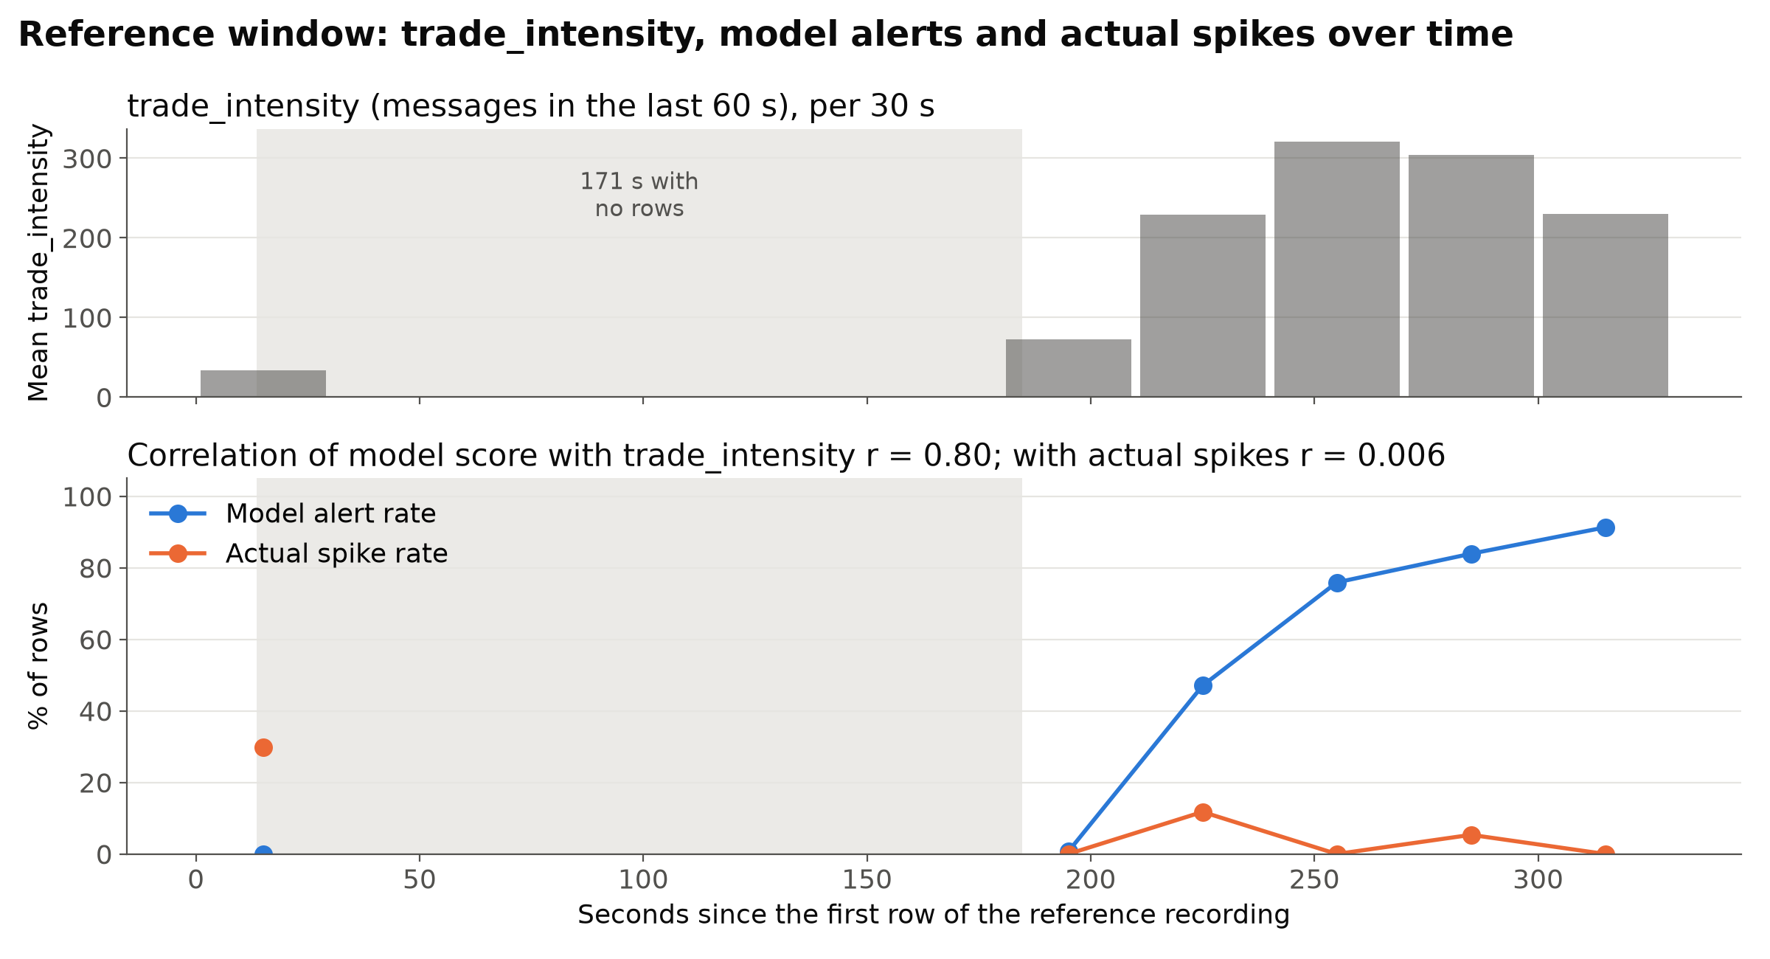
Diagnosis: Alerts follow trade intensity, not spikes
• PR-AUC 0.070 vs prevalence 0.073 on the reference window: above-baseline performance is not established on the available data.
• Score vs trade intensity r = 0.80; score vs the actual spike label r = 0.006.
• The recording has a 171 s gap. Trade intensity is a rolling 60 s count, so it refills afterwards (167 in the first 60 s after the gap, 305 later). The message rate is about the same: 4.92 vs 4.74 msg/s.
Interim correction: we had used the split-half comparison as a no-change control and called its flags a false alarm. It is a real change: alerts 13.5% to 78.3% while spikes are 6.1% vs 8.5%. It became S2; the new control is the interleaved split (S0).
Model alerts rise with trade intensity; actual spikes do not.
Notes:
"We revised the experiment rather than forcing the original explanation to fit."
(~45-50 seconds)

Slide 3
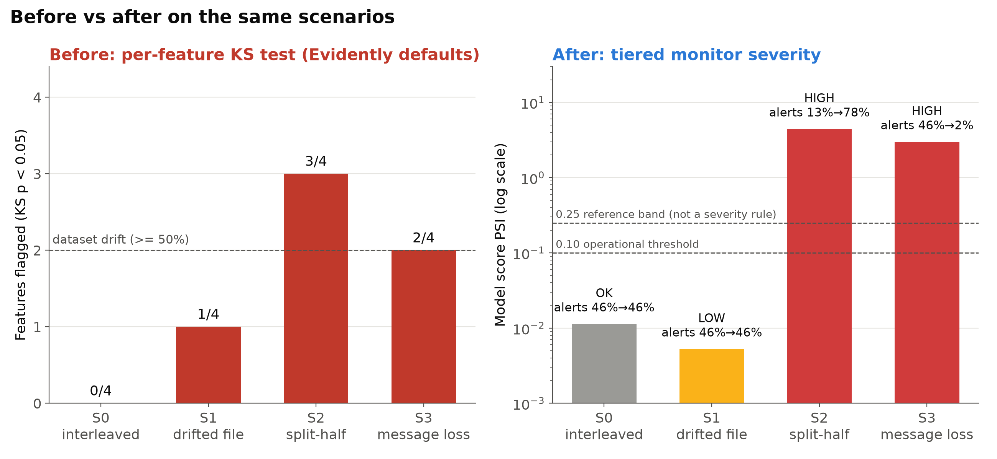
Intervention and evidence
Tiered monitor
Tier 1, serving status: HEALTHY / DEGRADED / UNAVAILABLE. PAGE only for serving unavailability.
Tier 2, drift graded by impact: LOW = feature drift only; MEDIUM = score PSI >= 0.10 or alert shift > 5 pp; HIGH = alert rate x2 or /2, or shift >= 20 pp.
Tier 3, separate and retrospective: PR-AUC vs prevalence. Never sets severity.
Raw drift flags do not show consequence; model-output impact separates S1 from S2/S3.
5 pp / 20 pp / 2x are project-specific operating thresholds.
 | KS before view | Monitor | Why
S1 | 1/4 (p≈0) | LOW | Spread PSI 8.2, but score PSI 0.005 and alerts 45.9% to 46.2%
S2 | 3/4 | HIGH | Alerts 13.5% to 78.3%
S3 | 2/4 | HIGH | Alerts 45.9% to 1.8%, with the service HEALTHY
S0 (odd vs even rows): KS 0/4, monitor OK. No change; stays quiet.
Notes:
Don't walk through each cutoff. Shorthand:
- Feature-only drift -> LOW
- Score/output drift or moderate alert movement -> MEDIUM
- Major alert-volume disruption -> HIGH
Then go straight to S1 versus S2/S3. Exact cutoffs are for Q&A.
"Both S1 and S2 show statistical drift, but in S1 the model's output and alert workload barely move, while in S2 alerts jump from 13.5% to 78.3%. That is why raw drift alone is not enough for an operational decision."
S3: "The service remains HEALTHY while alerts collapse from 45.9% to 1.8%."
(~60-70 seconds)

Slide 4
How far to trust it, and what to do
What we know
What we don't know
What we recommend
Across 1,485 tested monitoring-setting combinations, the S0–S3 ordering remained unchanged.
• All scenarios derive from one ~5-minute recording that also informed the design; there is no independent held-out evaluation.
• Whether the monitor and the model behave appropriately on unseen data.
• Provisional, limited use of the monitor until it is tested once on an independently recorded replay window.
• Do not automatically retrain on feature drift (S1): route it to a data-quality check.
• Re-evaluate the model on genuinely out-of-sample labeled data before changing thresholds, retraining or replacing it.
Internal threshold robustness, not independent validation.
Notes:
(~35-40 seconds)

Slide 5
B3 Backup B1: Severity ladder and Tier 1 status
Level | Triggered when (first matching rule wins) | Action
PAGE | Tier 1 UNAVAILABLE | Page on-call; restore the service. Model checks are not trustworthy until it is healthy.
HIGH | Alert rate doubles or halves (ratio 2x), or shifts by 20 percentage points or more | Escalate now to model owner and pipeline on-call; consider pausing alerts. Labeled evidence is needed to establish a performance problem; root-cause analysis determines whether retraining is appropriate
MEDIUM | Score PSI 0.10 or more, or alert-rate shift above 5 percentage points | Investigate same day; notify model owner; no retraining unless labeled evidence establishes a performance problem and root-cause analysis supports retraining
LOW | Any feature PSI 0.10 or more, with no MEDIUM/HIGH condition | Data-quality ticket: real change or feed bug? No model action
OK | None of the above | No action
Tier 1 status | Meaning | Operational behavior
HEALTHY | /health ok, model loaded, every attempted /score request produced a prediction | Proceed
DEGRADED | /health ok and at least one prediction produced, but one or more /score requests failed | Reported as a serving/reliability issue; not a drift severity; no paging cutoff
UNAVAILABLE | /health fails, the model is not loaded, or no /score request produced a prediction | PAGE
NOT_CHECKED | Tier 1 skipped (--no_api) | Tier 1 was not evaluated; this does not mean healthy

Slide 6
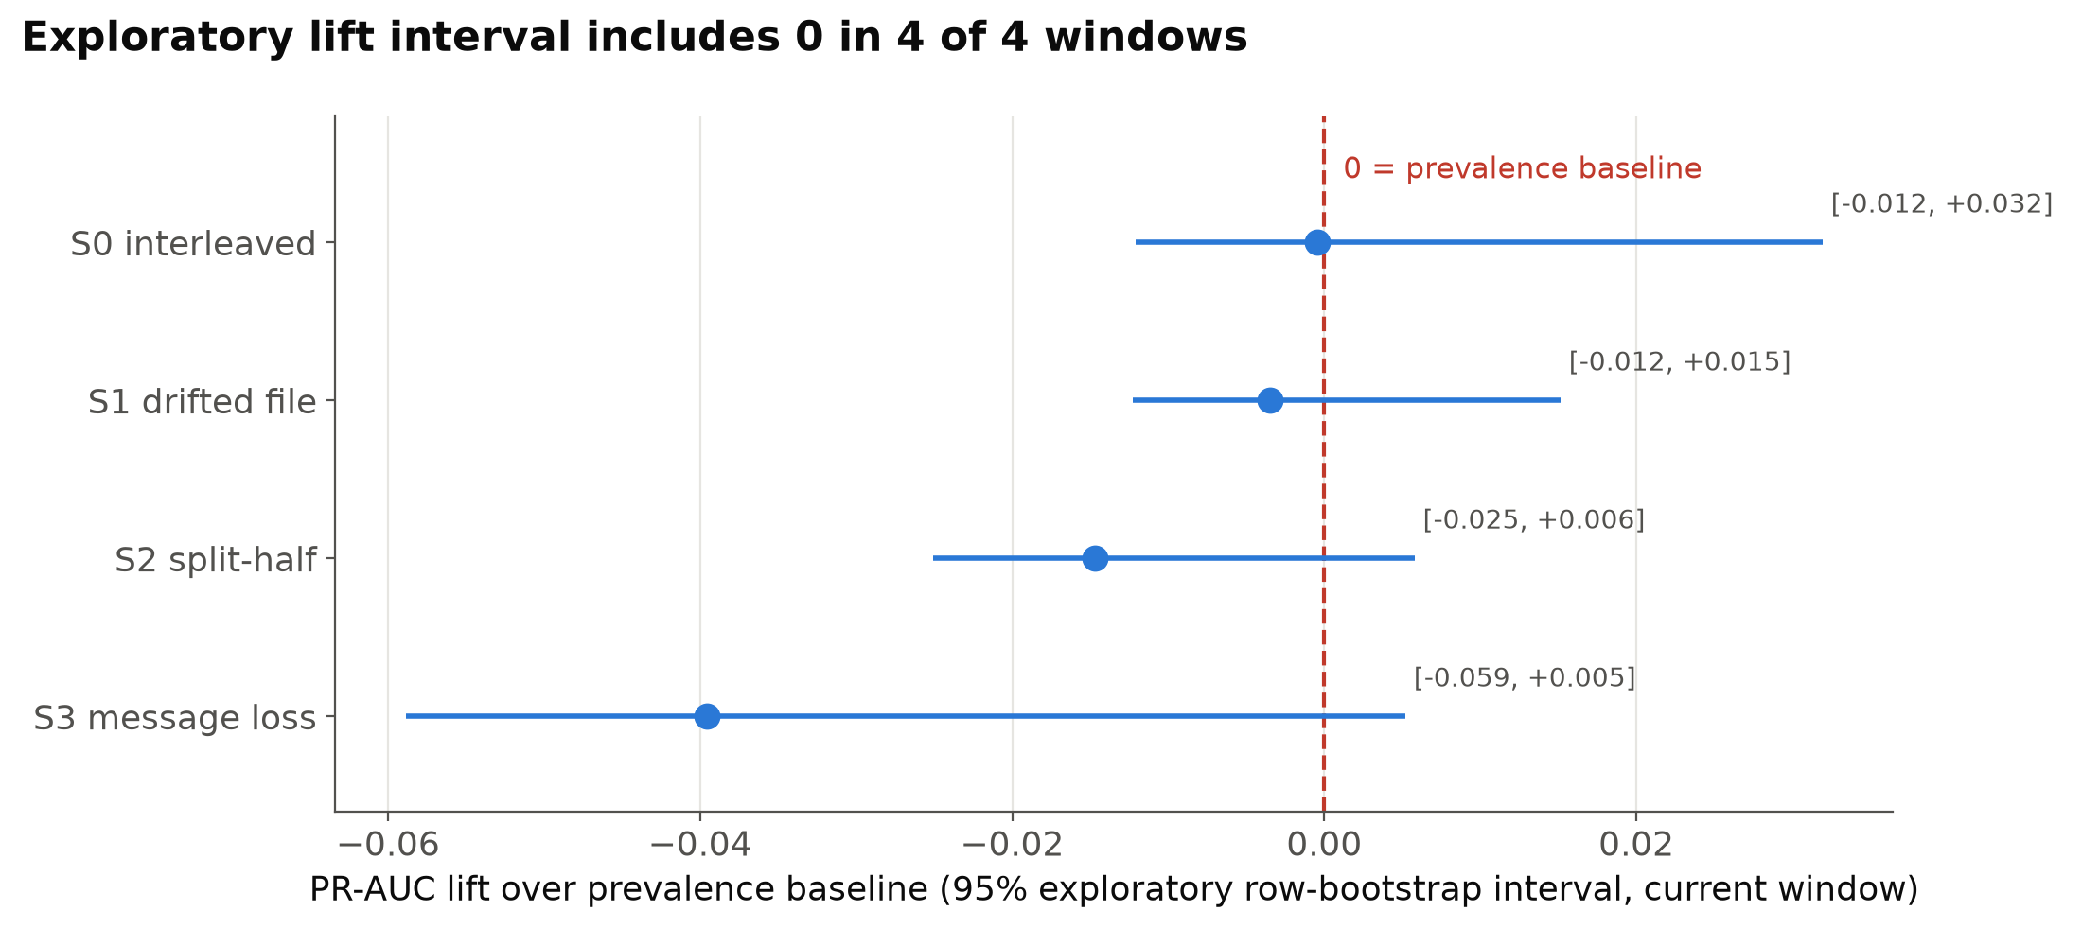
B3 Backup B2: Tier 3 exploratory lift intervals
Above-baseline performance is not established on the available data.

Slide 7
B3 Backup B3: Where each setting comes from
Setting | Value | Provenance
Alert threshold | 0.5 | Supplied code (score_service.py)
Spike label | 90th percentile, 20-row horizon | Supplied code (label_spikes defaults)
Operational PSI threshold | 0.10 | Externally sourced heuristic: conventional PSI band originating in credit-scorecard practice (Lewis 1994, as traced by Potgieter et al. 2026); not a universal statistically calibrated threshold
PSI reference band | 0.25 | Same source; descriptive/figure line only; does not independently determine severity
PSI bins | 10 | Matches Feature-engine's current default
PSI empty-bin handling | 0.0001 | Our monitor uses the same numeric constant, 0.0001, but a different implementation: Feature-engine replaces/adds the constant for empty or zero bins, whereas our psi() floors bin proportions at that minimum.
MEDIUM alert shift | 5 pp | AI-proposed project-specific threshold, accepted by owner
HIGH alert shift / ratio | 20 pp / 2x | AI-proposed project-specific thresholds, accepted by owner
KS p-value; dataset-drift share | 0.05; 50% | Evidently defaults, used for the baseline comparison
Bootstrap resamples; seed | 1000; 0 | AI-selected exploratory implementation choices

Slide 8
B3 Backup B4: AI supervision
1. Split-half explanation: wrong twice, caught by measurement. (a) AI assistance contributed the causal interpretation that the split-half flags came in part from the 60-second rolling feature window (the interim states that "part of this comes from the featurizer itself" and treated the split-half as an unchanged control). Subsequent diagnosis showed the rolling-window mechanism was real, but the conclusion that the comparison was a false alarm was wrong; (b) "the message rate roughly triples after a 171 s gap" was wrong: b3_diagnosis.py measured 4.92 vs 4.74 messages per second. Outcome: (b) removed everywhere; S2 kept as a real change with the corrected cause.
2. Operational thresholds: accepted provisionally, then stress-tested. Proposed: candidate alert-rate thresholds (5 pp for MEDIUM; 2x or 20 pp for HIGH) and prediction drift alone deciding HIGH. Response: the owner replaced "prediction drift decides" with the graded structure and kept score PSI alone at MEDIUM; the numbers were accepted as project-specific settings, not standards. Checked: the frozen monitor was rerun across 1,485 setting combinations and the S0-S3 ordering remained unchanged. This tests dependence on parameter choices; it does not independently validate monitor generalization.
Scope: the interim already established the high-level hypothesis; the AI assistant did not originate the B3 research question or hypothesis.

