Slide 1
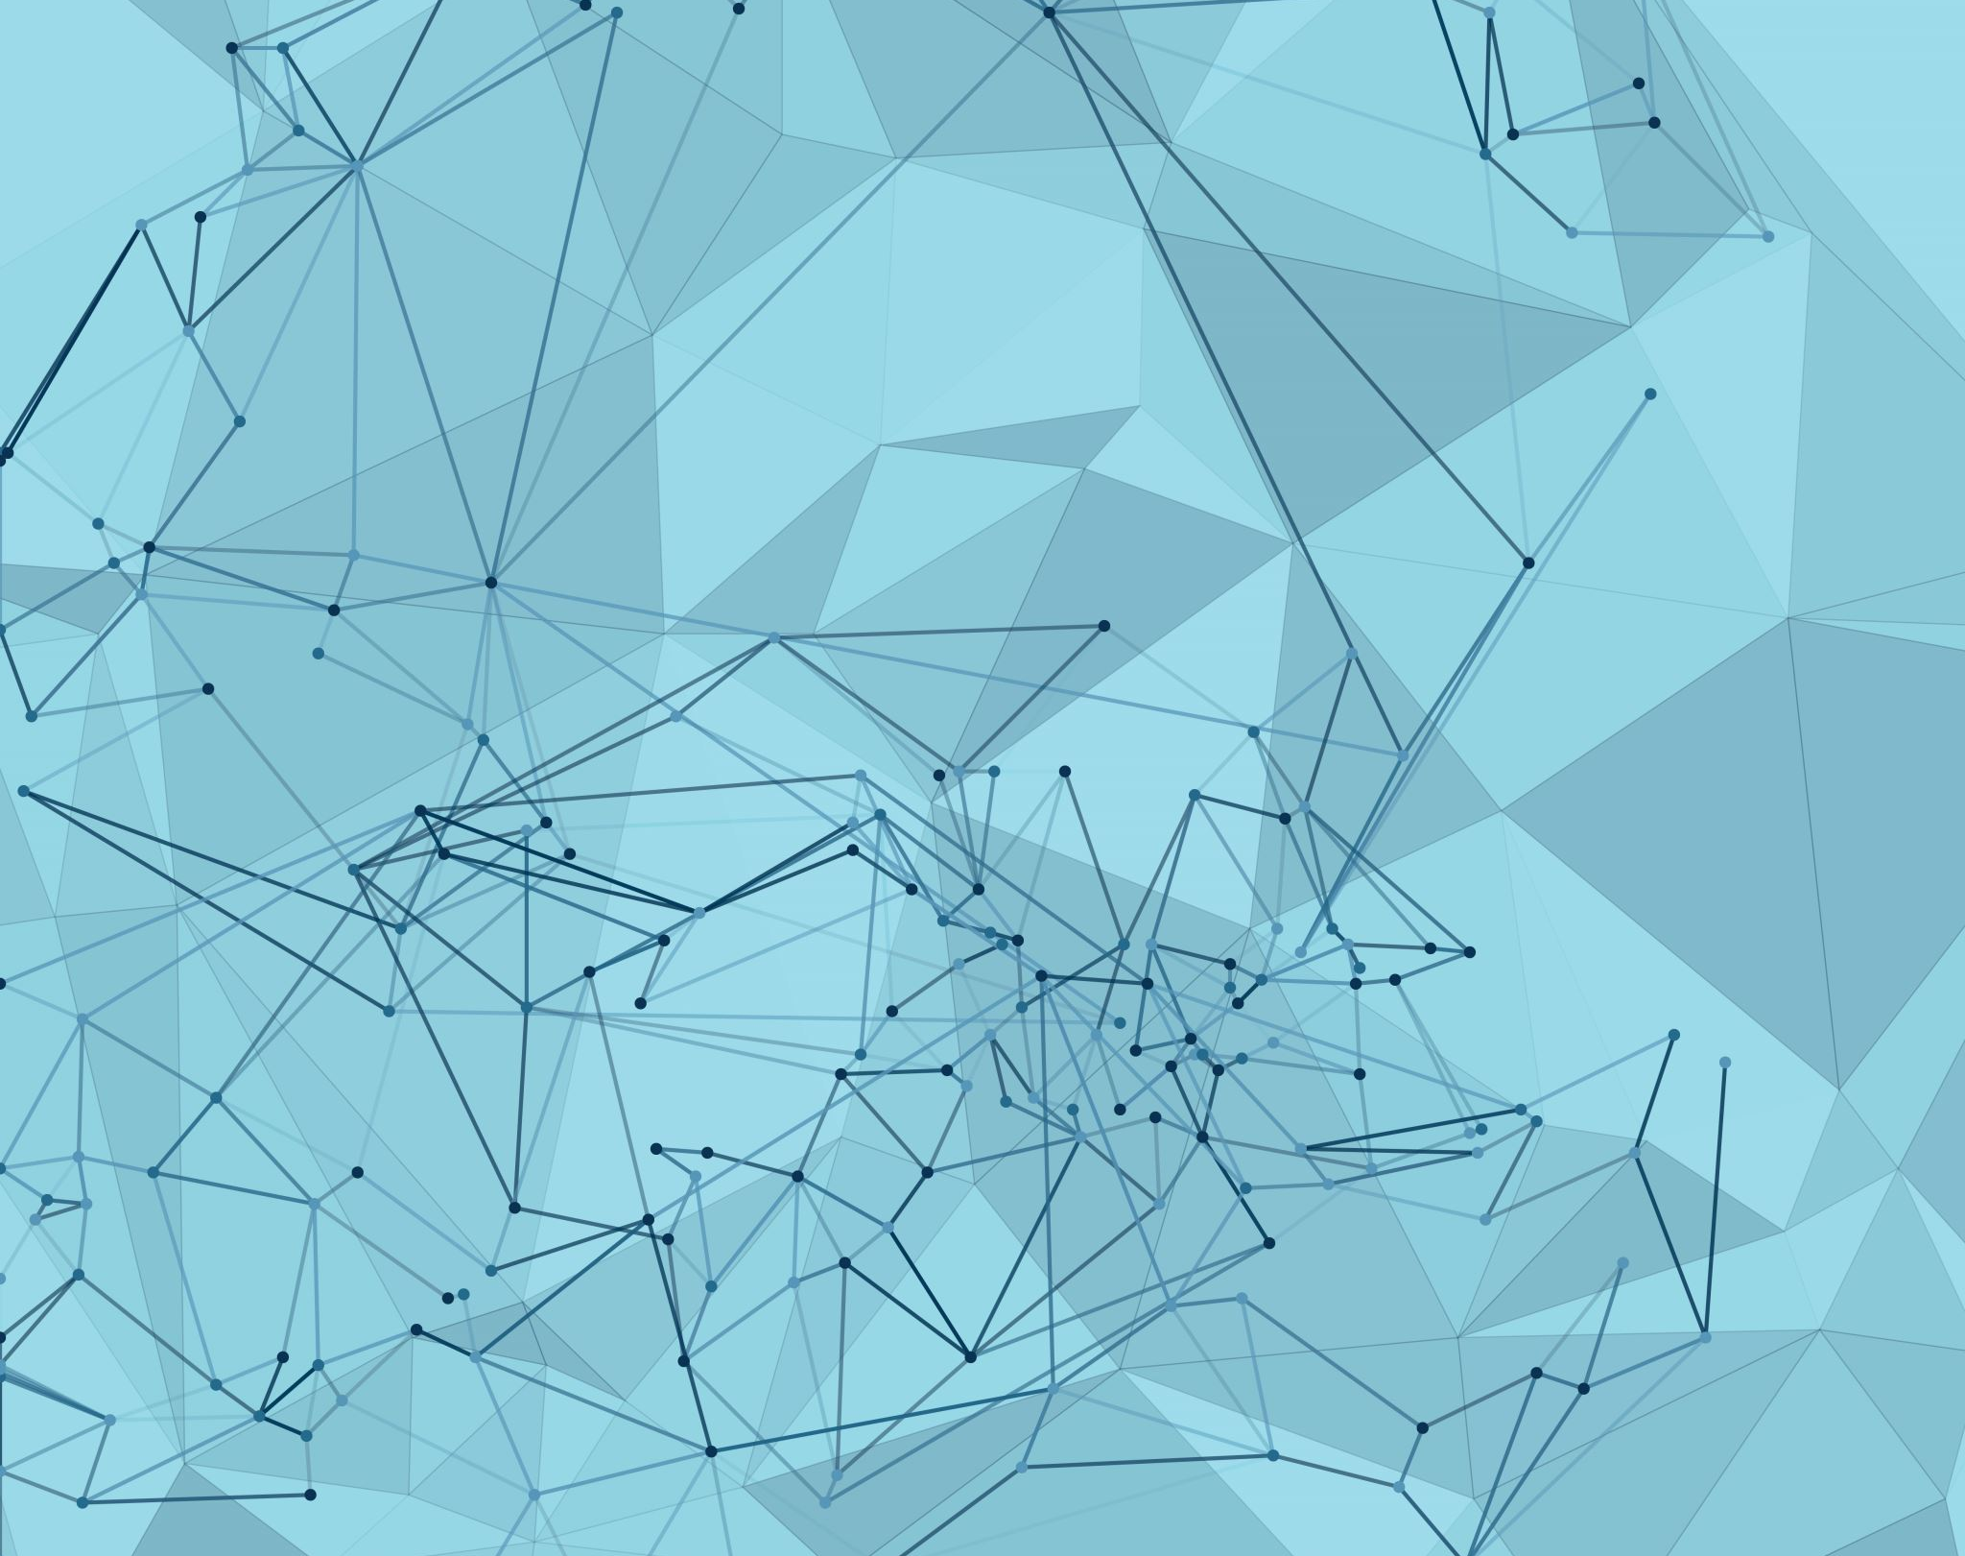
Fairness Evaluation of AI Approaches to Data Cleaning
Anna Stephens

Slide 2
Data Cleaning – 2 Steps
Raha_{[1]} – Error Detection
Baran_{[2]} – Error Correction
Run Multiple Algorithms
Feature Vector (1 per cell)
Clustering on the Feature Vector
(1 clustering algorithm per column)
Send samples to User
Iterate
Pretrain set of error correction models
Fine tune with user feedback
Error correction models predict possible corrections
Classifier predicts final correction

Slide 3
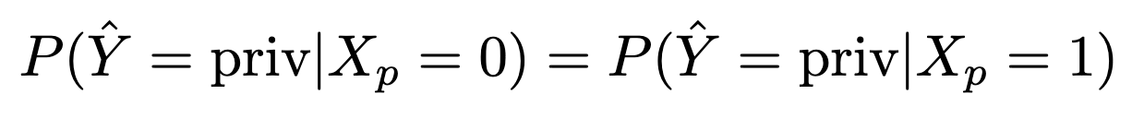
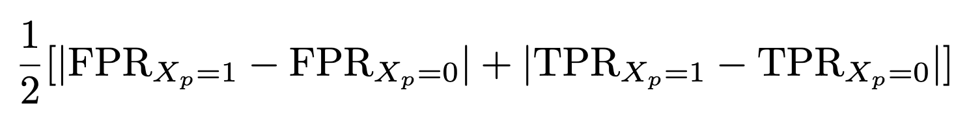
Fairness
Statistical Parity
Equality of Odds

Slide 4
Datasets
Dataset | N | Label | Priv | Protected |  | Feat | Cells
compas_{[3]} | 11757 | recid | 8054 | race | cauc: 4085, other: 7672 | 88 | 1034616
german_{[4]} | 1000 | credit | 300 | gender | male: 690, female: 310 | 58 | 58000
adult*_{[4]} | 20000 | income | 4986 | gender | male: 13454, female: 6546 | 102 | 2040000
*adult dataset was sampled per compute limitations

Slide 5
Experiments
Error Detection
Error Correction
Model
(NN, 2 Lin Layers)

Slide 6
Error Detection
 | compas | german | adult
accuracy | 0.846 | 0.898 | 0.961
equalized odds | 0.010 | 0.015 | 0.002
 |  | actual
 |  | error | correct
pred | error | 20497 | 110575
 | correct | 48681 | 854863
 |  | actual
 |  | error | correct
pred | error | 505 | 1712
 | correct | 4198 | 51585
 |  | actual
 |  | error | correct
pred | error | 3197 | 25186
 | correct | 54185 | 1957432

Slide 7
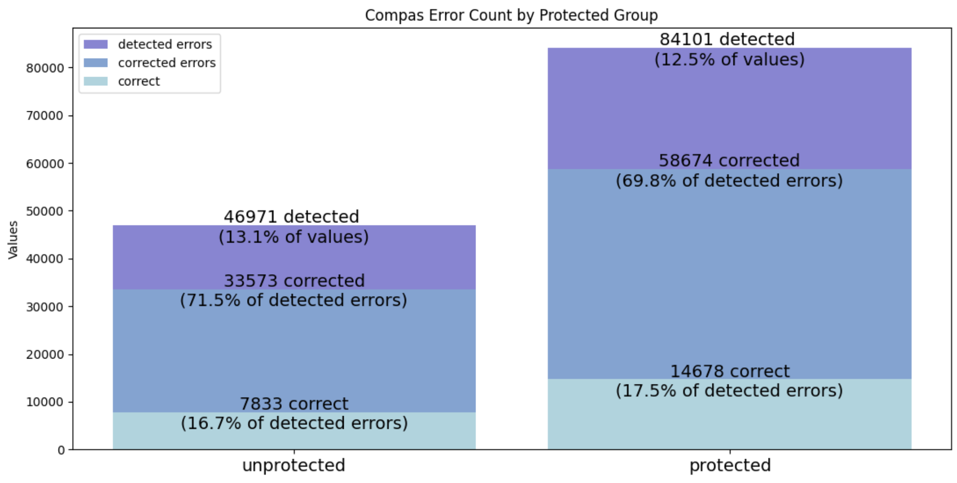
Error Correction compas
RMSE – total corrections
dirty | 2271104
corrected | 4490112
RMSE – corrected errors
dirty | 2496345
corrected | 6157615

Slide 8
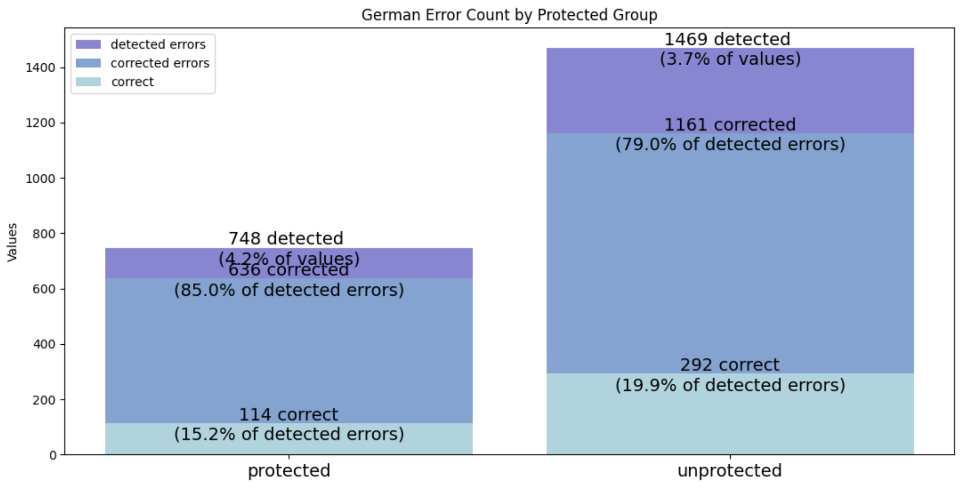
Error Correction german
RMSE – total corrections
dirty | 482
corrected | 1023
RMSE – corrected errors
dirty | 969
corrected | 1050

Slide 9
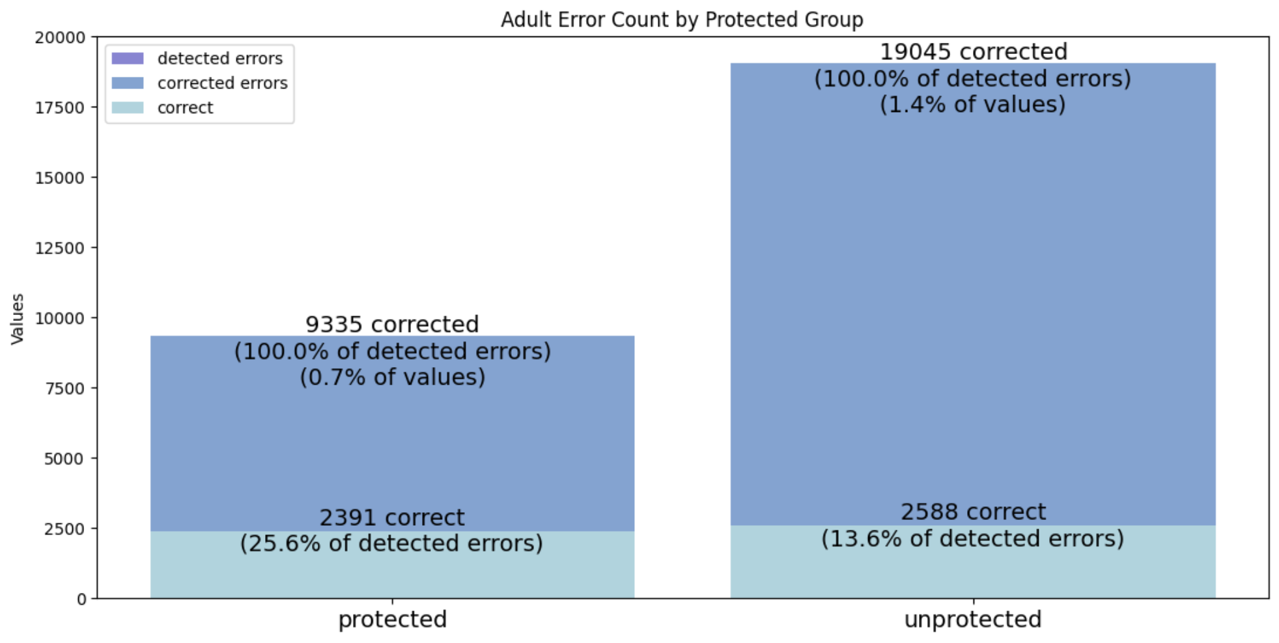
Error Correction adult
RMSE – total corrections
dirty | 100
corrected | 172
RMSE – corrected errors
dirty | 297
corrected | 168

Slide 10
Model Results
Accuracy
 | compas | german | adult
clean | 0.94785 +/- 0.01030 | 0.72600 +/- 0.03254 | 0.83238 +/- 0.00660
dirty | 0.89685 +/- 0.01120 | 0.68000 +/- 0.02236 | 0.80605 +/- 0.00939
corrected | 0.88843 +/- 0.01095 | 0.68950 +/- 0.03118 | 0.80605 +/- 0.00920
Equalized Odds
 | compas | german | adult
clean | 0.00979 +/- 0.00705 | 0.08770 +/- 0.06239 | 0.08263 +/- 0.01539
dirty | 0.02696 +/- 0.01585 | 0.06859 +/- 0.06732 | 0.05816 +/- 0.02253
corrected | 0.01589 +/- 0.01391 | 0.06382 +/- 0.05835 | 0.05484 +/- 0.02323
Statistical Parity
 | compas | german | adult
clean | 0.06012 +/- 0.01431 | 0.10678 +/- 0.08049 | 0.17019 +/- 0.01741
dirty | 0.07603 +/- 0.01408 | 0.03587 +/- 0.09377 | 0.13495 +/- 0.02634
corrected | 0.06523 +/- 0.01223 | 0.05291 +/- 0.07364 | 0.13225 +/- 0.02962

Slide 11
Conclusions

Slide 12
Further Questions

Slide 13
References
M. Mahdavi, Z. Abedjan, R. Castro Fernandez, S. Madden, M. Ouzzani, M. Stonebraker, and N. Tang. Raha: A configuration-free error detection system. In Proceedings of the 2019 International Conference on Management of Data, pages 865–882, 2019.
M. Mahdavi and Z. Abedjan. Baran: Effective error correction via a unified context representation and transfer learning. Proceedings of the VLDB Endowment, 13(12):1948–1961, 2020.
J. Angwin, J. Larson, S. Mattu, and L. Kirchner. Machine bias. propublica, may 23, 2016, 2016.
D. Dua and C. Graff. UCI machine learning repository, 2017. URL http://archive.ics.uci.edu/ml.

Slide 14

Questions

