Slide 1


Airbnb: Inferring Causal Effects of Marketing Ads on User Bookings
DRAFT
Diana Liang, Andrew Pagtakhan
Dec 4th , 2020

Slide 2

Agenda
Motivation
Data
Exploratory Analysis
Modeling
Next Steps
Appendix

Slide 3

Motivation
Text description here

Slide 4

Motivation
What is Airbnb?
Airbnb is an American vacation rental online marketplace company based in San Francisco, California, United States. Airbnb offers arrangement for lodging, primarily homestays, or tourism experiences
What is the research question?
This project aims to quantify the causal effects of direct marketing ads vs. non-direct marketing ads on user bookings (if any)
Terminology:
Direct marketing: direct attempts requesting a customer to purchase a product
E.g.: promoted or paid advertising on social media, video ads on YouTube
Indirect marketing: takes an awareness approach to building customer loyalty
E.g.: search engine optimization, sponsorships, online reviews
Why does this matter?
This project motivates other general questions – how much can marketing influence a potential customer’s purchasing habits, and in turn general consumption behaviors and trends?
Are there potential ethical concerns that arise?
Logo: https://www.airbnb.com/
Source: Airbnb - Wikipedia

Slide 5
Data
Text description here

Slide 6
Data
Dataset
User bookings data from 2010 – 2015 data with 4 main categories (see below table)
~106K users, 17 variables
There is also a sessions dataset which records user actions, but was not utilized for this analysis
Category | Example(s)
User Demographics | Age Gender Language
Platform Identifiers | Browser (Chrome, Firefox, etc.) Device Type (Windows Desktop, iPhone, etc.)
Marketing Data | Channel (direct, seo, etc.) Provider (baidu, bing, google, etc.)
Bookings Data | Destination Country (US, CA, etc.)
Source: Airbnb New User Bookings | Kaggle

Slide 7
Data
Dataset used for analysis
Due to computational reasons, data was sampled to 40K users
Category | Example(s) | Data used for analysis
User Demographics | Age Gender Language | Filtered to ages 18 – 80 Bucketed language into English and Non-English
Platform Identifiers | Browser (Chrome, Firefox, etc.) Device Type (Windows Desktop, iPhone, etc.) | Grouped top 5 browsers by frequency (Chrome, IE, Firefox, Safari, Mobile Safari), bucketed rest into “Other”
Marketing Data | Channel (direct, seo, etc.) Provider (baidu, bing, google, etc.) | Binarized channel into Direct vs. Non-Direct marketing
Bookings | Destination Country (US, CA, etc.) | Binarized destination country into booked / not-booked
Pre-treatment
Treatment
Outcome

Slide 8
Exploratory Data Analysis
Text description here

Slide 9
Exploratory Data Analysis
Data Exploration
NYU_Causal_Airbnb - | Tableau Public

Slide 10
Modeling
Text description here

Slide 11
Exploratory Data Analysis
In order to make causal inferences using propensity score matching, it is crucial to lay out the following framework assumptions:
Ignorability – all user demographics are captured in this analysis
Sufficient overlap between treated vs. non-treated users
Appropriate Specification of the propensity score is achieved
SUTVA – no interference among users and no hidden versions of marketing ad treatment
Source: Hill, Jennifer. APSTA-GE 2012 Topic 7, 10/02/2020. GMT20201002-133231_Causal-Inf_1760x900 (2) - NYU Stream

Slide 12
Propensity Score Modeling
Models that we’ve tried to estimate propensity score:
Logistic Regression
Probit Regression
CART
Random Forest
GBM
BART

Slide 13
Propensity Score Modeling
Models used to estimate propensity score:
Model | Description
Logistic Regression | GLM with a logit link function
Probit Regression | GLM with a probit link function
CART | Classification And Regression Trees Single Decision trees - Prone to overfitting
Random Forest | fits a number of decision trees on various sub-samples of the dataset and uses averaging to improve the predictive accuracy and control over-fitting
Gradient Boosting Machine (GBM) | Builds an ensemble of shallow trees in sequence with each tree learning and improving on the previous one
Bayesian Additive Regression Trees (BART) | “Sum-of-trees” model where each tree is constrained by a regularization prior to be a weak learner, and fitting and inference are accomplished via an iterative Bayesian backfitting MCMC algorithm that generates samples from a posterior

Slide 14
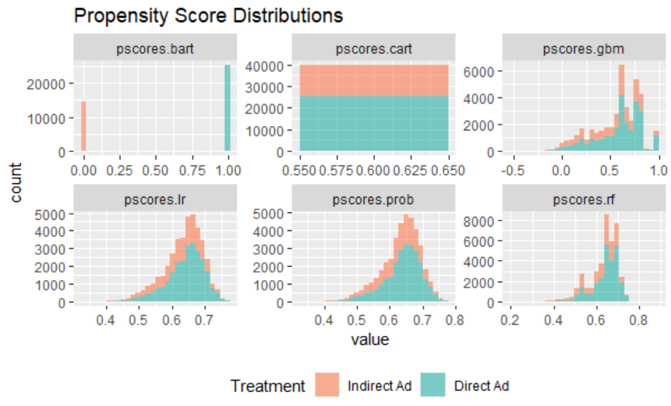
Propensity Score Modeling
Propensity scores for each model

Slide 15
Matching
We applied two matching schemes using propensity scores estimated from each different model:
1-1 Nearest Neighbor Matching with Replacement
Inverse Probability of Treatment Weighting (IPTW)

Slide 16
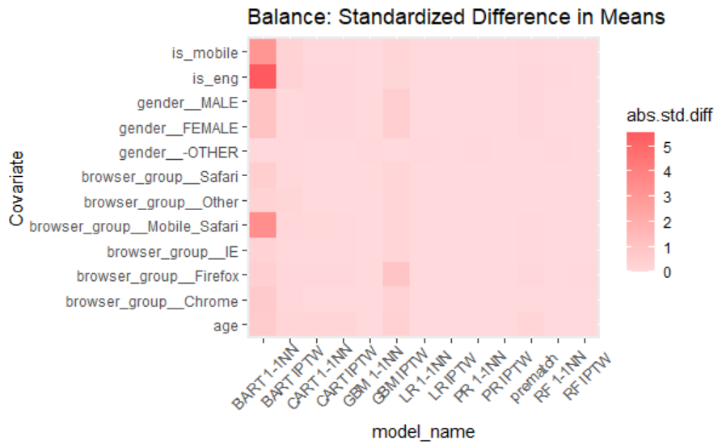
Balance across all methods

Slide 17
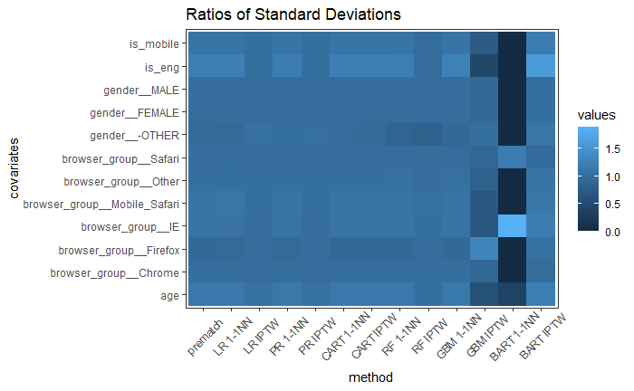
Balance across all methods

Slide 18
Decide a PSM method
We decide to adopt IPTW with the propensity scores estimated from Random Forest, as it has the Standardized Difference in Means closest to 0 across all covariates, and the Ratios of Standard Deviation closest to 1 across all covariates

Slide 19
Next Steps
Text description here

Slide 20
Appendix
Text description here

