Slide 1
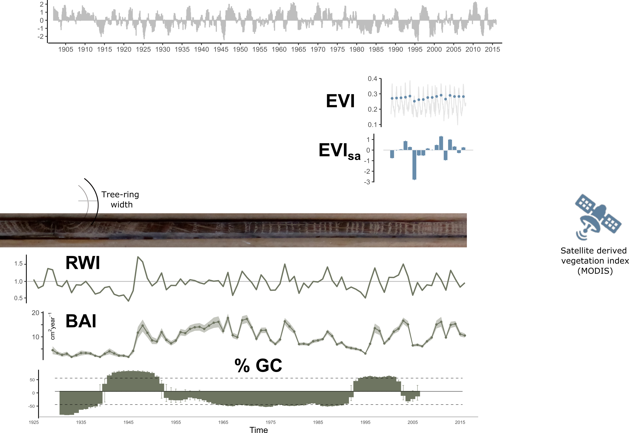


Population differences
2
Robust ANOVAs
Resilience metrics
$$Resilience \sim Drought event ∗Site$$
3
Drought severity
Characterization of severe drought events
Drought
Duration, severity, intensity
BAI
EVI
1
Identification of severe drought-events
Year
Temporal trends
Drought impacts
Non-climatic disturbances
Resilience
Resistance; Recovery; Resilience
EVI
EVI
Mann-Kendall
2005, 2012
Remote sensing
EVI_{sa}
3
1
Mean RWI
site chronologies
Dendroecology
1
Short-term
Long-term
Mean BAI
site chronologies
BAI
BAI
TRW GC
2005, 2012
Most severe droughts (n=8)
Site-disturbance chronologies
3
2
Mining activities
Wood (traditional charcoal)
Fires
Past Land-legacies
Reconstruction of anthropogenic alteration of hábitat based on historical documents
Forest Management practices
4

Slide 2

SPEI-12
2005
2012
1901
2016
1
Identification of severe drought-events
Characterization of severe drought events
2
SPEI-12; Regional Climatic data
Duration, severity, intensity
Drought
Resilience metrics
BAI
Resilience metrics
EVI
1
Resistance; Recovery ; Resilience
Drought severity
Year
Robust ANOVAs
$$Resilience \sim Drought event ∗Site$$
3

