Slide 1
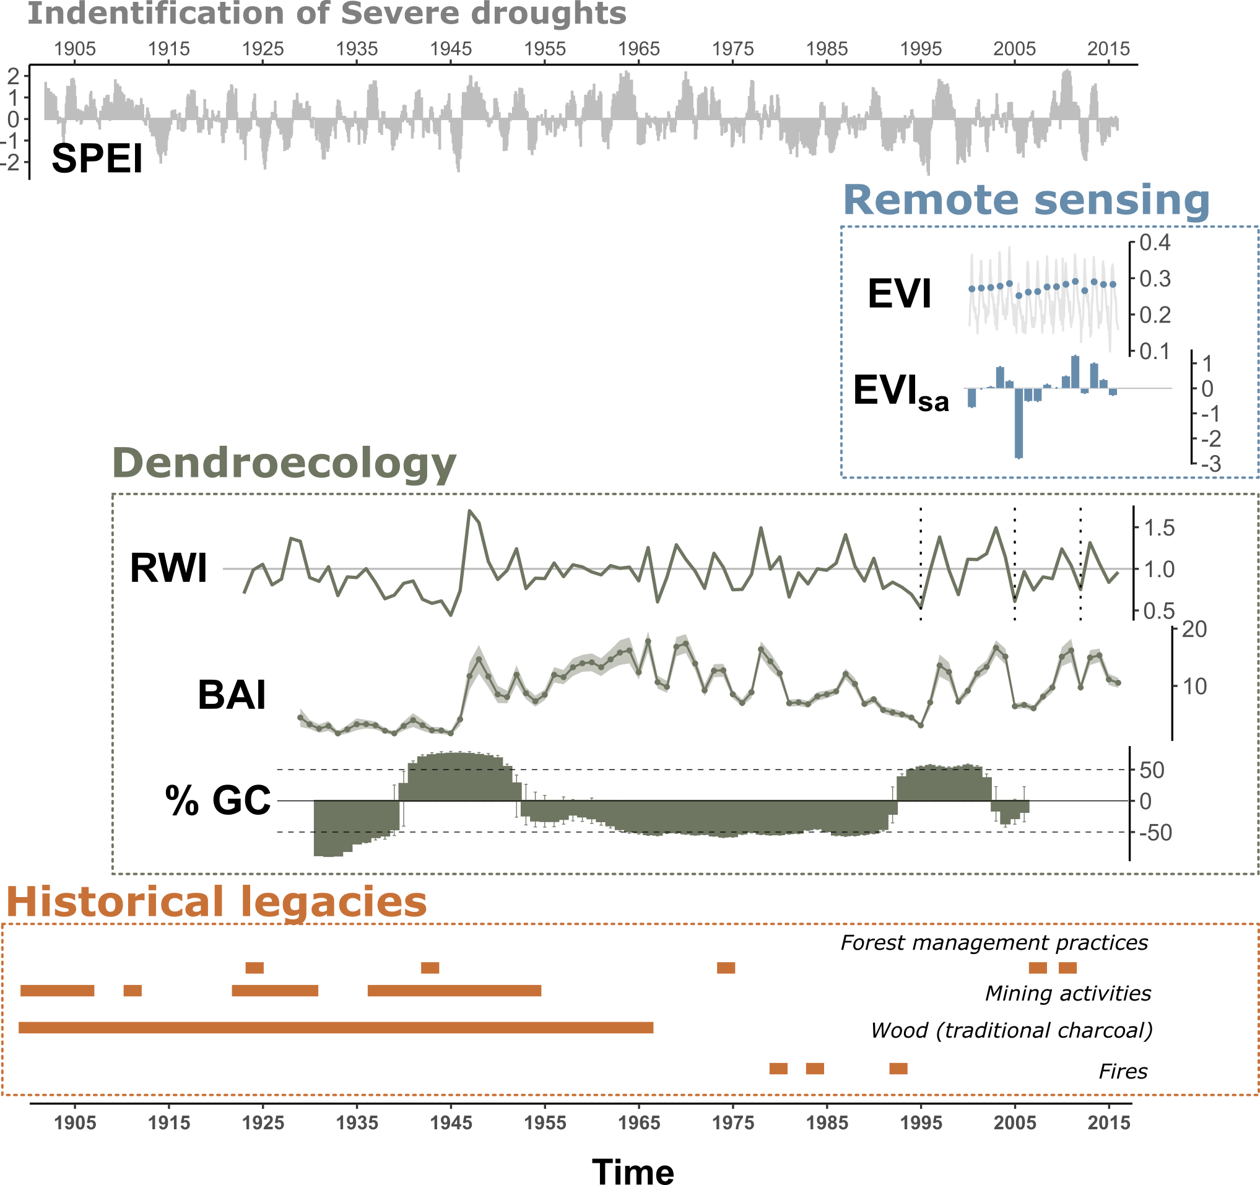
a
b
Impacts
Responses
at rear-edge
within rear-edge
Climate impacts
Non-climatic disturbances
Short-term
Long-term
EVI
resilience metrics
_{2005, 2012}
Mann-Kendall
temporal trend
EVI_{sa}
Comparison
between
populations
1
3
Mean RWI
site chronologies
BAI
resilience metrics
_{most severe droughts (n=8)}
Temporal trend
4
TRW GC
site-disturbance chronologies
2
Review of historical documents
to infer anthropogenic alteration of habitat

