Slide 1
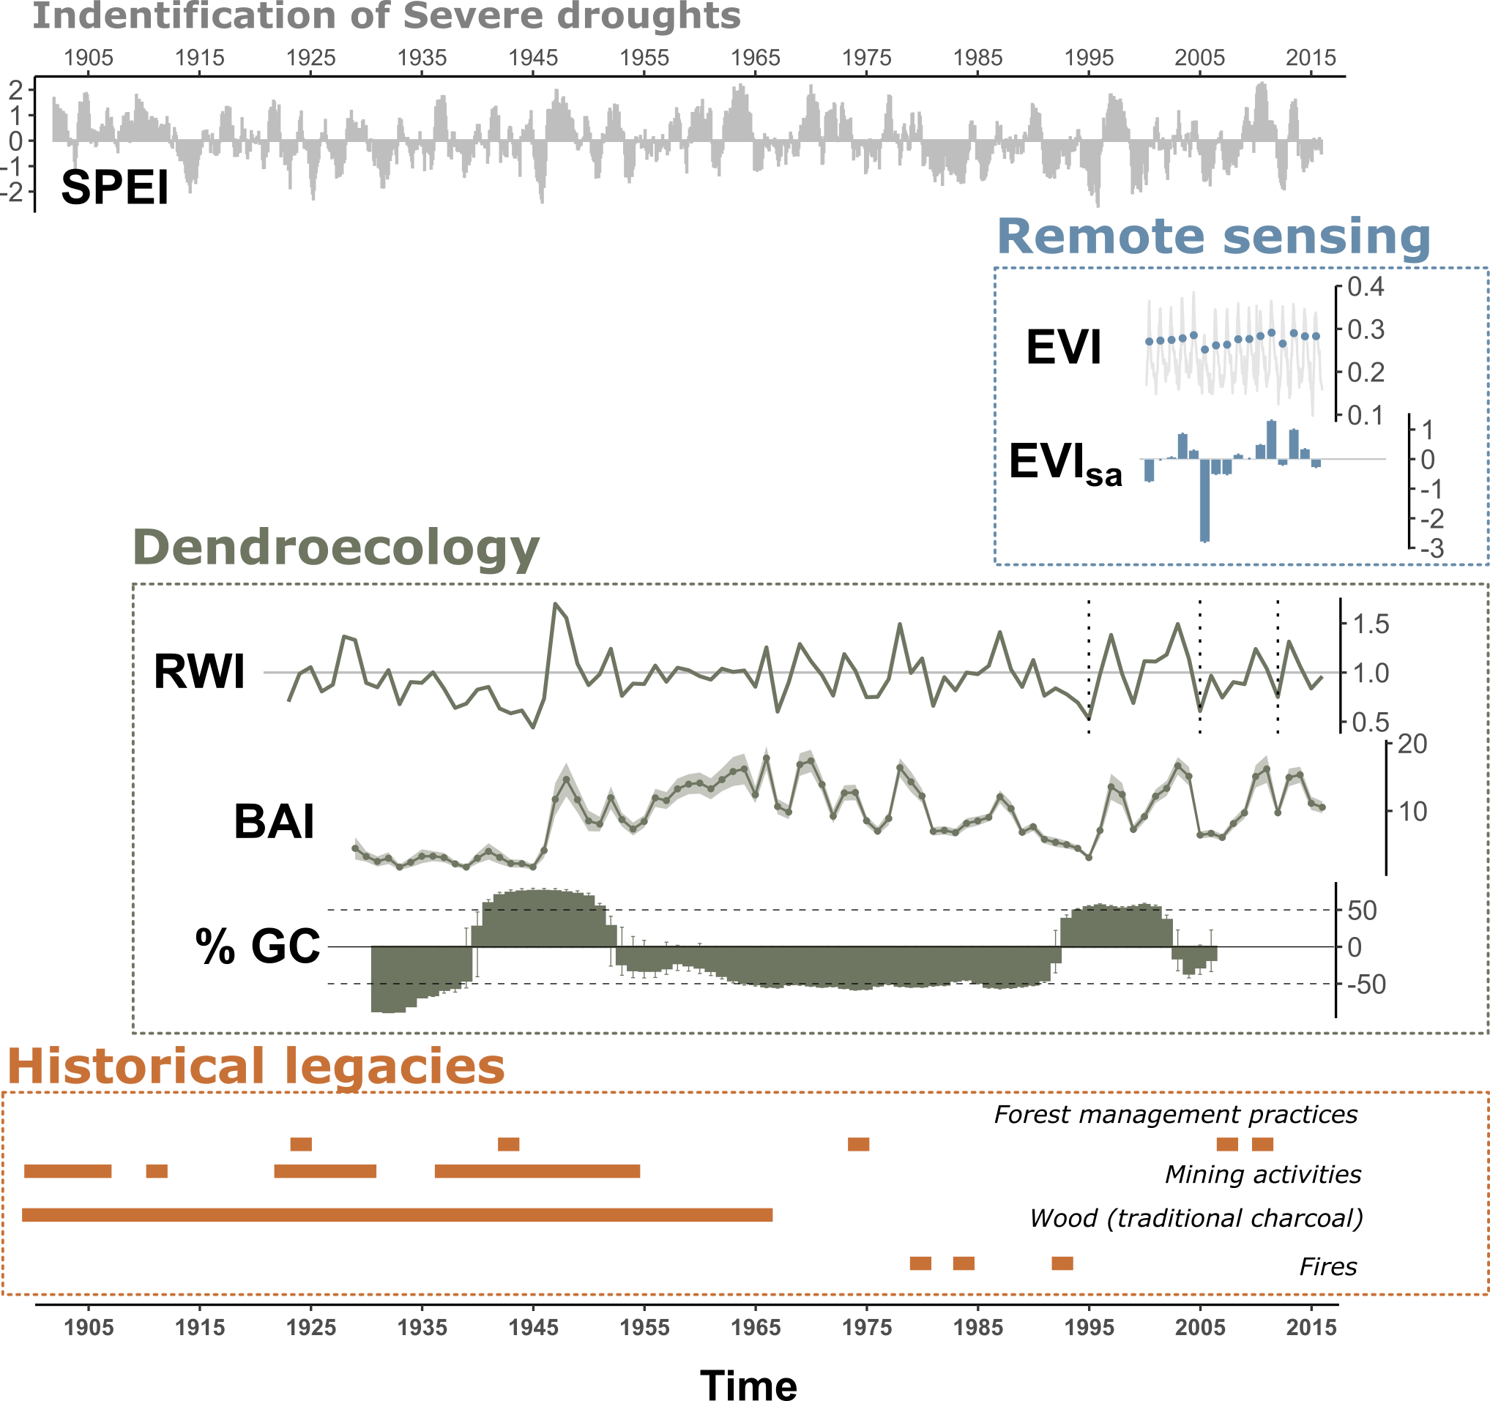



a
b
Impacts
Responses
Climate impacts
Non-climatic disturbances
Short
term
Long
term
EVI
resilience
metrics
_{2005, 2012}
Mann-Kendall
temporal
trend
EVI_{sa}
Comparison
between
populations
1
3
Mean RWI
site
chronologies
BAI
resilience
metrics
_{most severe}
_{droughts (n=8)}
Parametric temporal trend
4
TRW GC
site-disturbance chronologies
at rear-edge
within
rear-edge
2
Review of historical documents
to infer anthropogenic alteration of habitat

