Slide 1
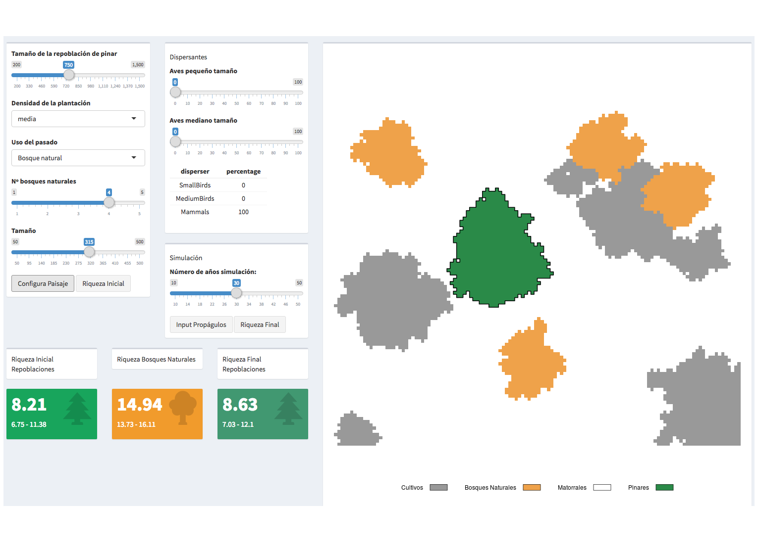
b
a
c

Slide 2
c
a
b
d

Slide 3
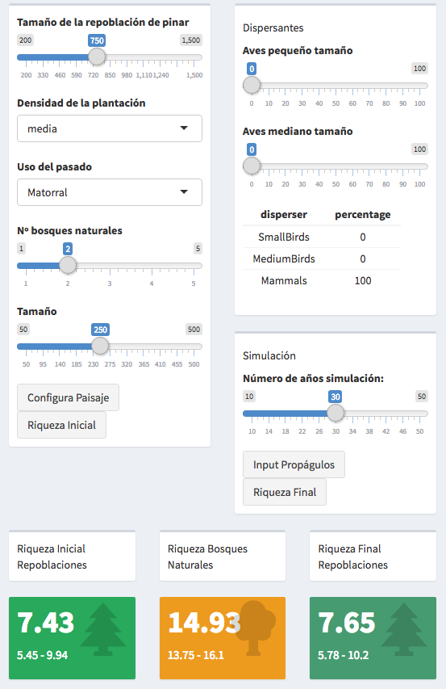
h
a
b
k
c
d
i
j
e
f
g

