Slide 1
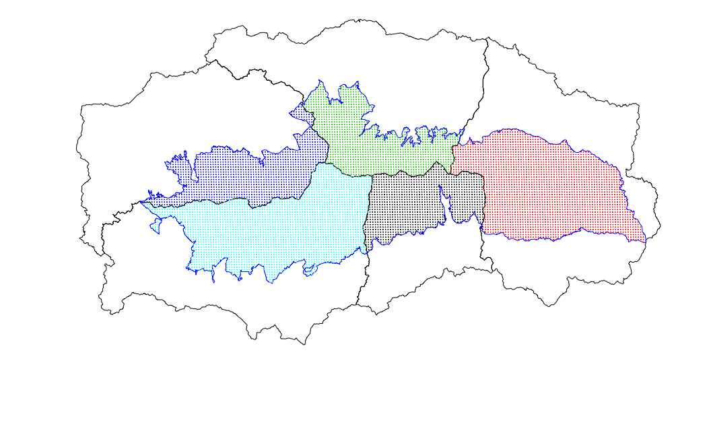
Fardes basin
scod
scd
scmd
-1.26
Genil basin
+0.73
-1.97
scod
scd
scmd
Andarax basin
-1.23
O
N
D
E
F
M
A
M
J
J
A
S
scmd
scod
scd
+1.38
-1.11
-1.17
+1.26
-1.40
O
N
D
E
F
M
A
M
J
J
A
S
O
N
D
E
F
M
A
M
J
J
A
S
Guadalfeo basin
Adra basin
scod
scd
scmd
scod
scd
scmd
-1.72
-1.21
+1.04
-1.82
+1.36
-1.63
O
N
D
E
F
M
A
M
J
J
A
S
O
N
D
E
F
M
A
M
J
J
A
S

Slide 2
a
b
scd
scod
scmd
+0.73
a
a
-1.97
-1.26
b
Fardes basin
+1.38
c
d
-1.11
Genil basin
-1.23
b
+1.04
b
ab
-1.82
Guadalfeo basin
-1.72
a
+1.36
c
b
-1.63
Adra basin
-1.21
b
+1.26
c
c
-1.40
Andarax basin
-1.17
b
O
N
D
E
F
M
A
M
J
J
A
S
O
N
D
E
F
M
A
M
J
J
A
S

