Slide 1
A4BP
Paris internship - Update 2

Slide 2
Agenda
Objectives Achieved
Next work
Demo

Slide 3
Past and actual state
BPMN20 – metamodel parser, ( no exits metamodel for smalltalk).
BPSIM10 – Model to set simulations configuration and results, (no exits metamodel for smalltalk).
Other representations , transformation is a field of study.
BPMN20 make parser for all basic definitions using in a implementation like: activities, relations, message.
Build the metamodel that can be use as a simulation input and output for the analisis.
We can express as a basic way a BPMN process into MAS.

Slide 4
No functionality qualities list
Type attribute | type attribute
Accessibility ( TBD) | Installation (NA)
Auditing and Control ( TBD) | Interoperability (NA)
Availability (BPSIM) | Load volume (BPSIM)
Compatibility (METAMODEL) | Maintainability (CFC)
Documentation (METAMODEL) | Performance (BPSIM)
Reliability | Scalability ( TBD)
Security ( TBD) | Usability (CFC)
Notes:
Indicar la aproximación a las preocupaciones de la arquitectura en función de los procesos que transcurren

Slide 5
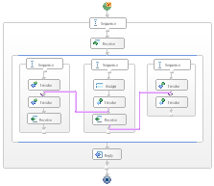
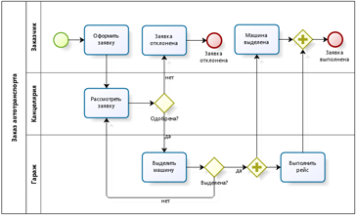

Boundaries
static
dynamic
BPMN – Metamodel 60%
Code – Model
Metrics – 80%
Complexity flow – 100%
Relations – 60%
Execution
Ontime 30%
Process Logs 0%
Simulations 50%

Slide 6
Available in smalltalkhub
Gofer new smalltalkhubUser: 'ajperalt' project: 'A4BP'; package: 'ConfigurationOfA4BP'; load.
(Smalltalk at: #ConfigurationOfA4BP) loadDevelopment.
To be use, you need to download www.moosetechnology.org pharo image.

